Slide 1



Tool Time: wqReport
USFWS Southeast Region I&M Branch
Michelle Moorman
USFWS Inventory and Monitoring Ecologist
Michelle_moorman@fws.gov
Nicole M. Rankin
USFWS Inventory and Monitoring Network
Climate Connection Workshop
September 13, 2012
Notes:
We need information in order to make informed decisions on our management in the face of climate change
And that information requires reliable and trustworthy data
One of my many jobs as an USFWS I&M ecologists is to help turn reliable climate, water, and ecological data into information to support NWR management decisions
“Water is life. We must ensure the availability and integrity of this resource for generations to come.”
“Climate change has had a devastating impact on the sustainability of freshwater.”

Slide 2
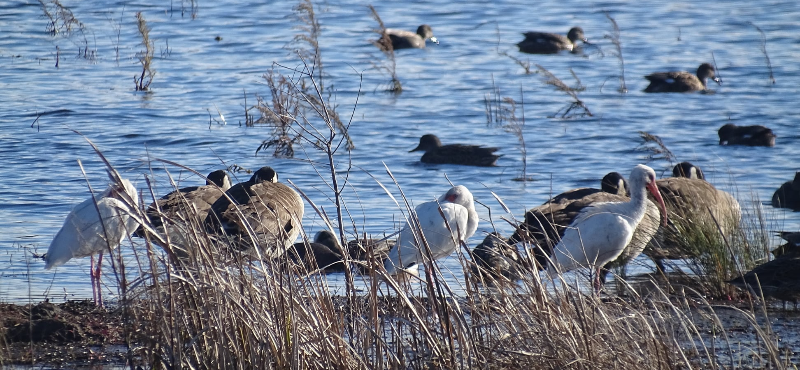
Why develop a water quality reporting tool for NWRs?
Notes:
NWRs have a huge focus on wetland management and many of our trust species depend on wetlands and water bodies for survival.

Slide 3
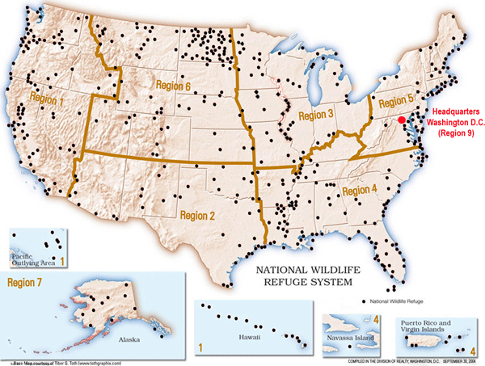
The mission of the United States Fish and Wildlife Service is, "... working with others to conserve, protect, and enhance fish, wildlife, and plants and their habitats for the continuing benefit of the American people."
Notes:
The refuge system has since grown to more than 566 national wildlife refuges spanning approximately 100 million acres of lands and 750 million acres of oceans in the United States.
The Inventory & Monitoring program provides science support to advance scientific-based conservation planning and management at multiple spatial scales

Slide 4
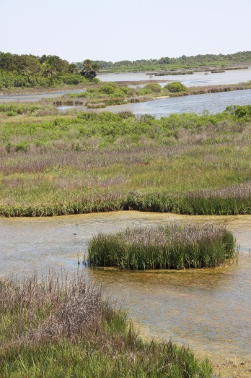
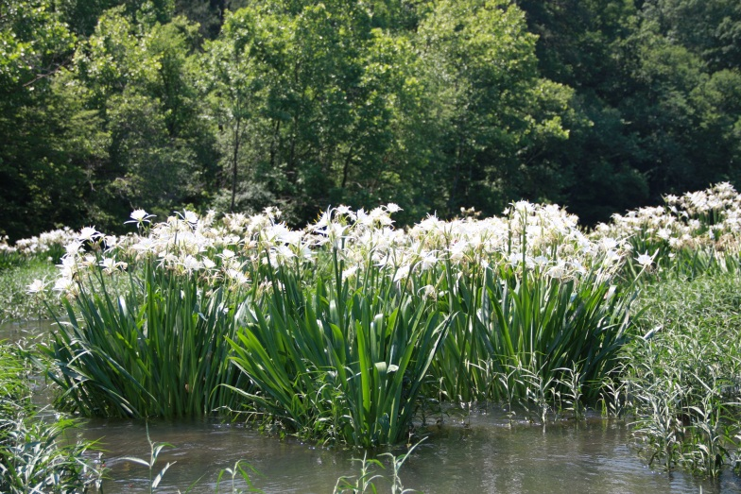
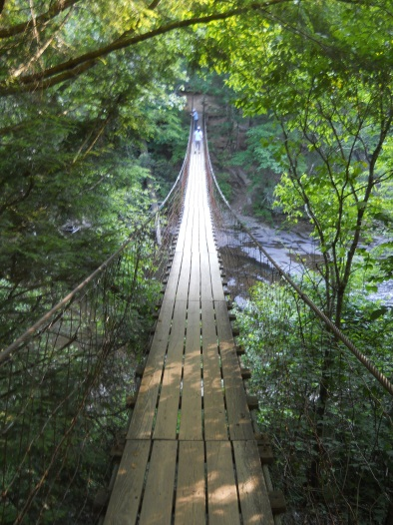
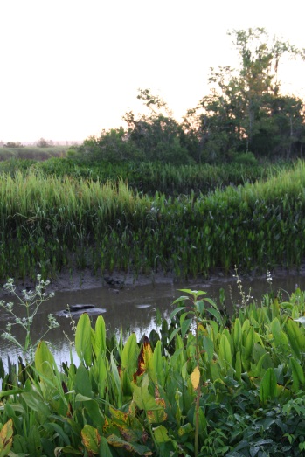
Southeast Region – Refuge System
National Wildlife Refuge (NWR) System in the Southeast Region
131 Refuges
4 million+ acres

Slide 5
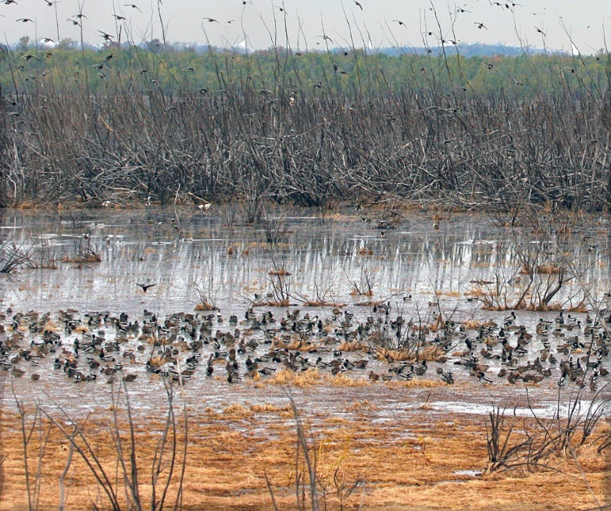
81% of Southeast NWRs have aquatic habitat management as a primary focus
NWRS monitors water resources as a result of the Refuge Improvement Act of 1997
“assist in the maintenance of adequate water quantity and water quality to fulfill the mission of the System and the purposes of each refuge”, and to “acquire, under State law, water rights that are needed for refuge purposes”
Nicole M. Rankin
USFWS Inventory and Monitoring Network
Climate Connection Workshop
September 13, 2012
Moist soil management is a key tool Refuges use to provide habitat for wintering waterfowl
Algal bloom at Wapanocca Lake, Wapanocca NWR
Notes:
National Wildlife Refuges depend on water as a major component of their management, restoration and preservation of wetland and aquatic habitats and the species that inhabit them. Therefore, it is critical that the refuges have an understanding of water resources; including, but not limited to, water availability, water quality, land management within the watershed, aquatic ecosystem needs and status, and our changing climate. Water monitoring can provide indications of how a specific refuge, or complex of refuges, can best manage and protect their water resources. Monitoring can be as simple as collecting water levels from an outfall gage, or as complex as continuous water quality and quantity measurements and modeling at multiple locations on a studied waterbody. Developing and implementing strategies for monitoring is influenced by the types of water issues present at the refuges, historical references and investigations, and resources available (funding, time, staffing, etc.).

Slide 6
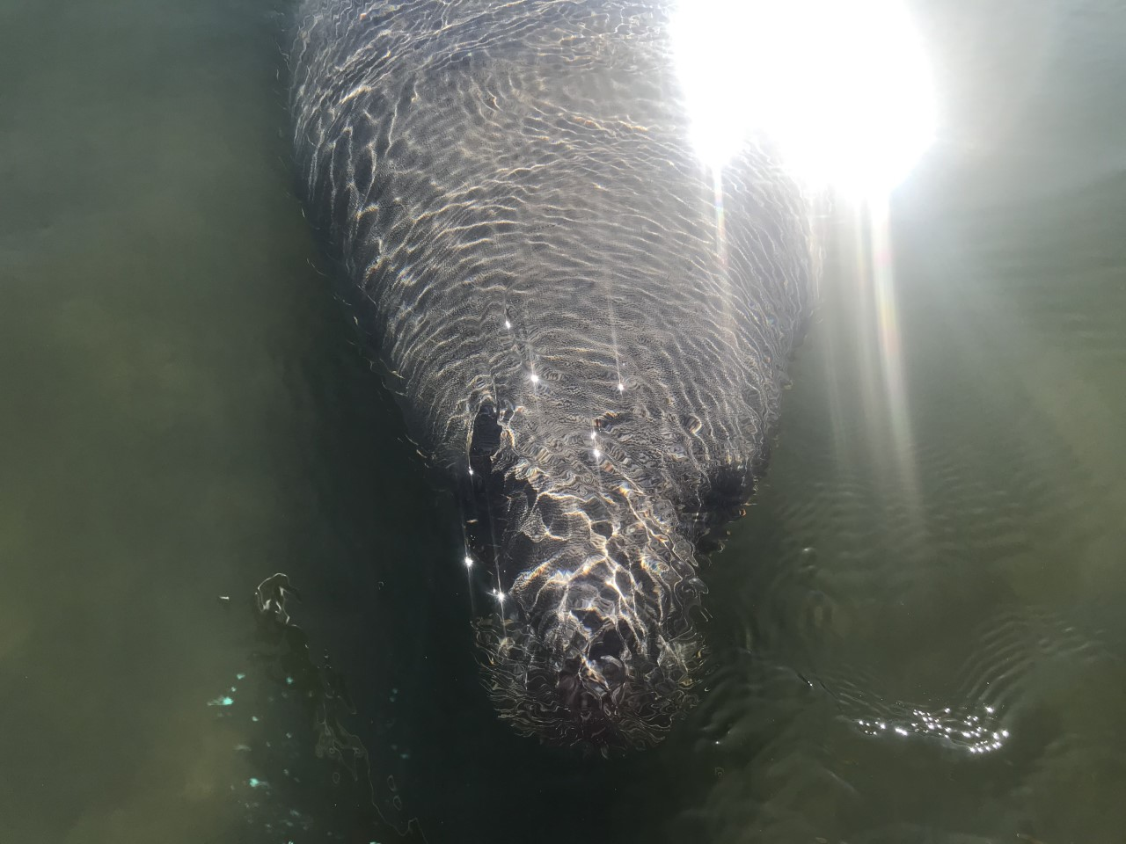
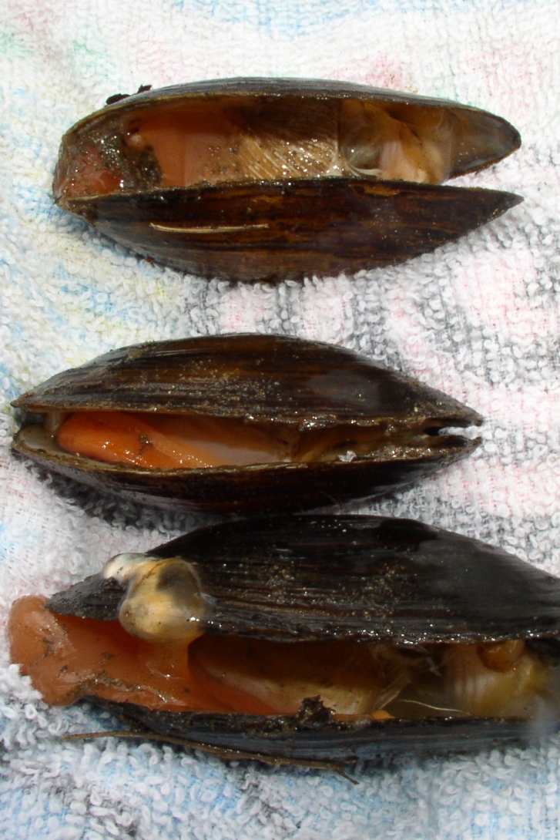
Many of USFWS’s trust species depend on healthy aquatic ecosystems and adequate water quality for survival
Notes:
Picture of a manatee and dead and dying Appalachian elktoe mussels, 2 species that depend on good water quality for survival
Manatees depend on SAV in the winter to survive. Recently there have been food shortages for manatee due to declining SAV, partially as a result of poor water quality which has resulted in USFWS needing to enact an emergency response team to help feed and care for the starved manatees.
North American mussel fauna was diverse (~300 species); 269 known from the Southeast
Many populations and species are declining or gone and water quality cited as most significant threat to population declines

Slide 7
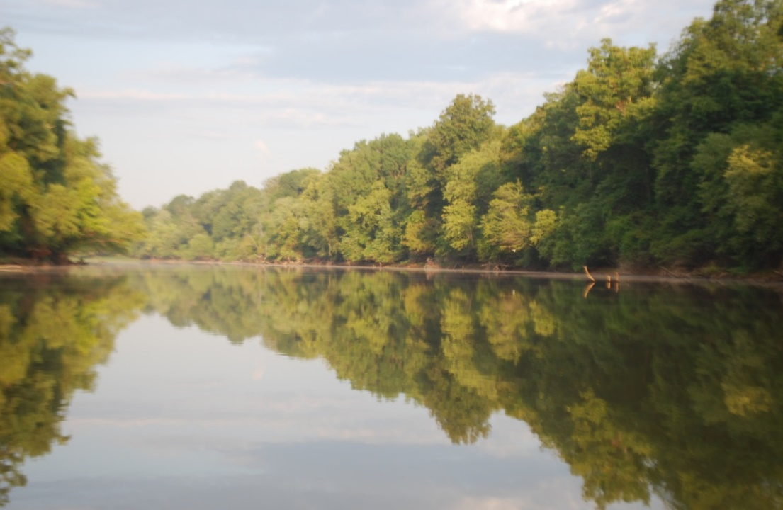
Inventory & Monitoring National Objectives: Develop an accurate reconnaissance-level assessment of water resources on refuges
Pond Creek NWR
Notes:
Inventory baseline information on natural setting, water rights, water quantity, water quality, water management, and climate, threats to water supplies, and other water resource issues for each Refuge

Slide 8
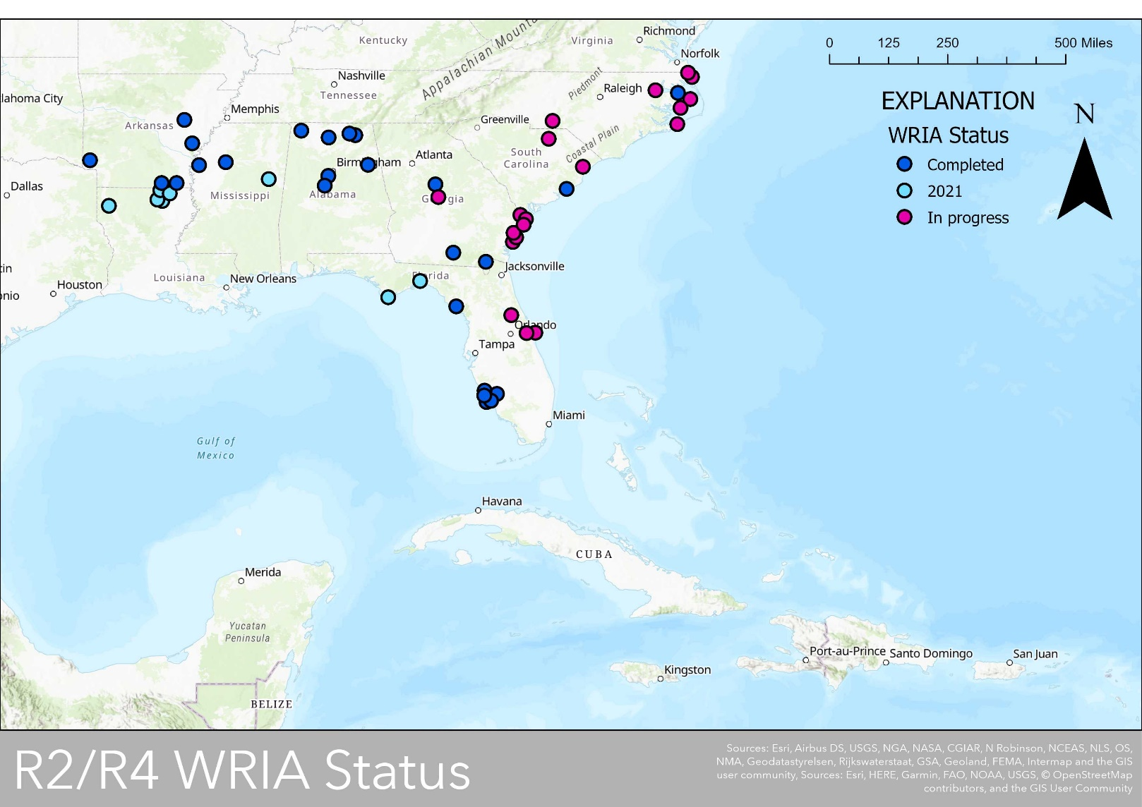
National initiative to complete Water Resource Inventory and Assessments: 42 NWRs completed since 2018
Nicole M. Rankin
USFWS Inventory and Monitoring Network
Climate Connection Workshop
September 13, 2012
Notes:
51 NWRs completed in total for Southeast region, 42 have been completed since 2018 with a contract with the UGA

Slide 9
Issue: Water-quality inventories are not very informative
Synthesize monitoring locations, sampling periods, and number of samples
Do not provide data or data synthesis for specific parameters
Notes:
Not very informative for assessing water quality
Most NWRs expressed concerns about water quality in threats and needs assessment

Slide 10
Can we get better baseline water-quality assessments for our NWRs and WRIAs?

Slide 11
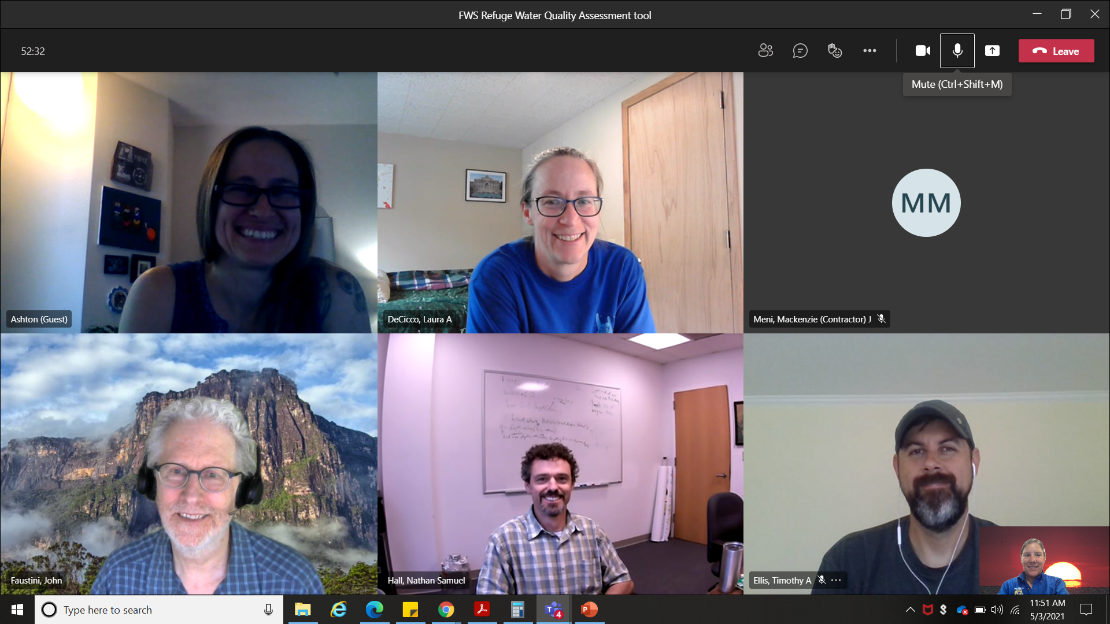
Key developers of the wqReport package: FWS and their partners
USGS and FWS
Student Interns
Ashton Drew: Original Coder
Laura DeCicco: USGS Package
John Faustini, USFWS, retired
Nathan Hall: WQ specialist
Tim Ellis: APNEP
Notes:
Thus this project became a partnership between USFWS, USGS, APNEP, UNC-CH, and KDV solutions
It began in 2019 as a collaborative pilot project with Ashton Drew with KDV solutions and Nathan Hall (UNC-CH) and we developed 2 reports using the data Retrieval package for
In 2020, we decided to expand the code to see if we could develop a report that covered more parameters and all the NWRs across the southeast (and country)

Slide 12

What is wqReport?
NWR report and watershed water quality report (HUC 8 and HUC 10)
Utilizes data from water quality portal
Summarizes existing datasets for pre-defined parameters
Compares measured values against published benchmarks for aquatic life and known standards
Notes:
-Summarizes data for specific parameters initially chosen as Tier 1 parameters by the APNEP Monitoring and Assessment team or identified by the SAV monitoring team. It should be noted there are 1000s of potential parameters in wqPortal – so there was a need to choose a limited number of parameters.
-Utilized a crosswalk table to compare reported parameters that utilized different units – for example filtered nitrate as Nitrogen in micrograms per a liter could be converted to filtered nitrate as nitrate in mg/L so that all reported samples could be compared – no need for post-hoc user conversions
-A table of known aquatic benchmarks and state standards was created so that values could be quickly compared to known standards to have a better snapshot of “good or bad”

Slide 13
Data Source: Water Quality Portal
Premier source of discrete water-quality data in US
National Water Quality Monitoring Council initiative
Integrates publicly available data from:
  USGS
  EPA (including legacy STORET)
  400 state, federal, tribal, and local agencies
Ensures data sources have proper metadata
USGS R-based tool for dataRetrieval

Slide 14
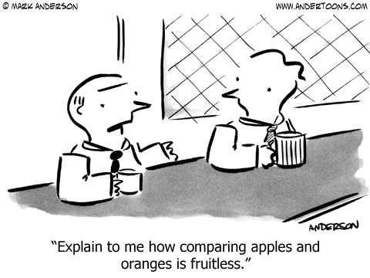
Challenges of Big Data
Some agencies have missing or erroneous metadata such as units and medium
Same parameter, different units
Multiple state standards with multiple assessment methods
Lots of information: Over 10,000 chemicals could be measured
Notes:
1) Do we keep it or throw it out?
2) Crosswalk table with equations to convert disparate units into a common language
3) Currently reporting all thresholds, but no context provided

Slide 15
wqReport: one solution to our big data challenges
Flexible design: dataRetrieval retrieves available data for a specified list of parameters defined in paramLookup and specified dates
Sample values are compared to known benchmarks for aquatic life or state standards
A crosswalk table was developed to allow measurements of equal parameters, disparate units to be compared
Data is retrieved by geographic location by specified NWR(s) and HUC 10

Slide 16
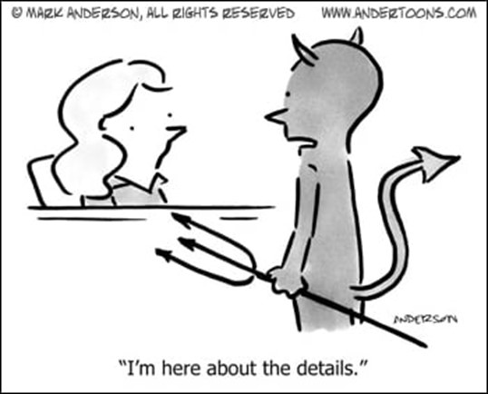
Benefits of a code-based workflow
Rapid water-quality assessment reports by Refuge or watershed that can be updated through time
Utilizes existing data
Incorporates conversion tools to bring disparate parameters into a single unit
Compares concentrations against known standards and thresholds
Provides context of Refuge data relative to the surrounding area
Can evaluate watersheds, other chemicals, subsets of parameters, and selected time frames
Report can identify data missing from the wq Portal

Slide 17
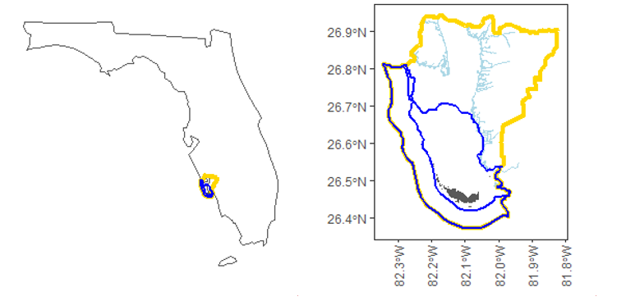
What’s in a Water Quality Report produced by wqReport?
Notes:
Introduction with location map

Slide 18
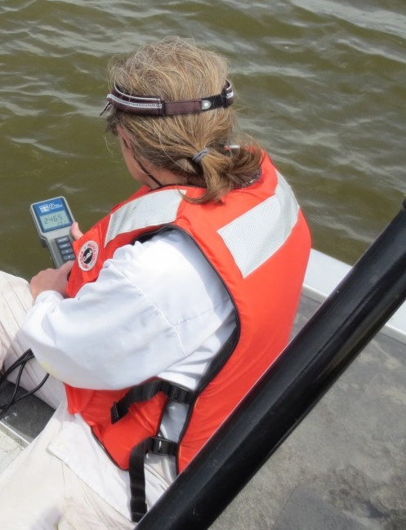
Broken down by “Chapters”
Biological
Major Ions
Minor Ions
Metals
Nutrients
Microbiological
Physical measurements
Pesticides
Organics
Notes:
Each report is broken into chapters. This combines “like parameters” into a single chapter. For our reports, we utilize 8 chapters
-Each report has a table of contents that allows the users to scroll through the various chapters
Chapters are sorted by Parameter Groups
Biological: Algae
Inorganics, Major, Non-metals: Major Ions
Inorganics, Minor, Non-metals and DO: Minor Ions
Inorganics, Minor, metals: Metals
Nutrients
Microbiological: Fecal Indicator Bacteria
Physical measurements: field parameters, turbidity and solids
Pesticides
Organics

Slide 19
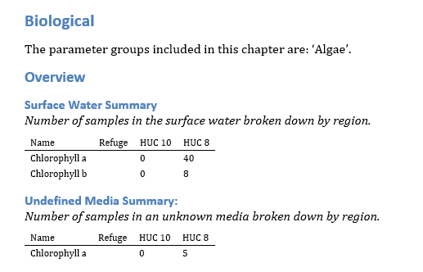
Notes:
We can see what this looks like for the Biological chapter in this example:
The overview provides a summary of the number of surface water, groundwater, and “undefined media” samples at the geographies of interest
If no samples exist, then no table exists
A quick skim of these chapter tables provides a brief overview of the data available – in particular, it can quickly illuminate if data is available at the Refuge level in the wqPortal

Slide 20
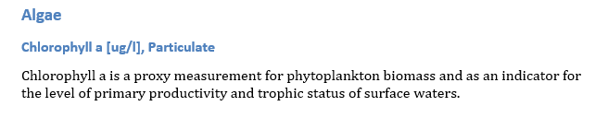
Notes:
Then we can take a closer look at a single parameter – Chlorophyll a
Each parameter has a brief description of that the parameter is

Slide 21
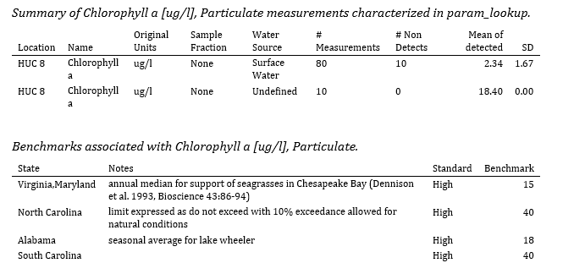
Notes:
Then a summary table of the number of the available samples and sample results for that parameter are provided

Slide 22
Notes:
A summary of benchmarks or standards associated with each parameter is provided.
Each report has a table of contents that allows the users to scroll through the various chapters
Chapters are sorted by Parameter Groups

Slide 23
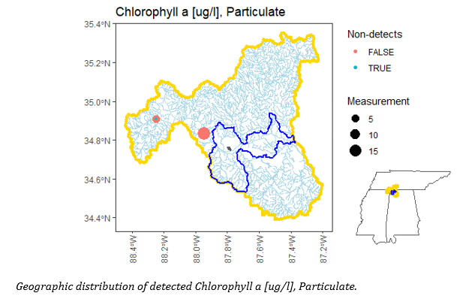
Map for each parameter
Sample locations
Color and size used to symbolize measurement
Outlines of HUCs and Refuge shown
Notes:
Additional plotting is provided for each parameter: including a map

Slide 24
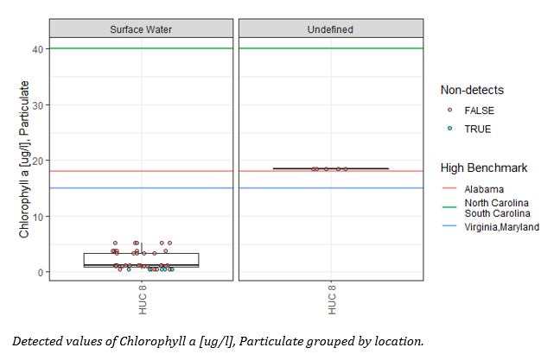
Notes:
The next section is an available data summary

Slide 25
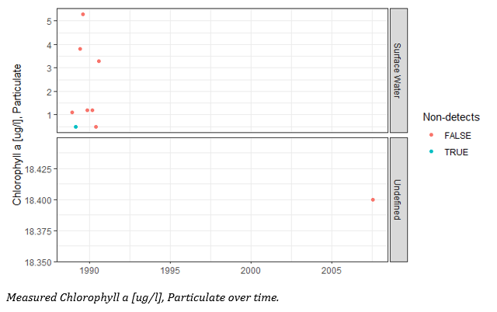
Notes:
Table 1. summarizes all available data from the WQ portal – it provide the source of the data, the number of sample sites and number of samples

Slide 26
wqReport regional report
Loop written to pull all refuge data for southeast region for specified parameters
Flexible design allows user to choose NWRs, timeframe, and parameters to be included in report
Report allows user to quickly identify data gaps and hotspots
Interactive plots in development for html version

Slide 27
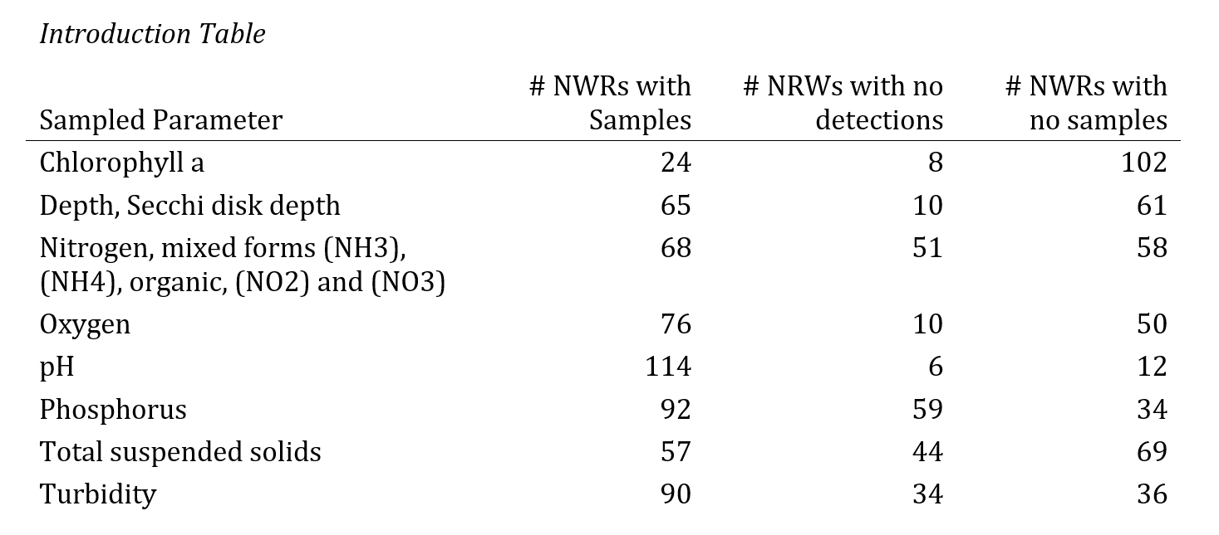
Report summarizes data for all NWRs in southeast

Slide 28
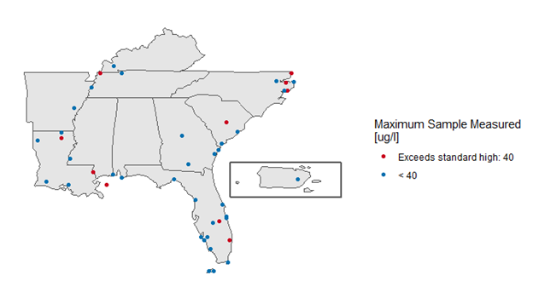
Minimum or maximum values are mapped against known standards
Notes:
With 131 NWRs, it was challenging to think about how we might visualize and synthsize the data in a meaningful way. The objective of the regional synthesis for NWRs in the southeast was to identify hotspots and data gaps. The point was this report was lean focused on commonly measured parameters that were Chlorophyll a

Slide 29
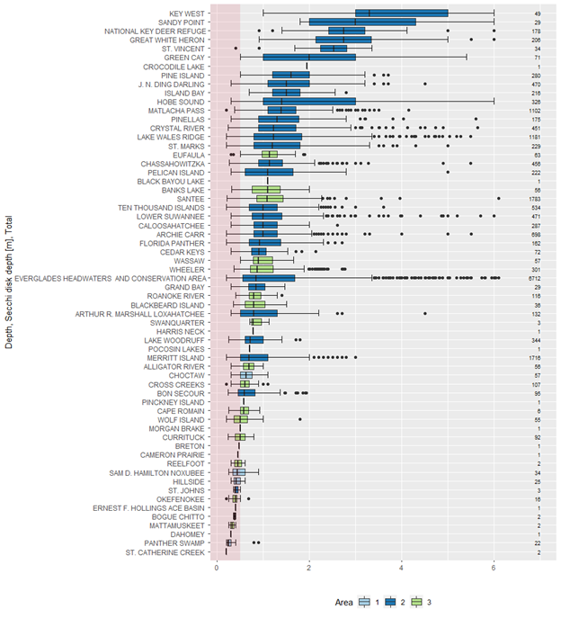
All NWR data is visualized in a boxplot
Allows for rapid assessment of hot spots or data gaps
Data shown sequentially by NWR
Benchmark exceedances are shown in red
Area of NWR is color coded
Number of samples available in wqPortal is provided

Slide 30
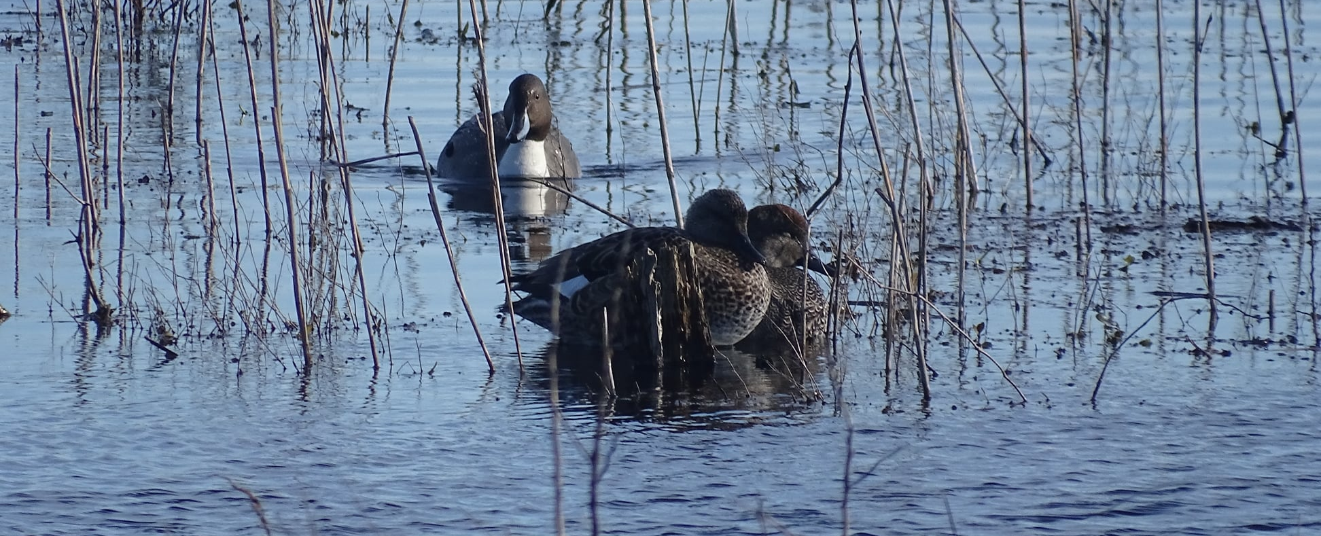
Advantage of new hydrologic analysis tools
Refuges need assistance with understanding their water data and regions have limited capacity
Having an automatic reporting tool based on existing data allows for rapid assessments
National application for both NWRs and water-quality professionals
Baseline assessments can be used as a platform to determine when and if additional monitoring is needed
Notes:
For example, additional storm tide monitoring at refuges

Slide 31
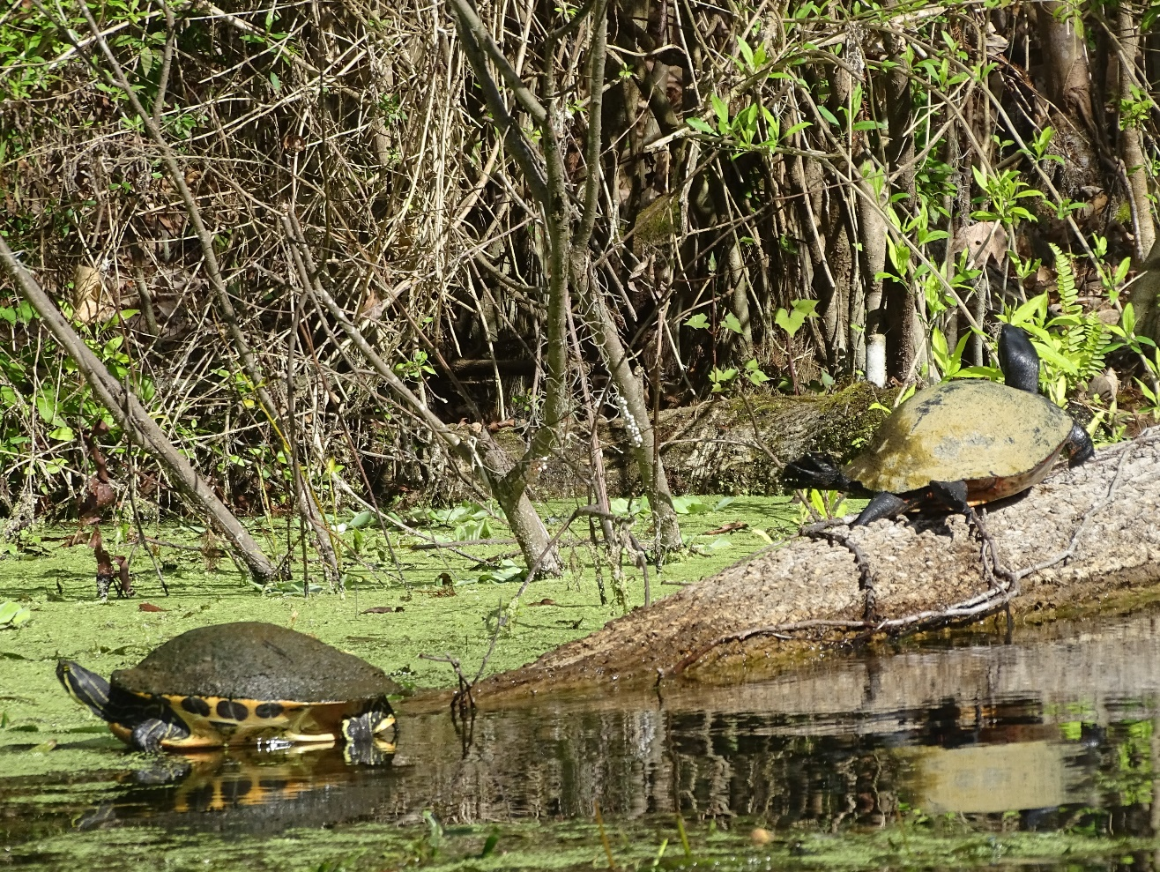
Additional applications
Watershed assessments and environmental assessments
Quantifying current and future conditions of water quality in an SSA
Identification of restoration areas or potential reintroduction or restocking sites for aquatic species
Notes:
Identification of vulnerable watersheds occupied by Threatened, Endangered or At-Risk species
Key Cave NWR: assessment of water quality in recharge areas and it’s risk to Alabama cave fish
Quantifying current and future conditions of water quality in an SSA: Tennessee cave salamander: Assessment of available data in a series of caves home to the fish
Mattamuskeet NWR: assessment for watershed planning and SAV restoration
APNEP: Watershed assessments for status and trend report focused on SAV restoration
Identification of potential reintroduction or restocking sites for aquatic species

Slide 32
Link to Tools and reports
wqReport: https://rconnect.usgs.gov/wqReport/
ServCat project for southeast region reports: https://ecos.fws.gov/ServCat/Reference/Profile/147358
Regional report for southeast region: https://ecos.fws.gov/ServCat/Reference/Profile/152664

Slide 33
Acknowledgements
KDV Solutions
  Ashton Drew
UNC-Chapel Hill
  Nathan Hall
USFWS
  Southeast Inventory and Monitoring Branch – Project Funding and Water Resource Inventory and Assessment Funding
  Southeast Ecological Services – Contaminants Assessment Program Funding
  John Faustini, Regional Hydrologist (retired)
  Rebekah Gibble, Jeremy Conrad, Dave Richardson, Chuck Hunter, Janet Ertel – Report Review
Albemarle-Pamlico National Estuary Partnership
  Project Funding
  Tim Ellis – Project review and feedback
USGS:
  WiM: Web Informatics and Mapping
  Laura DiCicco, Harper Wavra, Milan Liu
  Dave Lorenz for training me to use R for water quality analysis 10 years ago

Slide 34
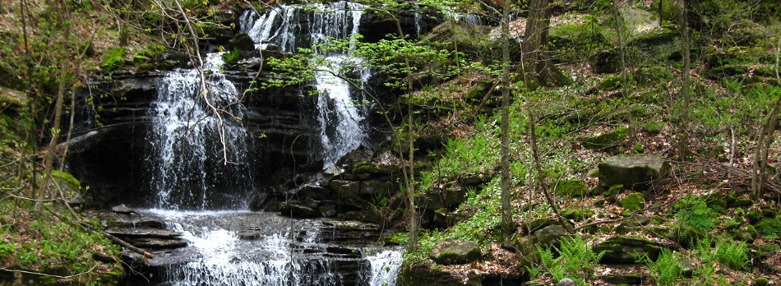
Questions and Comments?
Michelle Moorman
USFWS Inventory and Monitoring Ecologist
Michelle_moorman@fws.gov
Waterfall on Fern Cave NWR
Nicole M. Rankin
USFWS Inventory and Monitoring Network
Notes:
ADD links to Vignette: https://rconnect.usgs.gov/wqReport/

