Slide 1
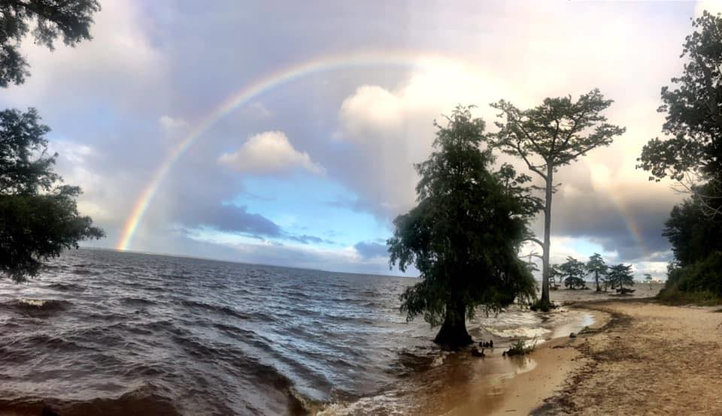
APNEP Tribal Resilience Project
  Project Goals:
  Increase engagement between Tribal organizations, government agencies, and university faculty;
  Acknowledge the unique knowledge and cultural perspectives of tribal communities surrounding climate change impacts;
  Build capacity for Tribal communities to incorporate resilience into local planning processes

Slide 2
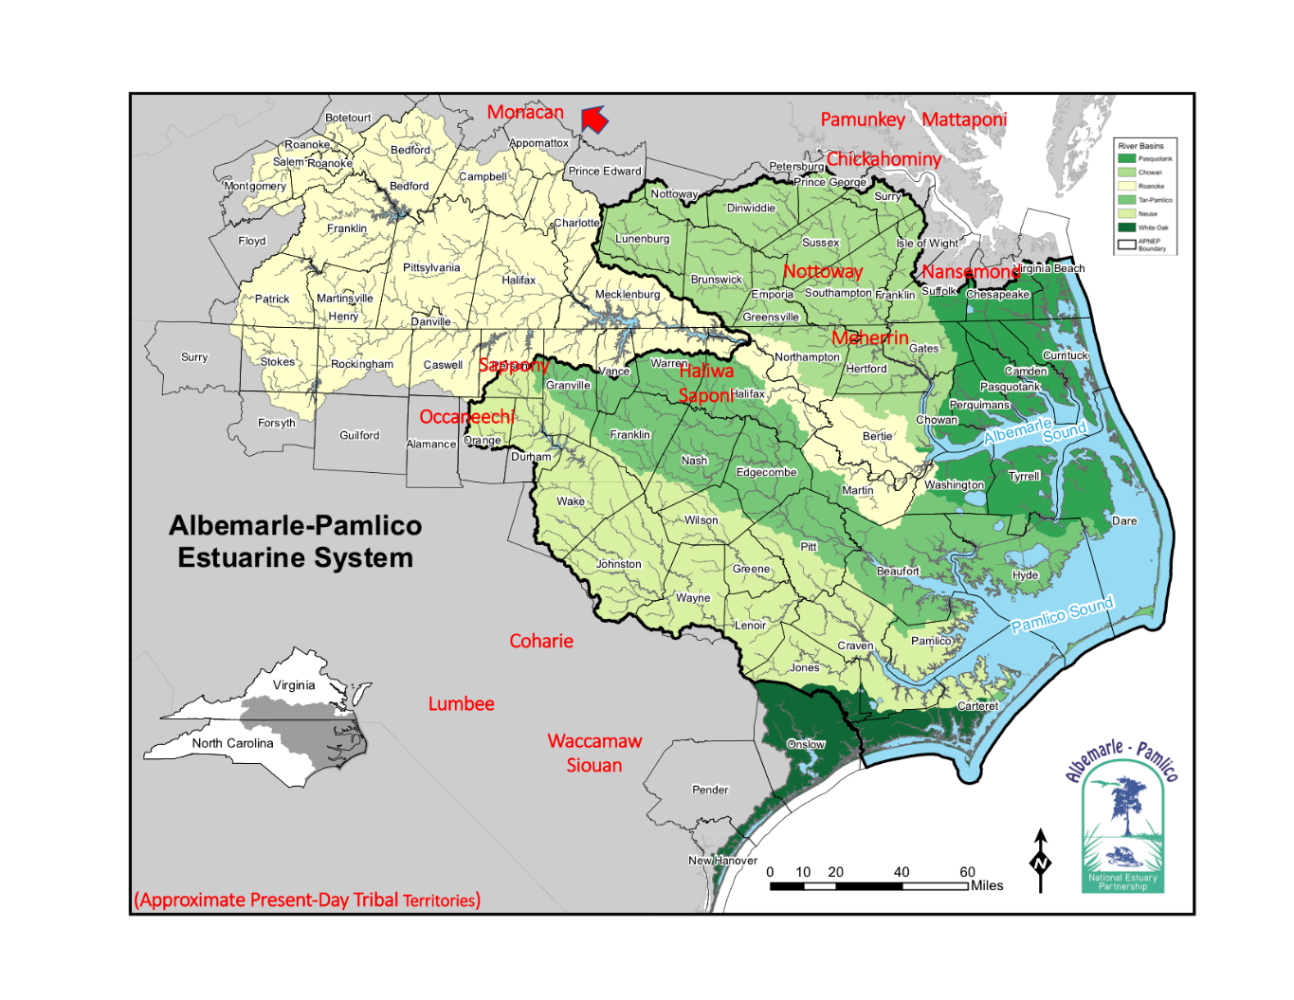
Present Day Coastal Plain Tribal Territories

Slide 3
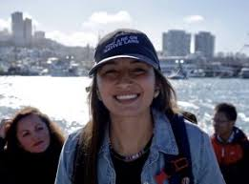
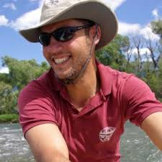
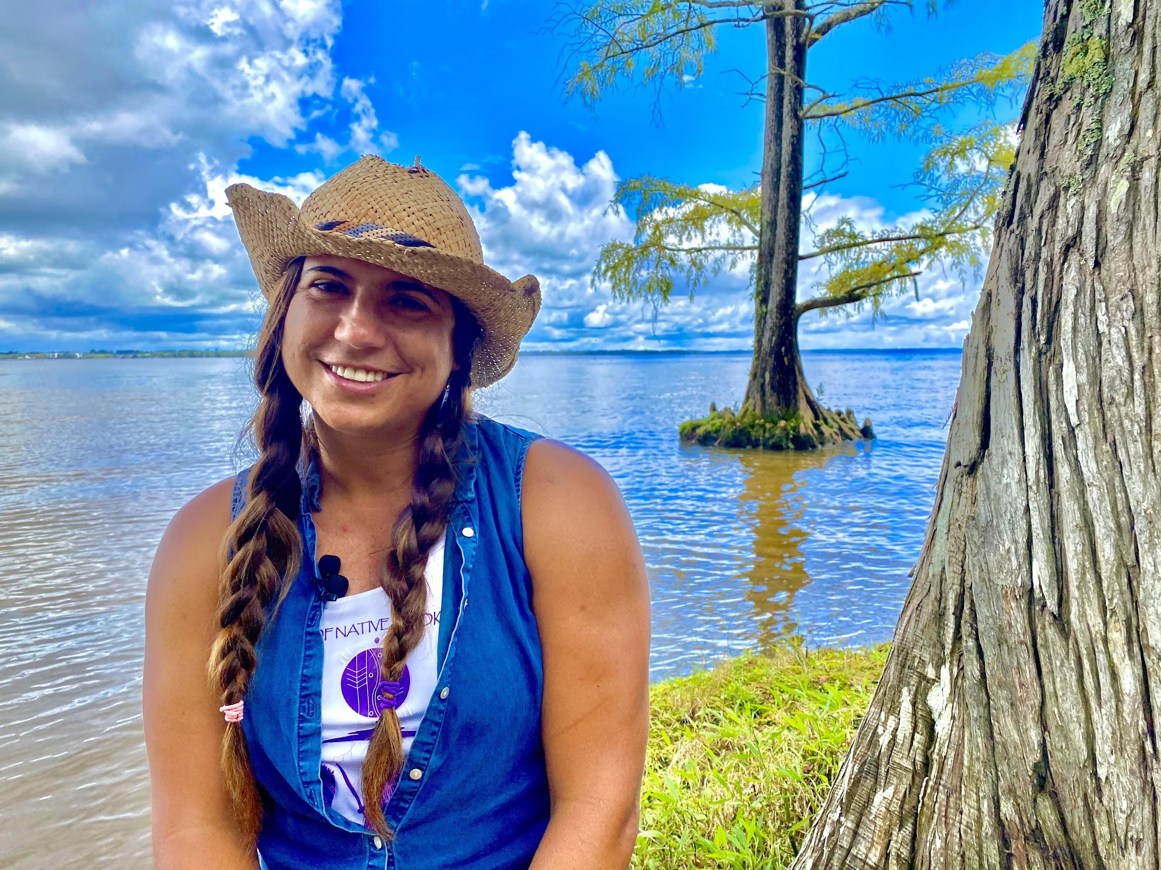
North Carolina Commission of Indian Affairs (NCDOA)
  Director Greg Richardson
  Beth Roach, Project Coordinator (Nottoway Tribal Councilwoman)
    Project management
    Convene steering committee
    Engage with VA/NC Tribal communities
    Host workshops and webinars
North Carolina State University
  Dr. Ryan Emmanuel, Ecohydrologist ( Lumbee Tribe)
  Jocelyn Painter, PhD student (Winnebago Tribe of Nebraska)
    Analysis of tribal engagement throughout US
Virginia Coastal Policy Center
  Elizabeth Andrews, Angela King, Ashley Atkins Spivey (Pamunkey Tribe)
    Assist with coordination with VA Tribes and Commonwealth of VA

Slide 4
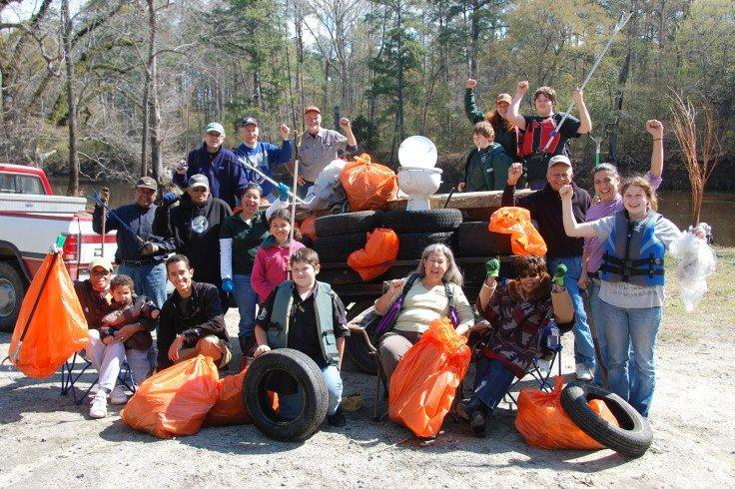
May Our Minds Become One
Steering Committee Members
NCCIA EJ Cmte Members
Tribal reps from VA/NC
NCORR, NCDCR, NCDEQ
Project Advisors
  UNC American Indian Center
  William & Mary Tribal Resource Center
  SECASC
  University partners
  Tribal Youth Organizations
Interested Parties
  NOAA, CISA, Center for Progressive Reform

Slide 5
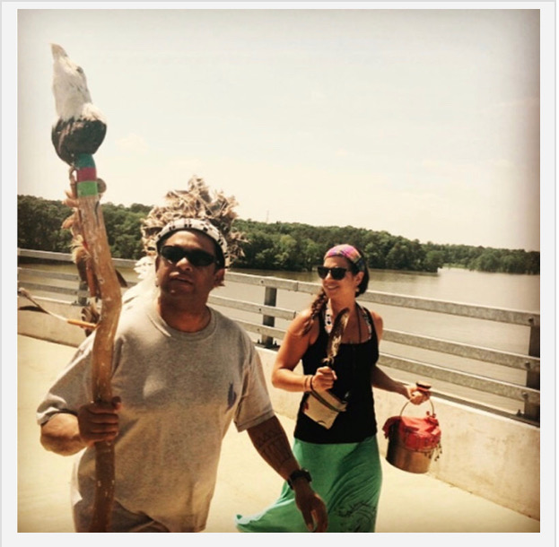
Work to Date and Next Steps
Launched #WaterStory Campaign on Indigenous Peoples Day
American Indian Heritage Month
Convene Steering Committee January 2021
Engage with communities interested in pilot/next phases
North Carolina Indian Unity Conference March 2021
Final report Spring 2021

Slide 6
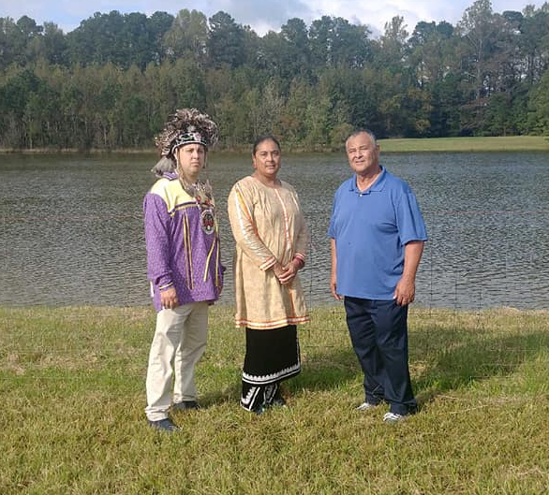
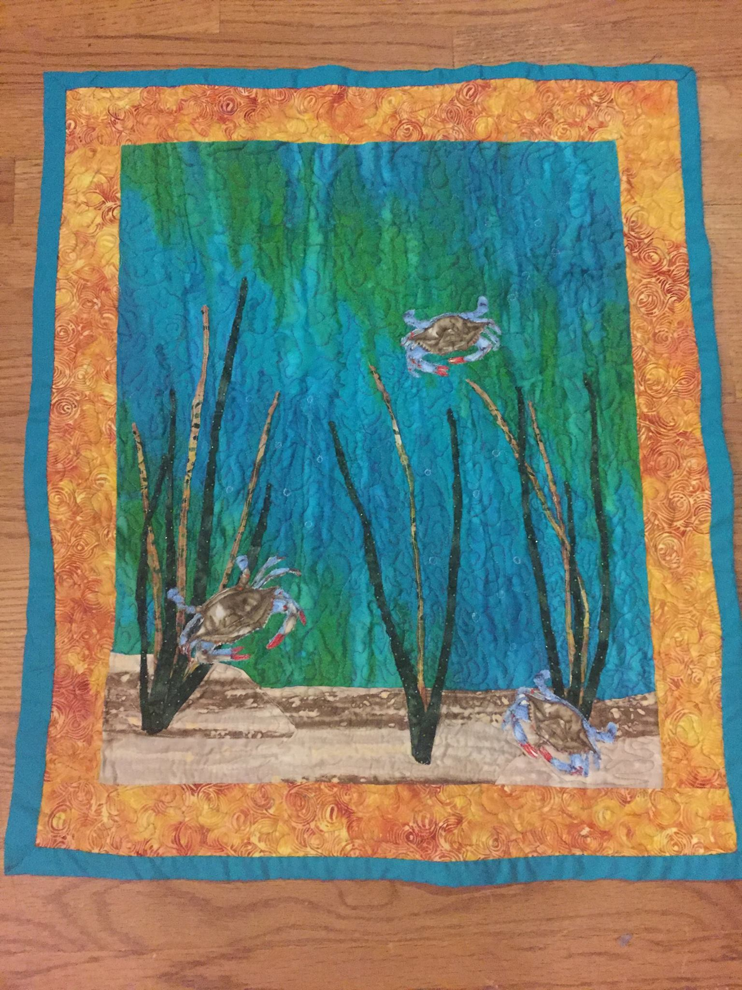
WATER STORIES
Nottoway
  song, art, pictures, live updates
Nansemond
  oyster reef project, shared page
Lumbee
  NC Native Youth Org, Dr. Ryan Emanuel
Tuscarora
  memories of paddles and creeks
Meherrin
  group pic and language

Slide 7
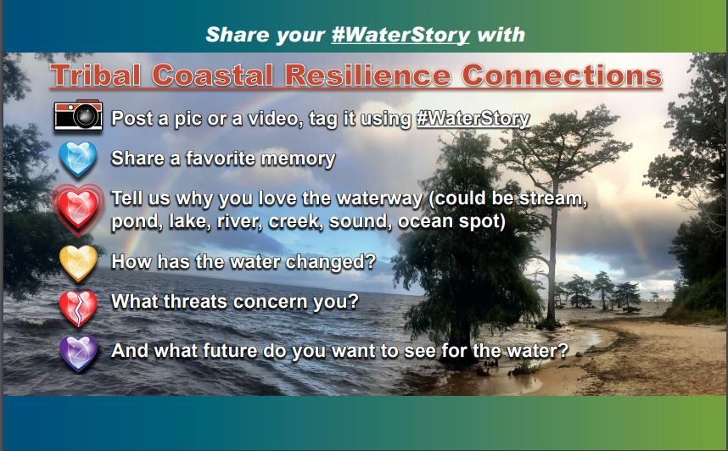

Slide 8
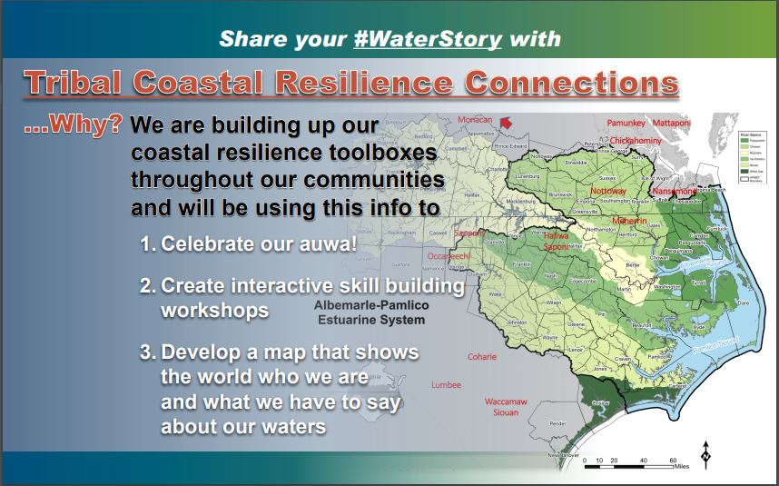

Slide 9
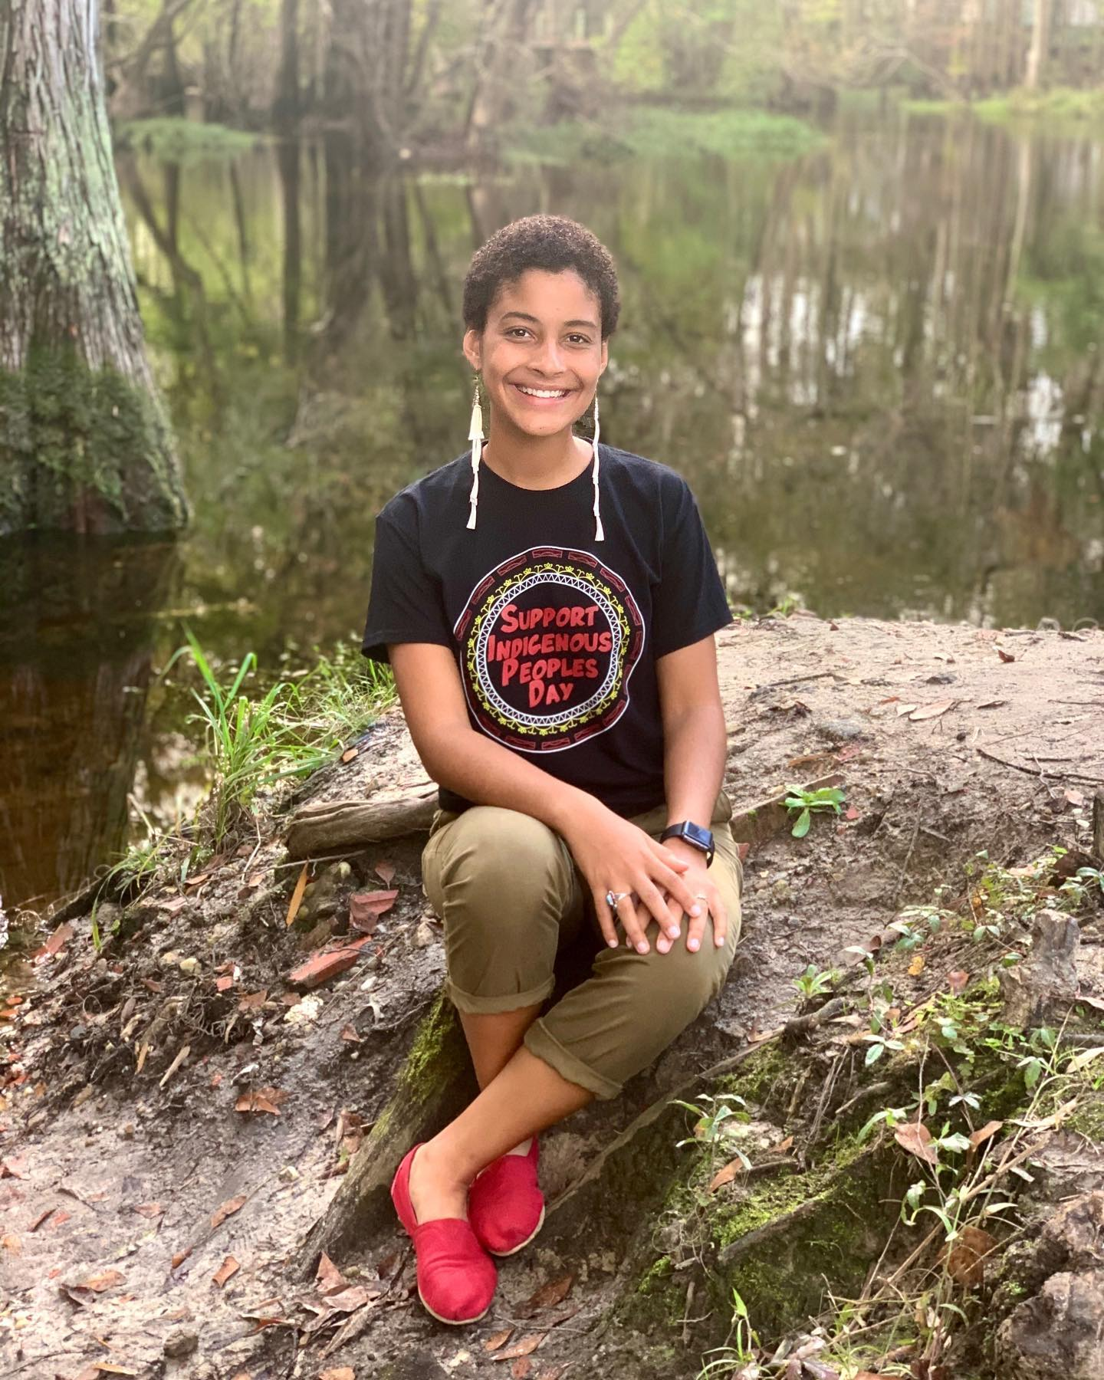
OUTREACH
Send formal letter and flyer to tribal leadership in NC and VA
Coordinate Steering Committee meeting for January
Liaise with recently appointed Courtney Wynn, Director of Indigenous/Native American Outreach in VA

Slide 10
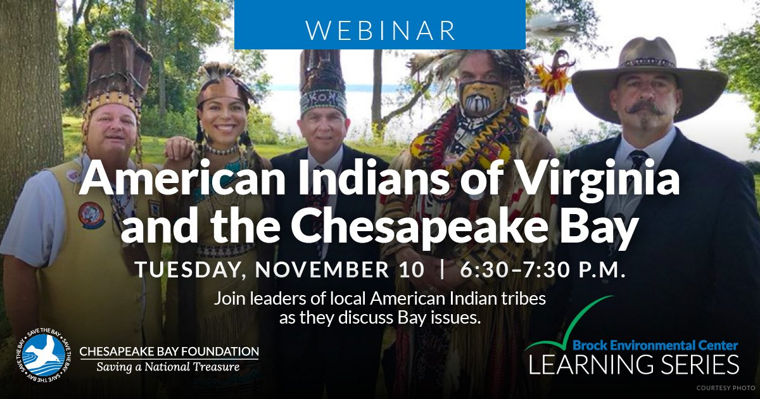
Native American Heritage Month Activities
Chesapeake Bay Foundation - American Indians of VA and the Chesapeake Bay, November 10
  Beth Roach, Project Director, joins this panel with Nikki Bass (Nansemond) and Reggie Tupponance (Upper Mattaponi)

Slide 11

Native American Heritage Month Activities
Water is Life: Environmental Issues and Native Communities
  Dr. Ryan Emanuel, Greg Jacobs, and Phillip Bell
Resilience in Tribal Communities
  Beth Roach and Jocelyn Painter

Slide 12
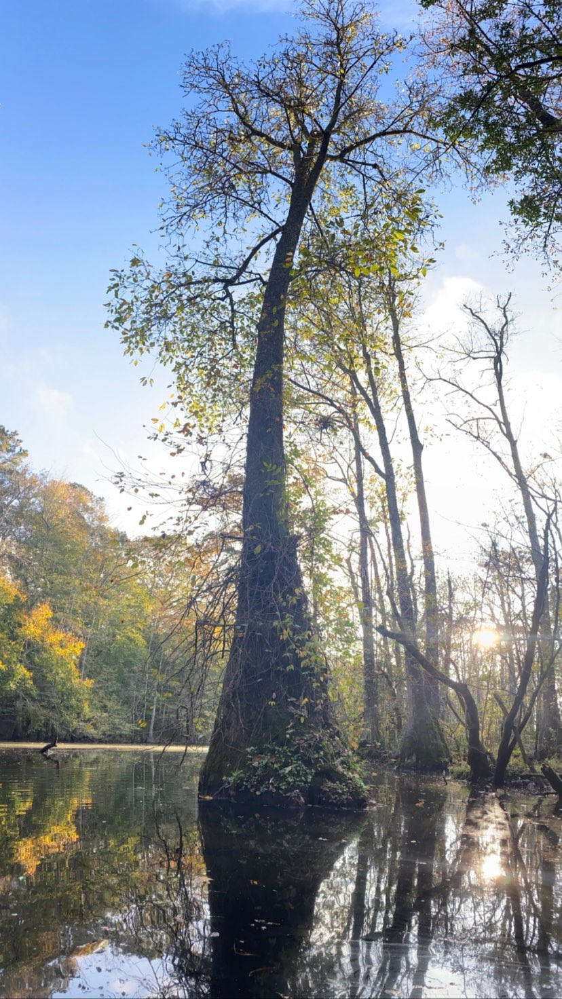
What Does Success Look Like?
Tribal communities actively co-manage their watershed via restorative actions
  Share stories, concerns, threats, and future desires
  Co-create shared vision of how to manage resource
  Local, state, federal agencies, NGOs, corporations, public residents, and academia develop trust through meaningful relationship building
Workshops
  Storytelling and Mapping
  Working Together With Policy Makers
  Restoration and Climate Adaptation
  Intertribal Paddles

Slide 13

