Slide 1
STAC Update: Jul-Aug Activities
STAC personnel changes
STAC Executive Board discussions
STAC summer (August 18) general meeting

Slide 2
STAC Personnel Changes
New co-Chairs
Paul Angermeier, Jud Kenworthy (2022-2024)
New Executive Board
Carolyn Currin, Heather Deck, David Glenn
New STAC members
Paul Cough, John Walker, (more on the way)

Slide 3
STAC Executive Board Discussions
Reviewed Jan 2020 Directive to STAC from LC
Develop near-term focal areas
Rebuild more functional, effective STAC
Reviewed Mar 2019 STAC Action Plan
Overview of STAC roles (per bylaws)
Major tasks for 2-year plan

Slide 4
STAC Executive Board Discussions
Strategic planning for 2022-2023
Develop priority topics for STAC activities
Water Quality
Develop presence in upcoming WQ Summit
Resilience
Develop planning / engagement actions
Recruit new STAC members (up to 6 seats)
Expertise germane to priority topics

Slide 5
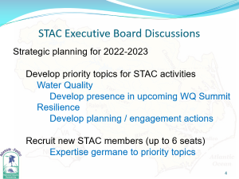
STAC Summer (August 18) General Mtg
Presentation by Greg Taylor (STAC)
Coastal Zone Soil Survey in the
Albemarle-Pamlico Estuarine System
Presentation by Jimmy Johnson (APNEP)
STAC Support Opportunities for Implementation of North Carolina Coastal Habitat Protection
Plan Amendment
Open discussion of STAC 2022-2023 priorities
General concurrence with EB suggestions

