Slide 1
STAC Update: Activities Since Late May
STAC personnel changes
STAC Executive Board discussions
STAC summer general meeting

Slide 2
STAC Personnel Changes
New Committee Co-Chair (2024-2026)
Jud Kenworthy, Wilson Laney
New Executive Board member (2024-2026)
David Glenn, Donna Bilkovic, Nathan Hall
New STAC members
Deanna Hardesty (USGS)
Ashley Hatchell (US-ACE)

Slide 3
STAC Executive Board Discussions
July Workshop: Strategic planning for 2024-2025
APNEP 2024 Science & Technology Priorities
Monitoring & assessment teams
Science & technology webinars
Focus teams
Spatial analysis targeting project
Regional ecosystem assessment plan
A-P ecosystem model(s) development

Slide 4
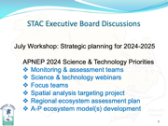
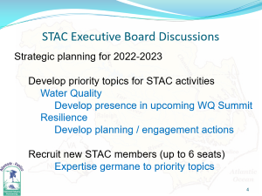
STAC Summer (mid-August) Meeting
Discussion Topic 1
APNEP “Metric Report” Assessments
Discussion Topic 2
Topics for APNEP’s S&T Webinar Series

