Slide 1
CCMP Addendum Update
6 Oct 2022

Slide 2
Scope
CCMP: Comprehensive Conservation and Management Plan
Will serve as an updated CCMP, building upon the foundation the 2012-2022 version
“Revision” will be the CCMP for the 2023-2028
It will remain consistent with APNEP’s Ecosystem-Based Management approach.
Goals and Objectives to remain pending LC approval
Continue to address climate change impacts
Work to address equity, diversity, and inclusion

Slide 3
Scope
Themes:
Water Quality,
SAV
Coastal Wetlands
Oysters
Community Resilience
Aims:
Identify tangible outputs and outcomes
Identify significant APNEP roles
Identify lead organizations and foster partnerships
Tie to financial strategy
Tie directly to the BIL long-term plan*
Additional documents to be developed:
Monitoring plan additions
Restoration plan ( or address in CCMP)
Financial strategy
Communication / engagement strategy

Slide 4
*Tie directly to the BIL long-term plan
BIL long-term Strategy
5-years with funding
Support CCMP implement
“Disadvantaged Communities” & Resilience
Conceptual Approach
CCMP = Goals, Objectives, Actions, & Targets
BIL Long-term Plan = Strategy implementing actions
Annual BIL work plan = Projects directly supporting Actions
Annual 320 work plan = Projects and Administration
Additional elements: Financial Plan, Equity Strategy, Restoration Plan, Monitoring Plan, Engagement Strategy
Notes:
M

Slide 5
EPA Requirements / Checklist
Reaffirm existing goals (Are new goals needed?)
Reaffirm objectives, and any actions plans (Note that new actions should indicate whether they are replacements for or enhancements);
Any change to key partners or entities that will serve as lead implementers;
A timeline and milestones for completion;
Where the action will take place and/or the natural resources affected;
Description of potential costs;
Description of performance measures (quantitative/environmental results wherever possible); and
A crosswalk description of how all new actions/updated actions compare with related original actions and what the basis was for change.

Slide 6
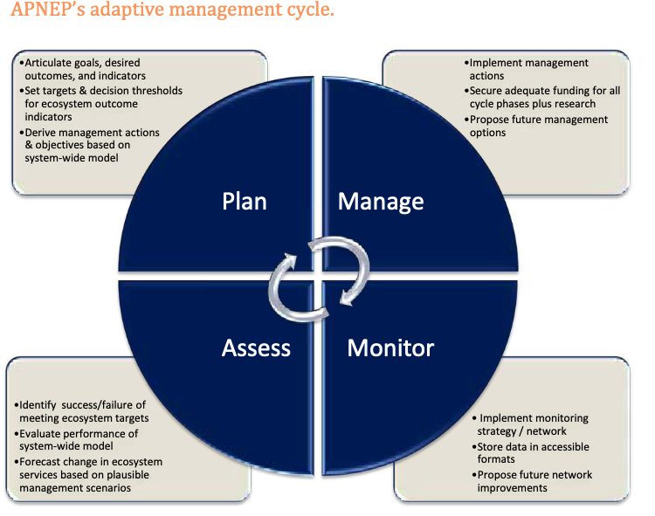
Next Steps
October 2022
Leadership Council Meeting (10/6)
Conceptual overview
Review/Approval BIL Workplan
Submit BIL Workplan to EPA
November 2022
Establish CAC
STAC Meeting
Further draft CCMP revision
December 2022
Leadership Council Workshop?
Water Monitoring Plan
2023
CCMP Development
Scope/ RFP for Financial Plan
Equity Strategy
Long-term BIL plan
320 Work plan
Draft Communication Strategy
Action Assessment
Themes/ Priority Actions
Leads
Funds
Crosswalk

Slide 7
Goals & Ecosystem Outcomes
1: A region where human communities are sustained by a functioning ecosystem
Waters are safe for personal contact.
Designated surface and ground water supplies are safe for human consumption.
Surface hydrologic regimes sustain regulated human uses.
Fish and game are safe for human consumption.
Opportunities for recreation and access to public lands and waters are protected and enhanced.
2: A region where aquatic, wetland, and upland habitats support viable populations of native species
The biodiversity, function, and populations of species in aquatic, wetland, and upland communities are protected, restored, or enhanced.
The extent and quality of upland, freshwater, estuarine, and near-shore marine habitats fully support biodiversity and ecosystem function.
Non-native invasive species do not significantly impair native species’ viability or function, nor impair habitat quality, quantity, and the processes that form and maintain habitats.
3: A region where water quantity and quality maintain ecological integrity
Appropriate hydrologic regimes support ecological integrity.
Nutrients and pathogens do not harm species that depend on the waters.
Toxics in waters and sediments do not harm species that depend on the waters.
Sediments do not harm species that depend on the waters.

