Slide 1
Regional and State
Salt Marsh Conservation
Claire Rapp
Marine Fisheries Commission Meeting
May 25, 2023

Slide 2
Regional and State
Salt Marsh Conservation
Claire Rapp
CHPP Steering Committee Meeting
May 31, 2023

Slide 3
Regional and State
Salt Marsh Conservation
Claire Rapp
APNEP Leadership Council Meeting
July 12, 2023

Slide 4
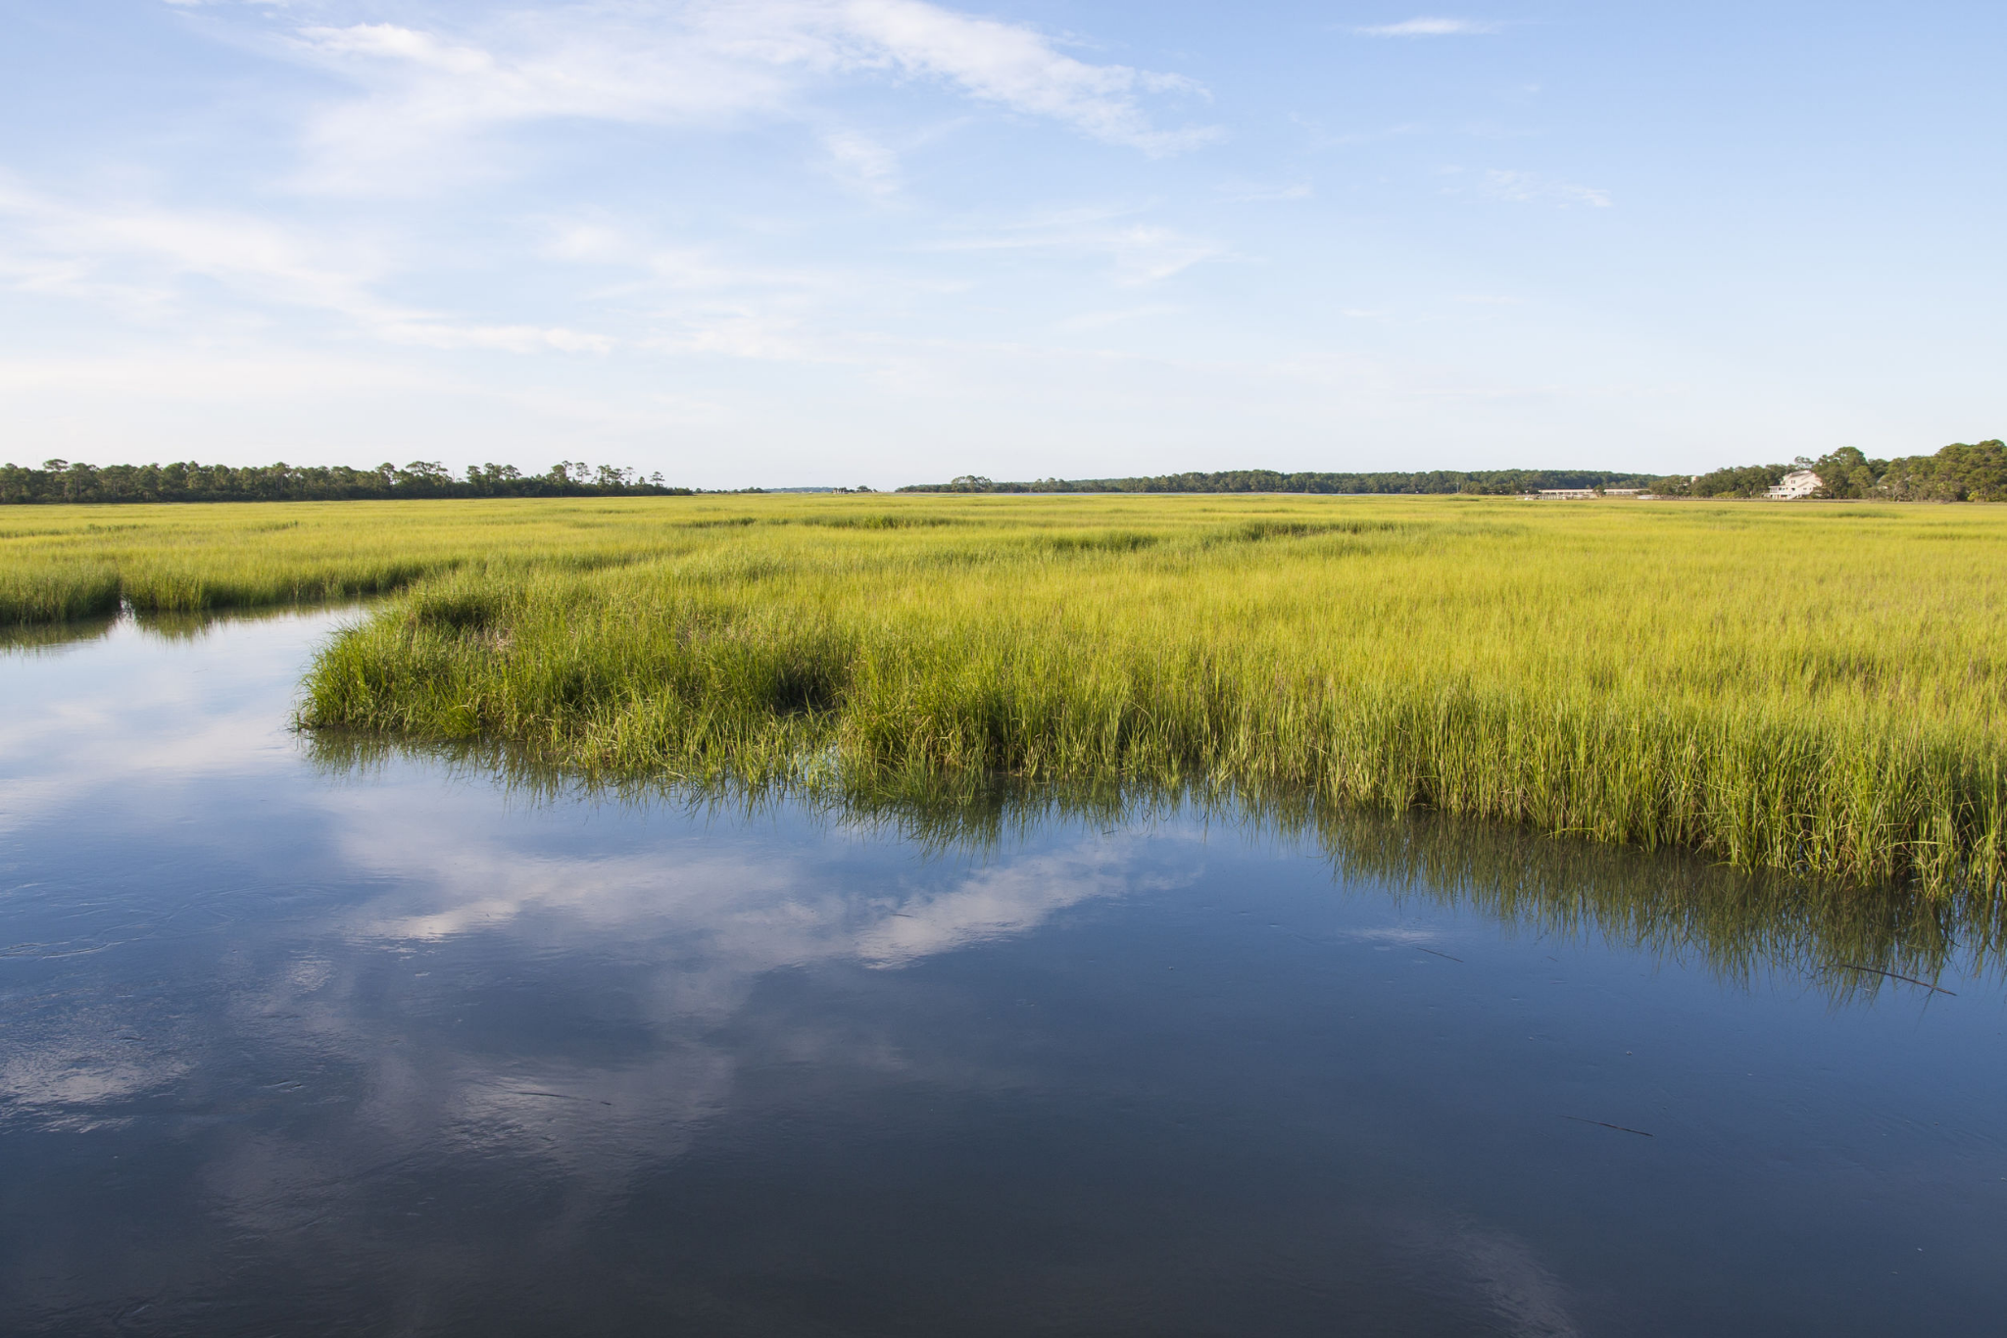
Outline
Introduction
Video - Marsh Forward: South Atlantic Salt Marsh Initiative
The Importance of Salt Marsh
South Atlantic Salt Marsh Initiative
SASMI Regional Salt Marsh Plan
NC Salt Marsh Conservation Action Plan
Next Steps and Needs

Slide 5
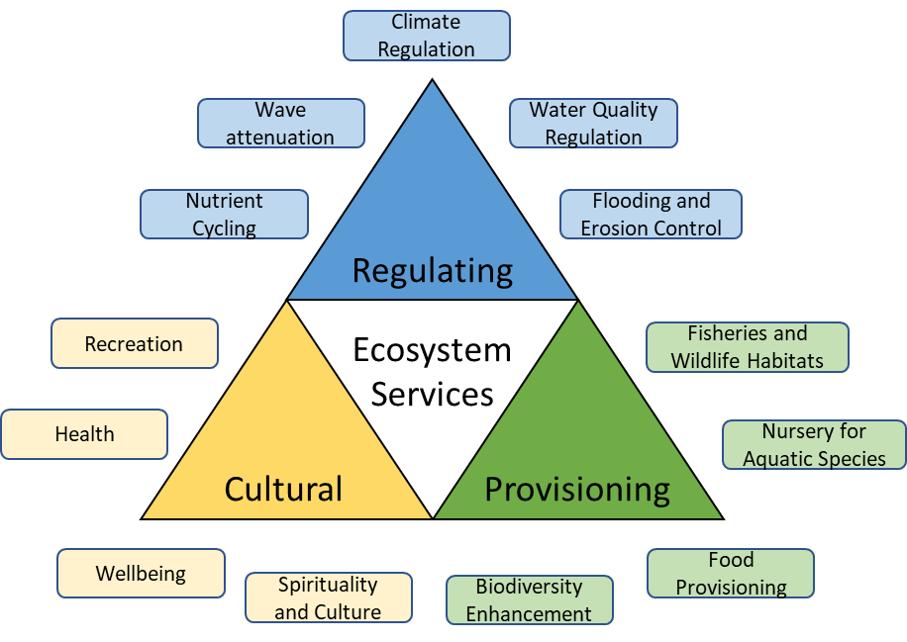
The Importance of Salt Marshes
J Lee (Instagram: @growingwilder)
Notes:
SA region of US has approximately 1 million acres of salt marsh stretching from NC through NE FL
Ecosystem services
Threats - esp SLR

Slide 6
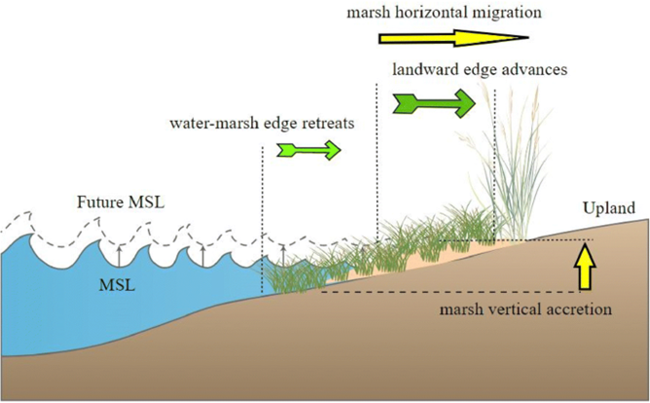
Marsh Response to Sea Level Rise
Marsh horizontal migration
Lanward edge advances
Water-marsh edge retreats
Future MSL
Upland
M S L
Marsh vertical accretion
Nunez et al., 2020

Slide 7
Notes:
A regional effort from a voluntary, non-regulatory partnership

Slide 8
South Atlantic
Salt Marsh Initiative (SASMI)
Officially launched May 2021
300+ members consisting of leaders from SERPPAS and other local, state, and federal partners, communities, and NGOs from NC, SC, GA, and FL
Notes:
Pew Charitable Trusts helped launch SASMI, which is under the leadership of Southeast Regional Partnership for Planning and Sustainability (SERPPAS) in May 2021
300+ member coalition made up various stakeholders
Goal → conserve 1 million acres of salt marsh between NC and FL

Slide 9
SASMI
Goal: To enhance the long-term abundance, health, and resilience of the approximately 1 million acres of salt marshes within the South Atlantic states to ensure no overall loss of the benefits these wetlands provide to fish, wildlife, and people.

Slide 10
SASMI’s Regional Salt Marsh Plan
Officially launched Tuesday, May 16th
Available on the Website:
https://marshforward.org/
Notes:
SASMI’s action-oriented 10-year plan launched today. It is one of the only landscape-scale salt marsh protection plans in the country and the first to prioritize actions directly benefiting national defense, fish and wildlife, communities and cultures of the South Atlantic states. Partnership made this plan possible. It is the culmination of over a year of work by SASMI’s broad and diverse coalition which has grown to include approximately 300 stakeholders in a couple quick years.
There are two documents: the full SASMI Plan, which clocks in just over 50 pages, and the eight-page Executive Summary document, which was designed as a stand-alone document that provides all the essential info from the full SASMI Plan in a more easily printed, shared and read size.
The plan includes an Executive Summary, Case for Conservation, Plan section, two core Strategies, four Crosscutting Approaches, Plan Implementation discussion, appendices and reference list, as well as eight case studies illustrating salt marsh protection, restoration, and migration projects from throughout the SASMI region that are peppered throughout the plan, strategies and cross-cutting approaches sections. The Case for Conservation provides an overview of what salt marsh is, the ecosystem services and cultural values South Atlantic salt marshes provide, primary threats and conveys a strong sense of urgency and need for collective action as the SASMI Coalition working together across boundaries to protect the future of the million-acre salt marsh expanse.
The Plan section defines key terms such as objectives and strategies, and lays out the SASMI goal, overviews of the strategies, crosscutting approaches, and approach to implementation.

Slide 11
Two Strategies
Protect and restore the health and function of existing salt marshes
Conserve marsh migration corridors and remove or retrofit barriers to ensure salt marshes can shift as sea levels rise
Notes:
The first of the two SASMI Plan strategies is to:
Protect and restore the health and functions of existing salt marshes.
This strategy includes key objectives and actions designed to:
Minimize impacts to marsh habitat from adjacent development and sustain ecosystem and community health.
Support hydrologic connectivity, waterflows and sediment replenishment that is favorable to salt marshes and broader estuary health. Expand use of living shorelines to maintain and enhance salt marshes, and lastly,
To Advance investment in monitoring, mapping and research of measures to protect and restore existing marshes and improve marsh function.
The SASMI Plan’s second strategy is to Conserve marsh migration corridors and remove or retrofit barriers to ensure salt marshes can shift as sea levels rise.
Strategy #2 includes key objectives and actions designed to:
Prioritize public and private investment in conserving migration corridors where salt marshes can thrive in the future as sea level rises, and to
Remove and avoid creating new barriers to the migration of salt marshes by including marsh migration as a priority in planning and federal and state investments in public infrastructure, wetland restoration and working lands.

Slide 12
Four Cross-Cutting Approaches
Policy
Culture and Community
Funding
Communication, Education, and Outreach
Notes:
The plan also includes four cross-cutting approaches that relate to and serve the two primary strategies. These cross-cutting approaches center on the following:
Obtaining funding necessary to accomplish generational, landscape-scale actions in a critical 10-year time frame in a strategic, coordinated approach to maximize benefits and understand the consequences of irrevocable changes. Ensuring diverse cultural and community engagement and collaboration to shape inclusive, equitable, just and durable SASMI outcomes.
Building upon existing policy, laws and programs at the local, state and federal levels and pursuing new policies to plan and implement initiatives to conserve, restore and accommodate the migration of salt marshes. And lastly
Seeking opportunities and building capacity to improve communication, education and engagement about the importance of the South Atlantic’s vast salt marshes, the many ecosystem benefits they provide, and
support implementation of the SASMI Plan.

Slide 13
Implementation
Focusing most on the importance of
Close coordination
Collaboration
Co-creation
Organizational structure modified from the America’s Longleaf Restoration Initiative
Notes:
The plan concludes with a section on implementation. Importantly, this section is kept brief, focusing more on the importance of close coordination, collaboration and co-creation as we shift from developing the SASMI Plan to implementing it.
The potential organizational structure modified from the America’s Longleaf Restoration Initiative and previously shared with the SASMI SC is offered up as an example. However, the plan makes clear that such decisions will be made with the guidance and agreement of SASMI partners.

Slide 14
North Carolina
Salt Marsh Action Plan

Slide 15
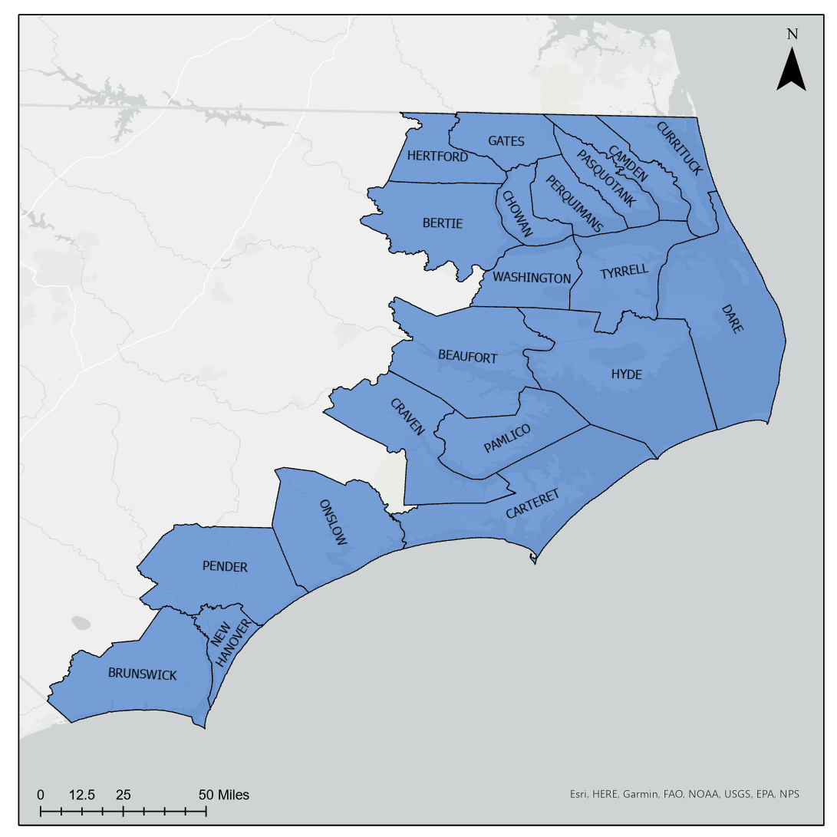
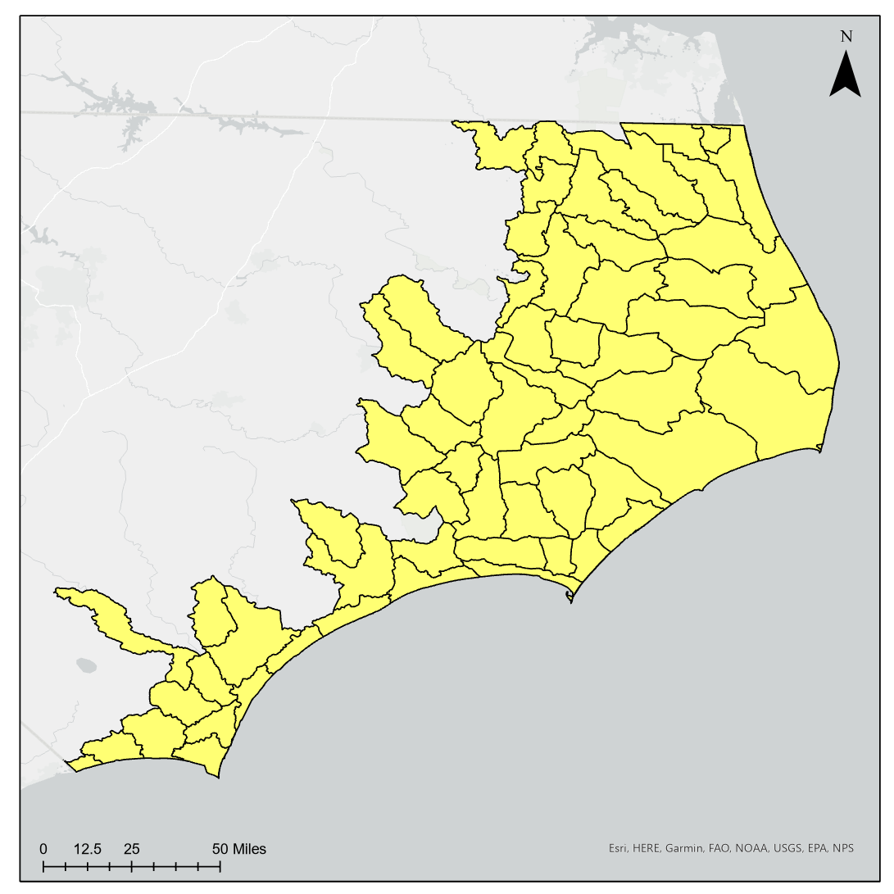
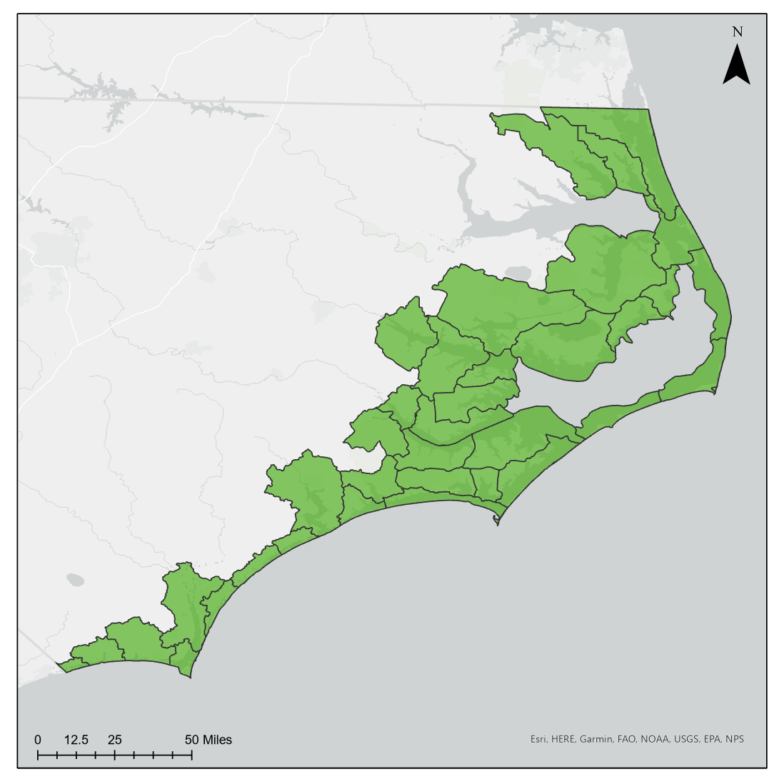
Creating Conservation Planning Units
CAMA Counties
HUC-10
CPUs
Notes:
First thing we wanted to do was establish planning units to which we would justify everything. This was a way to break the coastline up into smaller pieces, which would allow for more specialized suggestions and recommendations that focused on the specific needs for those smaller areas
We started with the Coastal Area Management Act (CAMA) counties along the coast and viewed them at the HUC-10 level. We then manipulated the HUCs based on ecological and jurisdictional needs and came up with these 38 CPUs - conservation planning units

Slide 16
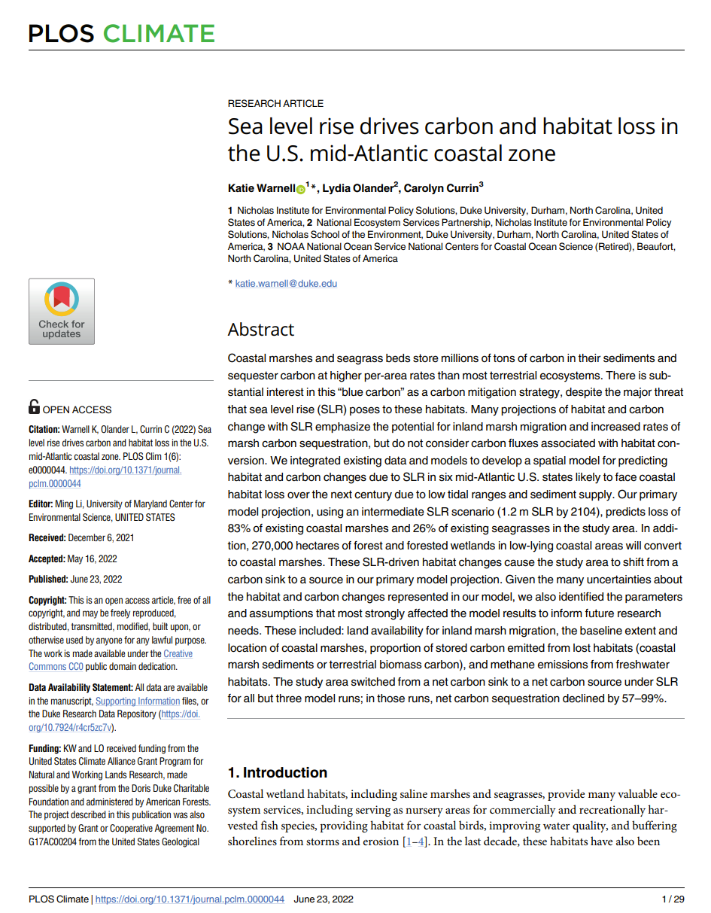
NC Salt Marsh Projections*
Nearly 220,000 acres of salt marsh currently
More than 92,000 acres lost by 2050
Approximately 270,000 acres gained by 2050
Net gain of about 180,000 acres by 2050
About 400,000 acres of salt marsh by 2050
*data used are not scaled for parcel level decision making and should be used as regional estimates only
Notes:
Actual 218,004 and 396,509 acres
Mike and jessie took Katie’s data and simplified it for us and our purposes
We took their data
this is the data that was used to inform this and what it tells us is that under intermediate SLR, we stand to gain 180,000 based on current development without intervention to try and impede transgression
Here is where that growth is…

Slide 17
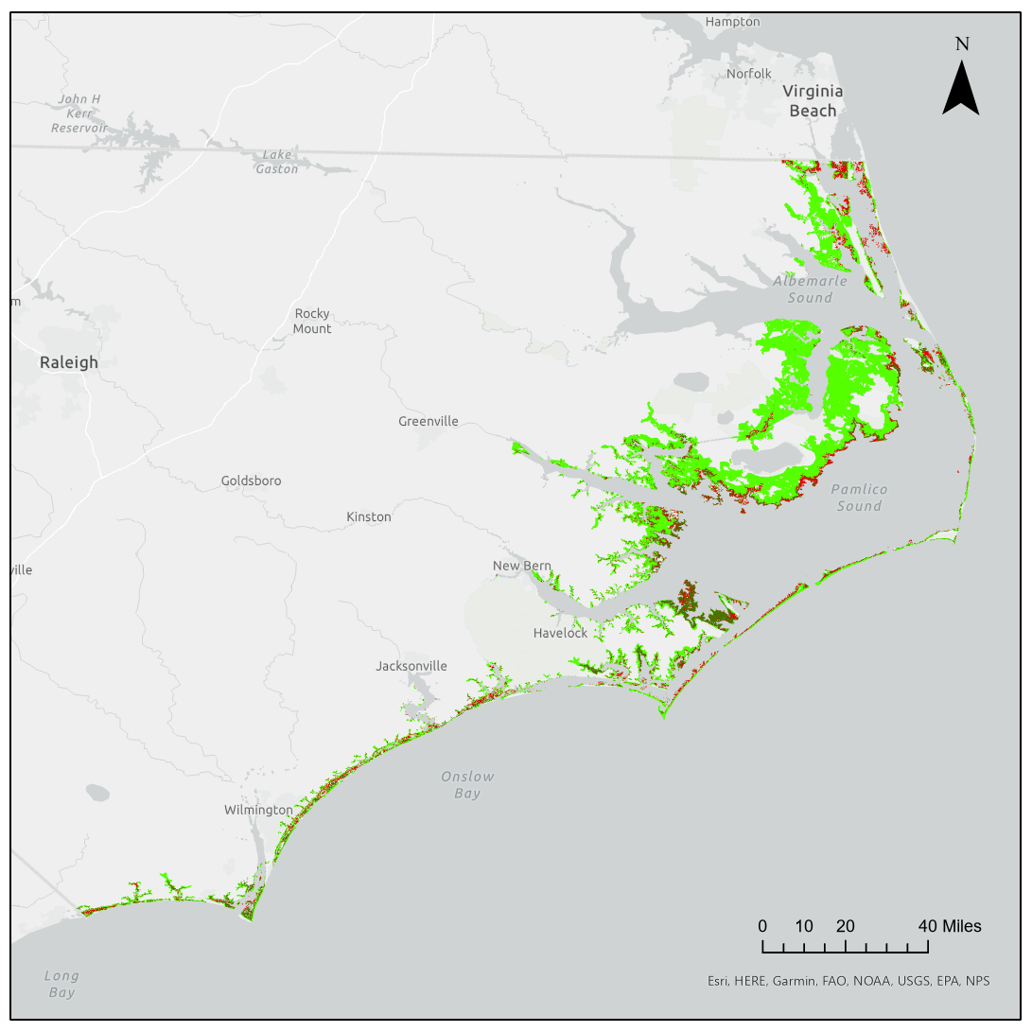
Salt Marsh Gain and Loss by 2050
Notes:
Once we had our planning units, we were able to take the utilize the data from Warnell that was used for the workshop and, with the help from Mike and Jessie, we were able to calculate how many acres of marsh would be lost or gained in each CPU by 2050
Mike and jessie took katies data and simplified it
Converting = migrating into forested or ag land
We recognize the large-scale ecosystem services of marshes but then there are also hyper local - conserving at the HUC-ish level is what will be needed

Slide 18
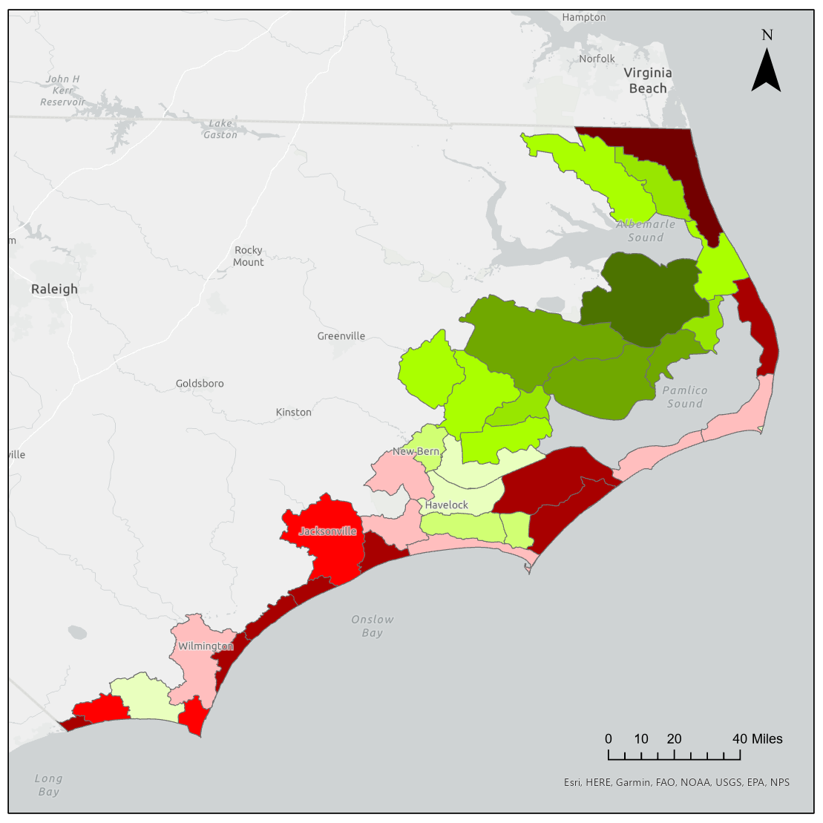
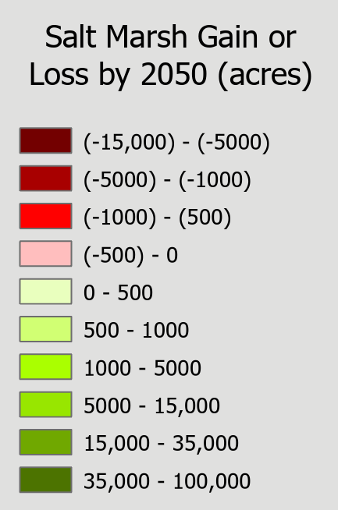

Slide 19
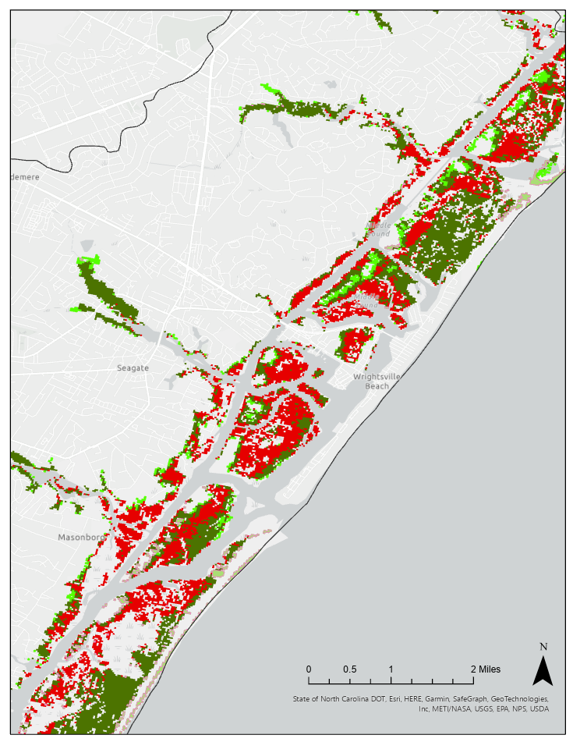
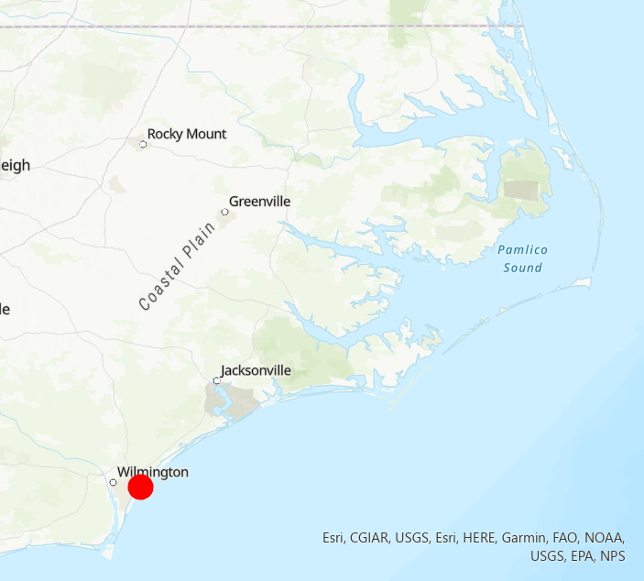
Protection and Restoration

Slide 20
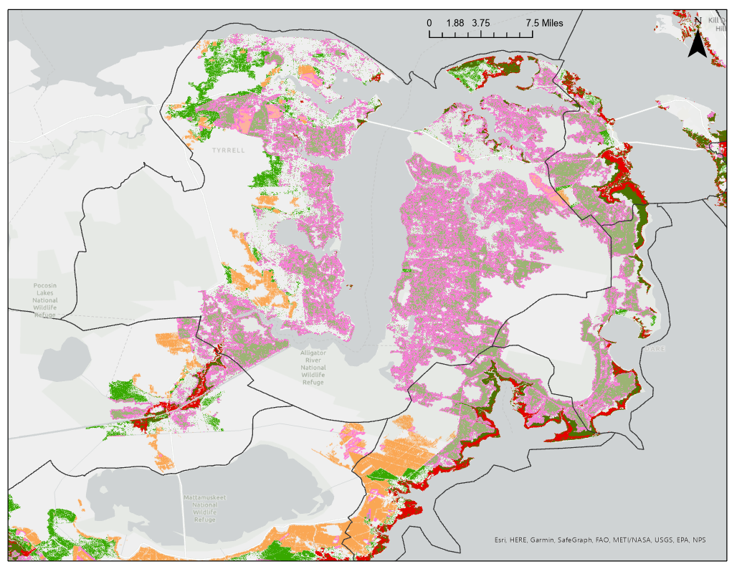
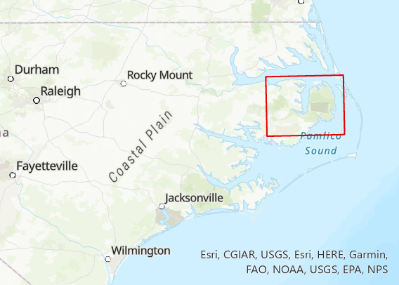
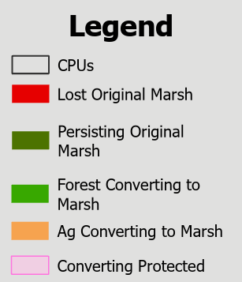
Migration Facilitation

Slide 21
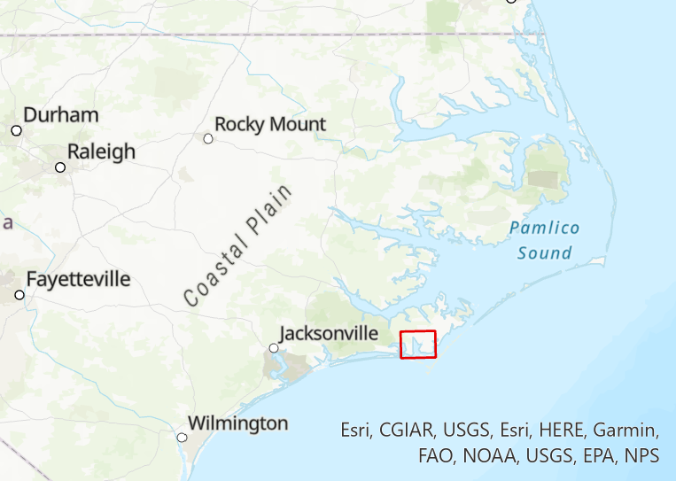
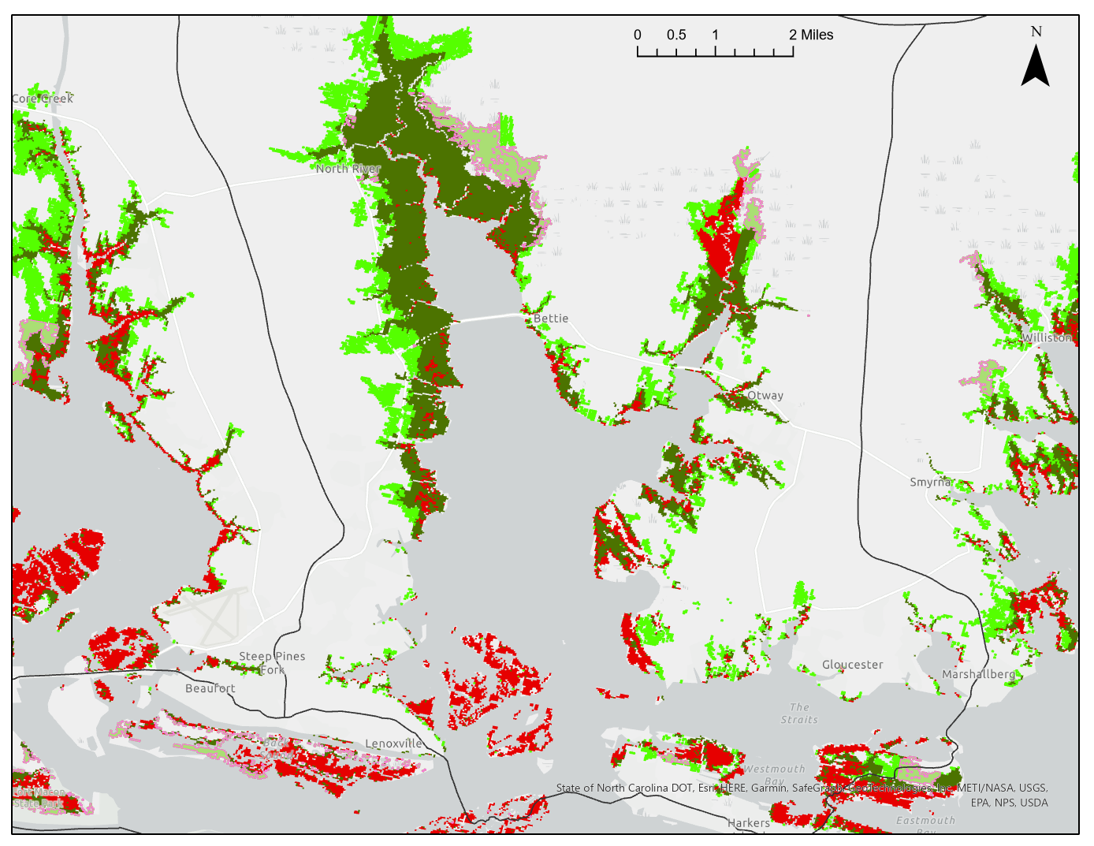
Both Restoration and Migration Facilitation

Slide 22
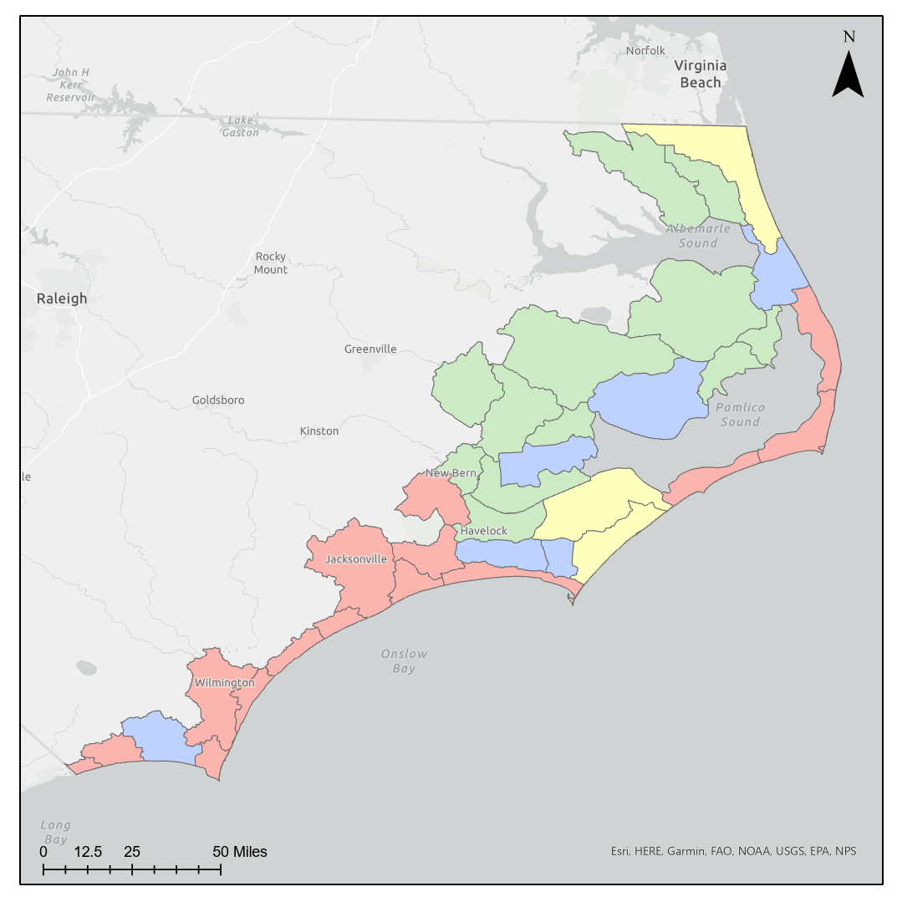
Priority Action Suggested for each CPU
 |  | Suggested Priority Action for Salt Marsh Protection
Cluster | *Net Gain or Loss | Protection/ Restoration | Facilitate Migration
Red | Loss | X
Yellow | Loss | X | X
Blue | Gain | X | X
Green | Gain |  | X
*Net loss or gain refers to the difference in salt marsh acreage per CPU between now and 2050 under intermediate SLR scenario (1.5ft) - assuming current levels of development. Developed from data by Warnell, Olander, and Currin (2022).
Notes:
Tried quantitative methods, but ultimately went with qualitative approach

Slide 23
Recommendations
Goal 1: Protect, Restore, and Enhance Existing Fringing and Isolated Salt Marshes
Goal 2: Facilitate the Successful Migration of Future Salt Marshes
Goal 3: Support and Facilitate Ancillary Needs of Salt Marsh Protection, Restoration, and Migration
Notes:
Recommendations are divided into 2 main goals: the protection, restoration, and enhancement of existing marshes, and the facilitate the successful migration of future marshes. There is a third division that includes the ancillary needs of the overall initiative, including education/communication program development, funding mechanisms, etc.
Each goal as several corresponding objectives and necessary actions needed to accomplish each objective.
These recommendations have been developed through collaboration with various program teams within the coastal federation and will be discussed and refined by stakeholders during the upcoming workshops
Preliminary recommendations have been drafted that will be vetted and built out through stakeholder driven workshops

Slide 24
Next Steps
Stakeholder Workshops
Southeastern NC - focusing on Restoration and marsh Protection strategies
Northeastern NC - focusing on Migration Facilitation strategies
Publish online Webmap to showcase GIS salt marsh projections and stakeholder-determined priority areas
Release NC Salt Marsh Action Plan late Fall 2023
Notes:
Next steps:
2 workshops - one in SE focusing on restoration, one in NE focusing on migration
Fill out webmaps
Completed plan late fall

Slide 25
Implementation Phase
Hopefully awarded NFWF NCRF grant
multi-state proposal – NC, SC, GA, FL
capacity building in underserved communities
working with communities to determine where to pursue future projects to build resilience through salt marsh protection, restoration, or migration
Notes:
SASMI NCRF project – if funded, it will help build out and advance community prioritization projects in up to 5 coastal communities across the state
Showing commitment to supporting implementation of these actions – efforts that will be sustained and ramped up to take advantage of unprecedented federal and state funding for climate resiliency

Slide 26
Thank You!
Claire Rapp
Salt Marsh Campaign Coordinator
North Carolina Coastal Federation
clairer@nccoast.org
Chris Baillie
Resilience/Climate Adaptation Coordinator
chrisb@nccoast.org
Todd Miller
Executive Director
toddm@nccoast.org
Ana Zivanovic-Nenadovic
Chief Program Director
anaz@nccoast.org

Slide 27
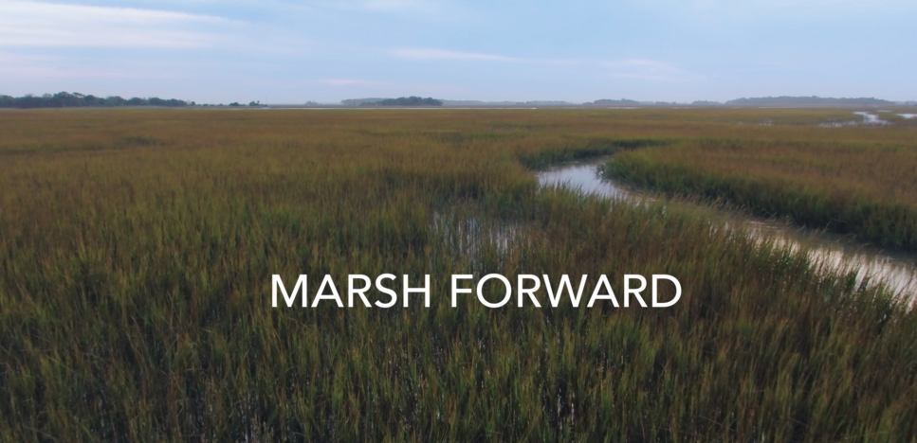
Marsh Forward: South Atlantic Salt Marsh Initiative
Produced by the Cornell Lab of Ornithology
→ Independent partner of SASMI
Notes:
Youtube link to full video: https://www.youtube.com/watch?v=b_1oHvp9PuY

