Slide 1
FLOOD DYNAMICS IN THE BERTIE WATER CRESCENT
INTEGRATING THE DYNAMICS OF COMPLEX DRAINAGE SYSTEMS TO MINIMIZE STORM IMPACTS AND MAXIMIZE AQUATIC ENVIRONMENT VIABILITY, BERTIE COUNTY, NC
NORTH CAROLINA LAND OF WATER (NC LOW)
www.nclandofwater.org
NC LOW TEAM
Dr. Stanley Riggs and Dr. Robert R. Christian: North Carolina Land of Water (NC LOW)
Additional Contributions By:
Ms. Dorothea Ames: North Carolina Land of Water (NC LOW)
Dr. David Mallinson: ECU Department of Geological Sciences
Dr. B. Duffy, Dr. J. Dame, Ms. K. Bolam, & Ms. S. Kylander: Chowan University

Slide 2
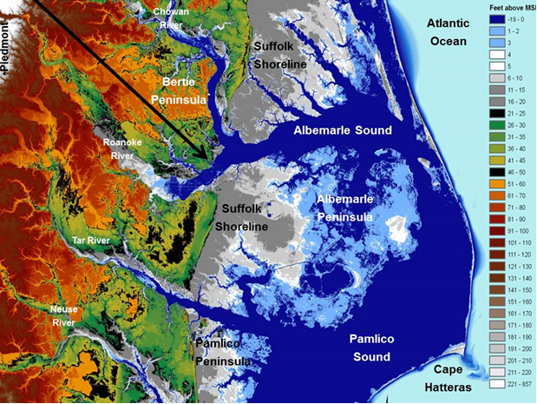
What’s to come
Study not designed for low flows but flooding
Relevant information hopefully comes from study
Bertie County waterways
  Cashie River
  Roanoke River
  Chowan River
Take home messages for APNEP

Slide 3
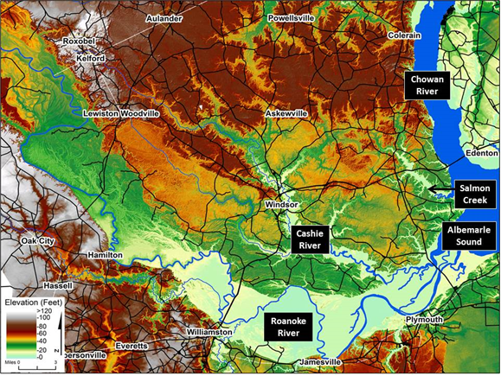
Bertie County

Slide 4
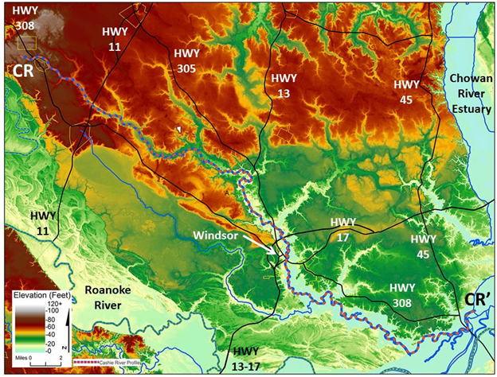
Cashie River

Slide 5
Factors affecting water levels
NCSU Report 2018, NC LOW Report 2019, Not studied

Slide 6
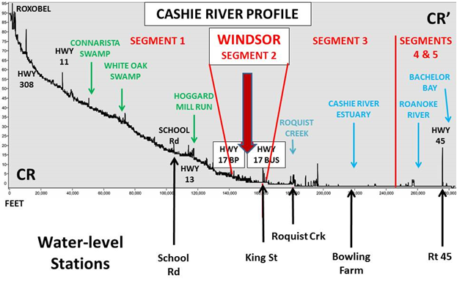
Study Sites

Slide 7
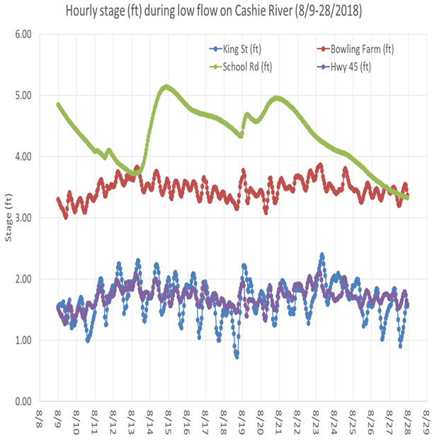
Semi-diurnal tides
Diurnal cycles

Slide 8
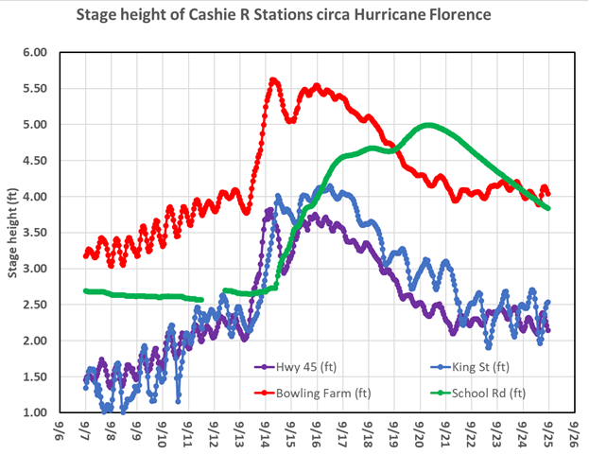

Slide 9
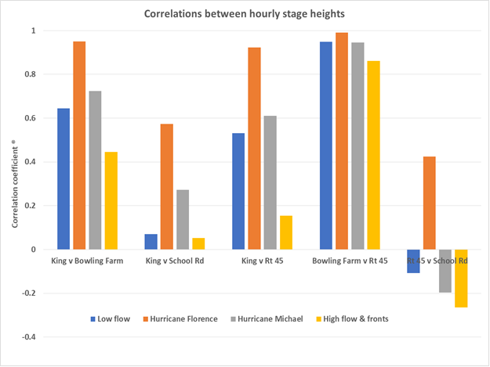

Slide 10
Level comparisons relative to Windsor from selected flows at School Rd.

Slide 11
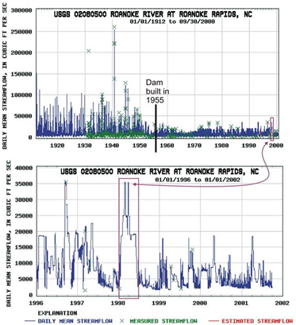
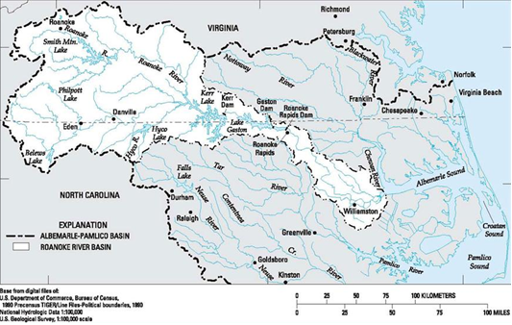
Roanoke River

Slide 12
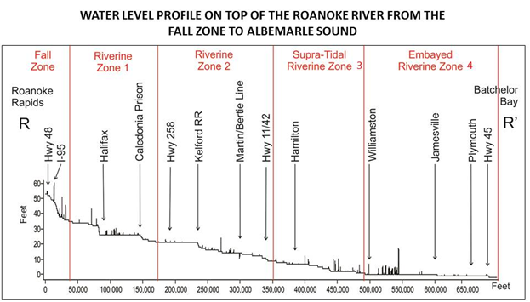

Slide 13
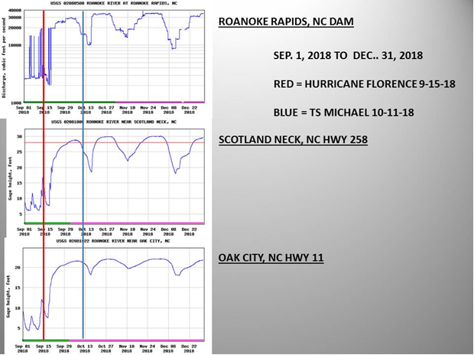
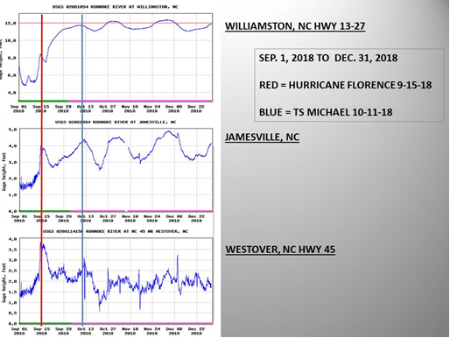

Slide 14
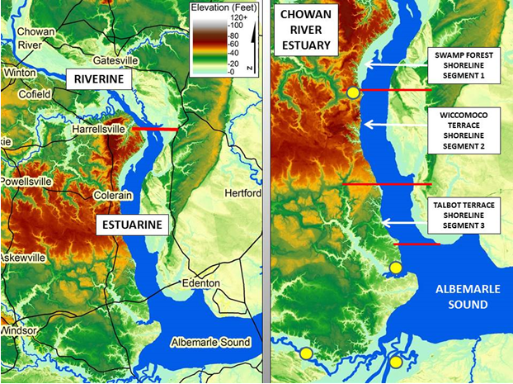
Chowan River

Slide 15
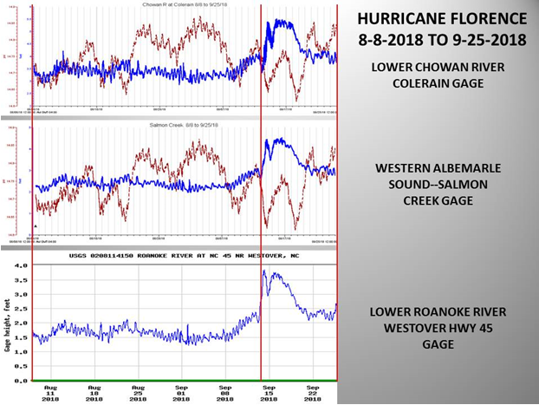

Slide 16
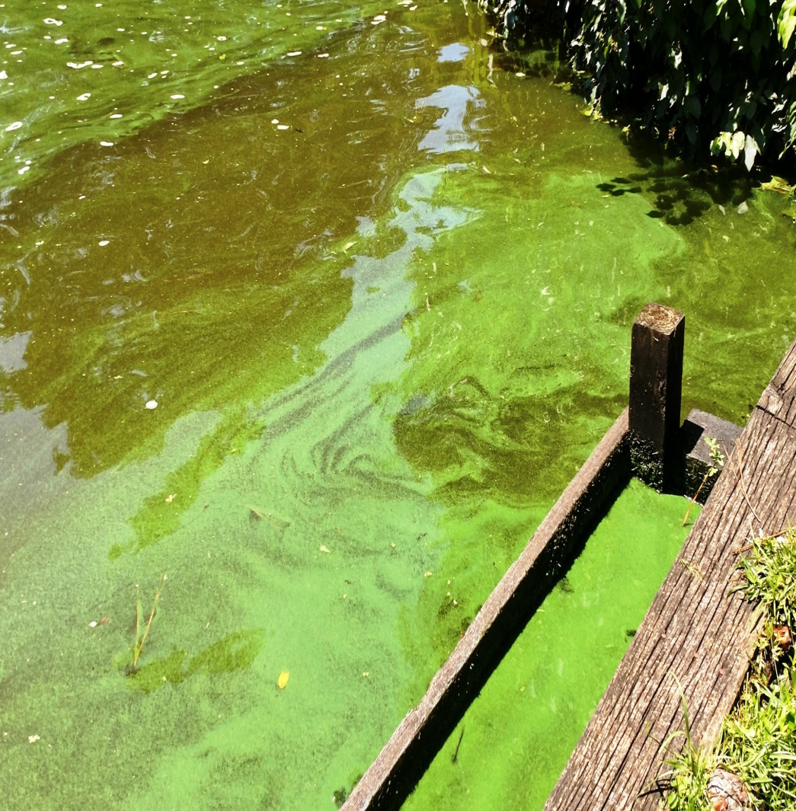
Cyanobacterial blooms with low flow

Slide 17
Take Home Messages
Might use water levels in lieu of flows.
Elevation of thalweg relative to sea level is a key feature.
Downstream conditions matter.
Changes in flow dynamics can occur within a few miles with flow dependence on precipitation.
Cyanobacterial blooms may be an explicit negative response to low flows
High flows may also have ecological consequences.

Slide 18
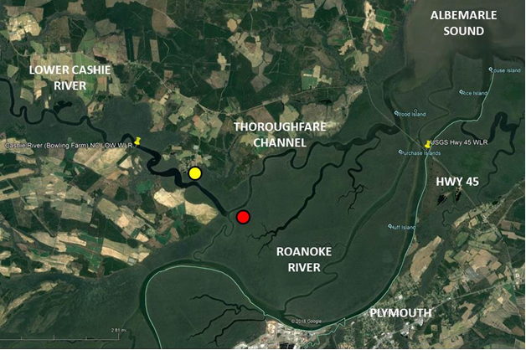

Slide 19
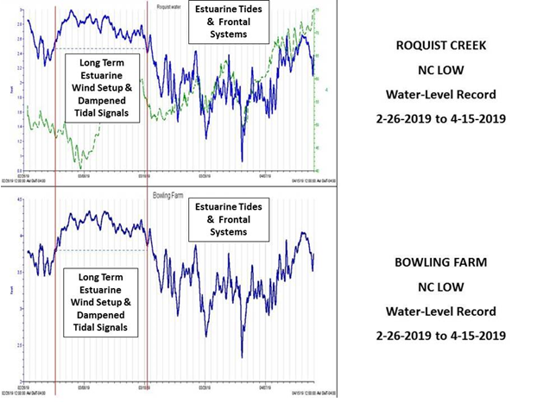

Slide 20
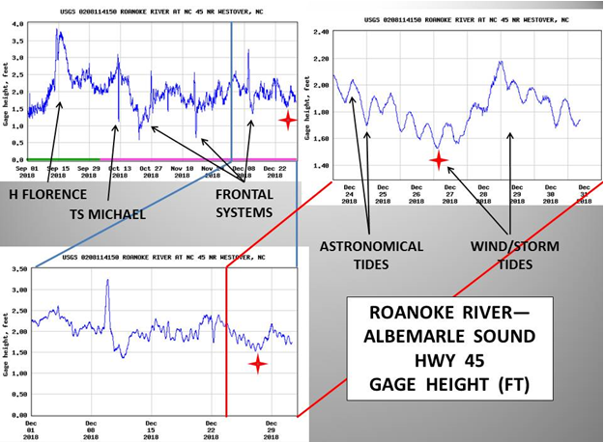

Slide 21
