Slide 1
Stacey Webb Feken
Policy and Engagement Manager
Bipartisan Infrastructure Law & Scuppernong Study Update
July 12, 2023
Leadership Council Meeting
Albemarle-Pamlico National Estuary Partnership (APNEP)

Slide 2
EPA Feedback on draft Equity Strategy
Submitted BIL Long Term Strategy to EPA Region 4 May 30; comments not yet received
Submitted Equity Strategy (Appendix to BIL Strategy) May 30, comments received June 26 from EPA
Comments minor overall ; no red flags, edits due July 26, also partner edits to include
Governance Structure Clarification
Management Conference - EPA role, Leadership Council oversight/approving body
Indirect benefits
Indirect benefits: include more specific examples of indirect benefits anticipated
Stakeholder engagement
Acknowledge we didn’t use template because specific projects haven’t been identified
Suggest using template for ongoing projects including Scuppernong Study and Tribal Coastal Resilience instead (hired a contractor to help develop Engagement Strategy for Scuppernong Study with team for NOAA Digital Coast grant)
Compliments
Integration of BIL long term plan & Equity Strategy with current CCMP revision
Numeric Target discussion thoughtful:
Reflects appropriate strengths and challenges to meet Justice 40 target
Highlight that building trust with communities is key to implementing Equity Strategy
Plan to incorporate the equity strategy into our existing stakeholder engagement plan and DEI initiatives.
Note: External feedback received from partners about hiring equity/diversity consultants to review plan and Management Conference bylaws

Slide 3
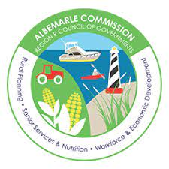
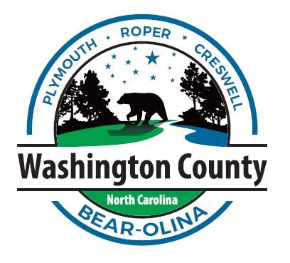
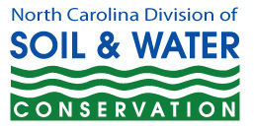
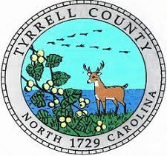
Scuppernong Regional Water Management Study
APNEP has facilitated a regional partnership to conduct a hydrologic study of the northern Albemarle-Pamlico peninsula in Washington & Tyrrell counties since 2018
Leadership Council direction:
Show where “little APNEP” can add value
Work with local governments
Integrate across multiple focus areas and disciplines
Lessons learned/capacity
Implements multiple plans:
APNEP CCMP
NC Climate Risk and Resilience Plan
Natural and Working Lands Action Plan
RISE
BIL / Equity Strategy
Notes:
2020 MOU adds new signatories

Slide 4
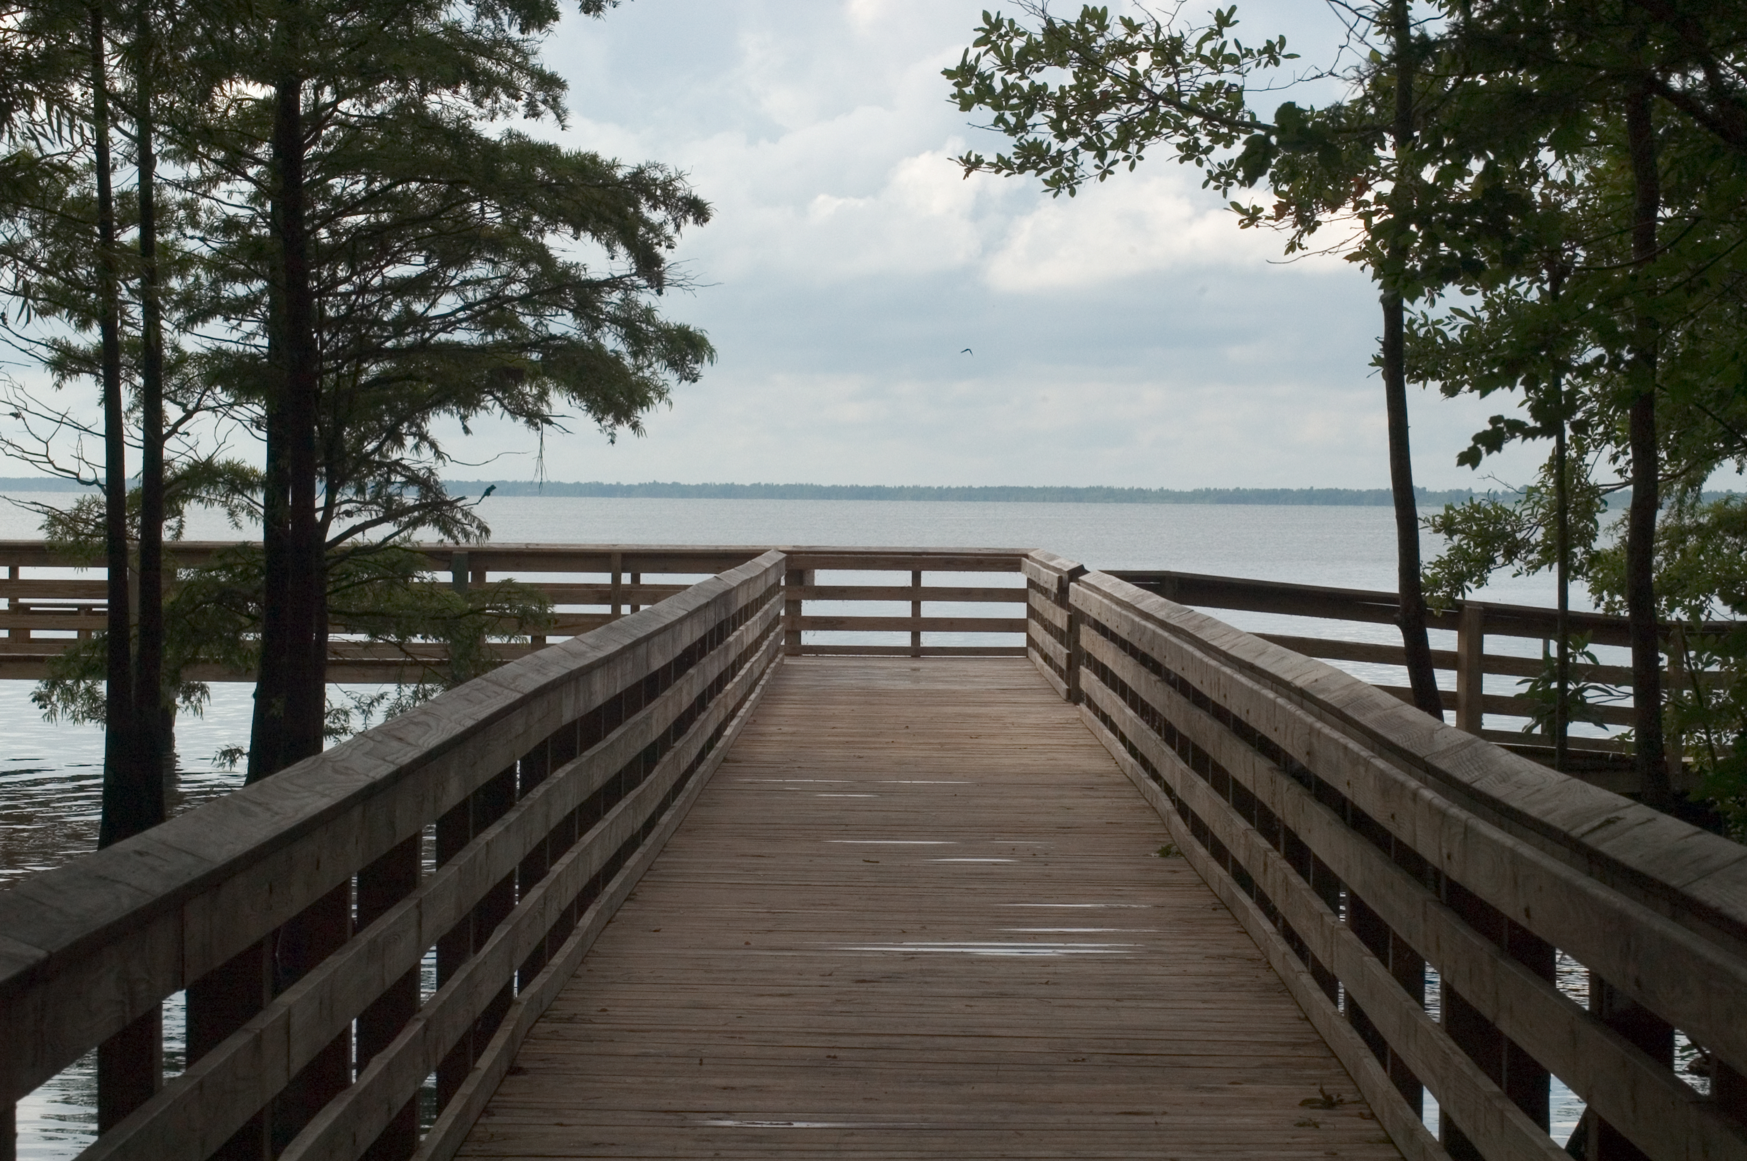
Potential for Partnering
Opportunities
Lake Phelps is a small portion of the overall watershed
Need for overall coordination in the region
Allow for credibility in the region
Ability to bring partners to the table
Water Management Study

Slide 5
Original Concept:
Update Lake Phelps Water
Management Study
Need:
Need to update outdated 1980 Lake Management Study
Cycles of flooding and drought
Flooding on adjacent lands
Washington County 2016 Resolution requesting legislative support
USGS Scope of Work: Hydrologic Study
Water Management Study

Slide 6
Potential for Partnering
Ongoing Discussions & Opportunities:
USFWS pocosin restoration efforts
Hydrologic modeling / updates to 1994 plan
DEQ Scoping Meeting April 2018
Potential for partnering on a new hydrologic study
Need to have a neutral science based partner to facilitate the process
Water Resources Development Grant Fall Cycle
Water Management Study

Slide 7
Potential for Partnering
Challenges
Some distrust of government organizations in the region
Cost of funding a new water management study (~$500,000 Lake Phelps estimate)
Stakeholders have widely differing views of how water should be managed in the region
Water Management Study

Slide 8
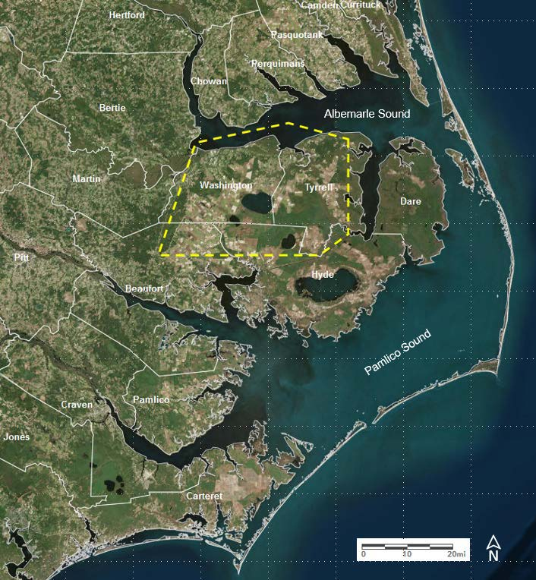
Scuppernong Regional Water Management Study
NC Division of Parks and Recreation requested APNEP serve as a neutral science-based partner in 2017
Leadership Council approved April 2018
APNEP convened steering committee in Fall 2018 (USFWS, USGS, NCDPR, NCDWR)
Developed a phased, collaborative approach for a hydrologic study of the northern Albemarle-Pamlico peninsula around Lake Phelps, Pocosin Lakes NWR
Scuppernong Coastal System (NCLOW Riggs et al.)
Notes:
*Quick overview of timeline / APNEP involvement
*Chose Scuppernong as neutral name for Study, partners wanted to reflect regional approach, fortunate to have a report from NCLOW, Dr Riggs gave us permission

Slide 9
Scuppernong Study
Expand partnership:
Local governments who have requested assistance from the state with flooding
Soil and Water Conservation Districts
Counties, regional council of government
NGOs/universities/local landowners
$200K Water Resources Development Grant awarded to Albemarle Commission
DEQ Contract finalized March 2023
APNEP co-applicant / grant administrator
5 Grant Partners
(in-kind match)
Technical subcontract:
Kris Bass Engineering
Draft SOW April 2023
Planning/Feasibility Study:
Develop water budget for region
Interactive hydrologic models
Update outdated management plans, regional coordination
Notes:
*Set off on path of applying for grant funding, seeking match, local government partners, many challenges and hurdles along way, progress now

Slide 10
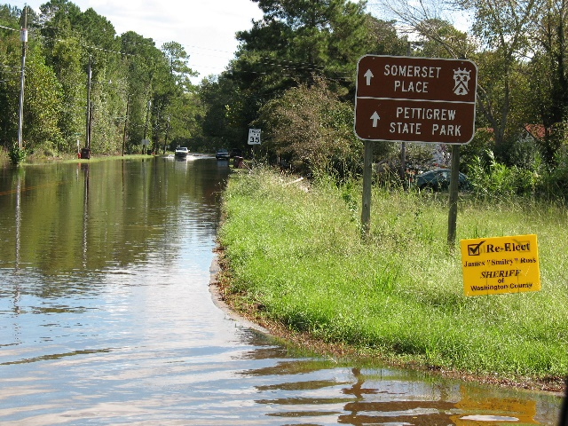
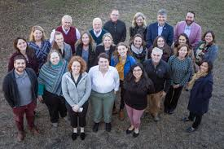
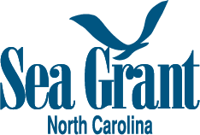
Engagement Strategy for the Scuppernong Regional Water Management Study
NC Coastal Resilience Community of Practice secured funding
NOAA Digital Coast Connects/ NERRA
Develop an equitable and inclusive Engagement Strategy to guide project planning and incorporate meaningful stakeholder and community feedback into the process
Design and implement a series of workshops to engage stakeholders in shaping the Study approach
and development
Team meets weekly (capacity/BIL Equity Strategy reminder)
Add Buckridge Reserve Site Manager as local expert
Form Steering Committee (grant partners +)
First met January; held in person workshop May 18
Hired consultant to help with Engagement Strategy
Design stakeholder / community / public workshops
Work closely with KBE on Study scope & development
Notes:
The Scuppernong Regional Water Management Study was requested by local governments and conservation land managers to help understand and resolve water-related issues on the northern Albemarle Pamlico peninsula, specifically Washington and Tyrrell Counties.
Funding has been awarded to conduct a regional engineering feasibility study to characterize the hydrology of the region, update water management plans, and address recurrent flooding. Given the interconnected nature of watersheds in this region, the goal is to create a comprehensive plan for addressing water management issues on both private and publicly-owned land.
Additional funding to develop the collaborative stakeholder engagement process was identified as a need--NCSG partnered with APNEP, the NC Coastal Reserve, and TNC secured a NOAA Digital Coast Partnership grant to develop an Engagement Strategy and design and implement a series of workshops to guide project planning and incorporate meaningful stakeholder and community feedback into the process.
Currently in the early stages—student assistant working through a literature review to identify critical elements of engagement strategies/plans and develop a high-level framework to engage project partners around as a first step toward developing the larger Engagement Strategy.
What we learn through this process will be invaluable to informing more thoughtful, inclusive, and equitable approaches to stakeholder engagement in other projects across coastal NC, especially those involving contentious issues and diverging perspectives!

