Slide 1
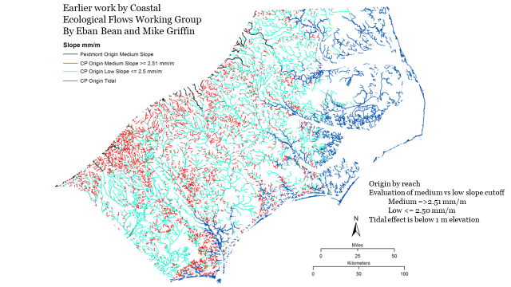
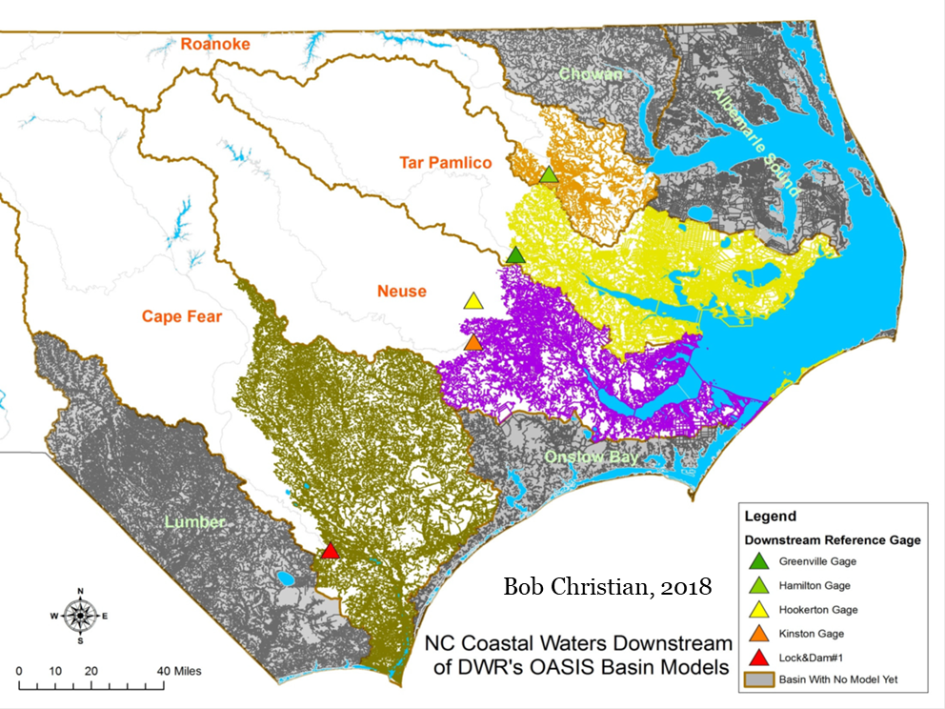
Ecological Flows Phase II Pilot Study

Slide 2
Coastal Plain Ecological Flows Evaluation Phase II Pilot
APNEP led Ecological Flows Action Team since 2015 at the request of partners that participated in the NC Ecological Flows Science Advisory Board (EFSAB);
Ecoflows Actions included in 2012 CCMP
Objective: Address data gaps and needs identified by members of the Board’s Coastal Ecological Flows Working Group.
E2.2: Develop and maintain an online resource that clearly conveys regional information in support of ecosystem-based management.
A3.3: Develop and refine ecological flow requirements for each major river.
D3.1: Develop and implement a strategy to improve decision-maker's understanding of the costs and benefits of environmental protection, restoration, planning, and monitoring.

Slide 3
Coastal Plain Ecological Flows Evaluation Phase II Pilot
Team members from ECU developed a proposal to develop research questions and criteria for establishing flow-ecology relationships in the coastal plain based on input and recommendations from team members at recent meetings.
Builds on a Phase I study conducted by ECU which focused research on the status of available ecological flow-related data for the Albemarle Pamlico Drainage Basin.
Objectives: Complete data compilation, field studies, and analysis needed to address data gaps in the coastal plain to identify surface flows needed to protect the ecological integrity of biota in coastal streams.
Trent River Watershed (Neuse Basin) selected by the Ecological Flows Action Team as an ideal location for a pilot project due to the availability of flow, water quality and ecological data; a diversity of land use and water users; proximity to the coast.
Study builds on the findings from the first phase of study (O’Driscoll et al. 2018), the NC Ecological Flows Science Advisory Board (NCEFSAB 2013) and research by Riggs and Christian (2019) on water-level dynamics on the waterways of Bertie County. Efforts include collation and analysis of previous data and information and collection and analysis of data on the Trent River and other appropriate systems.
Overall goal: Design and implement a study on a coastal watershed that can provide a scientific basis for guidance to recommend procedures and conditions for ecological flows in Coastal Plain watersheds within the APNEP region to NCDEQ/DWR

Slide 4
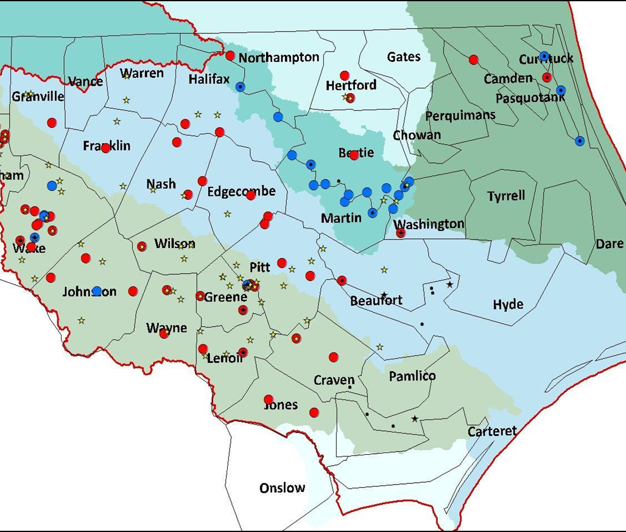
Next Steps:
Phase II Pilot Estimate:
$100K / 2 year study
APNEP Support:
$50K / FY20-21
Resources / Leverage Strategy/Team Partners
    USGS, NCDEQ, NCWRC
    Partner Outreach:
  TNC, Sound Rivers, WRRI, NC Conservation Network, American
  Leadership Council Ideas?
Notes:
2020 MOU adds new signatories

Slide 5

USGS Streamflow and Stage Monitoring Network
Tidal influence
Streamflow and Stage Network- USGS
No long-term flow data available in zone of tidal influence
(stage/discharge USGS
red circles)
Long-term flow records:
19 currently operational gages with
30 year records
Map of where current USGS streamflow gages are in NC APNEP watersheds. Red gages indicate stage and discharge sites. Blue gages indicate stage only. Yellow stars indicate inland water quality data available. Black circles indicate water quality data available in the estuary.
Notes:
Approximately 70 stations that are no longer in operation out of 119 stations

