Slide 1

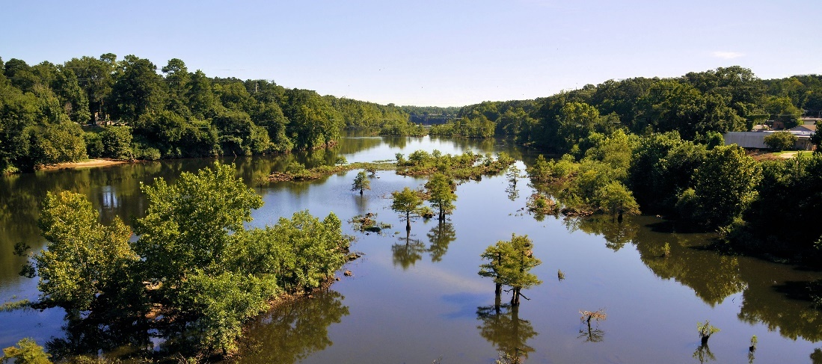

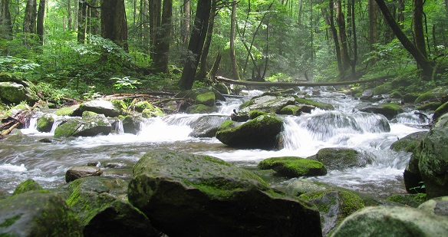


Protecting and Restoring Flows in Our Southeastern Rivers:
A Synthesis of State Policies for Water Security and Sustainability
Katherine Baer, River Network &
Grady McCallie, North Carolina Conservation Network

Slide 2
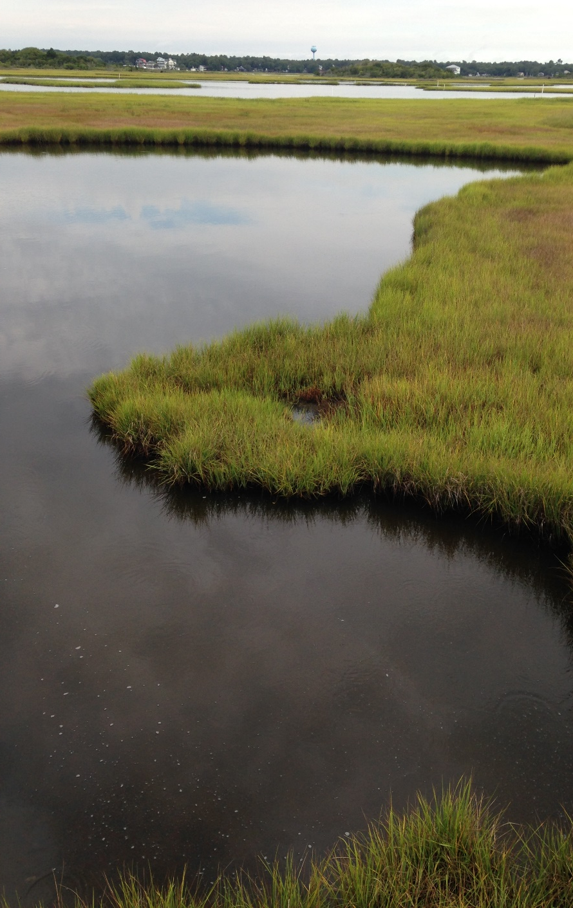
Presentation Outline
Context: why the SE flows report?
Overview of SE policy analysis
Comparisons from the region:
  Water withdrawals – water law
  Use of Clean Water Act
  Better stormwater management
Relationship to EFSAB outcomes

Slide 3
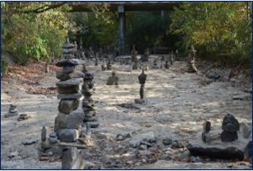
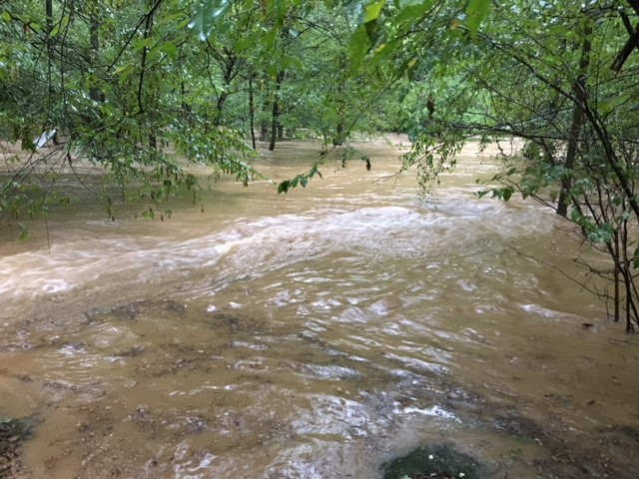
Context: why the SE flows report?
Notes:
Southeast a region of increasing water stress – both from high flows and low flows – impervious surfaces/development patterns, population growth, reservoir mgmt. – add to that climate change w more intense flood and droughts – need to address through policy and practice

Slide 4
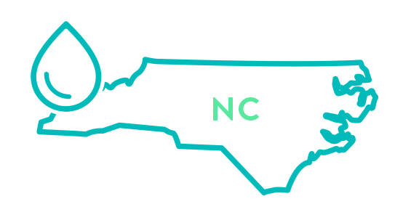
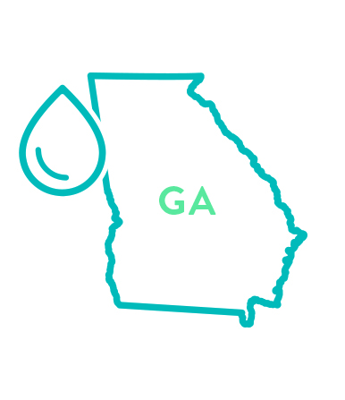


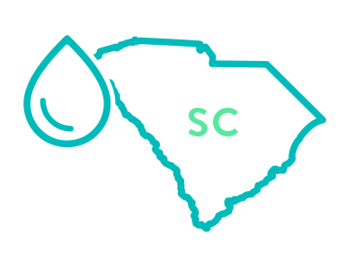
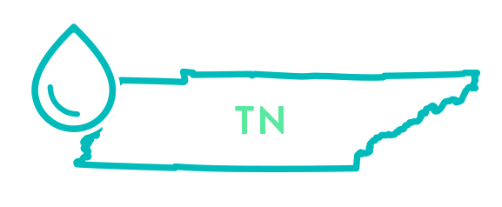
Overview of our analysis
Notes:
What the analysis did – research and overview of 5 SE states; overview of laws and policies – interviews w practiioners; external review; updated report this year
Policy analysis
Research
Interviews
Review
Refinement
Resources, examples, models

Slide 5
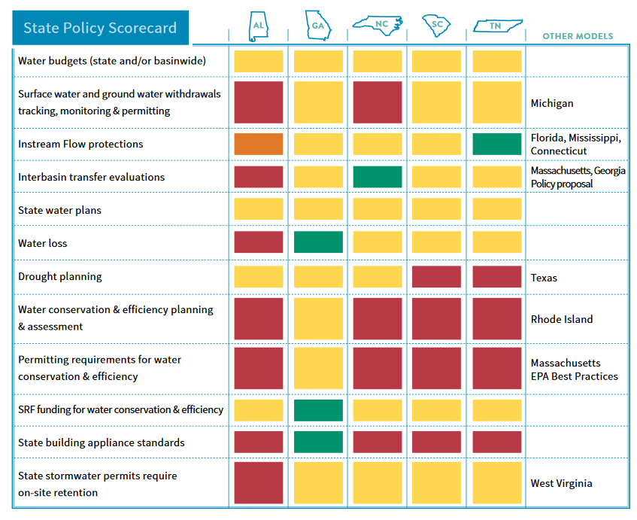
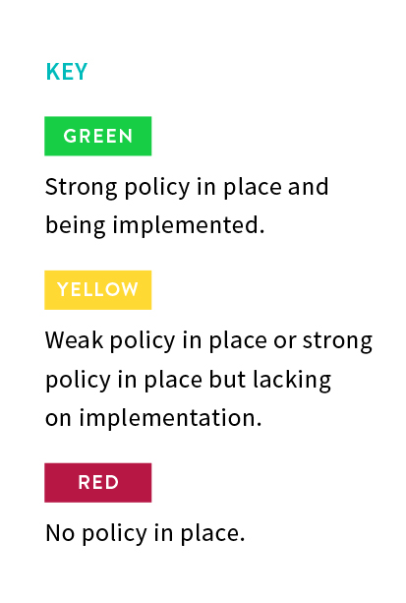
Analysis
Managing
supply &
flow
protections
Reducing
demand
Built
environment
Notes:
Overview of analysis 2019 UPDATE – focus on state policies as there was a gap there – local and federal also important
Explain policy categories – all of them affect flows in some way – high and low flows
SE – still much room for improvement
But some greens!
NC – IBT evaluation – AND – doesn’t show up on its own here,
North Carolina has the strongest interbasin transfer policies in the southeast
Other states having some policy in place but with significant opportunities to strengthen and improve them.
NC – IBT – strong but questions – recent case where judge ruled in favor of downstream city – RECORD was there b/c of law….
But see next slide

Slide 6
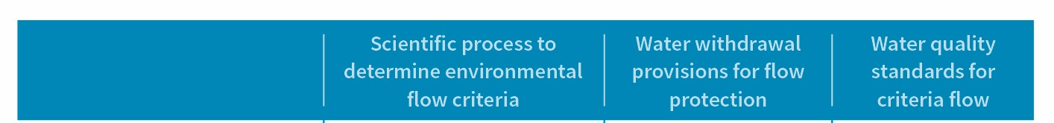
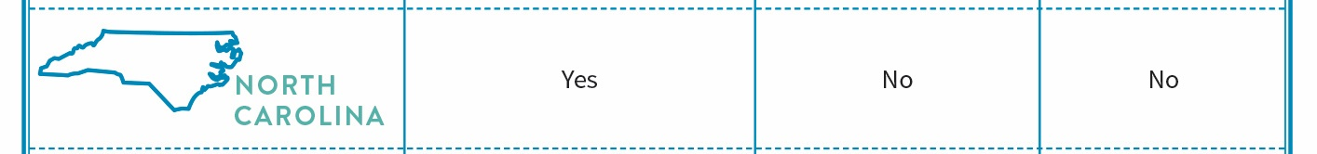
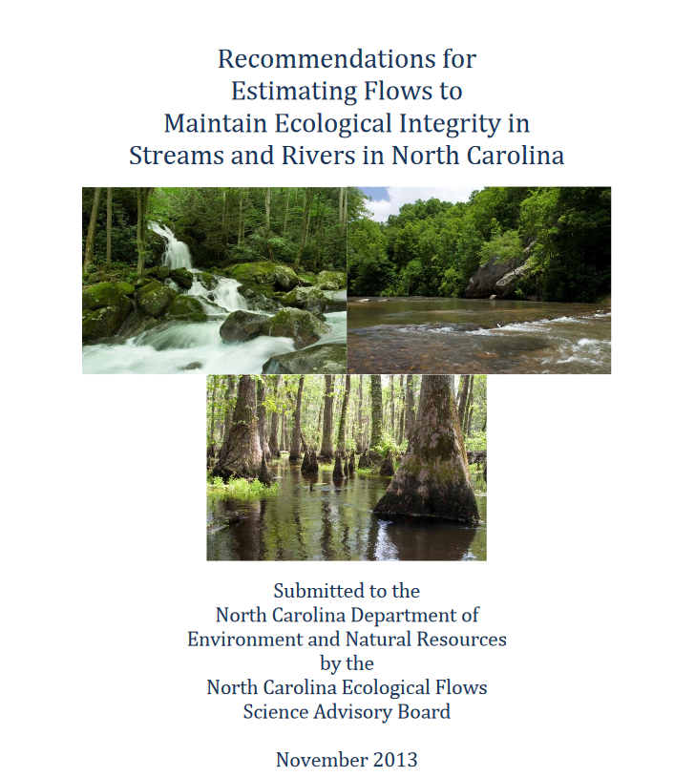
Analysis
Notes:
NC Process to establish ecological flow criteria via EFSAB – strong process with good result – application still pending for the most part

Slide 7
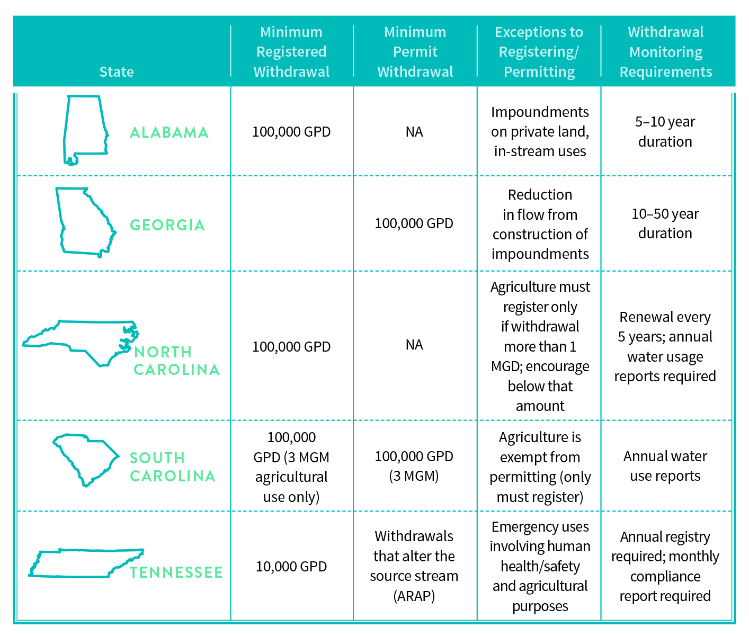
Policies for Managing Supply - Water Withdrawals
AL Focus Area – Certificates of Use and Permitting
Policy option: regulate water withdrawals
Some agriculture
included
“Capacity
Use Areas”
2011 law
Use of
Clean Water
Act
Notes:
No permit requirements in NC or AL – water law – still traditional riparian, so limited
AL: registration for water withdrawals is required for public water systems; self-supplied users of ground water or surface water; and users, including irrigators, who have the capacity to withdraw greater than 100,000 gallons per day (GPD)
GW: Minimum Registered Withdrawal - 100,000 GPD and 50 GPM (only coastal)
NC: certain withdrawals are required to register while others are encouraged to do so but are otherwise exempt
GW: Minimum Registered Withdrawal - 100,000 GPD
GA, SC, and TN have programs to permit withdrawals with conditions or limits, mostly for surface waters.
GA: requires withdrawal permits for any surface water withdrawal, diversion, or impoundment greater than 100,000 GPD on monthly average with some exemptions
GW: Minimum Withdrawal to Trigger Permit Requirement - 100,000 GPD on a monthly average
SC: require any non-agricultural withdrawer who extracts three million gallons or more in any one month to apply for and receive a permit. These permitting requirements do not apply to agricultural users, who are only required to register their use of 3,000,000 gallons during any one month.
GW: Minimum Registered Withdrawal - 3 MGM outside of Capacity Use Area/ Minimum Withdrawal to Trigger Permit Requirement - 100,000 GPD (3 MGM) in a Capacity Use Area
TN: water withdrawals fall under two main programs: Aquatic Resource Alteration Permit (ARAP) and registration of recurring withdrawals of either surface water or ground water over 10,000 GPD through Tennessee’s Water Information Act
GW: Minimum Registered Withdrawal - 10,000 GPD/ Minimum Withdrawal to Trigger Permit Requirement - Withdrawals that alter the source stream (ARAP)
Agriculture is largely exempt or treated lightly across the SE in terms of supply issues – although some places like GA do have withdrawal requirements that include some ag – important to address going forward given that ag is a consumptive use
Even in states like NC w/o withdrawals – some provisions that can be used to protect resources and limit withdrawals
Bright spots – GA – moved to regulated riparian in the 1970s so has had a permitting system for a good while – explain
TN uses CWA as part of withdrawals requirements – WILL DISCUSS ON SLIDE AFTER NEXT
NA -
Michigan
Link water withdrawals to environmental impacts on stream flows.
To fulfill the intent of the Great Lakes Compact to protect the region’s water resources, Michigan passed legislation that prohibits new, large water withdrawals from causing an “adverse resource impact” on state waters.
Using a scientific approach with stakeholder collaboration, the state developed an assessment process based on ecological response curves to determine the impact of proposed water withdrawals on streams.
From there, streams were classified by zones A-D reflecting different degrees of sensitivity to flow reduction;
zone A stream withdrawals are allowed
withdrawals from zone D streams are not allowed due to predictions of adverse impact.
In intermediate zones, water conservation or other measures may be required.
Potential water withdrawal applicants can easily determine whether their proposed withdrawal location and amount will negatively impact the local stream by using the Water Withdrawal Assessment Process and Internet Screening Tool
Florida
Florida law requires the state’s water management districts or the Florida Department of Environmental Protection to establish minimum flows and levels (MFLs) for aquifers, surface watercourses, and other surface water bodies, to identify the limits at which further withdrawals would be significantly harmful to the water resources or ecology of the area.
Waterbodies and their adopted minimum flows and levels, as well as those that are currently being developed or planning to be developed, are put on a Minimum Flows and Levels Priority List and Schedule.
Waterbodies are placed on the list based upon their importance to the state or region and the potential for adverse impacts associated with water use.
Peer review and stakeholder input are utilized to establish minimum flows and levels and to define what would constitute “significant harm.”
If flows or levels are, or are expected to be, below established minimum flows or levels, the water management district develops and implements a recovery or prevention strategy.

Slide 8
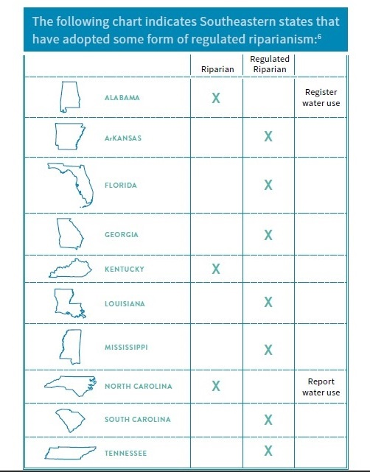
Policy option: regulate water withdrawals
Requires a change in underlying water law
Notes:
NC will require a move to regulated riparianism – move to administrative state, authority to state to regulate, set conditions, etc.

Slide 9
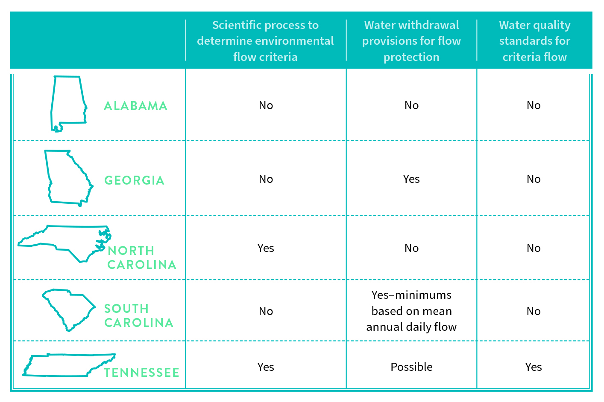
Policies for Flow Protection
Policy option: Clean Water Act standards
Notes:
Advantages and Disadvantages to both approaches – water withdrawal and wqs (see chart in paper)

Slide 10
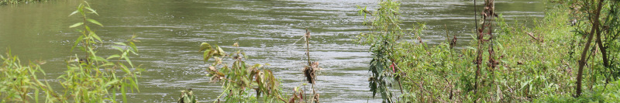
Policies for Flow Protection
Policy option: Clean Water Act standards
What Tennessee does
Water quality criteria – narrative standard:
‘waters shall not be modified through the addition of pollutants or through physical alteration to the extent that the diversity and/or productivity of aquatic biota within the receiving waters are substantially decreased’ TCR&R 0400-40-03-.03(3)(m)
Aquatic resource alteration permit:
‘An Individual Permit is required for water withdrawals which will or will likely result in alteration of the properties of the source stream.’
TCR&R 0400-40-07-.04(5)(c)
Notes:
TN relies on a tag-team of water quality standards, and a permitting requirement for any water withdrawals that will alter the properties of the source stream.

Slide 11
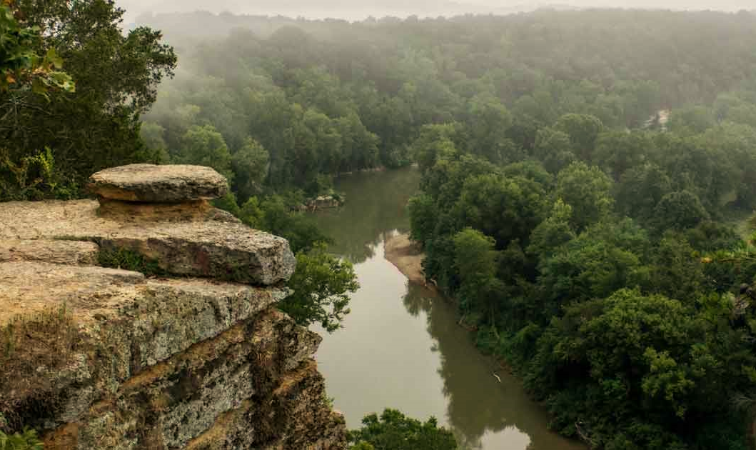
Policy option: Clean Water Act standards
The Harpeth River
Notes:
Photo credit: Tennessee State Parks
This is the Harpeth River. It’s story illustrates both the power and the weaknesses of the Clean Water Act based approach.

Slide 12
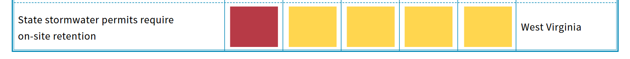
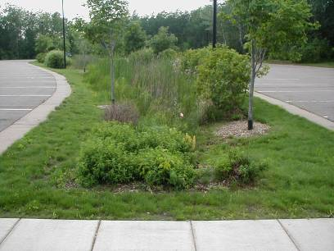
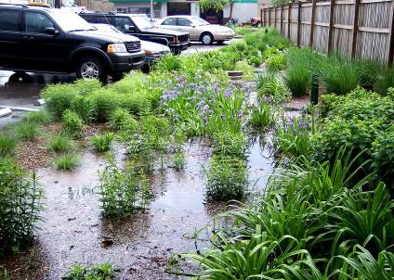
Policy option: stormwater management
Green stormwater infrastructure

Slide 13
Policy option: stormwater management
SC vs. NC language
South Carolina |  | North Carolina
MS4 general permit 4.2.5.2.2: Local ordinances must: “demonstrate the runoff reduction and pollutant removal necessary to approximate pre-development conditions to the [maximum extent practicable] and to protect water quality. The first inch of runoff must be addressed.” |  | 15A NCAC 02H .1017 (5): Required storm depth. For high density projects designed to achieve runoff treatment, the required storm depth shall be one inch. Applicants shall have the option to design projects to achieve "runoff volume match" in lieu of "runoff treatment" as those terms are defined in Rule .1002 of this Section.

Slide 14
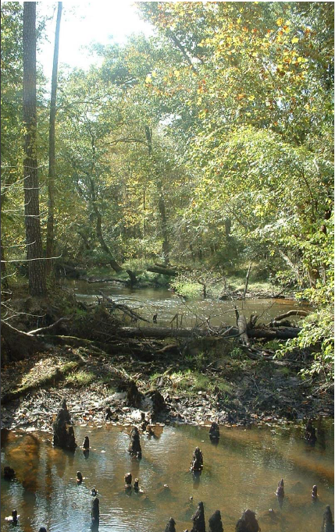
North Carolina: mandate to model flows
SL2010-143, Improve River Basin Modelling
State must create flow models for each basin.
Models must be designed to predict:
When yields will no longer meet all needs.
When yields will no longer meet ‘essential’ needs.
Adverse impacts to ‘ecological flows’.
Explicitly non-regulatory.
Definition of ‘ecological integrity’ codified
at NCGS 143-355(o)(1)(b).

Slide 15
North Carolina: EFSAB recommendations
Methods for evaluating ecological impacts of flows.
Recommendations:
  80% -90% flow by with a critical low flow component.
  Evaluate flows with biological response monitoring; any change in fish or aquatic insect index of greater than 5% to 10% should trigger closer study.
  Additional study needed for headwaters, coastal plain, large rivers.
Rule of thumb:
  Fast approval for less than 15% cumulative withdrawal from 201 baseline.

Slide 16
North Carolina: EFSAB reception at the EMC
September 2014
EMC adopts motion:
DEQ can work with NCGA to ‘resolve’ ecological flow definition.
No river models approved until the definition is changed.
DEQ can use the models for planning, but not using any general standard or value.
DEQ can only propose a general standard via rulemaking.
July 2015
EMC/Water Allocation Committee received presentation on peer review of EFSAB recommendations:
Peer review generally affirmed EFSAB.
Use 90% flow by rule, not 80%
Questioned the 2010 baseline.
Not what some commissioners wanted to hear. No presentations on this since.

Slide 17
Today’s NC EMC: your policy-making audience
Governor’s appointees
House appointees
EMC Chair Stan Meiburg
Dr. Suzanne Lazorick
Marion Deerhake
Shannon Arata
Maggie Monast
John McAdams
Pat Harris
Donna Davis
Yvonne Bailey
JD Solomon
Mitch Gillespie
Steve Keen
David Anderson
Charlie Carter
Don van der Vaart
Senate appointees
Notes:
Notes:
Stan Meiburg is the Chair of the EMC
Suzanne Lazorick is a pediatrician from ECU; she is the vice-chair; she has previously chaired the Water Allocation Committee and has become knowledgeable about flow issues.
John McAdams, new to the EMC as of July 2017, is the new chair of the Water Allocation Committee
Mitch Gillespie, House appointee, was one of the legislators who sponsored the 2010 bill establishing the EFSAB.
Donald van der Vaart, Senate appointee, was a former Secretary of the Environment for the last two years of the McCrory Administration.

Slide 18

Thank you & questions
Grady McCallie
Policy Director
grady@ncconservationnetwork.org
Katherine Baer
Director of Science and Policy
kbaer@rivernetwork.org
Southeast Flows Report
www.rivernetwork.org/resource/protecting-restoring-flows-southeastern-rivers/

