Slide 1
Flood Resiliency Blueprint Update APNEP Meeting
September 19, 2024

Slide 2
Agenda NC Flood Resiliency Blueprint
Progress Update
Blueprint Tool Update
Action scoring criteria
Implementation update

Slide 3
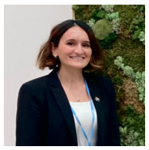
What’s Next
Flood Resiliency Blueprint Program Consultants
Jessica Gray
Cape Fear
Shana Shapiro
Lumber
Chris Dreps
Tar-Pamlico
Suna Morkoc
French Broad
Chris Dreps & Brad Connell
Neuse
Brad Connell
White Oak

Slide 4
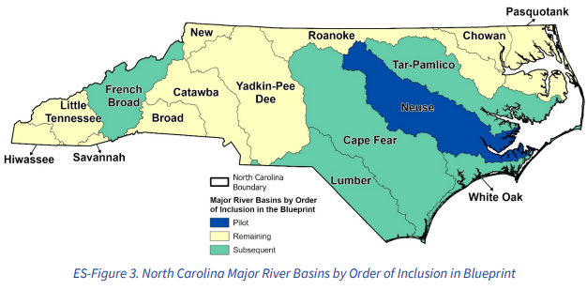
NC Flood Resiliency Blueprint Goals
Serve as the backbone of State flood planning
Increase community resilience to flooding
Reduce the cost and complexity for local government in the planning and implementation of flood risk reduction projects
“...A successful blueprint should ultimately lead to a prioritized set of projects and funding strategies that the State can implement.”
Basins: Neuse, Cape Fear, French Broad, Lumber, Tar-Pamlico, and White Oak

Slide 5
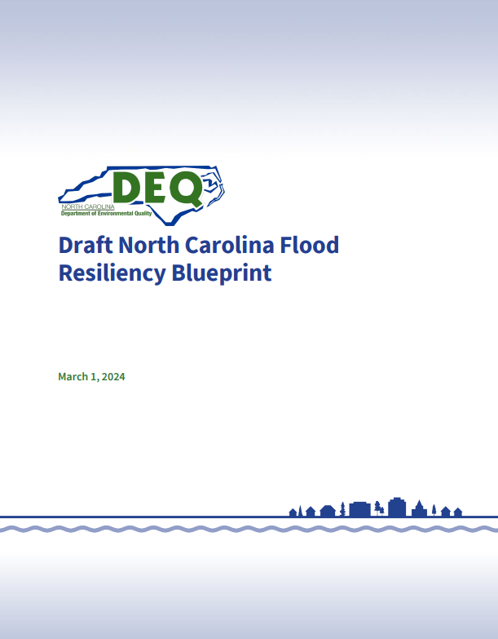
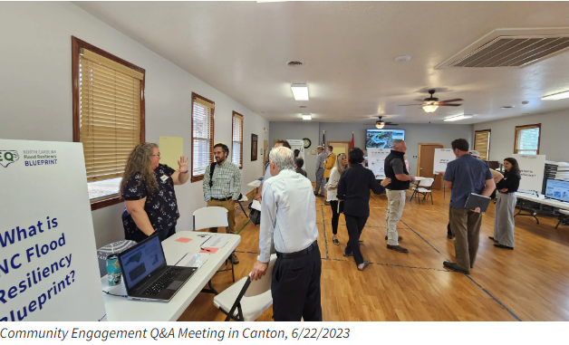
Blueprint Development - Multiphase Process
Phase I (2022 - 2024) - Complete
Research and evaluation
Gap analysis
Recommendations and decisions (Programmatic, Policy, Tools, Approaches, Needs)
Neuse River Basin Action Strategy (Pilot)
Draft Blueprint
Phase II (2023 - 2025) - Ongoing
Develop online decision support tool (Blueprint Tool)
Begin implementation
Phase III (2024 - 2025) - Ongoing
Develop Action Strategies for five prioritized areas
Refine Decision Support Tool
Continue Blueprint implementation
Refine Blueprint and Neuse Action Strategy (including additional modeling)
Notes:
Touch on $96M, need to use tool/process, but make informed investments now

Slide 6
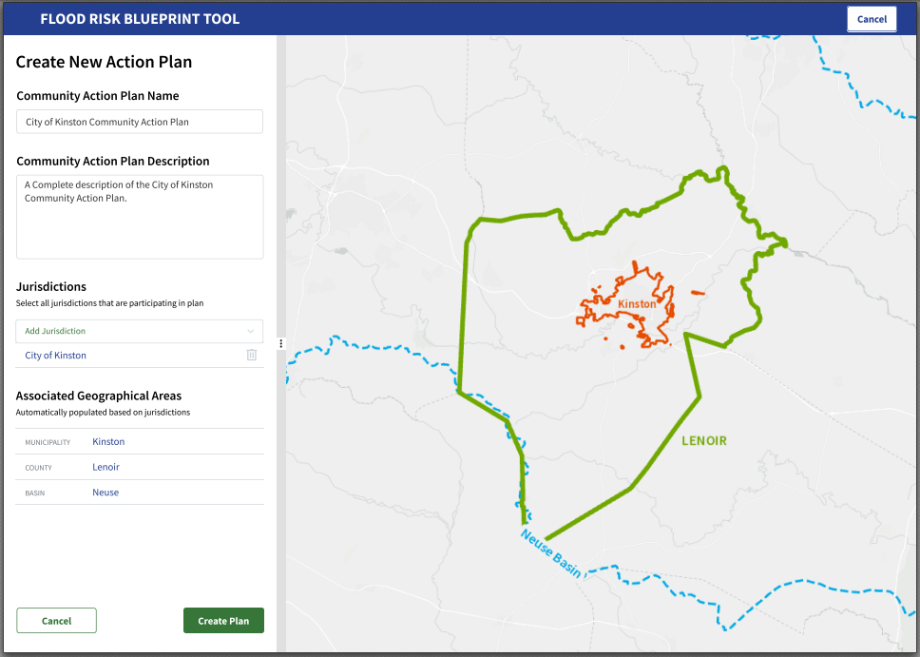
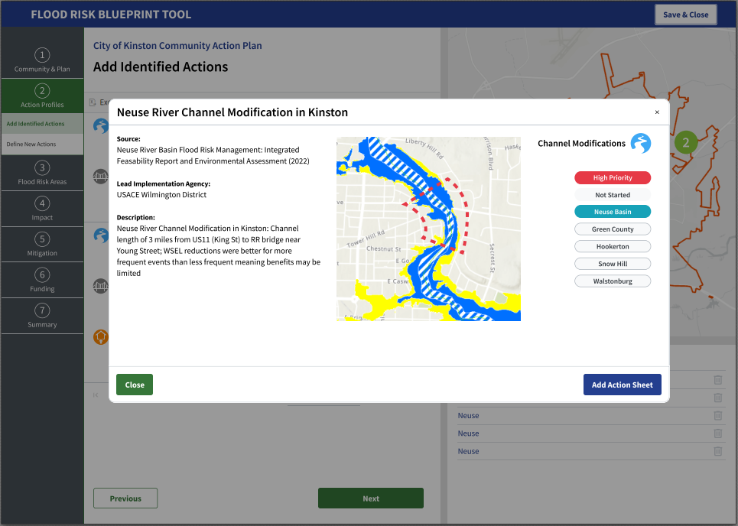
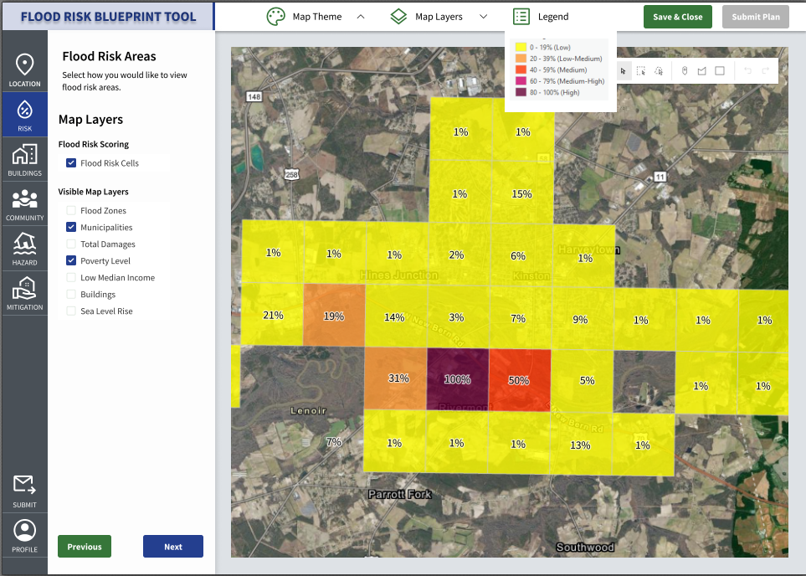
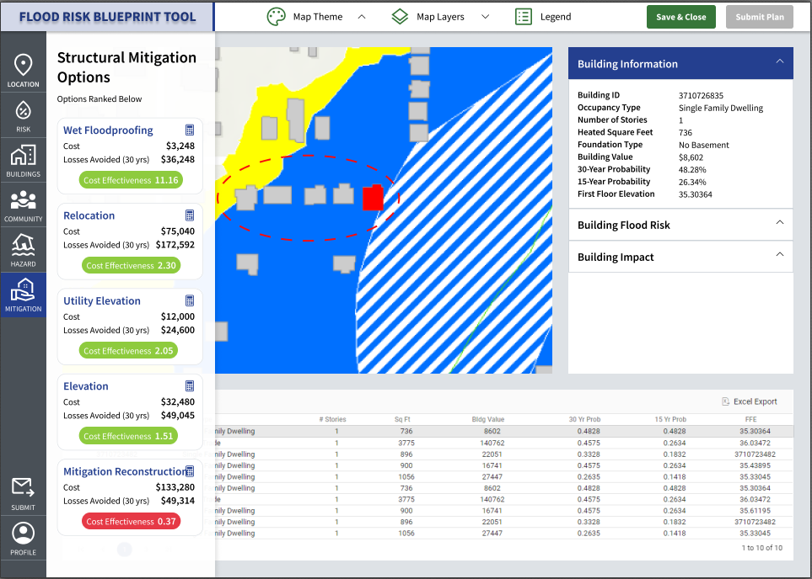
Blueprint Development - Multiphase Process
Phase I (2022 - 2024) - Complete
Research and evaluation
Gap analysis
Recommendations and decisions (Programmatic, Policy, Tools, Approaches, Needs)
Neuse River Basin Action Strategy (Pilot)
Draft Blueprint
Phase II (2023 - 2025) - Ongoing
Develop online decision support tool (Blueprint Tool)
Begin implementation
Phase III (2024 - 2025) - Ongoing
Develop Action Strategies for five prioritized areas
Refine Decision Support Tool
Continue Blueprint implementation
Refine Blueprint and Neuse Action Strategy (including additional modeling)
Notes:
Touch on $96M, need to use tool/process, but make informed investments now

Slide 7
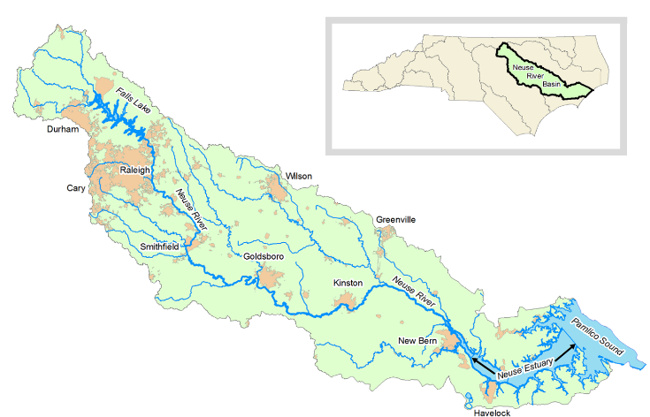
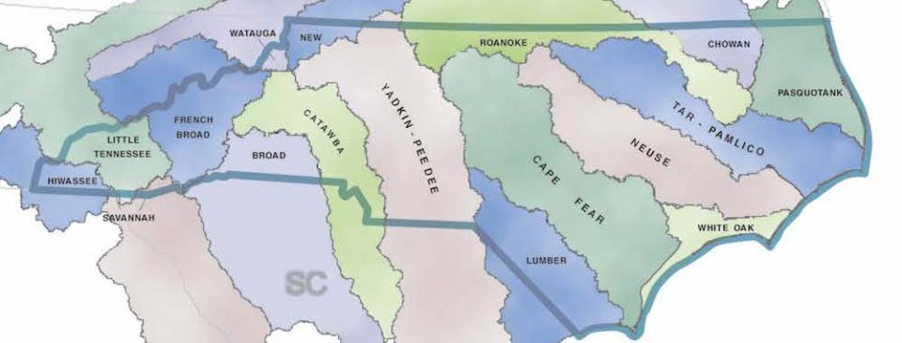
Blueprint Development - Multiphase Process
Phase I (2022 - 2024) Complete
Research and evaluation
Gap analysis
Recommendations and decisions (Programmatic, Policy, Tools, Approaches, Needs)
Neuse River Basin Action Strategy (Pilot)
Draft Blueprint
Phase II (2023 - 2025) - Ongoing
Develop online decision support tool (Blueprint Tool)
Begin implementation
Phase III (2024 - 2025) - Ongoing
Develop Action Strategies for five prioritized areas
Refine Decision Support Tool
Continue Blueprint implementation
Refine Blueprint and Neuse Action Strategy (including additional modeling)
Notes:
Touch on $96M, need to use tool/process, but make informed investments now

Slide 8
Flood Resiliency Blueprint Tool

Slide 9
NC Flood Resiliency Blueprint Tool
Built on Hydrologic and Hydraulic (H&H) models
New methodologies allow users to:
Develop, Evaluate, Prioritize Resilience Actions
Plan and marshal funding to implement priority resilience measures
Who is the Tool for:
Local governments
planners, floodplain managers
Fellow state agencies
Policymakers
Soil and Water Conservation District Staff, NRCS staff, SeaGrant extension, COG members
Public

Slide 10
NC Flood Resiliency Blueprint Tool
Tool Development and Model Improvement
April 2024 - Beta Testing
September 2024 – Version 1 - Testing
Spring 2025 – Version 2 - Public
2024 |  |  |  |  |  |  |  |  |  |  |  | 2025
JAN | FEB | MAR | APR | MAY | JUN | JUL | AUG | SEP | OCT | NOV | DEC | JAN | FEB | MAR | APR | MAY | JUN | JUL
TOOL DEVELOPMENT |  |  |  | Beta | DEVELOPMENT |  |  | V1 | DEVELOPMENT |  |  |  |  | V2 Release and O&M
 |  |  |  |  |  | Neuse Model Improvements
 |  |  |  |  |  |  |  | Additional Basins Model Improvements
 |  |  |  |  |  |  |  |  |  |  | Additional Basin Model Improvement

Slide 11
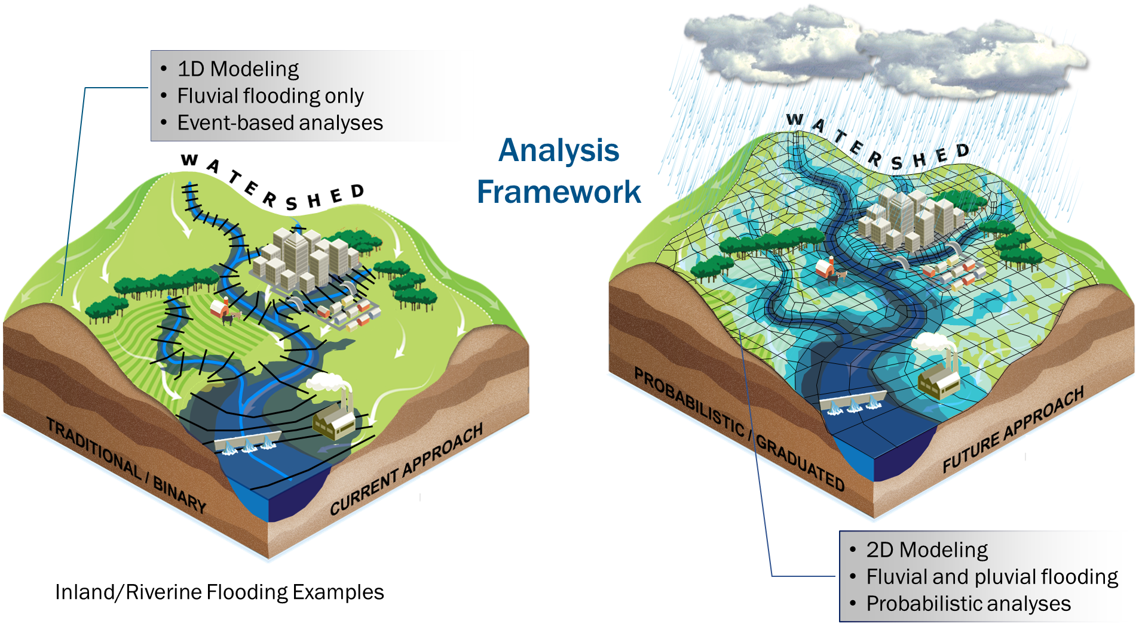
Flood Resiliency Blueprint
Model Improvements
Better define flood extent and depths
Current Conditions
Capture future flooding
Changes in precipitation patterns
Sea level rise
Increased impervious surfaces
Facilitate future improvements
Storm surge and compound flooding
Probabilistic framework
Support tool functionality

Slide 12
Flood Resiliency Blueprint
Model Improvements
“According to a 2022 study from North Carolina State University, 68% of flood damage reports were outside of FEMA's high-risk flood zones in 2020 [and]… 16% of damage reports were in unmapped locations.”

Slide 13
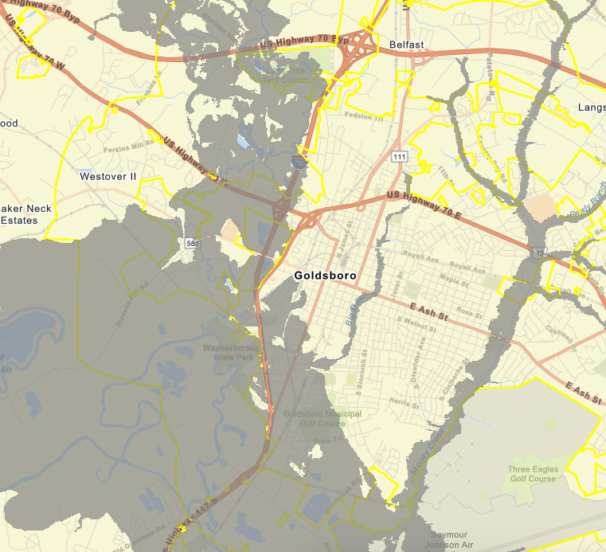
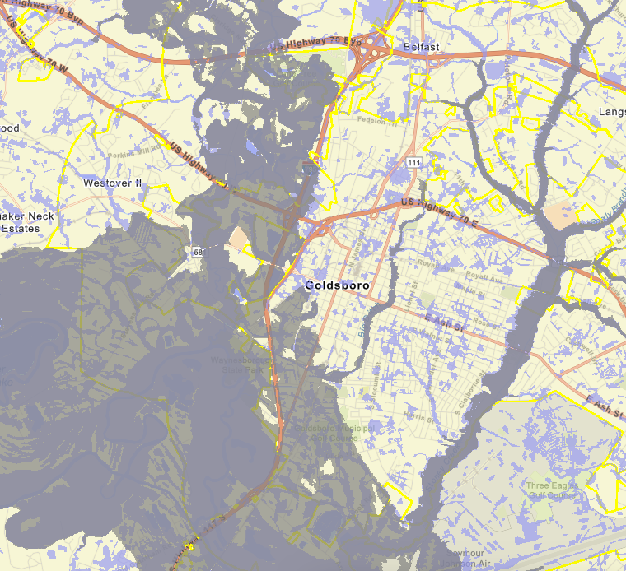
Flood Resiliency Blueprint Tool
1% Annual Chance
Regulatory Flood Plain
2D Rain on Grid
NCEM Advisory Flood Data

Slide 14
Flood Resiliency Blueprint
Model Improvements
Better define flood extent and depths
Current Conditions
Capture future flooding
Changes in precipitation patterns
Sea level rise
Increased impervious surfaces
Facilitate future improvements
Storm surge and compound flooding
Probabilistic framework
Support tool functionality

Slide 15
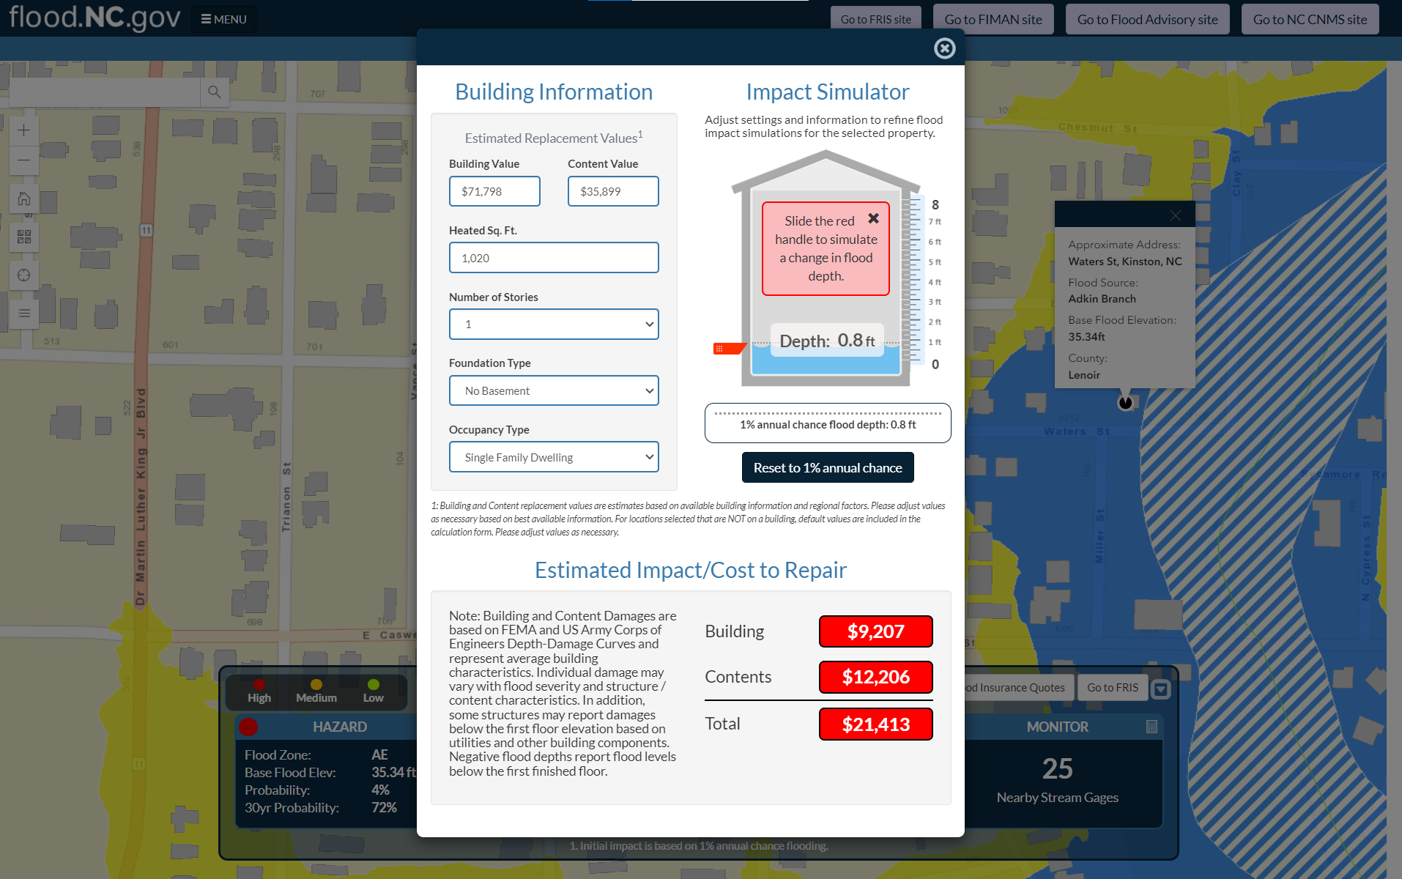
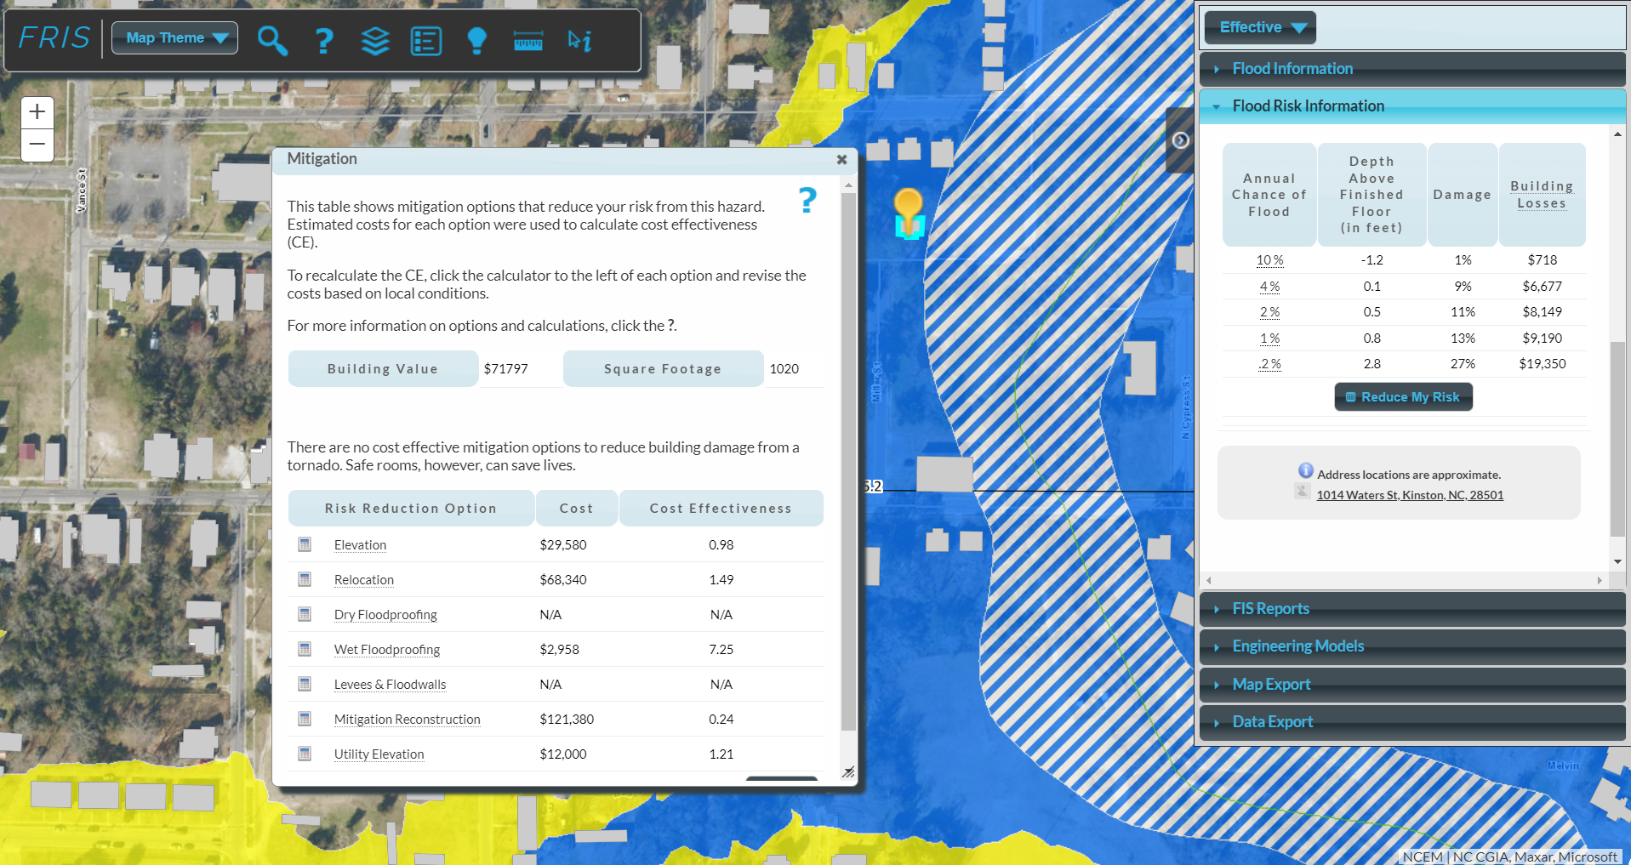
Flood Resiliency Blueprint Tool
Expands on existing tools with new data and methodologies
Integrates forecasted changes
Is scalable (catchment to statewide)
Allows for integration of future data and logic generated through multiple sources
Is dynamic and improves as data and methodologies improve
Flood.NC.gov
NC FRIS
Notes:
Reference other sites that we could use as reference. Other NC tools that have some portion. incorporate elements. flood.nc.gov, fris, inventory, number of tools. ideas similar to.

Slide 16
Blueprint Tool Functionality
Develop a Detailed Community Profile
Fund Matching Tool
Community Capacity
Project Complexity
Flood Risk Scores
Ranking Actions
Estimating Impacts of Flooding on People, Environment, Infrastructure, and Economic Sustainability +
Data Repository
Explore Flood Risk
Build a local Action Plan
Develop New Resilience Actions
Action Management
(internal)
Goals:
Be a resource for riverine and stream management to reduce flooding
Reduce the cost and complexity for local government in the planning and implementation of flood risk reduction projects
Lead to a prioritized set of projects

Slide 17
Blueprint Tool Functionality
Develop a Detailed Community Profile
Fund Matching Tool
Community Capacity
Project Complexity
Flood Risk Scores
Ranking Actions
Estimating Impacts of Flooding on People, Environment, Infrastructure, and Economic Sustainability +
Data Repository
Explore Flood Risk
Build a Local Action Strategy
Develop New Resilience Actions
Action Management
(internal)
Flood Risk Scores

Slide 18
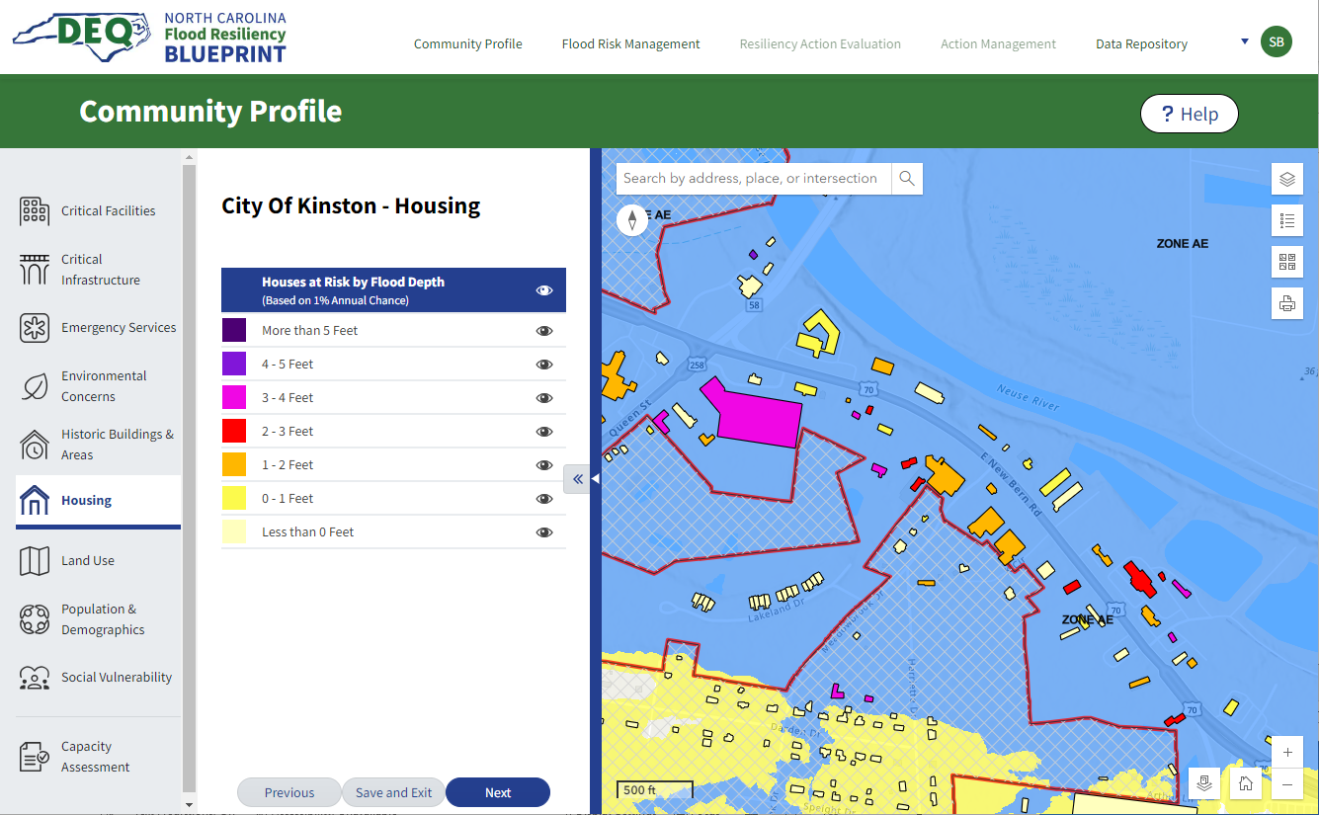
Flood Resiliency Blueprint Tool
Develop a Detailed Community Profile
Build a Local Action Strategy
Develop New Resilience Actions

Slide 19
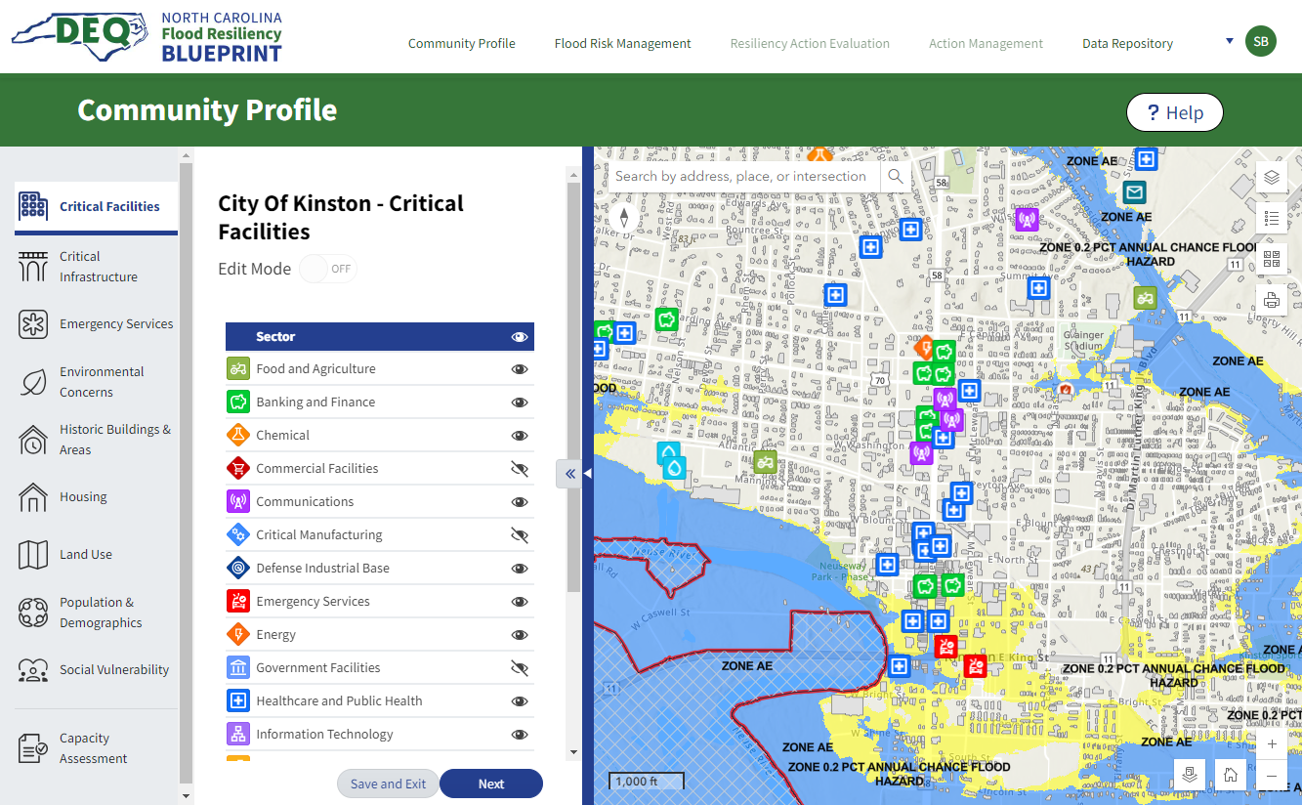
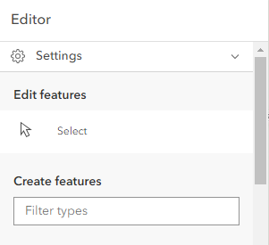
Flood Resiliency Blueprint Tool
Develop a Detailed Community Profile
Build a Local Action Strategy
Develop New Resilience Actions

Slide 20
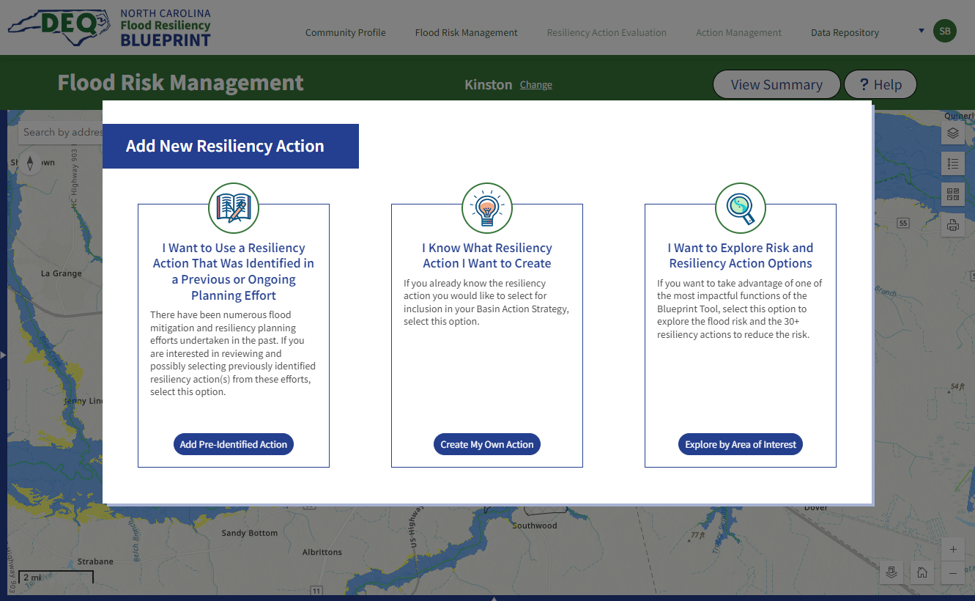
Flood Resiliency Blueprint Tool
Develop a Detailed Community Profile
Build a Local Action Strategy
Develop New Resilience Actions
Add Pre-Identified Action
Add New, Known Action
Explore & Develop New Action

Slide 21
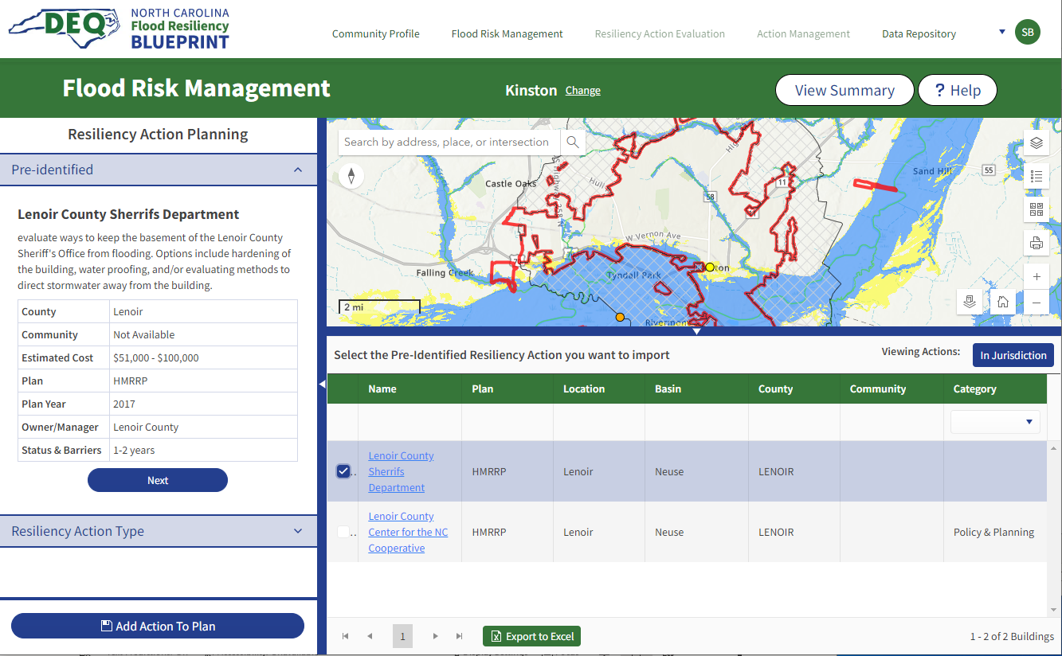
Flood Resiliency Blueprint Tool
Develop a Detailed Community Profile
Build a Local Action Strategy
Develop New Resilience Actions
Add Previously Identified Action

Slide 22
Flood Resiliency Blueprint Tool
Develop a Detailed Community Profile
Build a Local Action Strategy
Develop New Resilience Actions
Add New, Known Action
Explore & Develop New Action

Slide 23
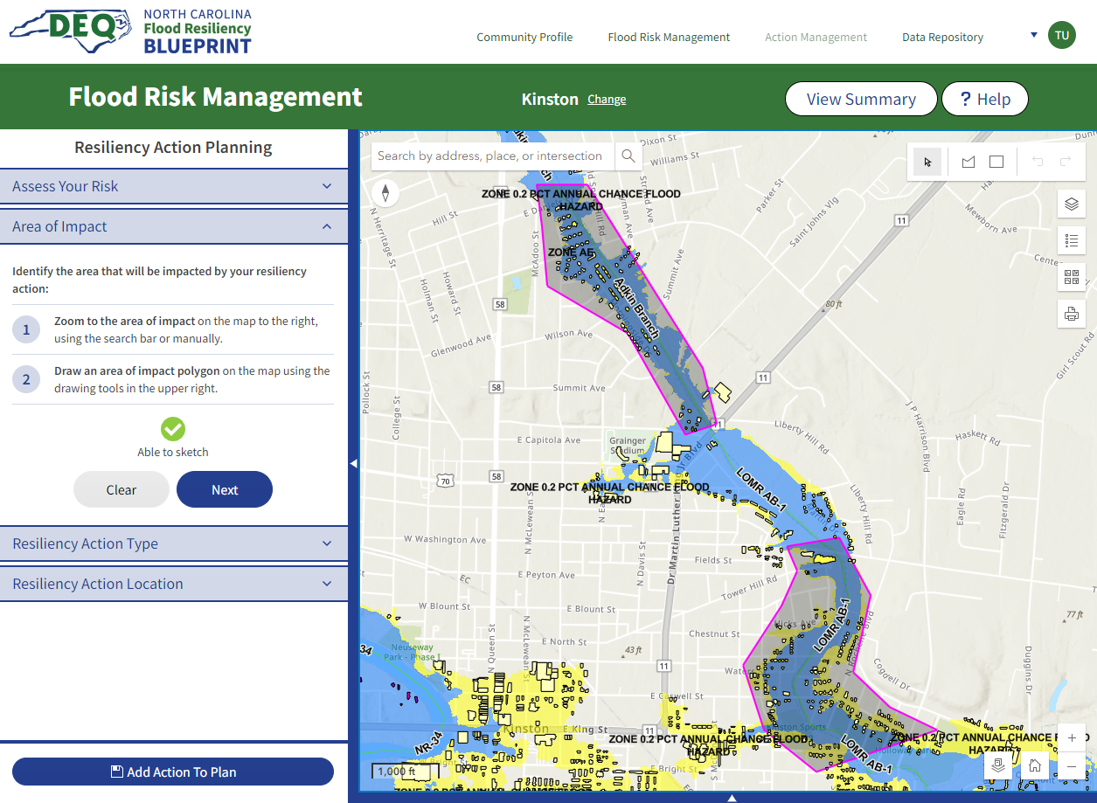
Flood Resiliency Blueprint Tool
Develop New Resilience Actions
Identify an area of interest

Slide 24
Flood Resiliency Blueprint Tool
Develop New Resilience Actions
Assess flood Risk

Slide 25
Flood Resiliency Blueprint Tool
Develop New Resilience Actions
Resilience Action Categories
Building level mitigation
Detention/Runoff reduction
Channel Improvement
Nature Based Solutions
Floodplain Restoration
Infrastructure
Policy and Planning
Explore Resilience Actions

Slide 26
Flood Resiliency Blueprint Tool
* Unique: Distinctive, offering capabilities not available in any other tools
+ Enhanced: Exists in other tools, but the Blueprint Tool extends these functionalities significantly, enhancing them to provide greater efficiency and effectiveness
= Leverage/Coordinated: Leverages the capabilities of similar tools, coordinating to provide cohesive advancements in data and function.
Nature-Based Solutions
Relocation =
Utility elevation =
Structural elevation =
Reconstruction =
Wet floodproofing =
Dry floodproofing =
Acquisition/ Demolition =
Infrastructure
Levee =
Dike/ Berm =
Roadway elevation/ Road crossing modification =
Stormwater management activities +
Policy & Planning
Enhanced zoning *
Land use/impervious area restrictions =
River corridor/ Greenspace implementation *
Stormwater, water quality, floodplain regulations =
Water farming *
Afforestation +
Bioretention +
Raingardens, bio-swales, etc. +
Permeable pavement +
Flood storage wetlands *
Stream restoration =
Floodplain Restoration
Riparian buffers +
Floodplain mitigation preservation *
Floodplain restoration/Multi-use floodplains *
Channel Improvement
Debris removal =
Channel dredging =
Channel widening =
Detention/Runoff Reduction
Reduction New structures +
Retrofit Existing structures +
Quarries *
Dry dams +
Building Level Mitigation
Debris removal =

Slide 27
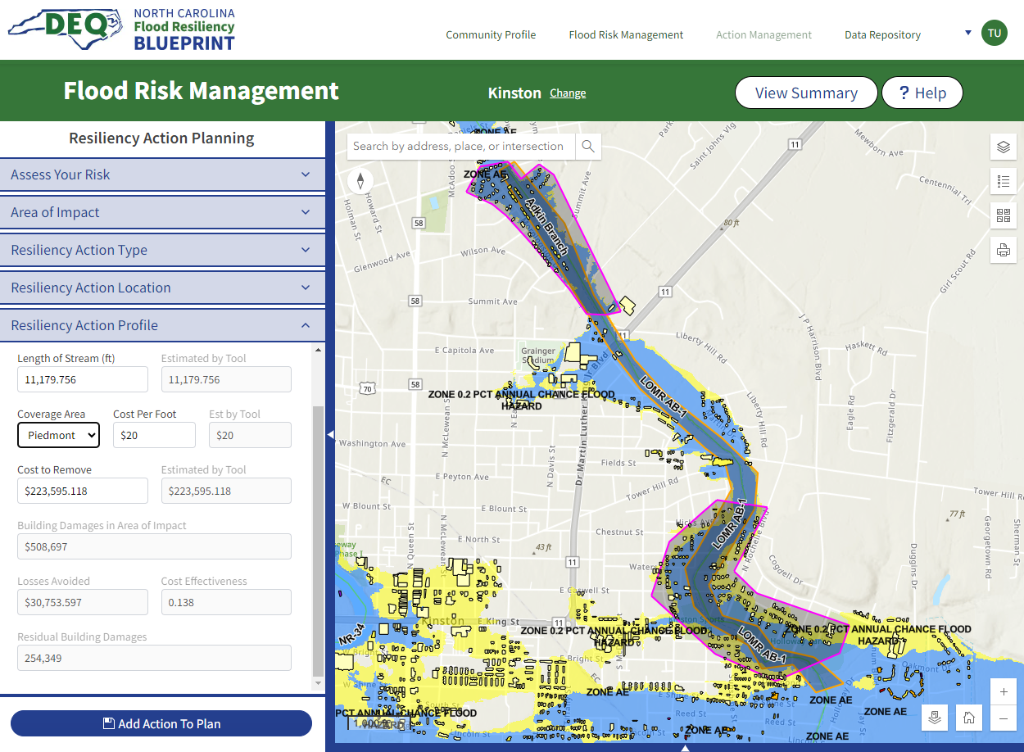
Flood Resiliency Blueprint Tool
Develop New Resilience Actions
Stream Debris Removal
Define Area of impact
Define Action Location
Cost: $223,595
Annual Losses Avoided: $30,735

Slide 28
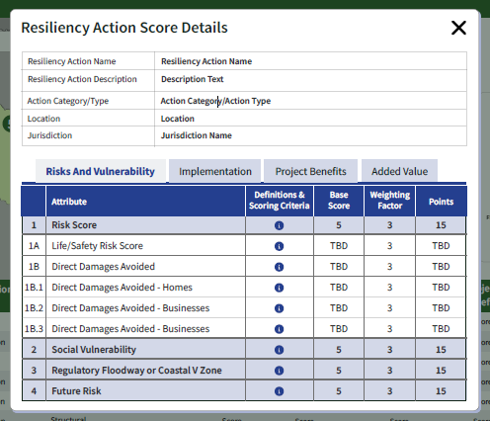
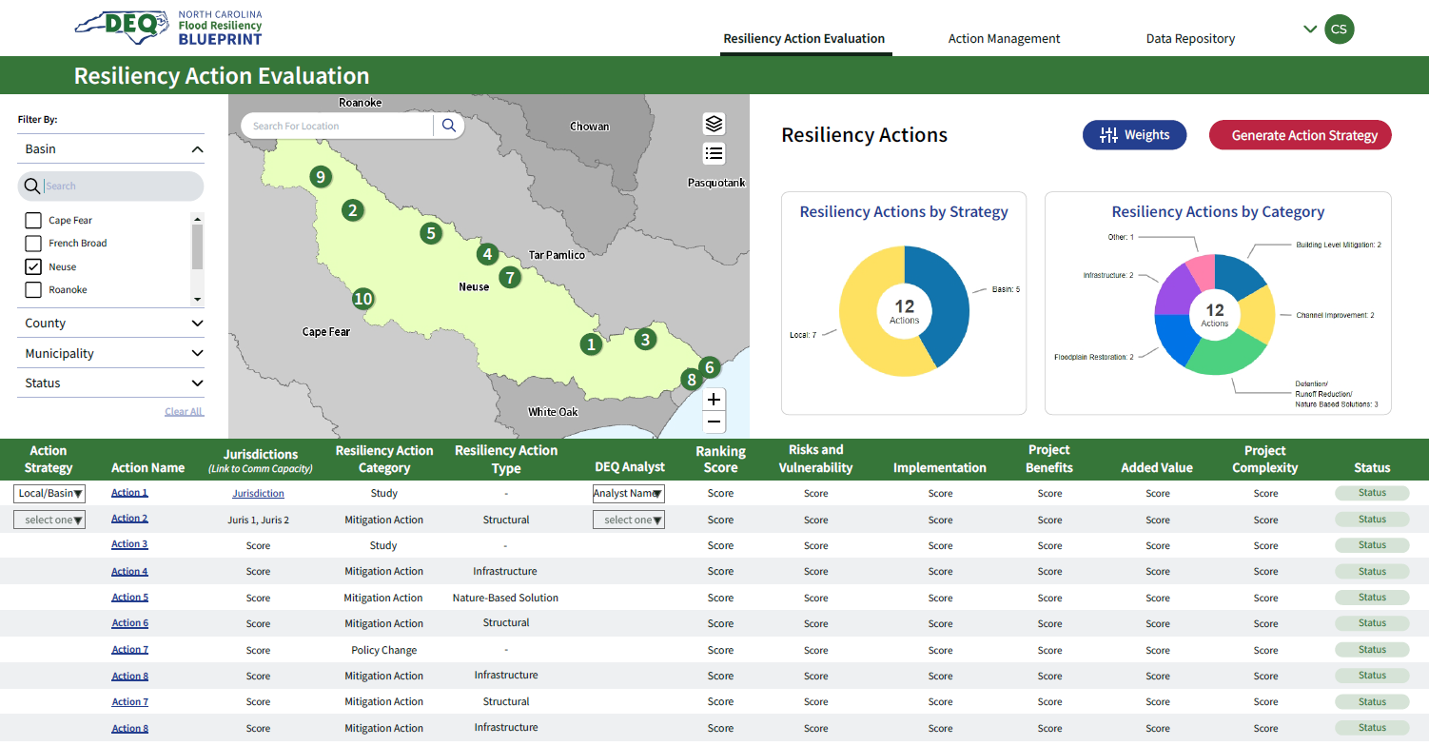
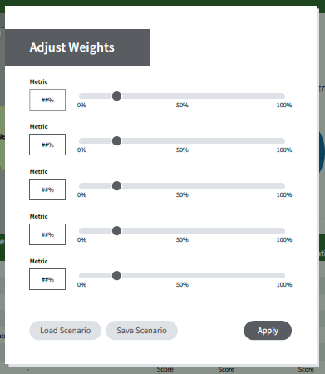
Flood Resiliency Blueprint Tool
Develop a Detailed Community Profile
Build a Local Action Strategy
Develop New Resilience Actions

Slide 29
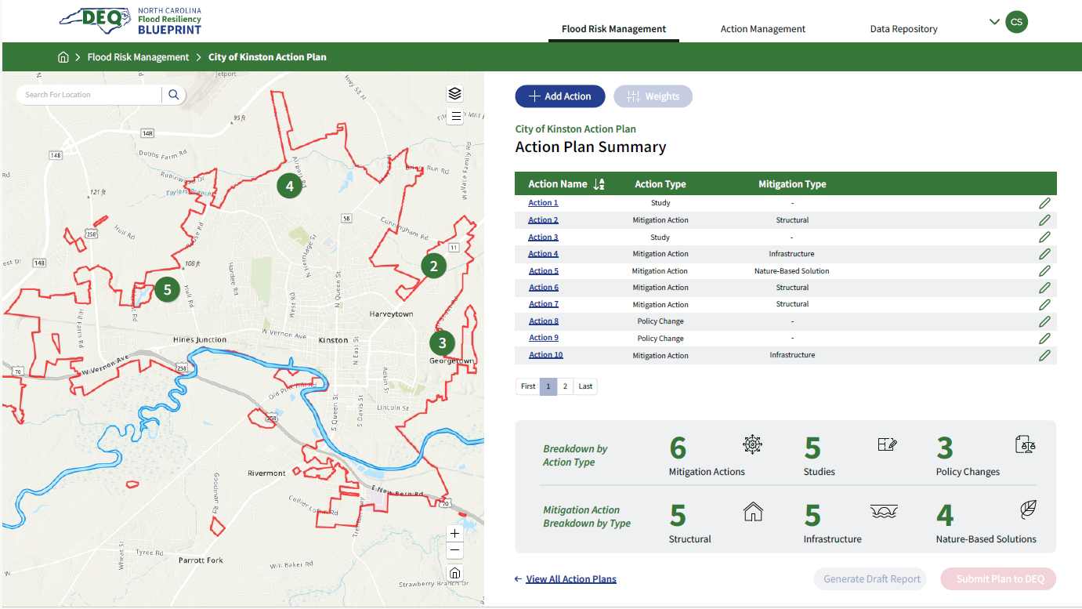
Flood Resiliency Blueprint Tool

Slide 30
Blueprint Tool Functionality
Develop a Detailed Community Profile
Fund Matching Tool
Community Capacity
Project Complexity
Flood Risk Scores
Ranking Actions
Estimating Impacts of Flooding on People, Environment, Infrastructure, and Economic Sustainability +
Data Repository
Explore Flood Risk
Build a local Action Plan
Develop New Resilience Actions
Action Management
(internal)
Fund Matching
Match proposed resilience actions with funding opportunities
Actively updated
Federal, state, philanthropic programs

Slide 31
Flood Resiliency Blueprint Implementation
Notes:
Hi, I'm Chris Dreps, and I'll describe some steps we have been taking to begin implementing flood resiliency projects throughout the state.

Slide 32
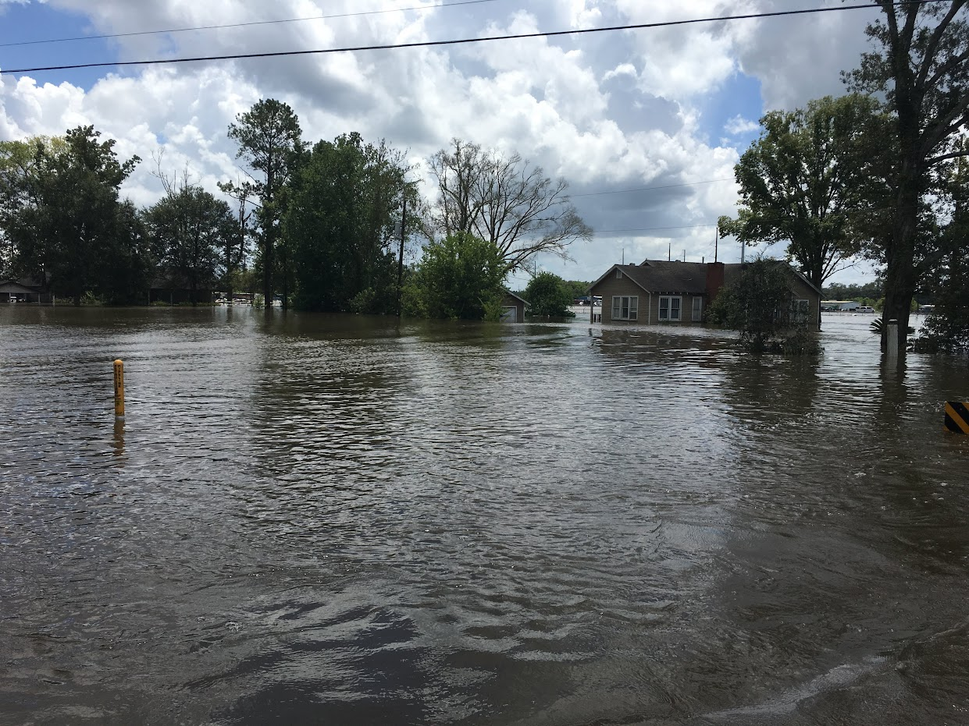
Project Implementation
2021 N.C.G.A allocation of $96M became available Spring 2024, to implement priority flood resilience projects.
Step 1: Blueprint coordinates with state agencies and programs
NCDACS Streamflow Rehabilitation Assistance Program (StRAP)
N.C. Land and Water Fund
N.C. Emergency Management
{HOLD IMAGE]
Notes:
In 2021, the N.C. General Assembly allocated $96M to the Division of Mitigation Services. This funding became available Spring 2024, upon completion of the first draft of the blueprint tool, to implement priority flood resilience projects.
As a first step in administering the funds, the Blueprint team is coordinating with fellow state agencies and programs with overlapping resilience priorities. So far, we are in the process of completing agreements with:
Department of Agriculture and Consumer Service's Streamflow Rehabilitation Assistance Program (StRAP), managed by the division of Soil and Water Conservation
N.C. Land and Water Fund (DNCR)
N.C. Emergency Management (DPS)

Slide 33
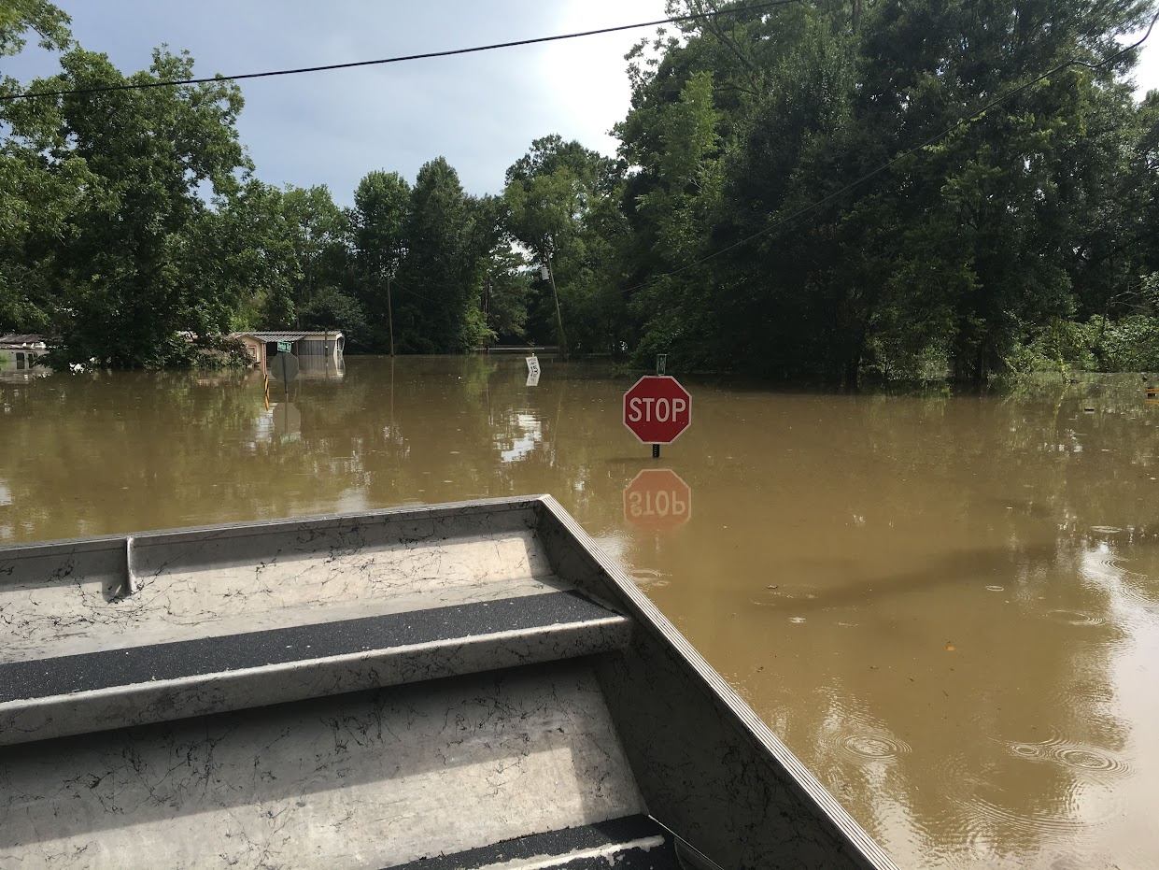
Project Implementation
Prioritizing projects based on:
ability to reduce flood damage to infrastructure, homes, businesses,
identification in Hazard Mitigation or Resilience Planning efforts,
location in a high-risk area,
likelihood of reducing flood risk to underserved communities,
additional public benefits (e.g. parks, trails, etc.).
[HOLD IMAGE]
Notes:
Through theses interagency agreements, Blueprint is prioritizing projects based on:
(ENTER)
their ability to reduce flood damage to infrastructure, homes, businesses, etc.,
whether the project has been identified in a Hazard Mitigation or Resilience Planning efforts,
whether the project is in a high-risk area,
their likelihood of reducing flood risk to underserved communities,
whether the projects serve additional public benefit (e.g. parks, trails, etc.).

Slide 34
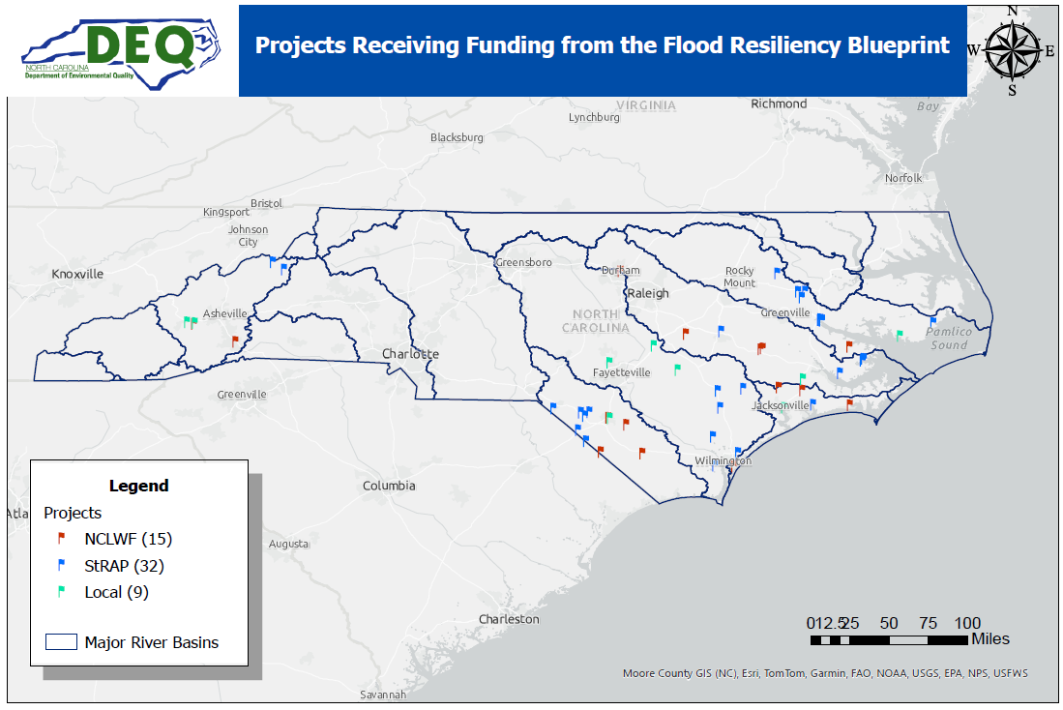
Project Implementation
56 projects totaling $17.4 million
DRAFT
Notes:
Here is a DRAFT map of the 56 projects that are in the process of being funded. As you can see, these are all in the priority river basins (French Broad, Lumber, Cape Fear, White Oak, Neuse, and Tar Pamlico)

Slide 35
Project Implementation
Partner | River Basin | Sum of Proposed DEQ Award
NCLWF | Cape Fear | $800,000
NCLWF | French Broad | $1,404,625
NCLWF | Lumber | $2,400,000
NCLWF | Neuse | $2,077,956
NCLWF | Tar-Pamlico | $704,809
NCLWF | White Oak | $1,660,014
NCLWF Total |  | $9,047,404
Other | Cape Fear | $1,500,000
Other | Lumber | $569,476
Other | Neuse | $110,000
Other | White Oak | $1,500,000
Other Total |  | $3,679,476
StRAP | Cape Fear | $921,775
StRAP | French Broad | $495,200
StRAP | Lumber | $975,500
StRAP | Neuse | $686,536
StRAP | Tar-Pamlico | $1,642,980
StRAP Total |  | $4,721,991
Grand Total |  | $17,448,871
Planned Awards to date
(Work with NCEM not captured)
DRAFT
Notes:
So far, the projects identified total almost $17.5 million. (out of the $96M allocated for projects)
This is a first step in funding.
Any questions?

Slide 36
Closing

Slide 37
What’s Next
PHASE II - Tool Development and Model Improvement
September 2024 – Version 1 Testing
Spring 2025 – Version 2

Slide 38
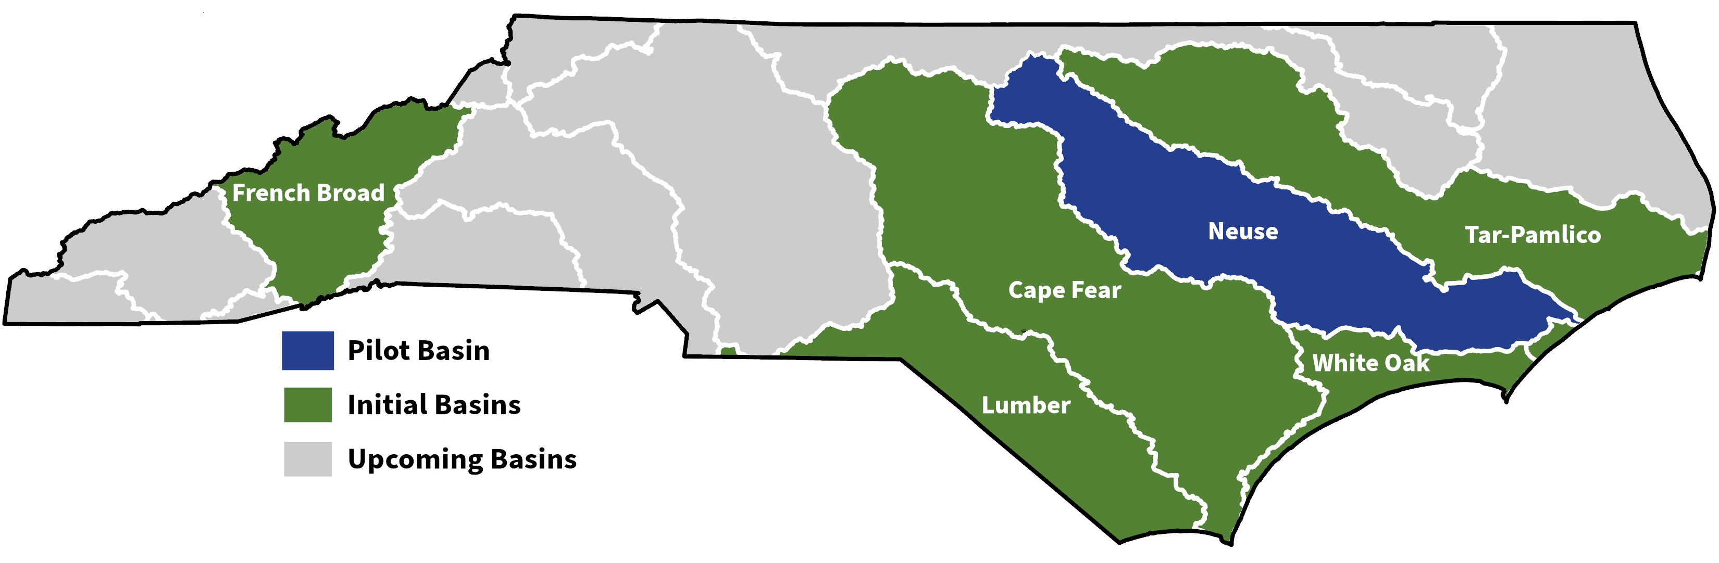
What’s Next
Phase III
Blueprint contracting with vendors – In Process
Supporting the development of Basin Action Strategies
Cape Fear, French Broad, Lumber, Tar-Pamlico, and White Oak
Establishing Basin Technical Advisory Committees

Slide 39
What’s Next
Continued Implementation
Working with NCEM and other State programs to identify funding opportunities
Mining Hazard Mitigation plans and other planning efforts
Agricultural Pond Flood Storage pilot project with Dept. of Agriculture

Slide 40
Thank You! | Questions?

