Slide 1
(APNEP)
2023 Program Evaluation (PE)
Review Period: July 1, 2017 – September 30, 2022
Leadership Council Meeting
July 12, 2023

Slide 2
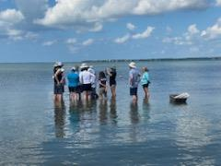
Thanks!
APNEP staff: Bill, Dean, Ezekiel, Heather, Jimmy, Stacey, Steve, Tim
Management Conference (MC) members and partners
PE Review Team
Rachel Hart, EPA-R4 Coordinator
Angela Padeletti, EPA-R3 Coordinator
Megan Mackey, EPA-R3 Coordinator (emeritus)
Vince Bacalan, EPA-HQ Coordinator

Slide 3
Congratulations!
APNEP receives a preliminary rating of Proficient for this Program Evaluation review cycle
Excellent progress on implementing the CCMP
Resiliency of staff in working through various challenges since the last PE visit
Notes:
This is a new format, a new PE process-first iteration of new process and did a great job
Not many gaps that need to be filled

Slide 4
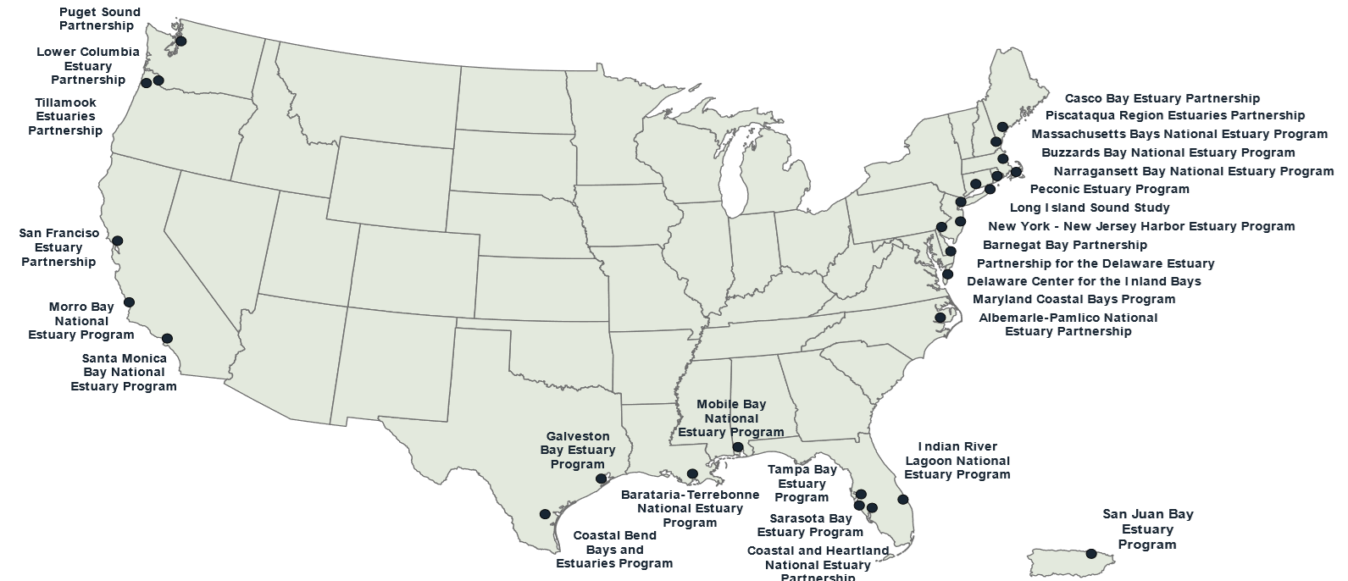
National Estuary Program (NEP)
CWA Section 320 designated 28 estuaries of national significance
Albemarle-Pamlico NEP was created in 1987
Notes:
Cornerstones of NEPs
Watershed-based approach
Science-based decision making
Collaborative problem solving
Consensus-driven
Public participation
Success is shared at the local and national level

Slide 5
Cornerstones of the NEP
* Watershed-based approach
* Science-based decision making
* Collaborative problem solving
- consensus-driven
* Public participation
*Success is shared at the local and national level*
Notes:
Cornerstones of NEPs
Watershed-based approach
Science-based decision making
Collaborative problem solving
Consensus-driven
Public participation
Success is shared at the local and national level

Slide 6
Purpose of NEP Program Evaluation
Ensure adequate progress is being made in CCMP implementation.
Highlight each Program’s unique environmental results, strengths and opportunities for improvement.
Identify areas where EPA can help provide resources to meet needs or enhance performance.
Confirm EPA’s continued support for the NEP and to seek stakeholders’ commitment to the Program.
Notes:
EPA’s continued support via multiple hats: financial, collaboration, oversight

Slide 7
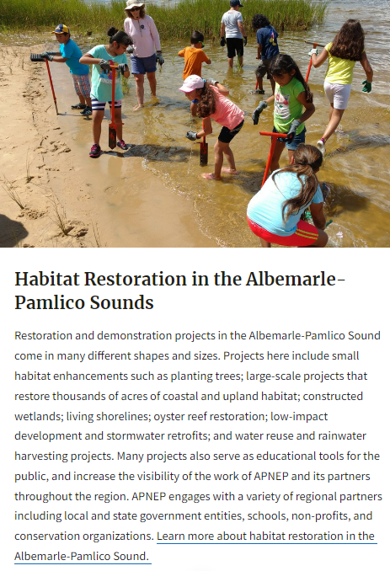
How EPA Uses Program Evaluations
Success stories and achievements highlighted on EPA NEP website, used for Congressional briefings, meetings with partners, etc.
Identified challenges help inform decisions
for funding support:
Climate resiliency and adaptation
Nutrients, HAB engagement
Support DEI initiatives
Make connections to other EPA
offices and programs
Share products/approaches/lessons
learned across NEPs and federal agencies

Slide 8
KEY Program Areas Evaluated
as described in 2021 PE Guidance (1 of 3)
NEP Environmental / Programmatic Workplan Accomplishments
Healthy Ecosystems
Clean Waters
Strong Communities

Slide 9
KEY Program Areas Evaluated
as described in 2021 PE Guidance (2 of 3)
NEP Program Implementation
NEP Administration and Governance Structure
Grant Obligations and Finance
Budget Summary
Opportunities for Improvement and NEP Priorities

Slide 10
KEY Program Areas Evaluated
as described in 2021 PE Guidance (3 of 3)
NEP Ecosystem and Community Status
Community and Stakeholders Engagement
Education and Outreach
Monitoring and Assessment
Clean Water Act Programs Relationship
EPA Priorities
Nutrient Reduction and HABs
Water Reuse and Conservation
Marine Litter Reduction
Green Infrastructure
Environmental Justice
Climate Change

Slide 11
Addressing 2018 PE Letter Challenges
Develop a common APNEP vision to promote its program identity
Explore additional opportunities for funding CCMP implementation activities
Finalize completion of a monitoring strategy
Better communicate programmatic accomplishments and environmental results
Revise CCMP before 2022
Notes:
RACHEL-
Governor’s budget
Significant improvement in workplan
SAV economic evaluation
Acknowledging comprehensive longterm strategy will be developed as part of CCMP revision

Slide 12
2023 Preliminary Findings: Strengths
Overcoming adversity and demonstrating resiliency
Strong alliances on multiple levels
SAV- strategy, field work and data availability
Notes:
Restructuring of program with each state administration
Loosing staff, staff getting cut
SAV- becoming a sought-after resource
Actively using relationships among workgroups

Slide 13
2023 Preliminary Findings: Opportunities for Improvement
Continue to expand engagement and build stakeholder coordination NEP products and outreach materials
Public facing coordination (CCMP, BIL)
Explore opportunities to define relationship between Leadership Council and host organization
Notes:
MEG-
Tribal, Equity strategy
Already on path
Repository of new outreach and materials going out

Slide 14
Next Steps for PE Review Team
EPA to develop PE findings letter to reflect rating of Proficient
Share with APNEP staff for comment
Incorporate feedback and submit to EPA management for signature
Send signed copy to NEP Director
Next scheduled PE: 2028
Notes:
This could also follow slide 3

Slide 15
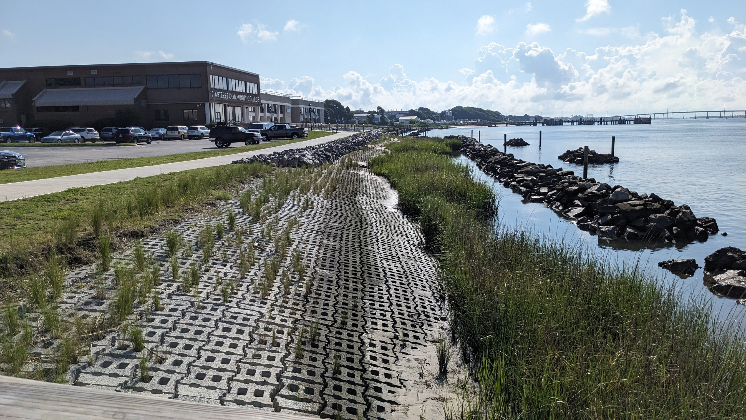
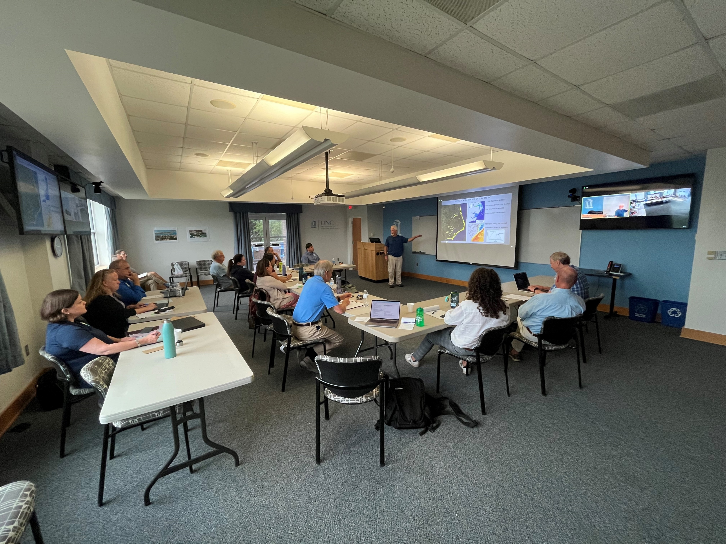
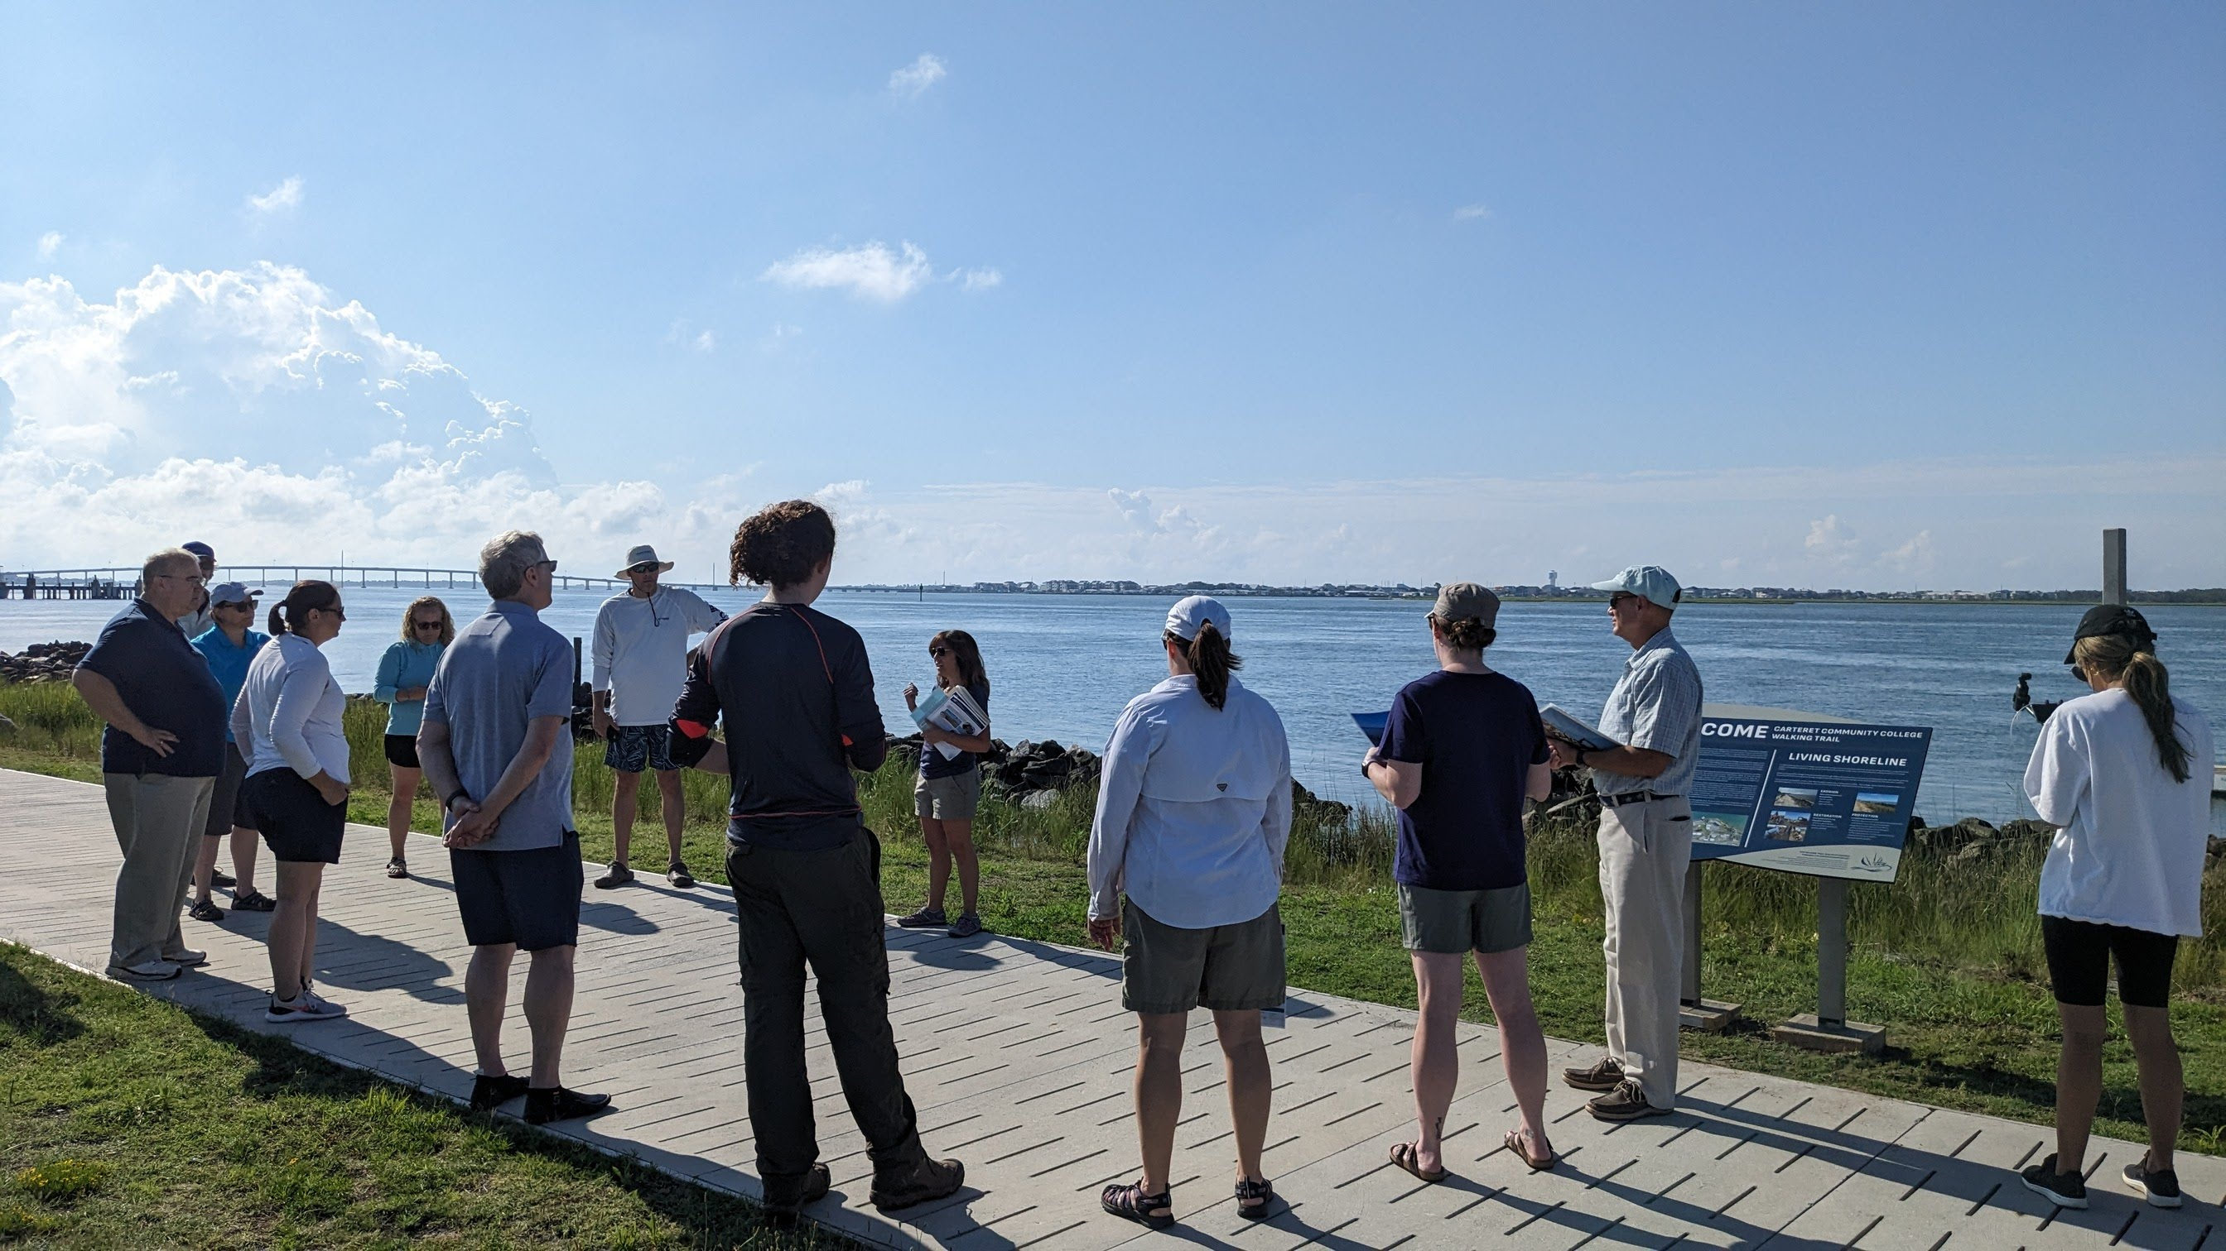
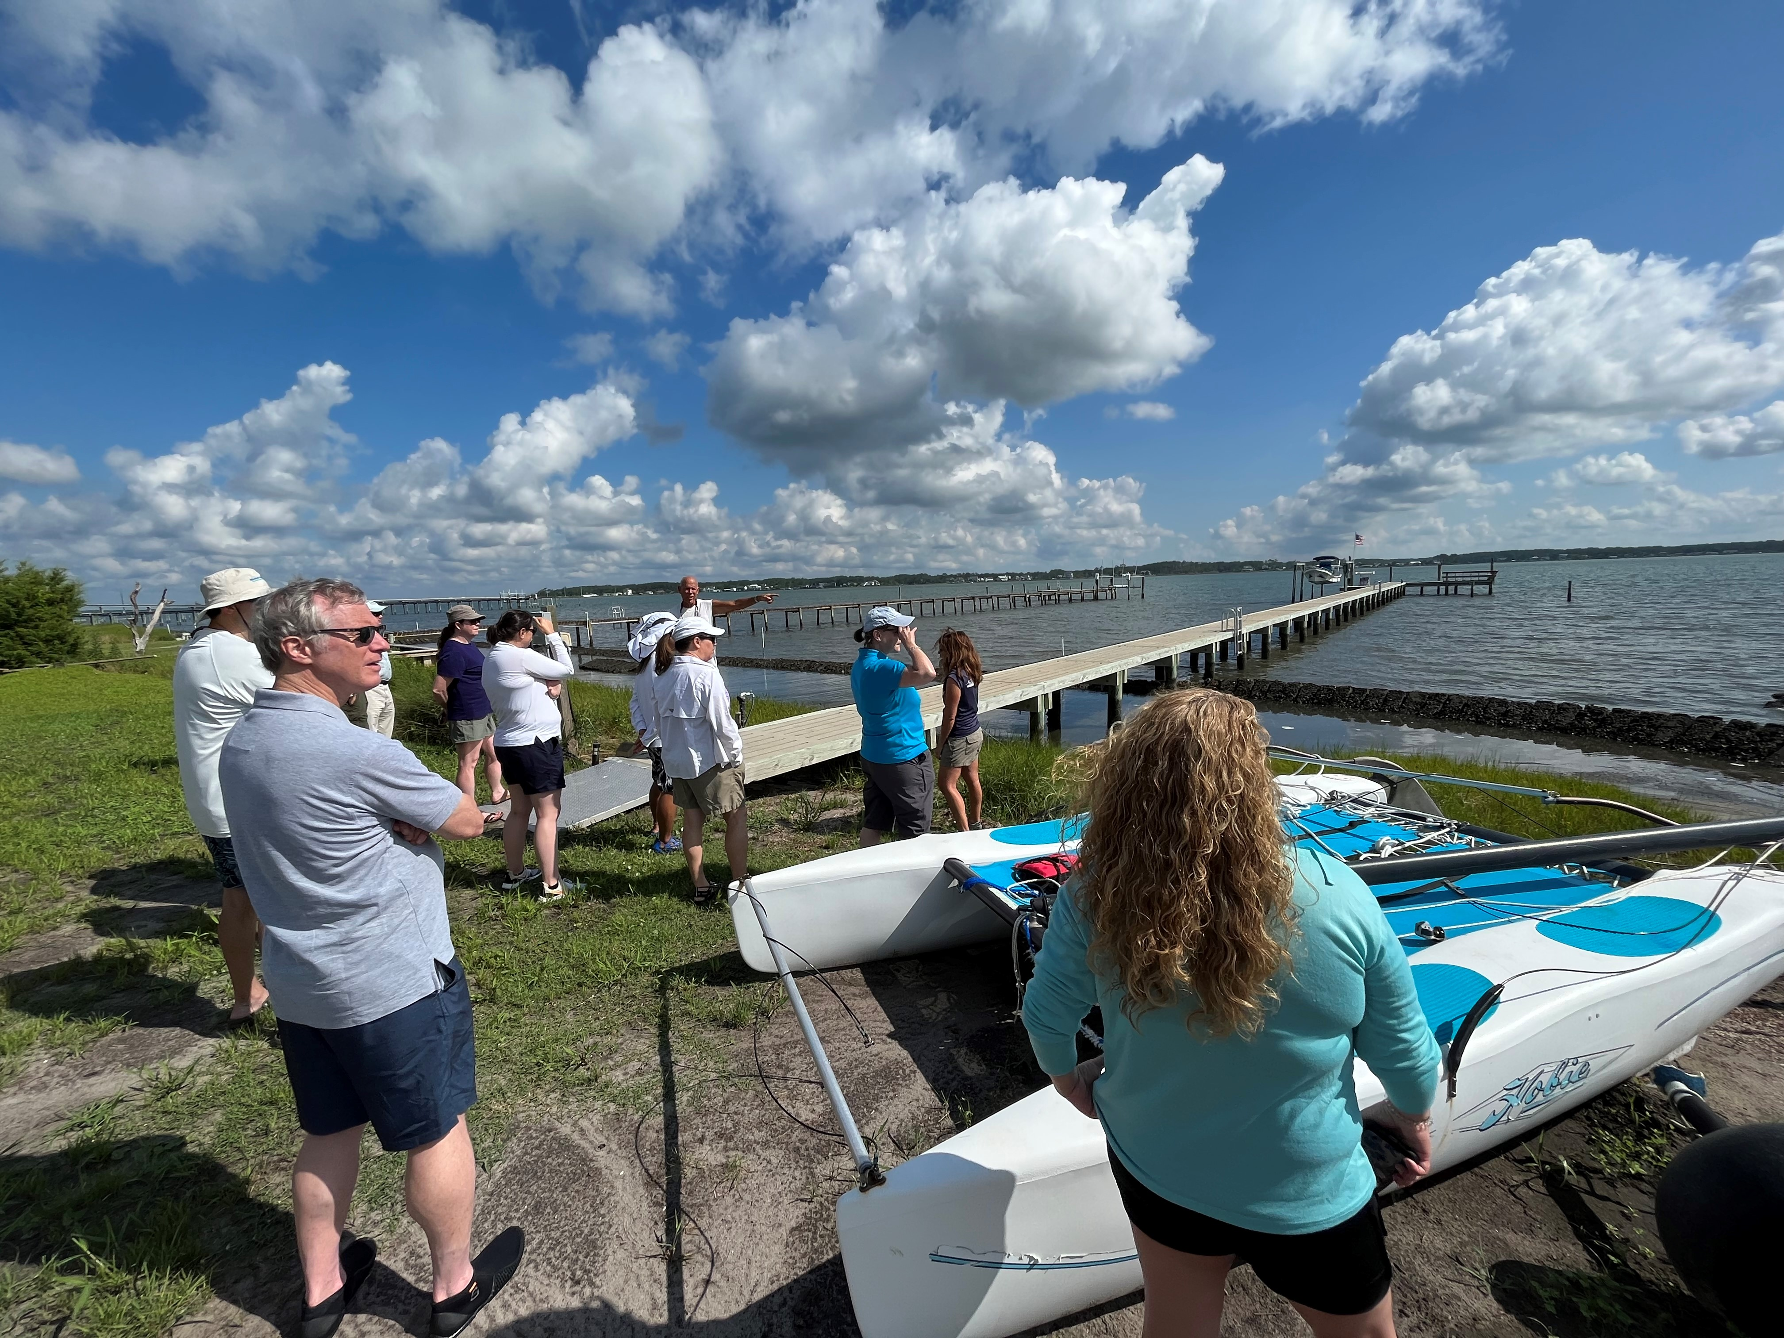
Questions and Discussions
Notes:
Placeholders for APNEP photos

