Slide 1
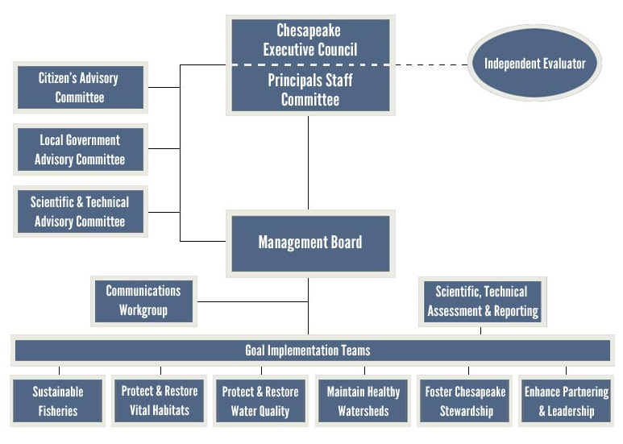

Slide 2
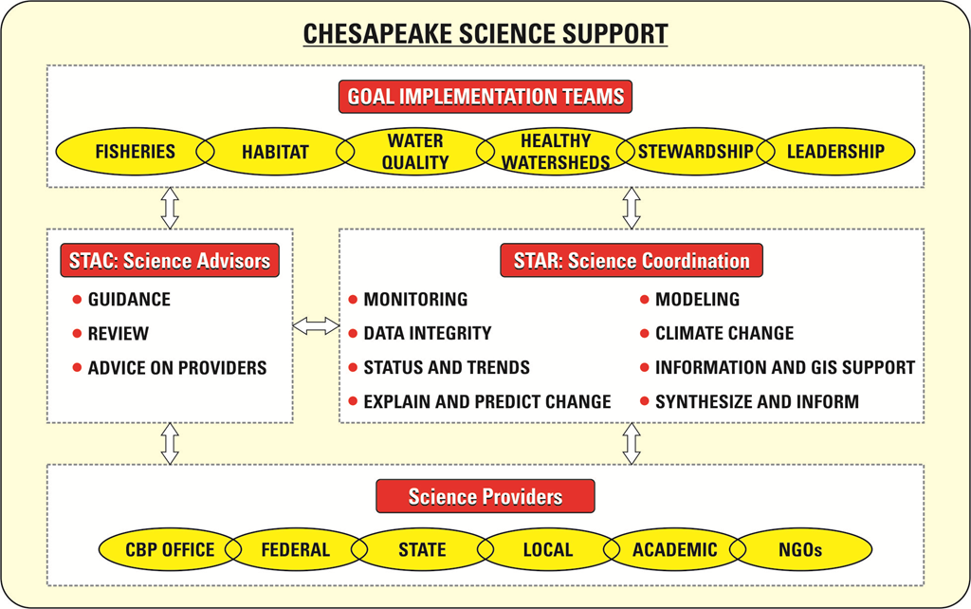

Slide 3
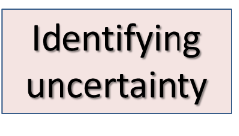
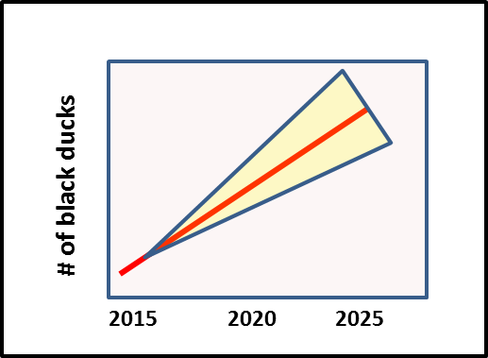
The Decision Framework
Restoring a large complex ecosystem to desired conditions is a process fraught with uncertainty. Success hinges on the ability of all partners in the process to commit to learning while doing – in other words – taking action without guarantees, supporting effective monitoring, transparently assessing progress, and redirecting efforts when warranted.
As a guide, we have described the following adaptive management decision framework for the Chesapeake Bay Program:
1. Articulate program goals.
Identify the goals the GIT is working toward.
2. Describe factors influencing goal attainment.
Identify and prioritize all factors that influence performance toward a goal. This step can help identify areas for cross-GIT collaboration.
3. Assess current management efforts (and gaps).
Identification of gaps/overlaps in existing management programs addressing the important factors affecting goal attainment.
4. Develop management strategy.
Coordination and implementation planning by stakeholders.
5. Develop monitoring program.
There should be a direct link between the monitoring program and the strategy. Needs to answer to main questions:
A. Is the strategy being implemented as planned?
B. Is the outcome what is expected and desired?
6. Assess performance.
Criteria for success/failure of management strategies should be known when the strategy is developed
and the monitoring program is designed. This is the analysis that informs program adaptation.
A. Did we do what we said we needed to do when we said we needed to do it?
B. Did the results appear at the level and at the pace expected?
7. Manage adaptively.
Stay the course or alter the strategy.

