Slide 1
APNEP
Monitoring Strategy Development
Dean Carpenter, D.Env.
Tim Ellis, Ph.D.
Albemarle-Pamlico National Estuary Partnership
Leadership Council Meeting
NC Department of Environmental Quality, Raleigh
14 May 2019
Notes:
The purpose of this presentation is to update the LC on indicator development and monitoring planning in light of EPA’s December program evaluation letter and staff facilitation with APNEP partners. Staff briefed the STAC on this topic during their April 30 meeting as a prelude to committee deliberation on the topic, which will continue soon with the STAC executive board. Today’s presentation first will provide LC with a brief overview of the strategy and tactics used since 2017, then provide a rationale for a shift in tactics beginning in early 2019, and conclude with some leading discussion questions.

Slide 2
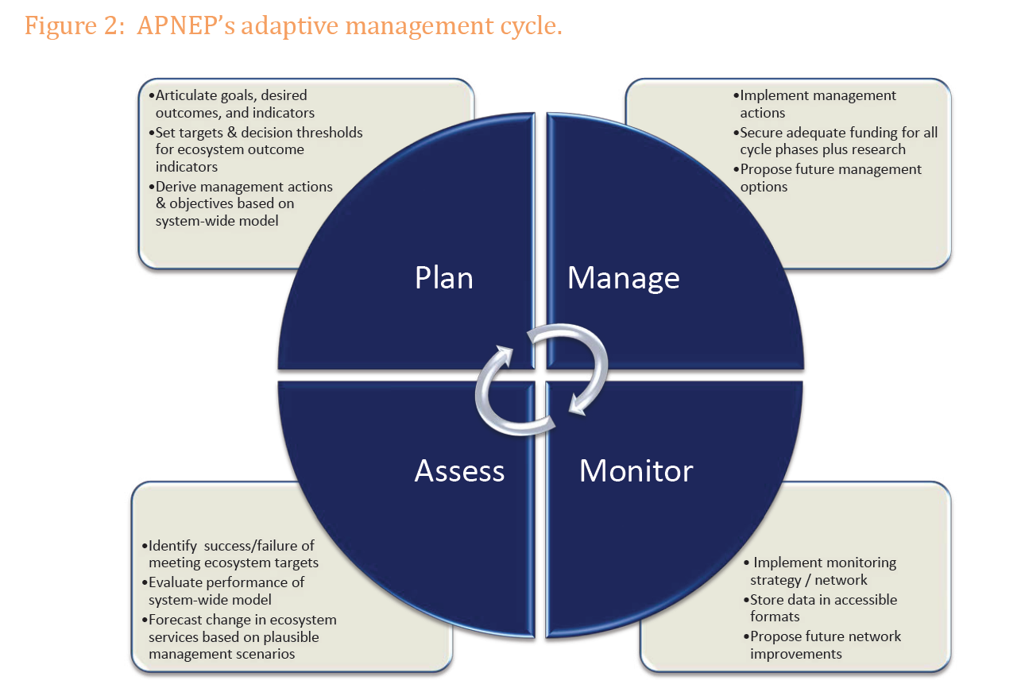
Notes:
Will focus today on the planning phase, largely on the first planning element but a bit on the second element as well.

Slide 3
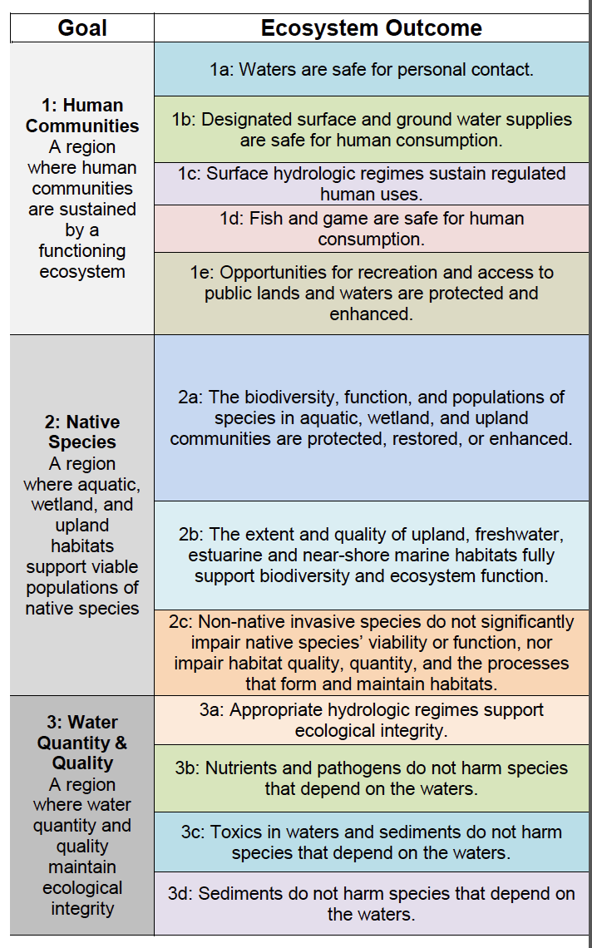
Notes:
APNEP goals and outcomes are articulated (table from CCMP)…APNEP staff facilitating the development of “Tier-1” indicators and supporting metrics. The difference between Tier-1 and Tier-2 more a lack of expertise on MAT for feedback on latter. Initial focus on ecosystem outcome indicators (EOIs).

Slide 4
APNEP Monitoring & Assessment Teams Activity: 2017-2018
MAT | Jan 2017 | Feb | Mar | Apr | May | Jun | Jul 2017 | Aug | Sep | Oct | Nov | Dec | Jan 2018 | Feb | Mar | Apr | May | Jun | Jul 2018 | Aug | Sep | Oct | Nov | Dec
Wetlands
SAV
Air
Water
Aquatic Fauna
Terrestrial
Human Dimensions
Green = first workshop
Blue = post-kickoff workshops
Yellow = webinars/teleconferences
Orange = MAT leads brief STAC
Notes:
Discussions among partners during Phase II of APNEP indicator development: most if not all these meetings were motivated by staff, i.e. very rare if MAT lead expressed desire to have a meeting. Not included are one-on-one sessions with team leads. Since late fall, with MATs having developed consensus on Tier I indicators, staff have begun working with individuals and sub-teams. The MAT process has been challenging for staff and hasn’t worked out like we hoped. Staff has recently reflected on the collective list of Tier-1 indicators and overall MAT progress.

Slide 5
Indicator Report: Guiding Questions
Why Is This Indicator Important Within The APNEP System?
What Does This Indicator Report (Specific Metric or Metrics)?
  Alternate: What Will This Indicator Report (for metrics not yet being monitored, but proposed for monitoring)?
What Do the Data Show (Status and Trends)?
What Is Not Shown by This Indicator?
  Alternate: Why Can’t This Entire Indicator Be Shown at This Time?
Why is This Happening (Diagnosis)?
  Alternate: Understanding the Data
  Alternate: Discussion
What Are the Implications for Management (Prognosis and Forecasting)?
What are the Proposed Ultimate and Interim Targets for this Indicator?
Notes:
Looking for initial MAT contributions in the form of indicator reports. Here is the 2018 “expanded” format when compared to the indicator report used in the APNEP 2012 ecosystem assessment. Reminder that this report targeted to “technically-inclined” managers. Added elements are colored green. The indicator report is an interim product for monitoring plans and ecosystem assessments (reporting). Because of time limitations, how these indicator reports feed into the ecosystem assessment product will not be addressed today.

Slide 6
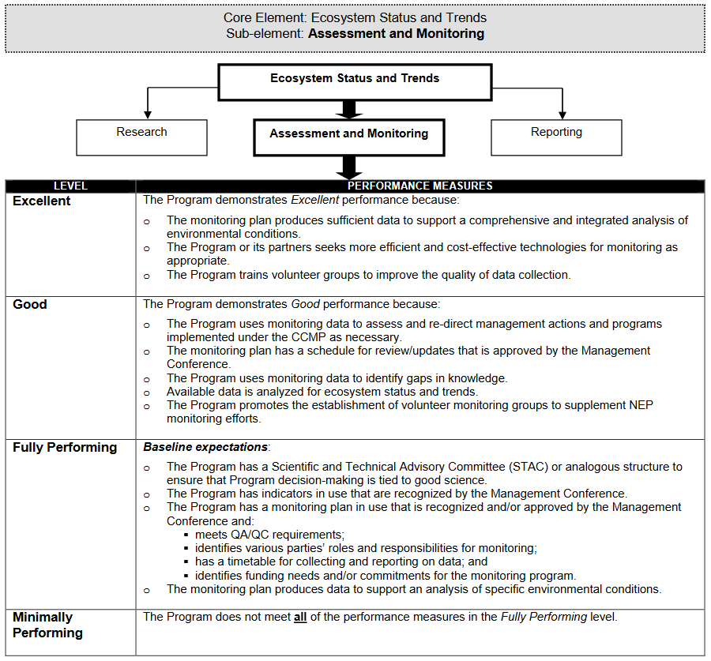
Notes:
EPA-NEP program evaluation letter received in December (based on review of 2013-2017). Assessment and monitoring one of APNEP’s challenges, with recognition of post-2017 progress. Note that staff, without being furished these “performance measures”, has been working to achieve all three levels concurrently.

Slide 7
Notes:
STAC since 2004…this July will mark the 15th anniversary of its first meeting.

Slide 8
Notes:
Indicators in use that are recognized by the Management Conference.

Slide 10
Notes:
EPA program evaluation wants a monitoring plan implemented by 2020.

Slide 11
Monitoring Practice References
NEP Monitoring Guidance (USEPA 1992)
Practical Advice for Implementing Long-Term Ecosystem Monitoring (Sergeant et al. 2012)
Ecosystem Monitoring for Ecosystem-Based Management: Using A Polycentric Approach to Balance Information Tradeoffs (Heenan et al. 2016)
A Road Map for Designing and Implementing A Biological Monitoring Program (Reynolds et al. 2016)
Effective Monitoring to Evaluate Ecological Restoration in the Gulf of Mexico (NRC 2017)
Notes:
Selected references from the literature a good refresher on best monitoring practice (BMP). Will share a few figures from the “road map” article (in green)…

Slide 12
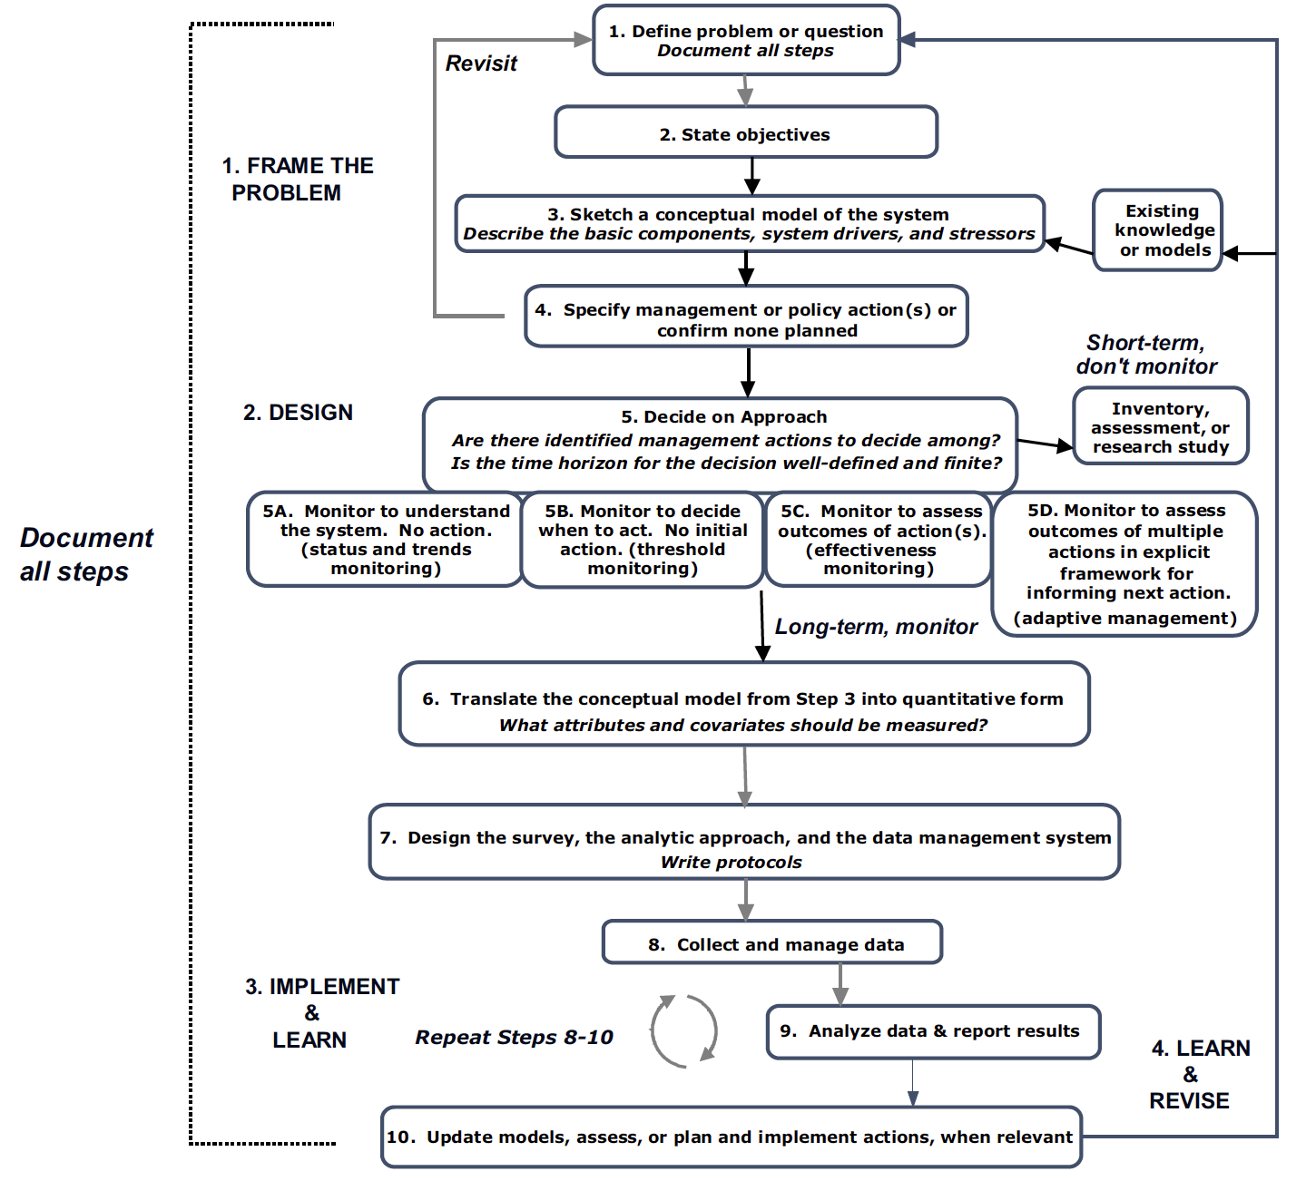
Course Map for Monitoring
Reynolds et al. 2016
Notes:
… to demonstrate the challenge that APNEP continues to face operationalizing monitoring.
Red arrow points to ”Approach 5D”, the monitoring approach required in cases of multiple actions and high degrees of uncertainty.
Importance of long-term monitoring demonstrated by DCERP
Green arrow points to the two monitoring design steps that must be undertaken, propose starting with water resources and SAV ecosystem components.
Result: remove ambiguity in what data are monitored, analyzed, and managed.

Slide 13
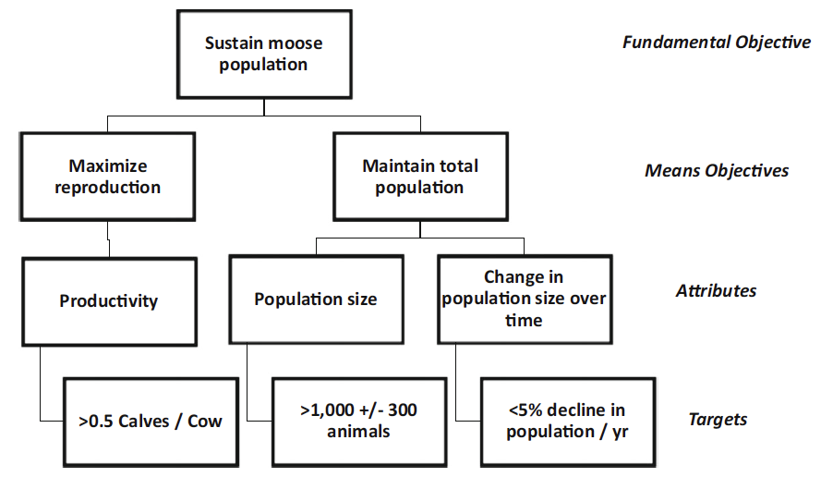
Outcomes-to-Objectives Hierarchy Case Study
Reynolds et al. 2016
Notes:
Staff during Phase I provided general guidance via biodiversity approach for the most complex outcome (2A): taxonomic diversity. MATs first determine “Fundamental Objectives”. Must develop the hierarchy from top to bottom, with increasing amount of expert input. APNEP staff involved with the FWS’ ENSEVA (now CAPES) Miradi process: never reached the attributes and targets.

Slide 14
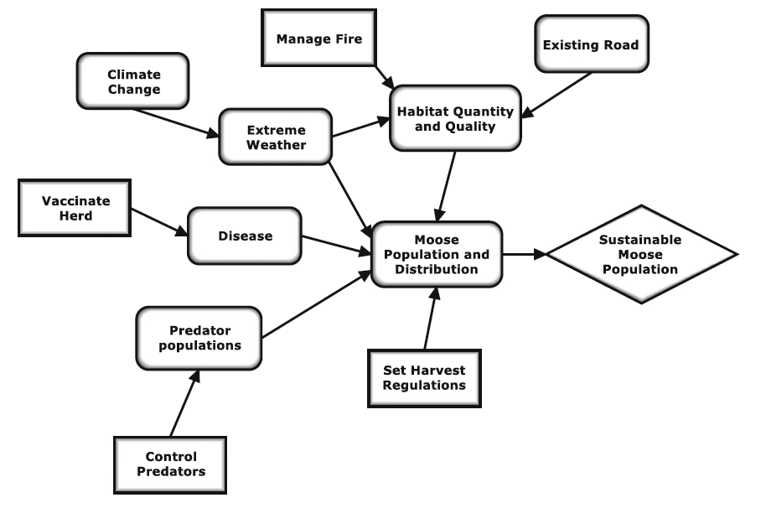
Influence Diagram Case Study
Reynolds et al. 2016
Notes:
Influence diagram one kind of conceptual model. First iteration was developed during APNEP EBM Transition Team’s development of factors influence ecosystem outcomes (as opposed to attributes).

Slide 15
APNEP Monitoring Elements
APNEP Monitoring Conference 2000
MAT Phase I 2008-2012
  Monitoring Template
MAT Phase II 2018-
  Indicator Reports
  Monitoring Plans
    EPA’s NEP monitoring guidance
    Other NEPs monitoring plans
    Large ecosystem programs
Notes:
Staff monitoring tactics pre-2019 to develop monitoring strategy. Large ecosystem programs such as Chesapeake Bay, Everglades, Gulf of Mexico, Great Lakes.

Slide 16
NEP Monitoring Plan References
Tampa Bay Indicators & Monitoring Plan (TBEP 2017)
New York/ New Jersey Harbor Environmental Monitoring Plan (2018)
Delaware Center for Inland Bays Environmental Monitoring Plan (2018)
Notes:
EPA-NEP guidelines on “Monitoring and Assessment” element. APNEP staff last week solicited from EPA staff (Hart, Mackey, Bacalan) their “gold standard” NEP monitoring plans. Note also that staff is reviewing indicators/metrics assessed by many other NEPs as well.

Slide 17
NEP Monitoring Plans: Select Insights
Tampa Bay Estuary Partnership
  Focus on outcome (environmental) monitoring
  No intention to be an integrated monitoring plan
  Objectives expressed as questions
  Monitoring and indicators matrix
  STAC responsible for filling research gaps
Delaware Center for Inland Bays
  Primary importance recommendations for new monitoring programs, or enhancing existing programs
  Monitoring and indicators matrix
  STAC responsible for plan implementation and updates
Notes:
TBEP monitoring plan a technical supplement to CCMP (15 pages). DIB plan is 36 pages plus 120 pages of appendices. The spatial extent of both watersheds are much smaller than that of APNEP’s, also their local partners contribute to monitoring implementation.

Slide 18
Insights from NEP Monitoring Plans
New York-New Jersey Harbor
  Monitoring plan in three distinct products
    Interactive map with inventory of current and historic efforts
    Companion digital storymap
    Research & monitoring recommendations, prioritized by objective

Slide 19
Monitoring Plan Tactics I
Utilize existing monitoring by our partners
Identify components of the monitoring strategy
  Focus areas
  Associated specific monitoring questions
  Standard EPA criteria like responsibilities
  Identified gaps and recommendations
  Reporting schedule/platforms such as ecosystem assessment, symposium, online GIS visuals

Slide 20
Monitoring Plan Tactics II
Priorities driven by specific monitoring questions associated with each CCMP outcome
Focus initial development on the water quality components of the CCMP outcomes, along with submerged aquatic vegetation (SAV)
Work with STAC executive board and an ad-hoc monitoring subgroup to develop this approach further
Notes:
If questioned about starting with water quality: this is logical given that water quality impacts nearly all our outcomes in some measurable way; such an incremental approach to achieving full EBM is necessary given our limited capacity and the breadth/complexity of our system

Slide 21
Leadership Council Input
Are staff’s proposed tactics to establish a monitoring plan prudent given capacity?
Would a draft monitoring strategy in late 2019 and final monitoring strategy in early 2020 be sufficiently responsive?
Would a draft ecosystem assessment in early 2020 and final ecosystem assessment in late 2020 be sufficiently responsive?
Notes:
The remaining time is reserved for LC discussion for any aspect presented, but here are some broad questions to begin. Second two bullets: responsive to all parties, given we are reaching for good/excellent. Last bullet: reminder of EPA reporting requirements, again we would reaching for good/excellent as well. Final comment: as we consider various indicators to include in the monitoring plan, much will depend not only on short-term contributions by partners but the probability of their long-term commitments and investments as well. Hopefully the LC will be “facilitators” as staff via the monitoring plan process make their case to partners of the importance of investing in monitoring, assessment, and reporting.

