Slide 1

Atlantic Conservation Coalition
A natural and working lands focused Climate Pollution Reduction Grant (CPRG) initiative

Slide 2
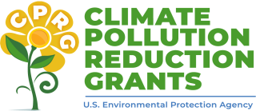
$4.3 billion of competitive funding from the Inflation Reduction Act to:
Reduce GHGs
Implement ambitious measures that will achieve significant cumulative greenhouse gas (GHG) reductions by 2030 and beyond
Community Benefits
Achieve substantial community benefits (such as reduction of criteria and hazardous air pollutants), particularly in low-income and disadvantaged communities
Maximize funding
Complement other funding sources to maximize these GHG reductions and community benefits
Innovative and Scalable
Pursue innovative policies and programs that are replicable and can be “scaled up” across multiple jurisdictions

Slide 3
Atlantic Conservation Coalition Initiative
Southeastern peatlands, coastal habitats, and forests are key natural carbon sinks with climate resilience co-benefits.
Rapid population growth and loss of protections put ecosystems under immediate threat
Regional approach by North Carolina, South Carolina, Maryland, Virginia, and The Nature Conservancy (TNC), to reduce GHG emissions by leveraging the carbon sequestration power of natural and working lands.

Slide 4
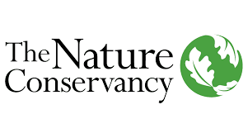

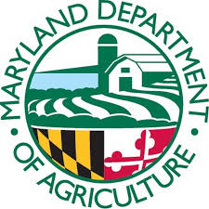
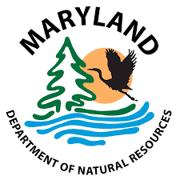
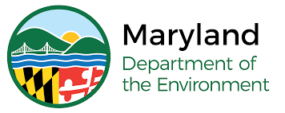
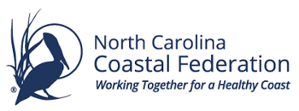
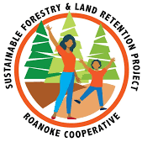
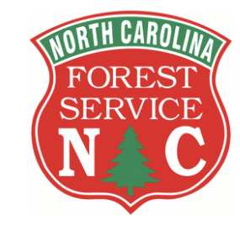
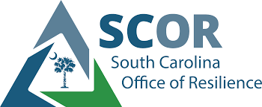
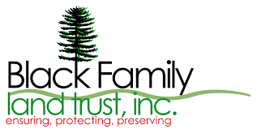
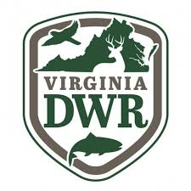
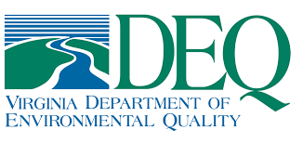

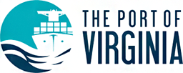
Project Partners

Slide 5
ACC at a glance
$421 million over 5 years
$50 million each in MD, VA, NC, and SC
$200 million to The Nature Conservancy across region
28 million metric tons CO2e reduced by 2050
2 project measures
1. Protect and restore coastal habitats and peatlands
2. Protect, use, and restore forested land
$15.03/MTCO2e reduced from 2025-2050
= removing 6.6 million gas cars from road for a year

Slide 6
ACC Funding Breakdown
$200 million State Allocation
MD $50M
$200 million TNC Regional Allocation
NC $68M
SC $42.4M
DNCR Funds Administration
$21M
VA $50M
NC $50M
SC $50M
MD $42.4M
VA $45M
$421 million

Slide 7
Expected Outputs
Coastal Habitat and Peatlands
Forestlands
67,647 acres of forests under improved management in the Appalachians in MD and VA (TNC)
25,447 acres of bottomland hardwood forest under improved management in SC and VA (TNC)
1,000 new acres of agroforestry practices installed (MD)
250 producers and landowners engaged on the benefits of agroforestry (MD)
500 new acres of forest and 13 acres of urban trees planted (MD)
Over 1,000,000 new native trees planted (VA)
1,200 urban trees planted (NC)
At least 55,000 acres of land reforested (NC)
Approximately 12,240 acres placed into conservation, with additional benefits for agroforestry, recreation, and flood mitigation (SC)
33,000 acres of peatlands newly preserved and/or restored in NC and VA (TNC)
150 acres of tidal wetlands restored in VA (TNC)
15 acres of peatlands and 595 acres of coastal habitats newly preserved and restored (NC)
3,300 acres permanently added to State Park System (NC)
Two National Seashores protected from erosion and sea level rise (NC)
10,000 of acres of forests, current or future coastal habitats, or agricultural lands restored (MD)
1,540 acres of coastal habitats restored (MD)
2,040 acres of created or improved wildlife habitat (MD)
217,700 trees and 4,800,000 native wetland species planted (MD)
100 properties protected from flooding after storms (MD)
Coastal Resilience Plan created for 100 properties, implemented at 5 properties (MD)
10,000 acres of shorelines and habitats restored (VA)

Slide 8
Supports NC’s Executive Order 305
Set goals to achieve the following by 2040:
Permanently conserve one million new acres of North Carolina’s natural lands, with special focus on wetlands
01
Restore or reforest one million new acres of North Carolina’s forests and wetlands
02
Plant one million trees in urban regions of the state
03

Slide 9
Project Summaries

Slide 10
Project Overviews: Maryland
Project 1: Coastal Wetlands ($35.3 million)
Install 400 acres of living shoreline, 200 acres of marsh restoration, 400 acres of tidal connectivity, develop coastal resilient management plans
Project 2: Agricultural Resource Conservation and Management
($4.8 million)
Windbreaks, alley cropping, and silvopasture to improve soil health and water conservation on 1,000 acres through cost-share grants
Project 3: Afforestation and Urban Trees ($8.1 million)
Restore 500 acres of critical habitat, enhance forest management on 1,000 acres, and expand state nursery to market locally sourced trees

Slide 11
Project Overviews: Virginia
Project 1: Hog Island Wildlife Management Area ($2.8 million)
Install 11 breakwaters along 3.4k feet of shoreline to protect 406 acres of marsh
Project 2: Ragged Island Wildlife Management Area ($9.7 million)
Install living shoreline and low breakwaters to protect eroding salt marsh
Project 3: Comprehensive Tidal Marsh Restoration In Guinea Marshes ($10.5 million)
Safegaurd 400 acres of acres of tidal wetlands and beach through erosion control
Project 4: Saltmarsh Acquisition and Protection at Frog Stool Preserve ($1.6 million)
Acquisition of 621 acres of high priority salt marsh
Project 5: New Wetland Restoration and Enhancement Project ($5.4 million)
Restoration of 3,000 acres of identified wetlands, doubling current efforts
Project 6: Acquisition and Afforestation in City of Chesapeake ($10 million)
Reforest 1.3k acre land tract between Great Dismal Swamp and Cavalier Wildlife Management Area
Project 7: Eastern Shore Wildlife Management Areas Forest Restoration ($4.7 million)
Sustainable forestry management on 1.5k acres of upland habitat
Project 8: Quail Roost Farm Afforestation ($3.3 million)
VA Port Authority to put conservation easement on site to enhance carbon stock and support urban agricultural park
Project 9: Tribal Restoration and Conservation Program Set-aside ($1.7 million)
Subaward grant program for federally and state recognized tribes for conservation and restoration activities

Slide 12
Project Overviews: North Carolina
Project 1: Coastal Habitat Enhancement Initiative ($30 million)
NC Coastal Federation- 100 acres of peatland restoration, living shoreline installation protecting 595 acres of salt marsh, 131 acres of conservation for marsh migration, USGS study on carbon sequestration in coastal habitats
Project 2: High Carbon Acquisitions for State Park System ($10 million)
Acquire up to 3,300 acres of forests and peatlands to add to the state park system and avoid conversion
Project 3: Climate Smart Forestry in Low-income and Disadvantaged Communities ($3 million)
Tree planting and climate smart forestry on 10,000 acres with historically marginalized landowners
Project 4: Rapid Tree Growth High-Carbon Forestry Cost Share ($5 million)
Cost share program to incentivize 49,000 acres worth of high-carbon tree seedling plantings across tree farms statewide
Project 5: Urban Tree Planting Program ($1 million)
1,250 urban trees to be planted and maintained. Priority will be given to small and medium-sized communities with limited financial capacity for urban forestry programs.
Project 6: Executive Order 305 Implementation ($1 million)
Funding for NCDNCR to implement goals and deliverables of EO 305

Slide 13
Project Overviews: South Carolina
Project 1: Pee Dee Upland ($5 million)
Acquire identified 2.4k acres for conservation
Project 2: Pee Dee Bottomland ($14.4 million)
Acquire identifired 2.3k acres for conservation
Project 3: Lowcountry Forest ($18.5 million)
Acquire identified 4.9k acres for conservation
Project 4: Unidentified Land Conservation ($11.5 million)
Acquire unidentified 2.4k acres for aquisition

Slide 14
Project Overviews: Regional (The Nature Conservancy)
67,647 acres of forests under improved management in the Appalachians in MD and VA
25,447 acres of bottomland hardwood forest under improved management in SC and VA
33,000 acres of peatlands restored in NC

Slide 15
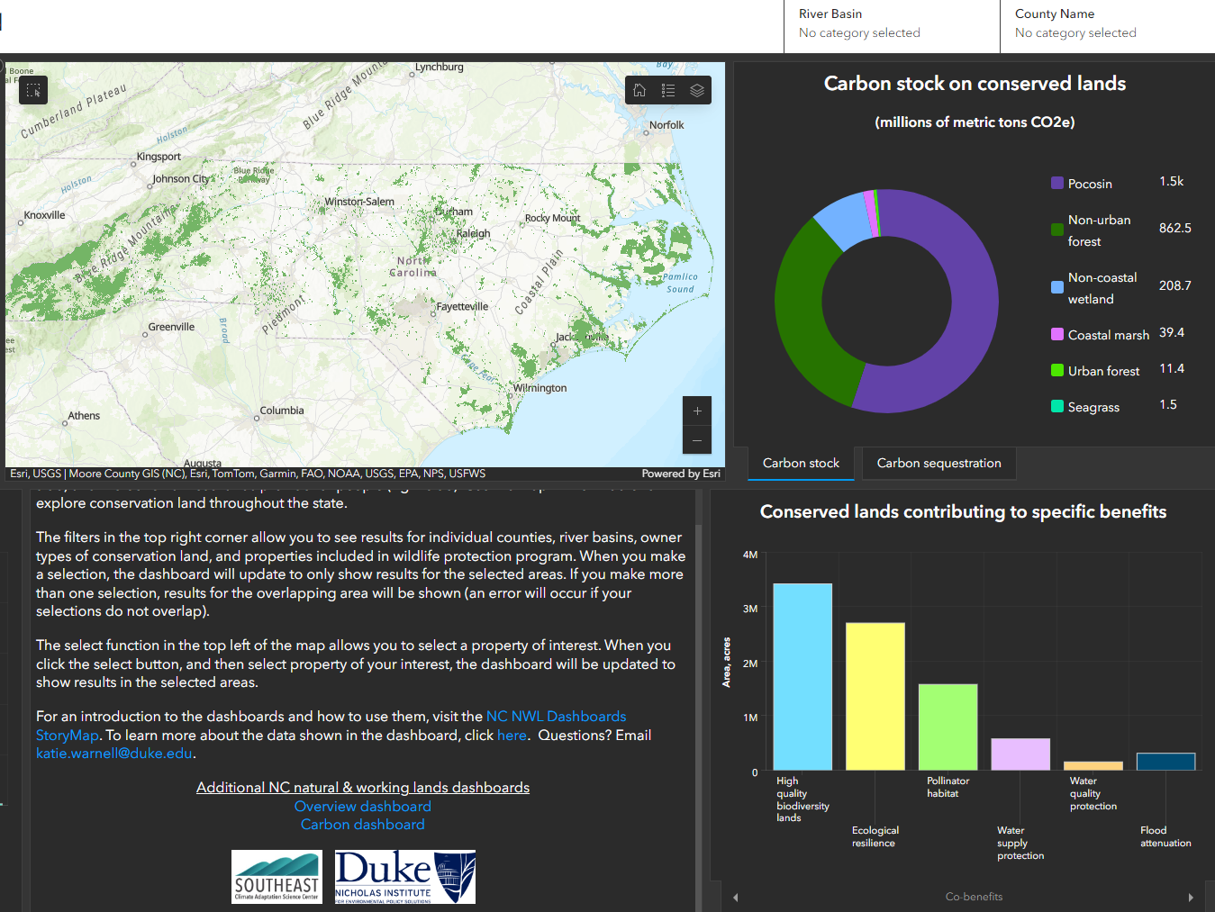
ACC Administration
Duke Conservation Dashboard
NC Dept. of Natural and Cultural Resources receive funds from EPA and sub-awarding to partners. DNCR will report progress to the EPA
Duke Nicholas Institute will be assisting with project tracking
  Will develop public dashboard with implementation progress
Grant will be administered over 5 years
DNCR expecting to receive funds from EPA Oct. 2024 and will lead implementation
https://dukeuniv.maps.arcgis.com/apps/dashboards/e887efaa9be3407c99d430757f34b07b

Slide 16
Climate and Community Co-Benefits

Slide 17
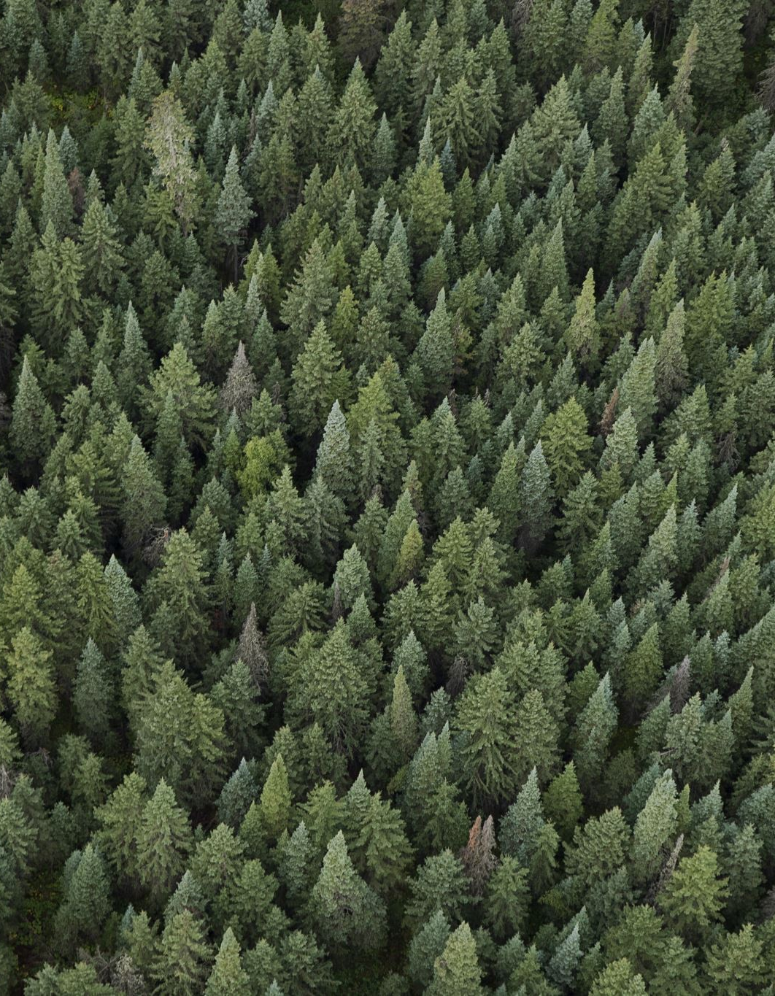
Carbon Sequestration and Storage
Coastal Habitat and Peatlands
  Will reduce 19.2 million MT CO2e by 2050
  Models used: calculations by K. Warnell based on current literature, NC and MD GHG Inventories,
Forested Land
  Will reduce 8.8 million MT CO2e by 2050
  Models used: USFS FIA data, Forest Vegetation Simulator, USFS i-Tree
Verification of Carbon Benefits
  TNC will use ACR Restoration of Pocosin Wetlands v1.0, VM0045 Methodology for Improved Forest Management v1.1, and VM0033 Methodology for Tidal Wetland and Seagrass Restoration v2.1 in years 2-5 to verify realized carbon benefits

Slide 18
Justice 40 and Environmental Justice
LiDAC Forestry Cost-Share Program NC
Urban Tree Planting for small towns that lack capacity, NC
Tribal Restoration and Conservation Program, VA
594 CEJST census tracts and blocks across 4 states could foreseeably benefits from funding
Supports rural economies through agriculture and outdoor recreation
Community engagement and volunteer opportunities for restoration projects
Project identification to ensure at least 40% of all projects benefit LiDACs
Public accountability through Duke dashboard

Slide 19
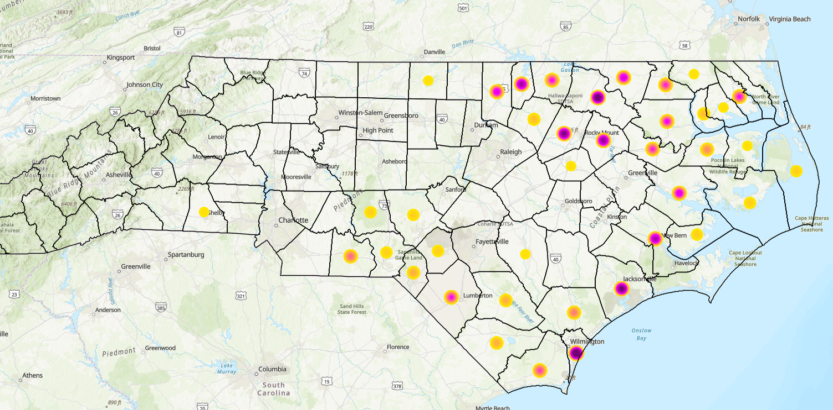
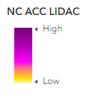
Low-income and disadvantaged communities that may benefit from NC projects
LIDAC Census Block Groups identified if historical data and project plans pointed a project potentially being in area
AND
Block group had at least one EJ index over the 80th percentile nationally using EJ Screen

Slide 20
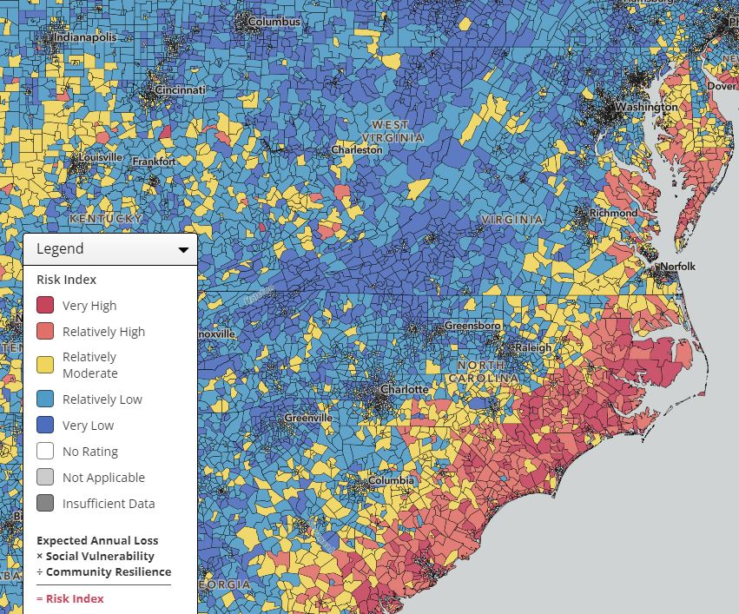
Climate Resilience
Restored peatlands are less vulnerable to wildfires
Living shorelines reduce erosion and protect from sea level rise
Urban trees produce shade, cooling
All ecosystem types assist in flood control

Slide 21
Other Co-Benefits
Habitat restoration and protection for coastal wildlife
Filtration of stormwater pollution, air pollution
Support recreational and commercial fisheries
Supports agriculture
Expands green spaces and outdoor recreation
Mitigates oceanic acidification

Slide 22
Concepts into Action

Slide 23
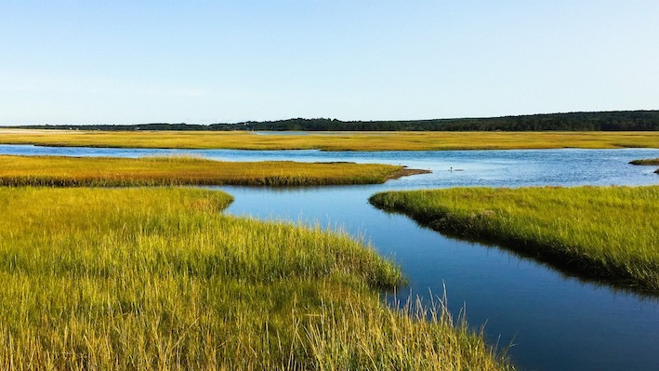
Blue Carbon
Emissions Reduction Assumptions
Coastal marshes have carbon stocks ranging from 298.30-415.11 mtCO2e/acre depending on marsh location and data source in the top meter of soils. These carbon stocks are emitted when marshes are lost due to sea level rise, erosion, or other stressors.
Coastal marshes provide an ongoing carbon benefit of 1.55-4.23 mtCO2e/acre/year depending on marsh location and data source. These carbon benefits stop accruing when marshes are lost.
Migrated coastal marshes provide ongoing CS benefits as well as additional benefits from reduced methane emissions when coastal marshes migrate into freshwater wetlands. The overall carbon benefit from marsh migration ranges from 1.55-5.12 mtCO2e /acre/year
Coastal wetlands that are disconnected from tidal flows become less saline, leading to increased methane emissions. Reconnecting these wetlands to tidal flows reduces methane emissions by 1.91-4.64 mtCO2e/acre/year, depending on specific salinity levels before and after restoration.
Sources
Warnell, Katie, Lydia Olander, and Carolyn Currin, "Sea level rise drives carbon and habitat loss in the US mid- Atlantic coastal zone," PLoS Climate 1, no. 6 (2022): e0000044. https://journals.plos.org/climate/article?id=10.1371/journal.pclm.0000044
North Carolina Department of Environmental Quality, “North Carolina Greenhouse Gas Inventory (1990-2050),” January 2024. https://edocs.deq.nc.gov/AirQuality/DocView.aspx?id=468498&dbid=0&repo=AirQuality&cr=1
Reithmaier, Gloria MS, Alex Cabral, Anirban Akhand, Matthew J. Bogard, Alberto V. Borges, Steven Bouillon, David J. Burdige et al., "Carbonate chemistry and carbon sequestration driven by inorganic carbon outwelling from mangroves and saltmarshes,“ Nature Communications 14, no. 1 (2023): 8196. https://www.nature.com/articles/s41467-023-44037-w
Maryland Department of Natural Resources and Maryland Department of the Environment, “Maryland Blue Carbon Flux: Estuarine Wetlands and Submerged Aquatic Vegetation. Data and Methodology Documentation as prepared for the 2020 Maryland Greenhouse Gas Inventory.” January 6, 2023 .https://mde.maryland.gov/programs/air/ClimateChange/Documents/VIMAL/MD_Bluecarbon_Flux_Methodology_01.06.23.pdf
Holmquist, James R., Lisamarie Windham-Myers, Norman Bliss, Stephen Crooks, James T. Morris, J. Patrick Megonigal, Tiffany Troxler et al., "Accuracy and precision of tidal wetland soil carbon mapping in the conterminous United States," Scientific Reports 8, no. 1 (2018): 9478. https://www.nature.com/articles/s41598-018-26948-7
The Nature Conservancy & Maryland Department of Natural Resources, ”TNC Maryland Blue Carbon Resilience Credit Feasibility Study,” December 2023.https://dnr.maryland.gov/ccs/Documents/Maryland- Blue-Carbon-Resilience-Credit- Feasibility-Study-2023-12-22.pdf

Slide 24
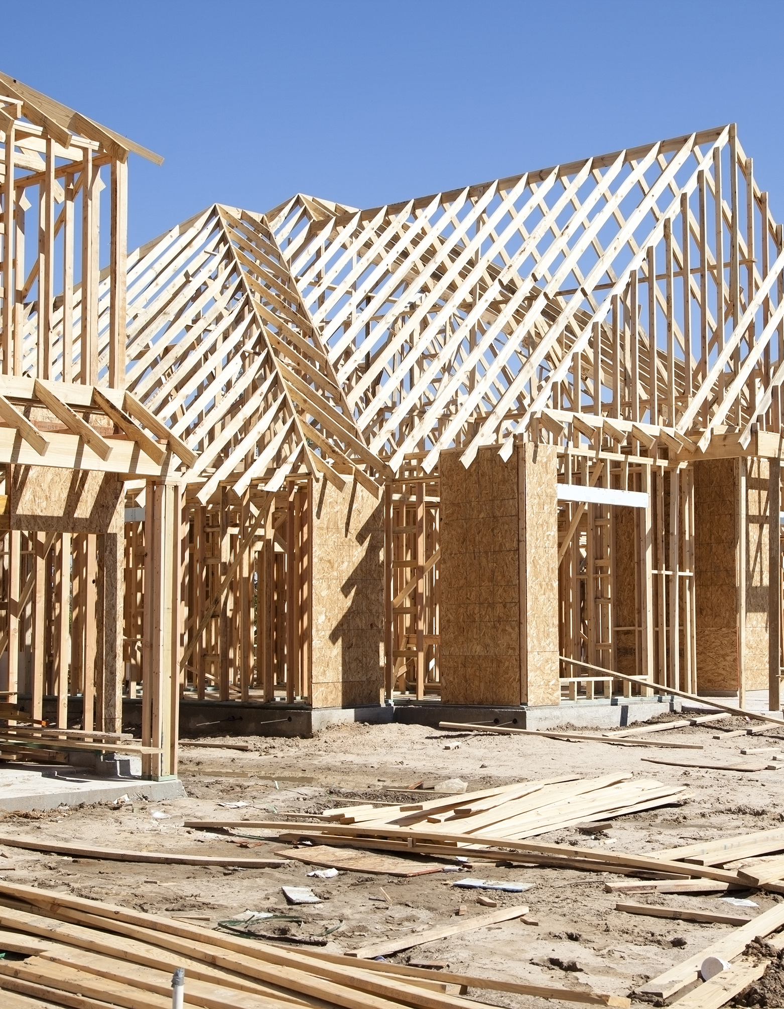
Avoided Conversion
Assumption: if not for putting x carbon-rich land into easement, x land will be bought and converted by developers, resulting in both release of carbon and prevention of future storage from lack of trees, peatland etc.
Total carbon benefits conservatively deduct 50% for uncertainty regarding additionality and leakage
Land with high carbon storage +
Existing and known development interests
= Preservation of most valuable land at highest risk of conversion

Slide 25
Contact
NC Gov Office- Bailey Recktenwald bailey.recktenwald@nc.gov
NCDNCR- Deans Eatman deans.eatman@dncr.nc.gov
NCDNCR- Emma Hughes emma.hughes@dncr.nc.gov
For carbon methodology contact katie.warnell@duke.edu

