Slide 1
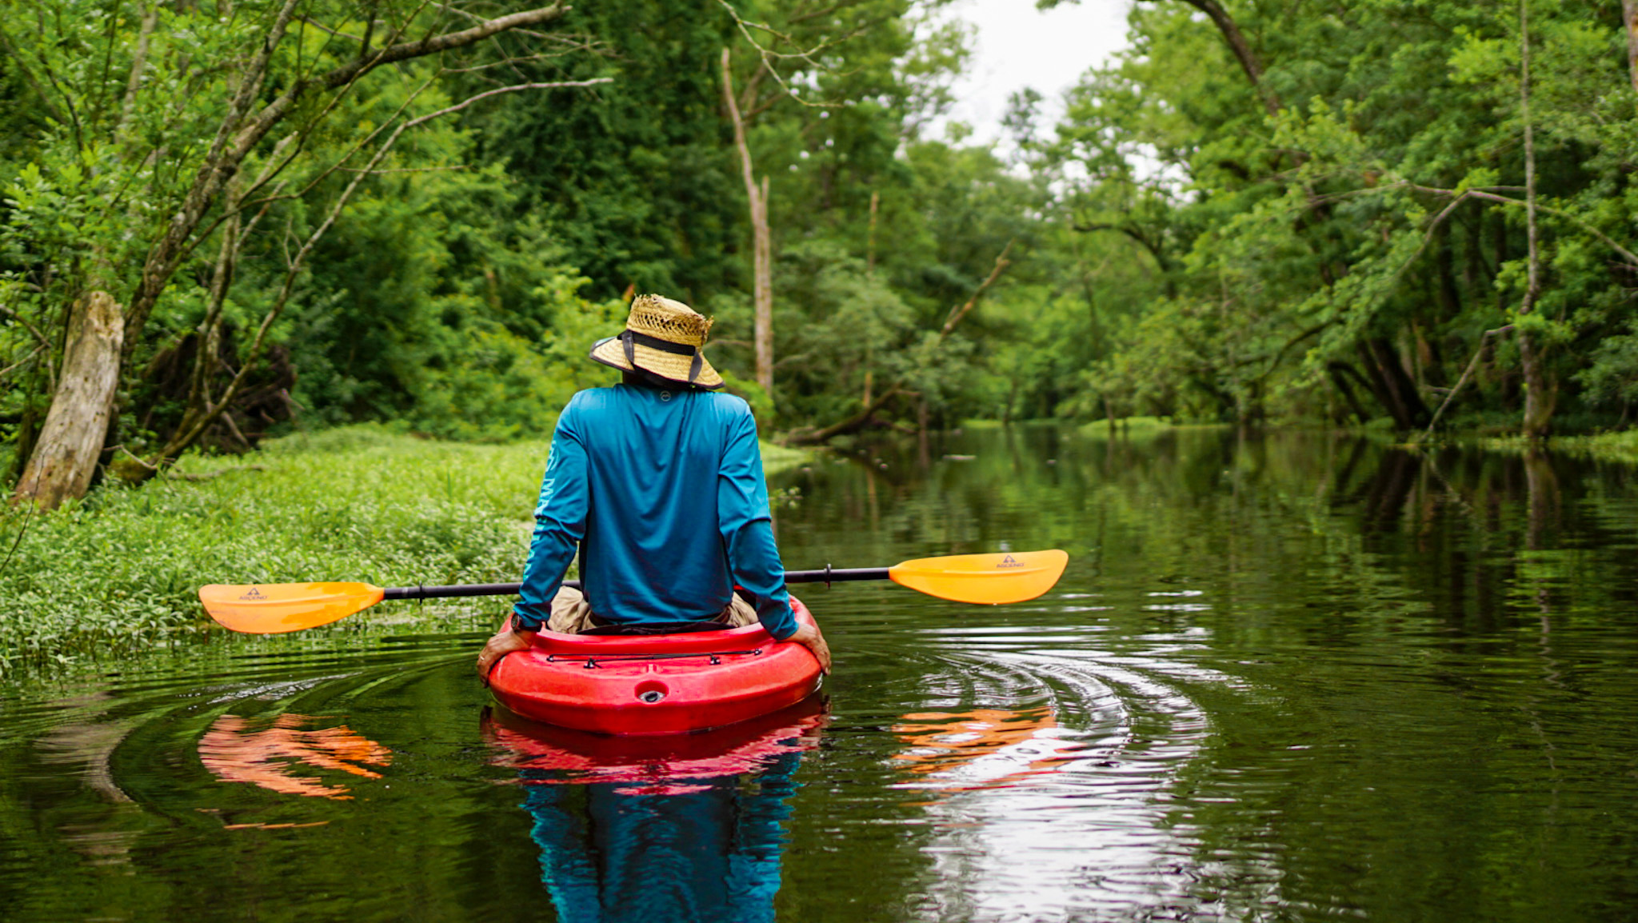
Tribal Coastal Resilience
📍 Coharie Creek, NC

Slide 2
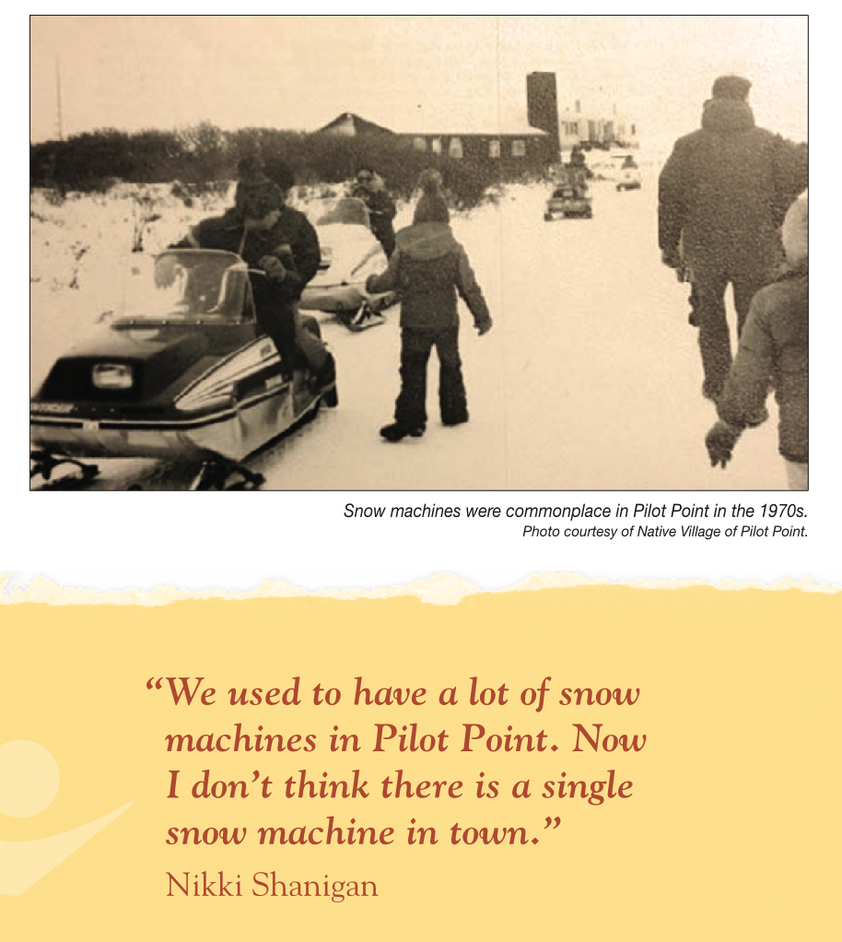
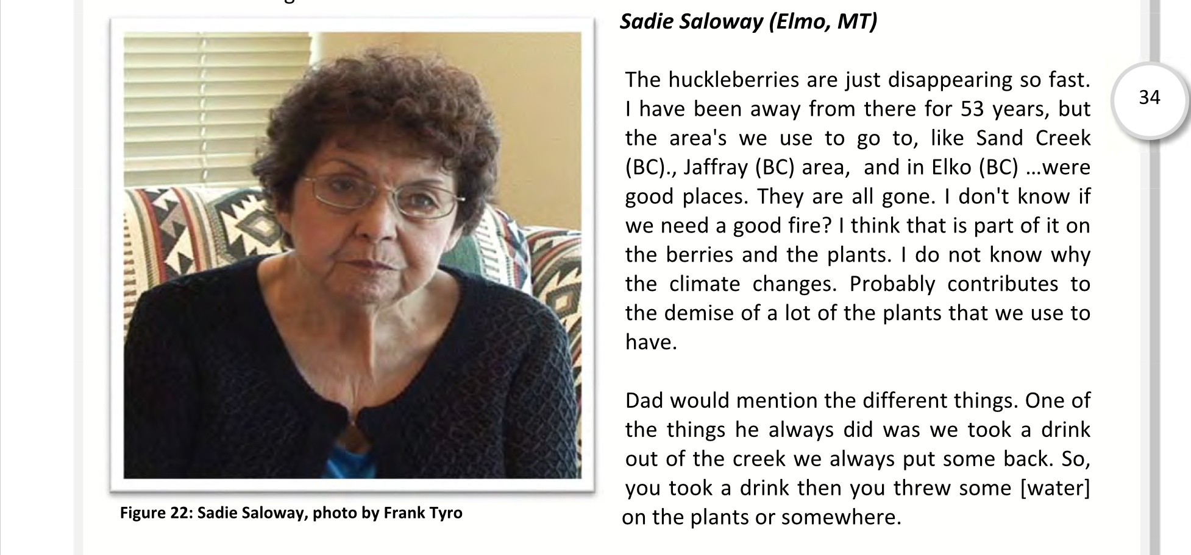
Climate Strategic Plan: Confederated Salish and Kootenai Tribes of the Flathead Reservation, 2016
Climate Change in Pilot Point, Alaska: Strategies for Community Health, 2013

Slide 4
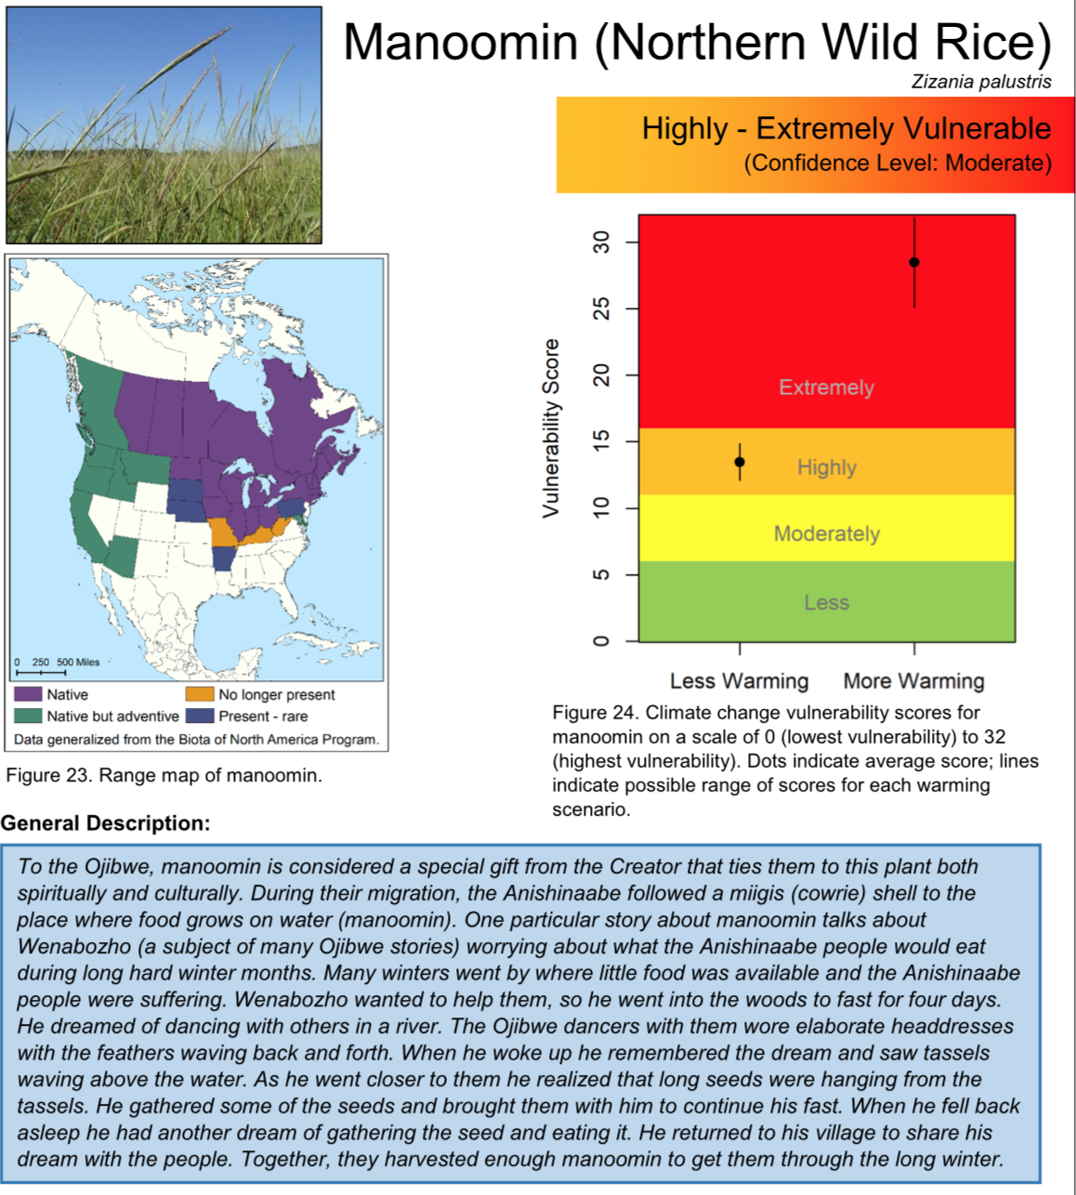
Great Lakes Fish & Wildlife Commission Climate Change Vulnerability Assessment, 2018

Slide 5
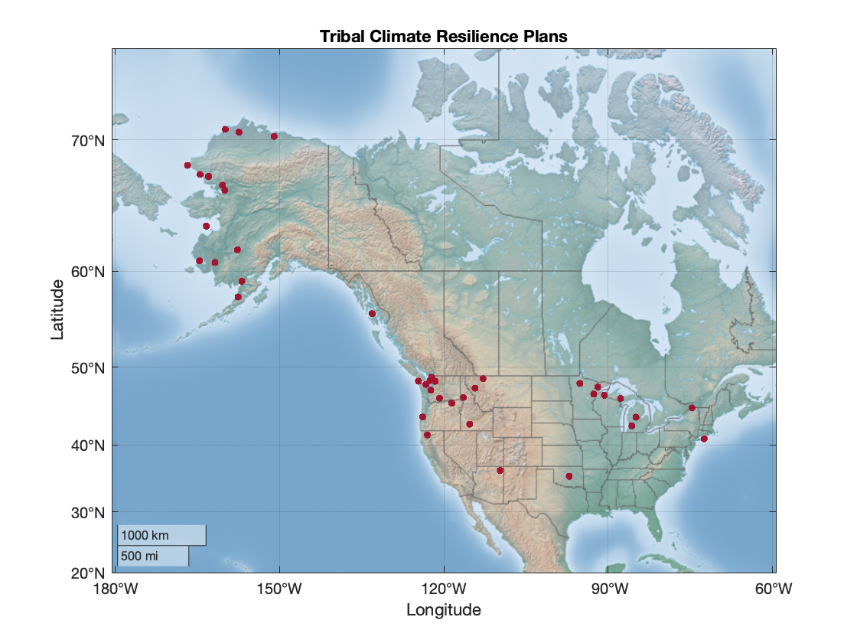
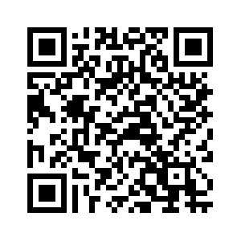
link to these
plans here:

Slide 6
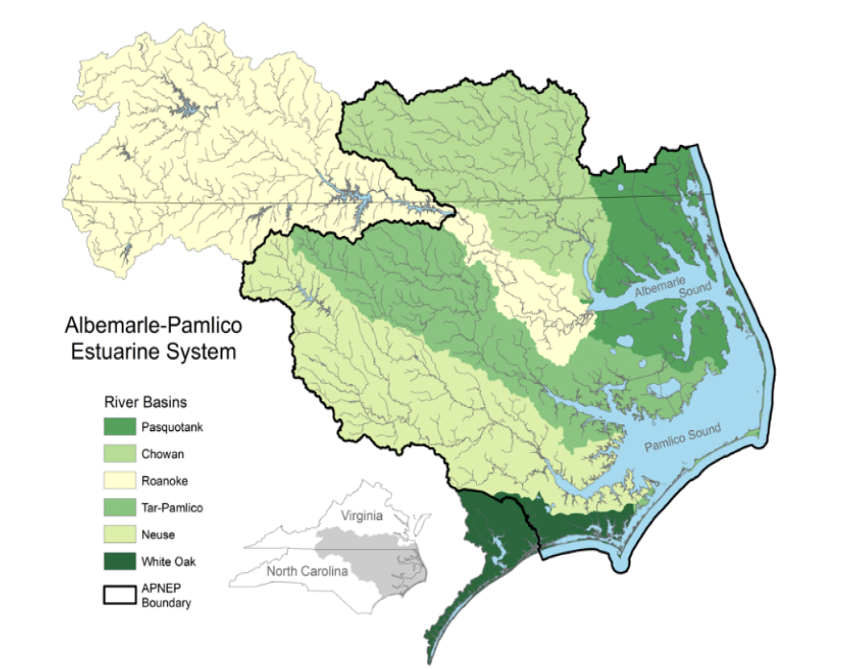
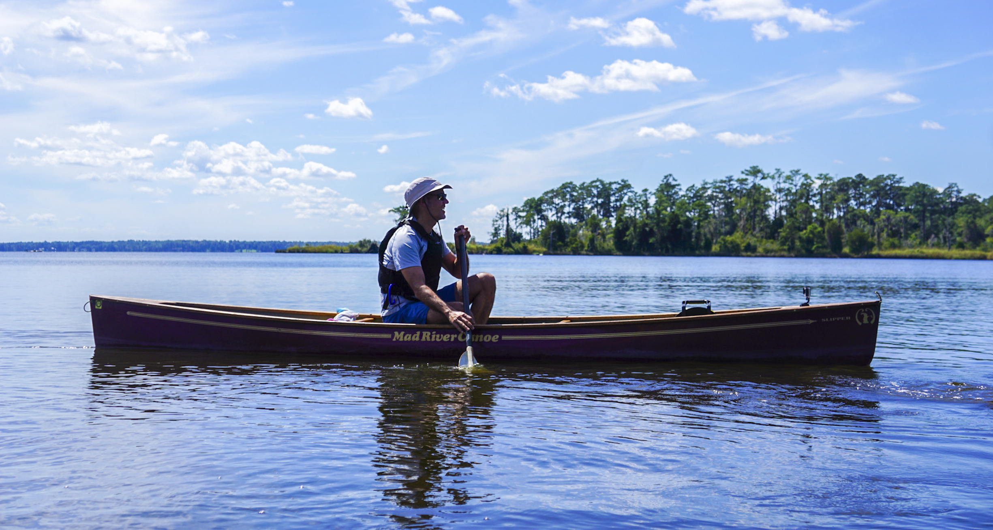
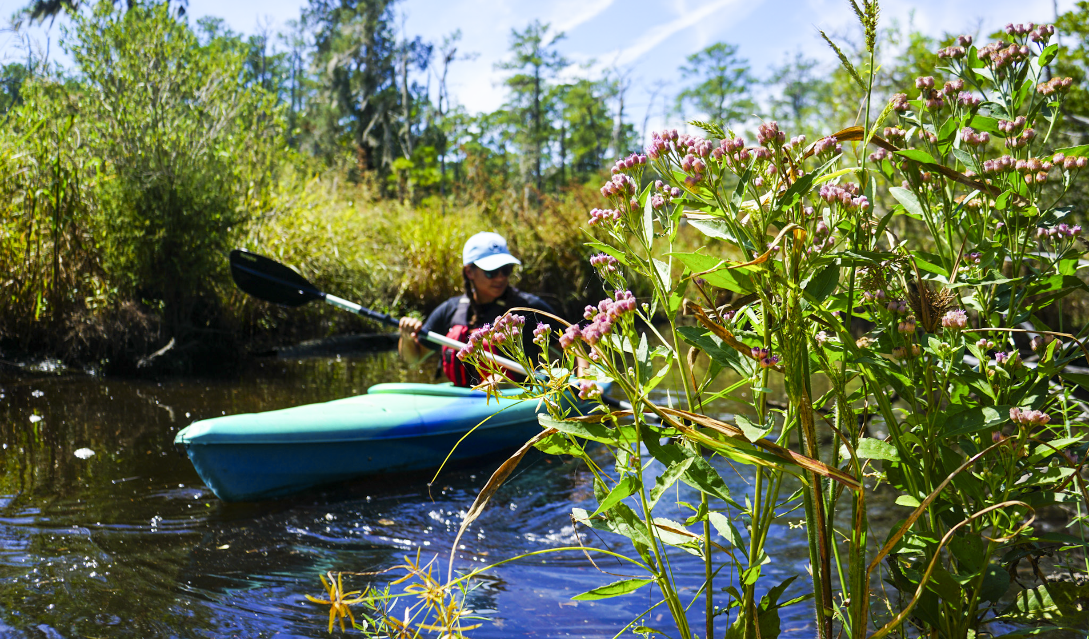
📍 Goose Creek, NC

Slide 7
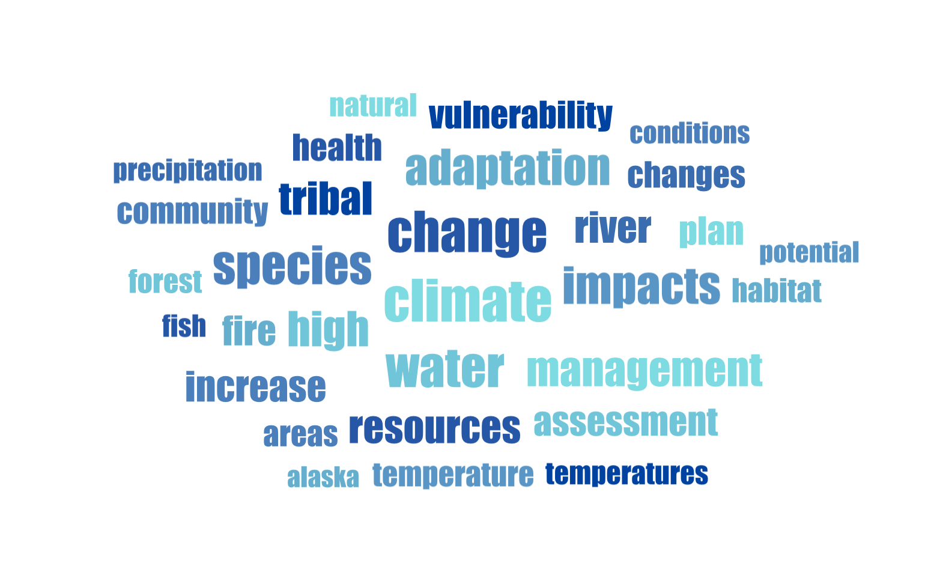

Slide 8
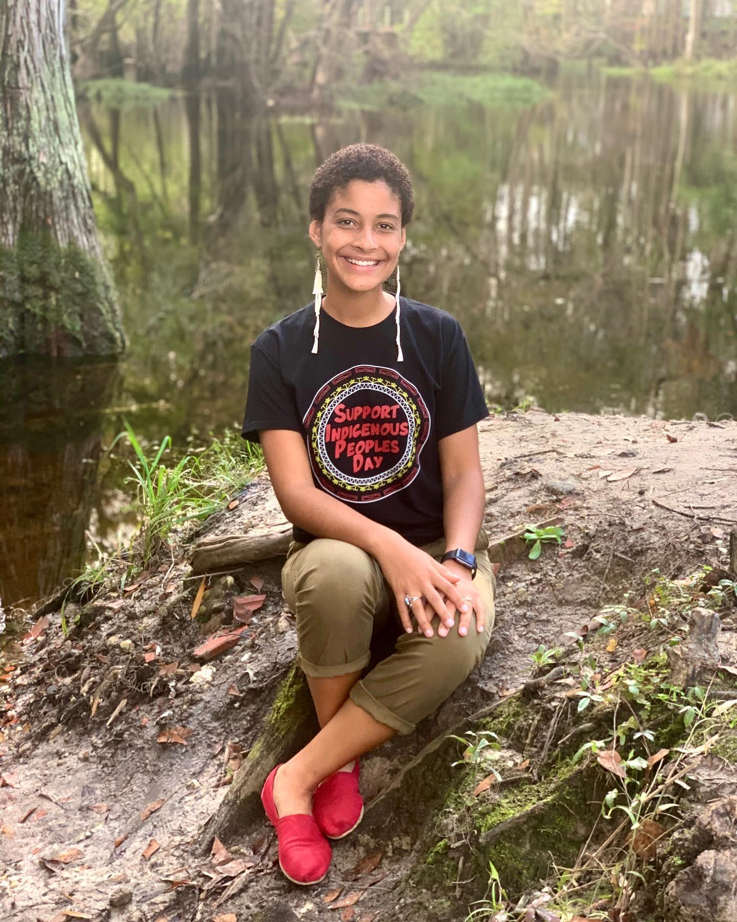
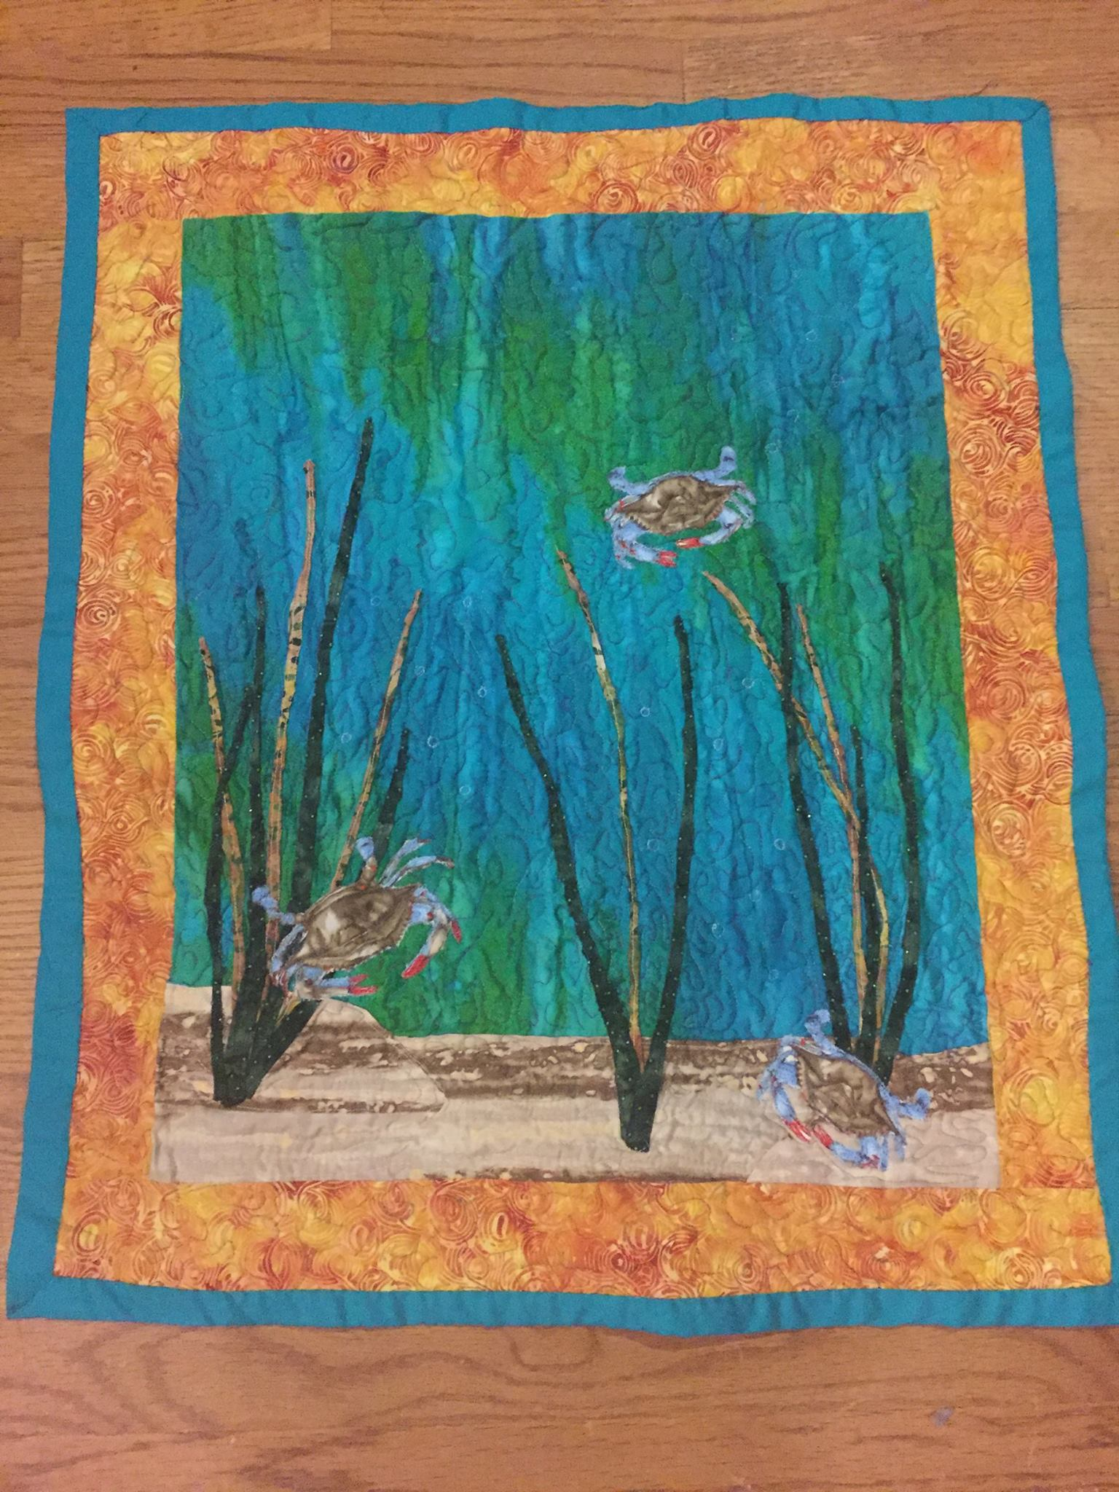
Tribal Coastal Climate Resilience

Slide 9
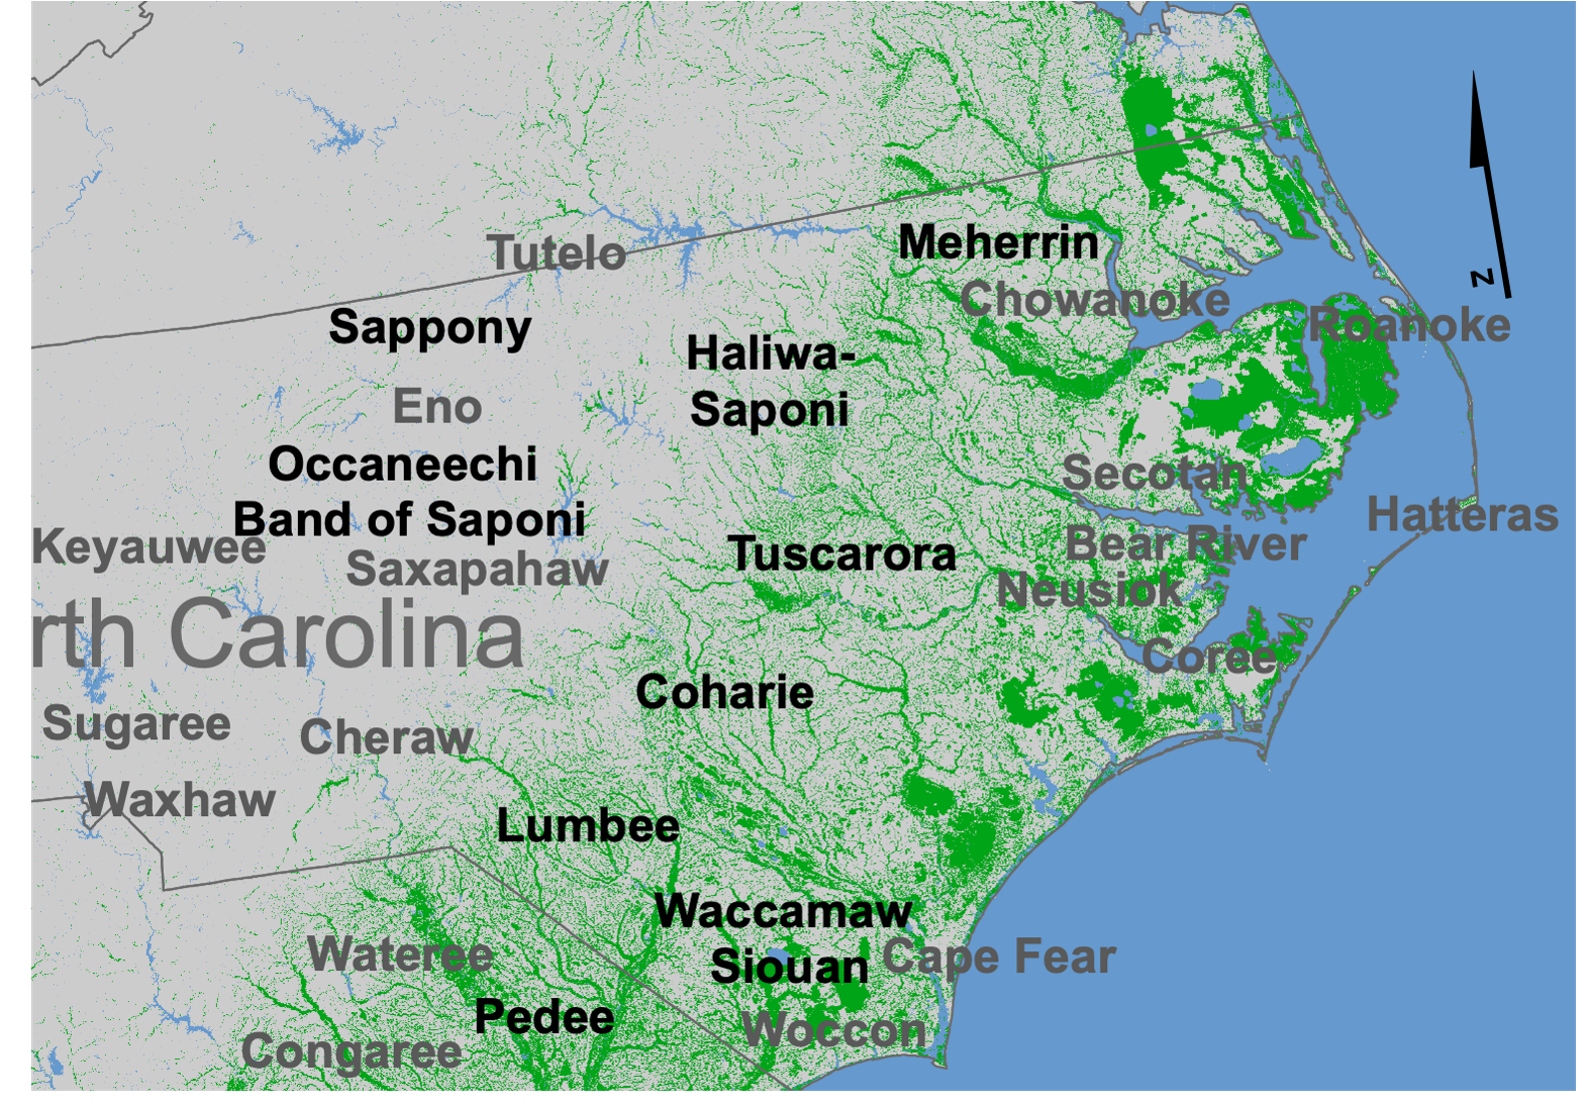
Nansemond
Monacan
Present Day Peoples
Nottoway
Historic Peoples (Partial listing)
Wetland
Indigenous communities make up complex social and political strata often invisible in discussions about the APNEP Region, the Southeast, and the US as a whole.
Map adapted from Emanuel and Wilkins (2020) Water

Slide 10
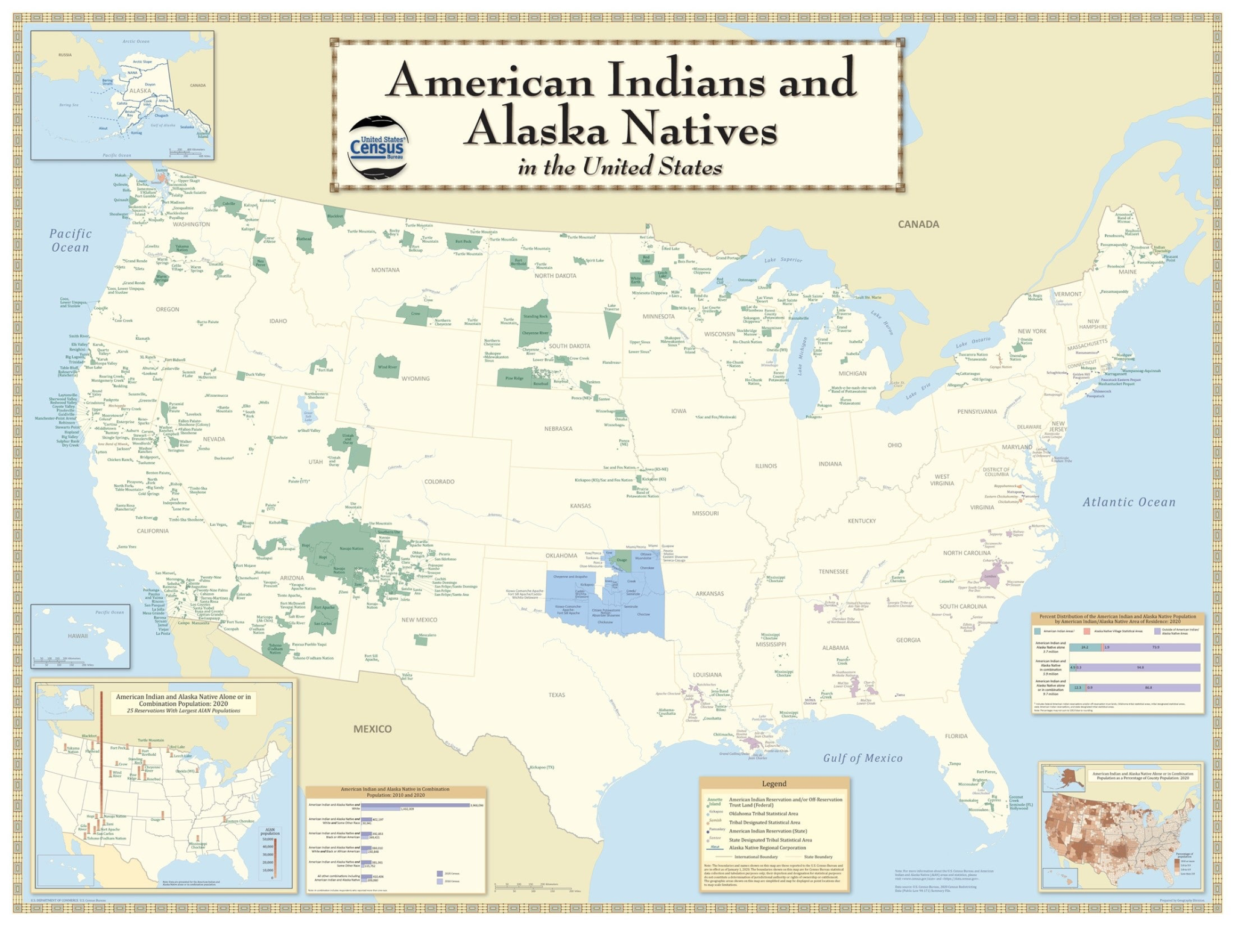
… But all of that complexity is typically reduced to simplistic representations in decision-making spaces.
Map of AI/AN Reservations, Federal Trust Lands, Tribal Statistical Areas (2020) US Census Bureau

Slide 11
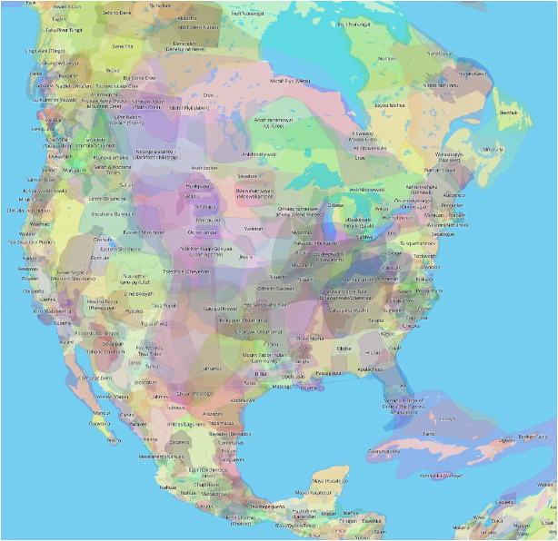
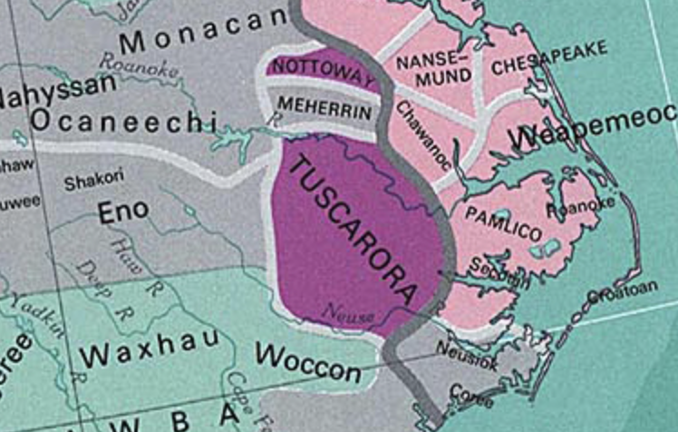
Where does this information come from?
Do the present-day groups represented here consent to this project?
Sturtevant Map (1967) Smithsonian Inst.

Slide 12
“Easy knowledge about Indians is a historical tradition.”
- Vine Deloria Jr. Custer Died for your Sins
Steps away from “easy knowledge” and toward meaningful engagement with Indigenous peoples in climate adaptation planning:
Recognize gaps in knowledge and expertise about diverse cultures, political identities, histories, and present-day experiences.
Recruit partners with expertise to fill gaps.
Build and maintain authentic relationships with Indigenous communities.

Slide 13
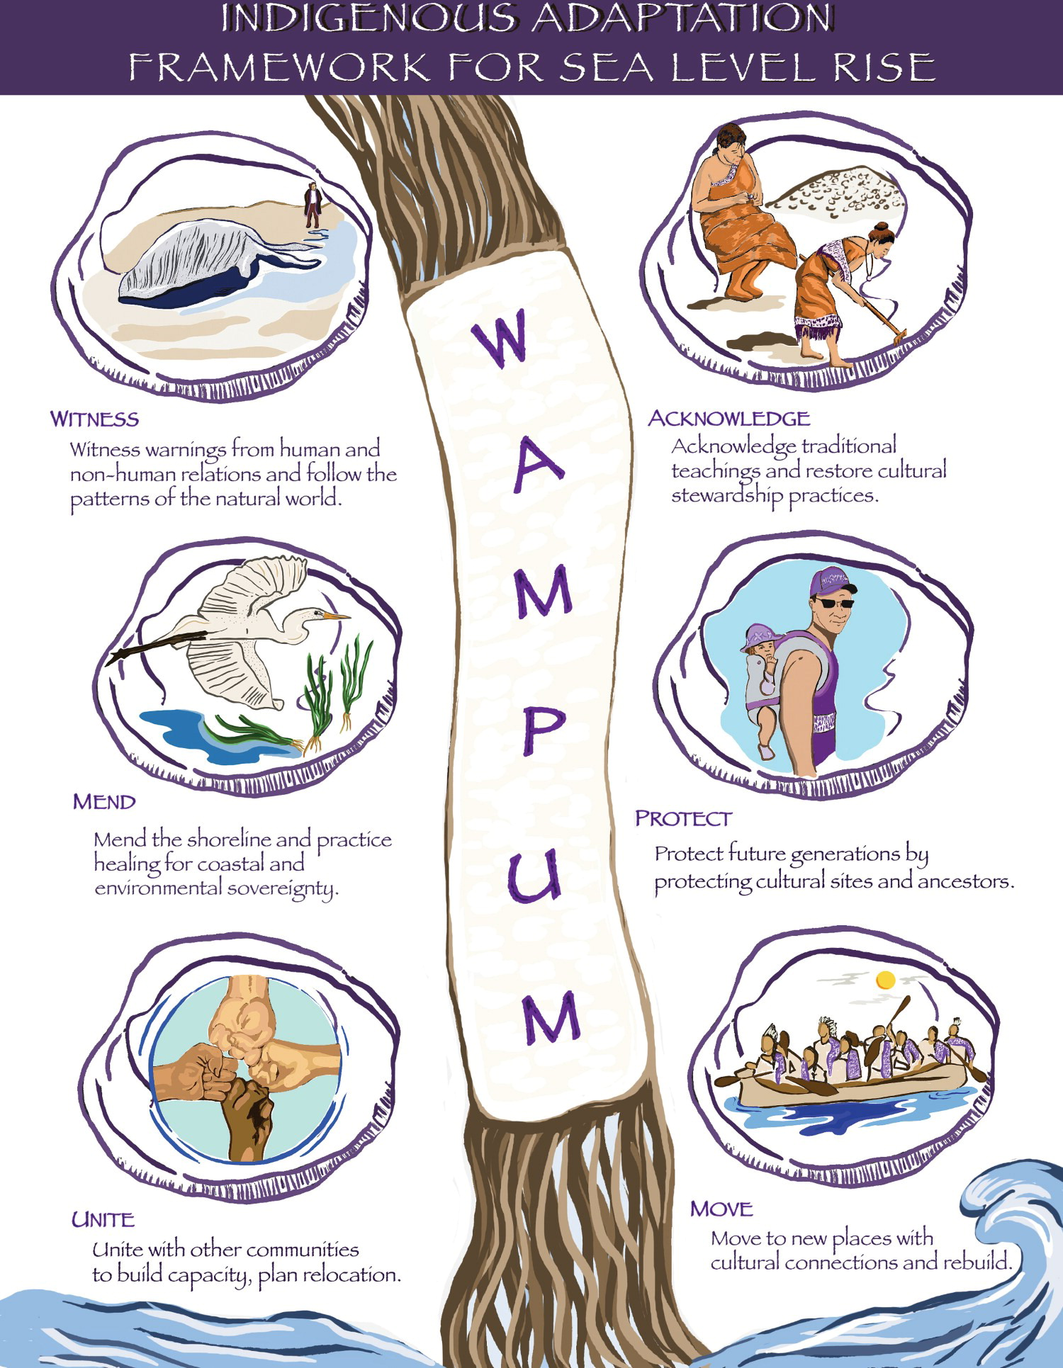
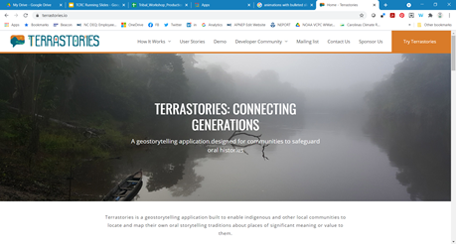
Kelsey Leonard (2021) WAMPUM Adaptation framework: eastern coastal Tribal Nations and sea level rise impacts on water security,
Climate and Development, DOI: 10.1080/17565529.2020.1862739

Slide 14
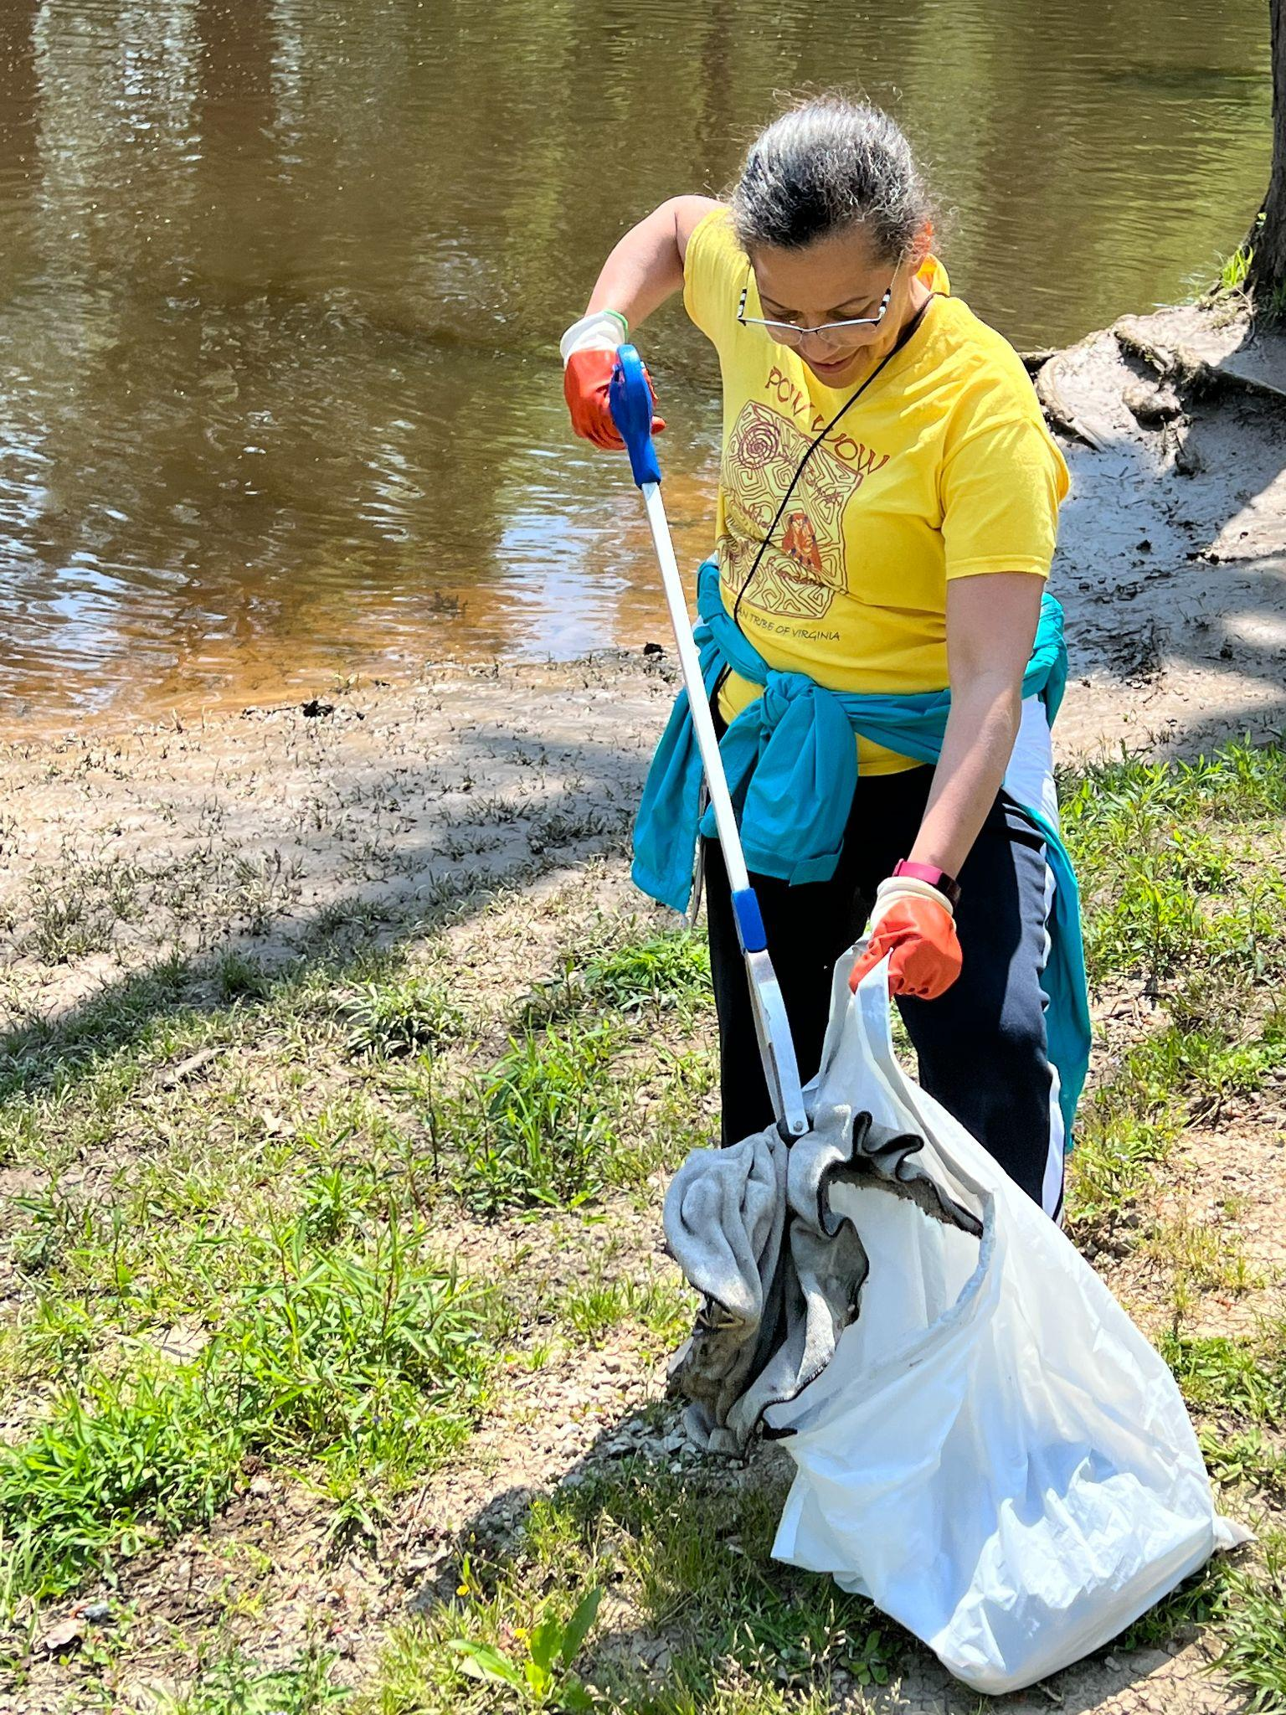
NEXT STEPS
Phase 1 findings to APNEP Leadership Council
In depth webinar with project team
Phase 2
Explore how to maximize new federal funds for climate resilience planning and implementation
Community Outreach via Paddles
Expand capacity for mapping using WAMPUM model

