Slide 1
2020 Natural and Working Lands Action Plan and Workgroup Updates
APNEP Leadership Council Meeting
October 13, 2023

Slide 2
Agenda
History of 2020 NWL Action Plan development
Plan highlights
Current efforts
Opportunities and next steps
Questions

Slide 3
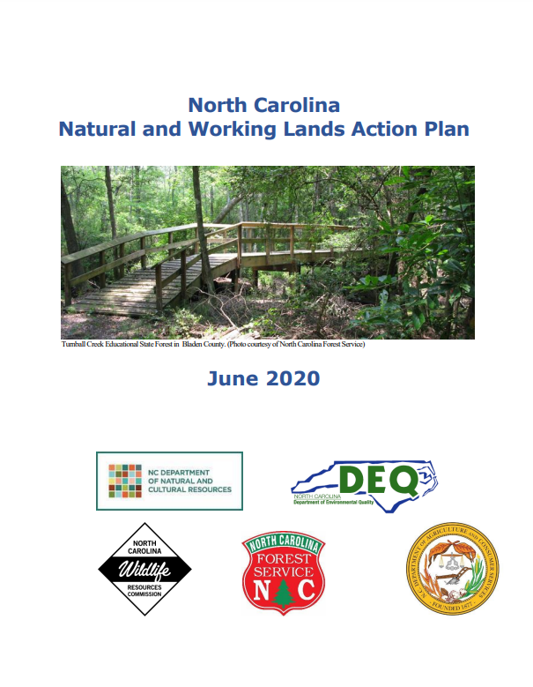
History of NWL Action Plan development
Executive Order NO. 80
USCA/American Forests NWL Learning Lab
2020 NC Natural & Working Lands Action Plan
NC Climate Risk Assessment & Resilience Plan

Slide 4
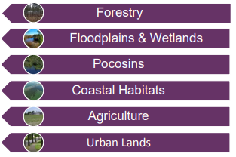
History of NWL Action Plan development cont.
Purpose of creating plan was to:
“identify and create opportunities and outline specific projects for North Carolina’s natural and working lands that sequester carbon, build ecosystem and community resilience, provide ecosystem benefits, and enhance our economy.”
6 subcommittee areas
Written over 9 months of stakeholder engagement

Slide 5
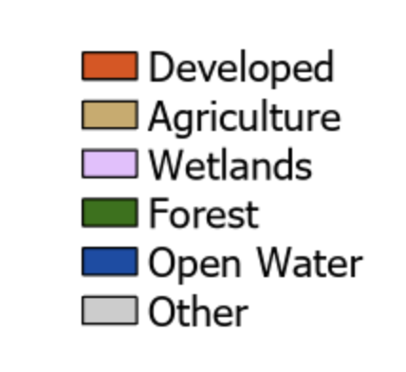
NWL Distribution in NC
Natural and working lands in North Carolina
Katie Warnell, Cate Jaffe, and Lydia Olander, Nicholas Institute for Environmental Policy Solutions, Duke University

Slide 6
Stakeholder Participation
NGOs
Research Institutions/Academia
Local/County Governments
Federal Government
State Government:
Albemarle-Pamlico National Estuary Partnership
Dept. of Agriculture and Consumer Services
DEQ: Air Quality; Coastal Management; Marine Fisheries; Mitigation Services; Energy, Mining, and Land Resources
Wildlife Resources Commission
Dept. of Natural and Cultural Resources
Industry
City Soil, Compass USA, NC Pork Council, NC Choices, NC Forestry Association, Resource Management Services, Pine Creek Forestry, Urban Offsets, NC Farm Bureau
NC State, Duke, Research Triangle Institute
City of Raleigh, Wake County, City of Asheville, Town of Cary
USDA, USFWS, NOAA, USGS
Audubon North Carolina, Carolina Wetlands Association, Dogwood Alliance, Environmental Defense Fund, NC Sentinel Landscapes Partnership, Nature Serve, The Nature Conservancy, Defenders of Wildlife, NC Sea Grant, Conservation Trust for North Carolina,

Slide 7
Final Recommendations

Slide 8
Long-term Goals
Protect 1 million acres of forest land by 2040
Restore 1 million acres of forest land by 2040

Slide 9
Policy Recommendations
Reinstate conservation tax credit
Incorporate additional provisions to Present Use Value system to reward landowners for protecting ecosystem services
Develop incentives with state and local governments and other public and private stakeholders to protect coastal habitats.
Develop a generalized framework to prioritize land protection in areas with high hydrology/water quality benefits within the watershed.

Slide 10
Programming Recommendations
Provide technical assistance to landowners interested in pursuing carbon offset practices
Encourage local governments to use NWL resources to improve new and existing local planning
Expand reforestation and restoration efforts on publicly owned lands, with a special focus on pocosin wetlands, riparian and coastal zones, or other areas with the highest potential for co-benefits

Slide 11
Programming Recommendations Cont.
Use conservation easements and innovative acquisition strategies to secure priority coastal wetland and other coastal habitat, migration pathways, and corridors.
develop statewide best management practices that would guide tree care protection policy, tree care standards, and urban forest management/planning across jurisdictions
Expand outreach and access to peatland restoration resources and technical support with workshops and virtual toolbox

Slide 12
Funding Recommendations
Increase funding for land acquisition grants
Increase funding for existing land and stewardship programs to help protect and enhance NWLs
Increase funding for the Forest Development cost-share program
Explore dedicated funding and leveraging opportunities to expand scale of peatland restoration on state-owned lands.
Expand Urban and Community Forestry Program in NC Forest Service

Slide 13
Research Needs
Research potential for a state-level ecosystem services market that could be used to finance NWL projects that build resilience in communities as well as other services.
Develop scenario-based modeling to identify saltwater intrusion potential on peatlands. Would eventually lead to prioritization of pocosins to protect
Compile existing Urban Tree Canopy Assessment data into a single database managed by a state entity. Create GIS data layers.

Slide 14
Current Efforts
Executive Order NO. 80
USCA/American Forests NWL Learning Lab
2020 NC Natural & Working Lands Action Plan
NC Climate Risk Assessment & Resilience Plan
Implementation
We are here
In 2023,
5 Steering Committee Meetings
NWL Learning Lab in DC
Implementation Tracker
Prioritization of recommendations
Incorporating Plan into grant opportunities

Slide 15
Opportunities and Next Steps
Budget requests
Peatland restoration pilot
Increased Forest Development Program funding
Coastal resilience funding
Programming
Technical assistance to local govs
Prioritizing conservation and restoration with highest co-benefits
Community engagement and education on importance of NWLs
Identifying grants to fund research
Accounting for NWLs as carbon sinks
Modeling for saltwater intrusion
Ecosystem services and carbon offset market research

Slide 16
Questions? Bailey.Recktenwald@nc.gov

