Slide 1
Equity Strategy Update
BIL Equity Strategy
Briefed you in July that comments and suggestions from EPA received June 26 were minor
Submitted revisions August 22, have since received 3 additional rounds of requested edits from HQ review
4th draft submitted October 3 for review
Heard today that the document has been sent to the final person for signature
Reminder, if approval from EPA Headquarters received, can waive match
BIL Long Term (5 Year) Strategy:
Will resubmit to EPA once Equity Strategy approved by HQ for Region 4 approval
Apply for remainder of funding (3 years)
Will update workplan with additional line-item projects and budget decisions approved by LC and 2x2x2 Committee
Annual workplan by June 1 each year with additional refinements and revisions

Slide 2
BIL 2 Year Budget
Activity | Budget Proposal
CCMP Financial Plan | $ 90,000
Spatial Decision Support | $ 100,000* (of $300K/5 yrs)
Water Quality Projects | $ 400,000
SAV Projects | $ 400,000
Wetlands Projects | $ 200,000
Oyster Habitat Projects | $ 200,000
Community Resilience Projects | $ 400,000
Program Administration | $ 10,000
Travel / Meeting Support | $ 10,000
Total Grant Funds | $1,819,600
Line item projects:
CCMP Implementation Financial Plan
Spatial Decision Support
(steering committee established)
Spatial Targeting Strategy
(continuation of STAC effort)
Estuarine Spatial Planning Assessment
Undesignated CCMP Implementation Projects: (5 buckets of funding for focus areas):
Submerged Aquatic Vegetation (SAV)
Water Quality
Wetlands
Oyster Habitats
Community Resilience
Minimal travel/administrative fees
No personnel / contract support
Notes:
Reminder of big picture budget approved with 2 year workplan

Slide 3
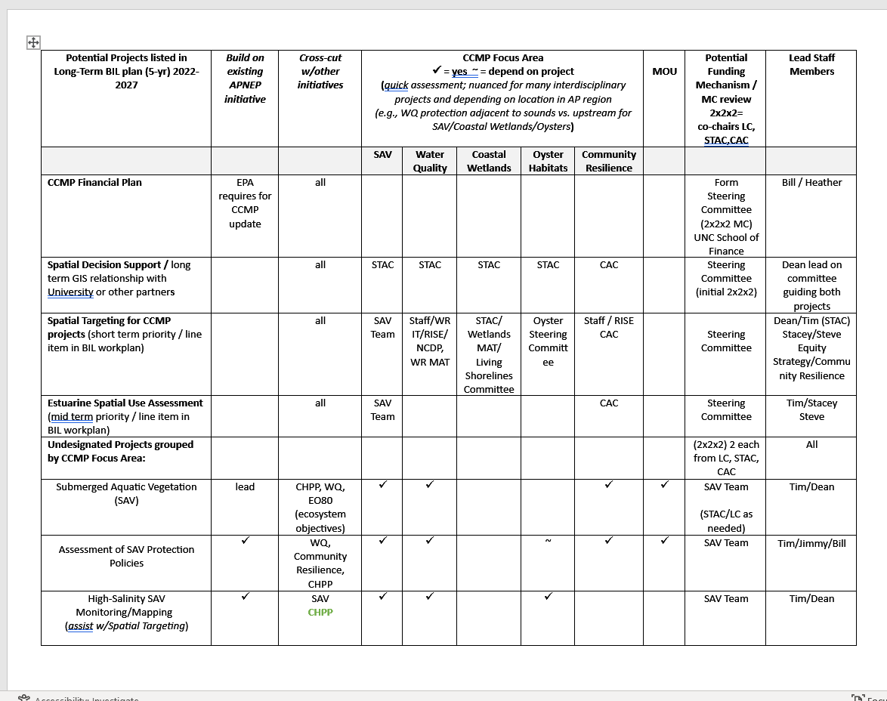
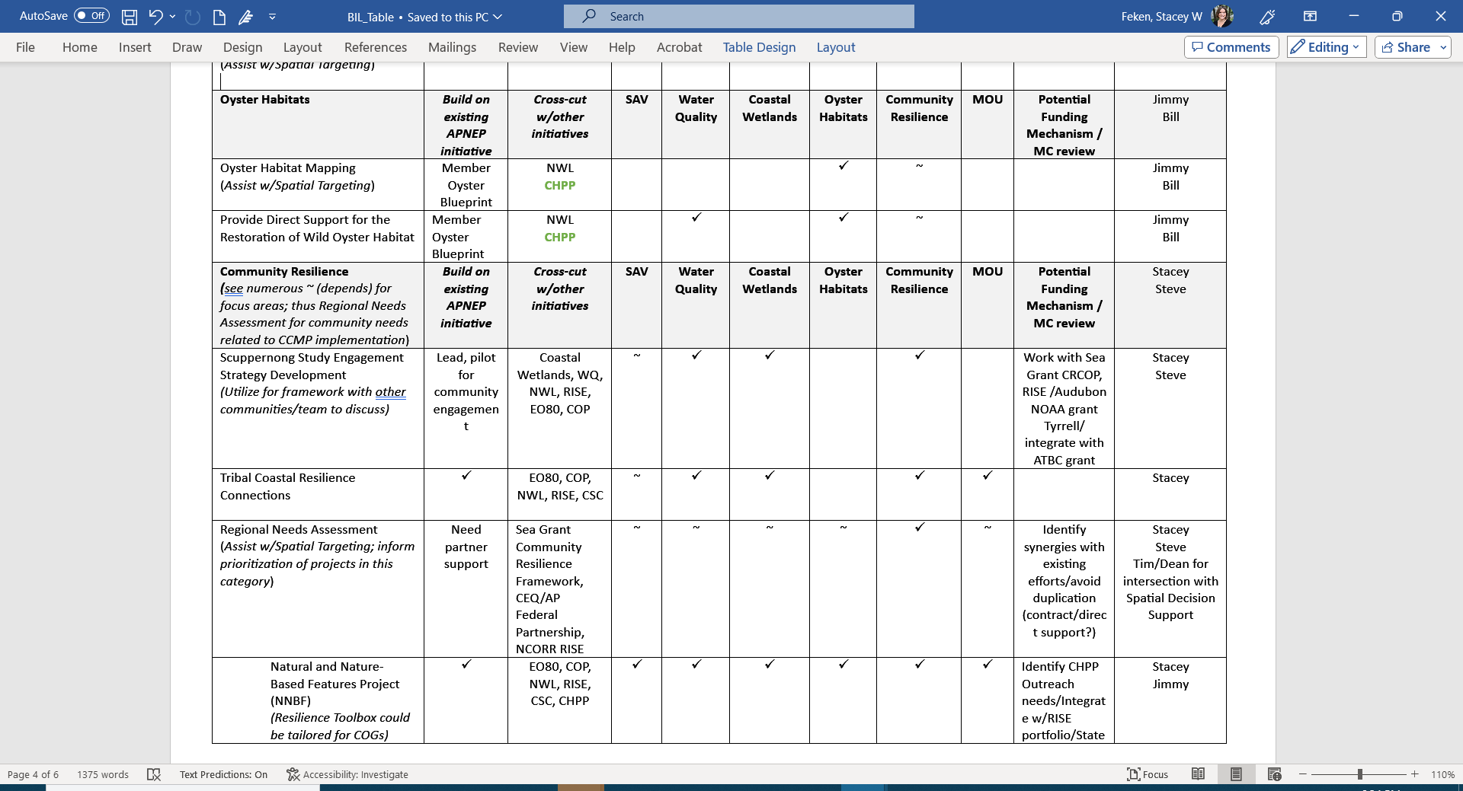
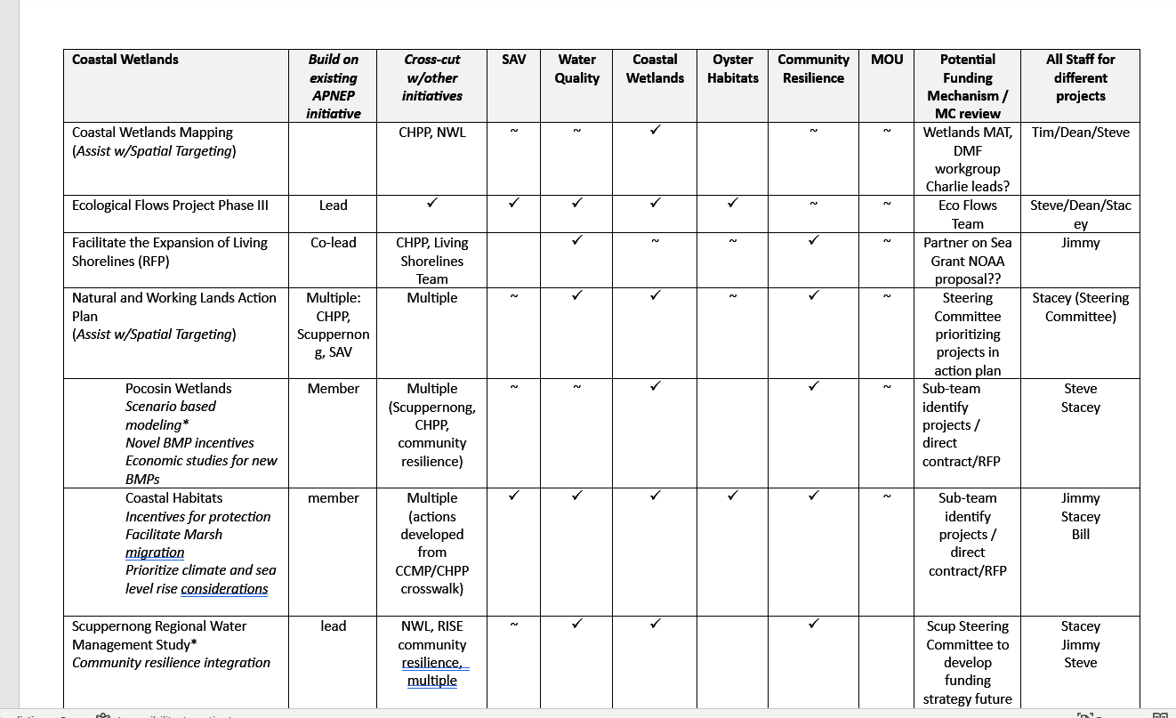
Integration Across Focus Areas + 5 Year Budget Planning
Notes:
Internal planning table still draft; just want to show that we heard comments about integration across focus areas’
Wanted to show we’re planning around all projects and ideas identified in the Long Term Strategy

Slide 4
BIL 2 Year Initial Budget (funds in house)
CAC & STAC RFPs (Multiple Focus Areas): Create equitable opportunity for citizens and partners throughout the region to apply for BIL funding
Direct support of APNEP and Partner led Initiatives:
Ecosystem Focus Areas (SAV, Wetlands, Water Quality, Oysters)
Direct support for known project needs identified by SAV Team, Wetlands MAT, Oyster Blueprint, etc.
Community Resilience
Continued support & increased investment in APNEP led initiatives + build upon relationships already built:
Scuppernong Community Engagement
Tribal Coastal Connections
Support partners leading resilience planning (RISE, NWL):
Notes:
But developing a more detailed budget focused initially on the 2 year budget so we can encumber funds we have now

Slide 5
Justice 40 Considerations /Spatial Targeting Approach Ecosystem Focus Areas vs. Community Resilience
Ecosystem Focus Areas (SAV, Wetlands, Water Quality, Oysters)
Spatial targeting can inform 3-year budget
Spatial targeting can help:
Prioritize protection and restoration activities over large geography
Identify communities that may benefit from “traditional” ecosystem protection and restoration projects
Integration across focus areas and projects
Quantify benefits for tracking Justice 40 / EPA Reporting
Community Resilience
APNEP already involved in working with underserved and under-represented communities (disadvantaged per EPA terms), not starting from scratch
Continued support & increased investment in APNEP led initiatives, build upon existing relationships:
Scuppernong Community Engagement
Tribal Coastal Connections
Partner led resilience planning efforts have already identified communities
APNEP participating and working to identify projects that fit ecosystem objectives of CCMP
“Targeting” already guided by community needs and resilience planning
Equity Strategy noted that can target communities that may not be interested or have the capacity to partner, relationship building takes time
CAC & STAC RFPs (Multiple Focus Areas): Create equitable opportunity for citizens and partners throughout the region to apply for BIL funding

Slide 6
Focus Area: | Example Projects | Guidance / Approach | Budget Proposal
SAV | Mapping, Monitoring, & Assessment Assessment of SAV Protection Policies | SAV Team Directed Activities | $ 400,000
Oysters Habitat | Habitat Mapping Wild Oyster Habitat Restoration | Oyster Steering Committee Directed Activities | $ 200,000
Wetlands | NOAA CCAP Mapping | Wetlands MAT | $ 200,000
Water Quality Projects | CAC RFP RISE project examples: Algal Bloom Collaboration Currituck Sound Coalition Projects (+SAV/wetlands) Stormwater, Agricultural BMPs | 2x2x2: Direct Support + CAC RFPs | $ 400,000
Community Resilience Projects | Scuppernong Community Engagement Tribal Resilience Connections CAC RFP RISE project examples (capacity building, green infrastructure, flood-prone farmland / wetlands) | 2x2x2: Direct Support + CAC RFPs | $ 400,000
Notes:
Provide

Slide 7
Questions
Stacey Webb Feken
Policy & Engagement Manager
Stacey.Feken@apnep.org

Slide 8
BIL CCMP Implementation Projects
Focus Areas: 5 buckets of funding: ~$800K each)
Builds upon existing APNEP efforts /Leverages work of partners including other federal programs
Priority consideration will be given to actions identified as a BIL priority in 2023 CCMP Update (January 2023 LC Workshop)
Some projects included in both 320 and BIL Strategy and Workplan to allow flexibility in funding, and because the 320 also serves as a mid-year report
Submerged Aquatic Vegetation (SAV)
Assessment of SAV Protection Policies
High-Salinity SAV Monitoring/Mapping
Low-Salinity SAV Monitoring Protocols Development
Analysis of Low-Salinity SAV Sentinel Site Data
Water Quality (also part of monitoring strategy)
Continued NC Nutrient Criteria Development Plan (NCDP) Support: (research, indicators, metrics)
Research & tool development tied to SAV protection (Chla/clarity standard, bio-optical model, data gaps)
Interagency Watershed Restoration Improvement Team (WRIT) (assist with spatial targeting)
Harmful Algal Blooms, Urban Waters, Chowan Healthy Waters, Stormwater (also see Resilience section)
Coastal Wetlands (also part of monitoring strategy)
Wetland mapping & monitoring
EO80 Natural and Working Lands Action Plan
Scuppernong Study / large scale hydrologic wetland restoration
Oyster Habitats
Oyster Habitat Mapping
Provide Direct Support for the Restoration of Wild Oyster Habitat
Community Resilience
Scuppernong Study Engagement Strategy / Tribal Coastal Resilience Connections
Tools and resources for local governments / EO80 NC Climate Risk and Resilience Plan
Regional Needs Assessment (assist with spatial targeting, Equity Strategy implementation)
RISE: draw on regional vulnerability assessments and project portfolios conducted in 2022 for COGs
Notes:
ONLY IF NEEDED Summarizes projects in Strategy

Slide 9
APNEP Bipartisan Infrastructure Law Funding Overview
National Estuary Program (NEP) BIL Strategy should seek to:
Utilize NEP as vehicles to accelerate and more extensively implement CCMPs
Ensure that benefits reach disadvantaged communities
Build the adaptive capacity of ecosystems and communities
Leverage additional resources; particularly federal
EPA guidance requires 5-year long term, equity strategy, strategy, annual workplans
BIL Long Term Strategy due by June 1, 2023
Less detail than annual workplans; may be modified at any time
Incorporates draft Equity Strategy (distributed April 2023 for review)
Incorporates approved initial 2-year BIL workplan (2022-2024)
Annual workplans will be submitted for remaining years
Long term strategy incorporates 2-year workplan (LC approved October 2022)
Grant application and workplan submitted to EPA October 2022
Cooperative Agreement between EPA/NCDEQ (2022-2027)
Funds from EPA received February 2023:
$909,800 first year / $1,819,600 for 2 years
BIL provides $132 million total to NEPs for fiscal years 2022 through 2027.
Each of the 28 NEPs will receive ~$900,000 per year for 5 years (~$4.5 million)
Notes:
ONLY IF NEEDED Background

