Slide 1
North Carolina Office of Recovery and Resiliency
July 12, 2023

Slide 2
A New Office with a Dedicated Focus
Administering $1B disaster recovery funds from multiple disasters
Resilience Team staffed in 2019
Within Department of Public Safety

Slide 3
What does RESILIENCE mean?
A resilient North Carolina is A state where our communities, economies, and ecosystems are better able to rebound, positively adapt to, and thrive amid changing conditions and challenges, including disasters and climate change

Slide 4
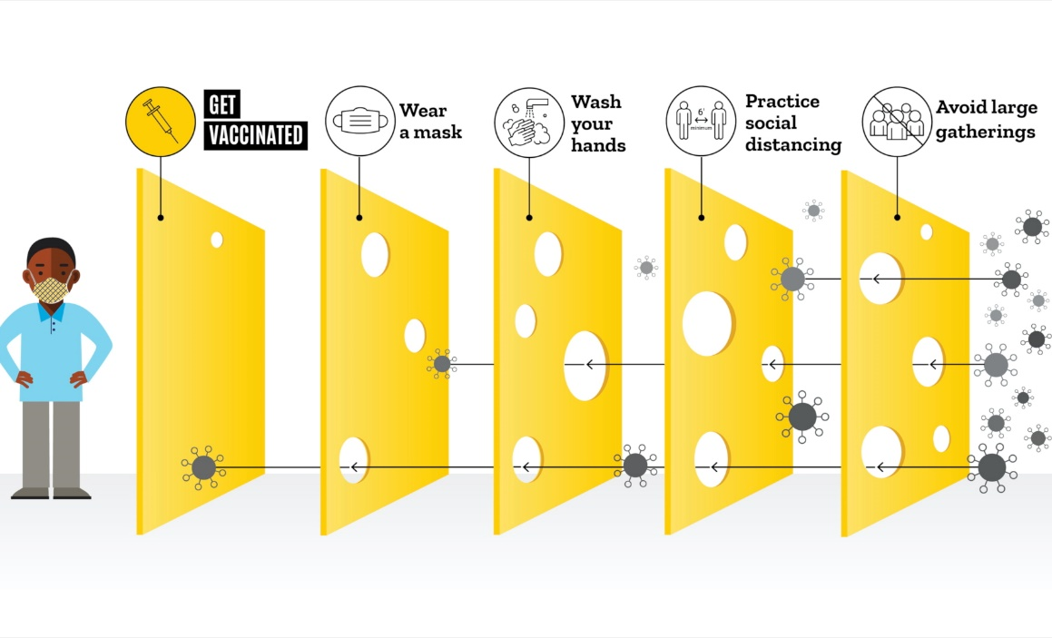
Swiss Cheese Model
Multiple layers of defense
No single layer provides 100 percent protection against harm
Acknowledge residual possibility of harm

Slide 5
Resilient North Carolina Guiding Principles 2020 NC Climate Risk and Resilience Plan
Act quickly and decisively to reduce the most harmful impacts of climate change—flooding, drought, landslides, and wildfires
Act thoughtfully and collaboratively to develop equitable solutions for the most socially challenging effects of climate change
Invest in safe, affordable, and connected communities
Strengthen regional economies
Support healthy communities, local identity, and recreational access to nature
Implement resilience best practices
Photo Baxter Miller/RISING
Photo Baxter Miller/RISING
Notes:
Much of our direction comes out of this plan,,, including NC Resilient Communities Program

Slide 6
What Do Resilient Communities Look Like?
land use
infrastructure
social and economic connectedness; civic capacity
emergency preparedness
Notes:
In drafting this, we traveled all over the state, including here to Sylva and Hickory, and what we heard over and over was that we needed to help local communities build capacity and plan so that they were ready with a list of ”shovel ready” projects when money became available

Slide 7
What does the
resiliency team do?
Resiliency
Technical Support- RISE
Policy
Outreach
& Education
Coordination & Collaboration
Implementation Support
Notes:
Provide expertise, technical support, and capacity building to communities for resiliency planning and projects to protect communities from flooding and other natural disasters
Coordinate and assist with the implementation of disaster recovery and resiliency projects at NCORR
Advise State decision makers on recovery and resiliency activities, and establish North Carolina as a national leader in integrative, cross-sector resilience planning and practices
Lead and coordinate resiliency efforts across State and federal agencies, regional and local governments, higher education, and other public and private stakeholders

Slide 8
Interagency Collaboration
Hazard Mitigation Plan Update (NCEM) - Integrating climate change into HMP
Building Resilient Infrastructure and Communities Grant (BRIC) Program (NCEM) – Review panel
US Army Corps of Engineers River Basin Studies (NCDEQ, State lead)
Updating State Floodplain Construction Standards (NCDOA)
Flood Resilience Blueprint (NCDEQ)
Climate Change Interagency Council (NCDEQ)
Natural Infrastructure Flood Mitigation Advisory Board (NCDEQ)
Resilient Coastal Communities Program Steering Committee (NCDEQ)
Natural and Working Lands Stakeholder Group (NCDNCR)
Transportation Corridor Risk and Resiliency Vulnerability Working Groups (NCDOT)

Slide 9
NCORR Funding Support for Resilience Studies and Programs in Other Agencies
Development of the Natural Infrastructure Flood Mitigation Program and Modeling of Nature-Based Solutions for Flooding
DEQ, Division of Mitigation Services
$340,800
NC Resilient Coastal Communities Program
DEQ, Division of Coastal Management
$500,000
Statewide Probable Maximum Precipitation Study
DEQ, Division of Energy, Mineral, and Land Resources
$500,000
Low Flow Statistics Re-Evaluation and Public Water Supply Boundary Area Assessment
DEQ, Division of Water Resources
$740,700
Establishing Future Rainfall Statistics (IDF curves) with Climate Data
State Climate Office and NCDOT
$350,000 (TBD)
Updating NOAA’s Atlas 14 data for precipitation frequency
NCDOT > FHA
$470,000 (TBD)

Slide 10
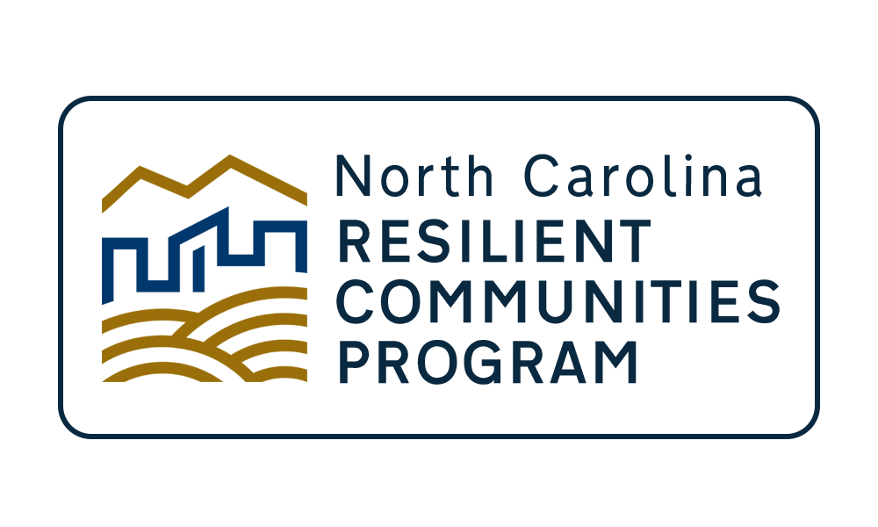
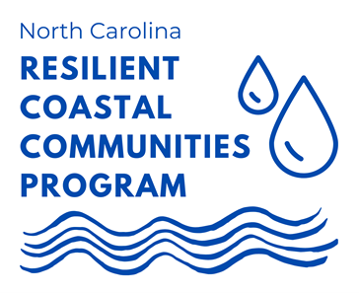

Slide 11
Regional Resilience Portfolio Program
NC Resilient Communities Guide
Homegrown Leaders
In partnership with the North Carolina Rural Center
Funded by U.S. EDA and NCORR through HUD CDBG-Mitigation Funds
Notes:
RISE is a program focused on providing technical assistance to communities for developing resilience to natural hazards. It is led by NCORR and the North Carolina Rural Center, with the support of many Councils of Governments across Eastern NC. The project is funded by the Economic Development Administration and FEMA’s Hazard Mitigation funds.
Homegrown leaders: regional leadership training workshops that emphasize resilience as a tool for community economic development.
Guide: A statewide resource detailing the different avenues, supports, and opportunities for building community resiliency. Review planning steps for resilience and include a list of case studies.
Portfolio: Providing technical assistance to regional partners to conduct: a community vulnerability assessments and to identify priority actions that will reduce risk and enhance resilience in your region. The technical assistance providers will also develop paths to implementation for each priority project.

Slide 12
RISE Objectives
Build local capacity for resilience analysis, planning, and implementation activities
Provide technical assistance for vulnerability assessments, planning, project/program identification, design and implementation support
Help identify funds to plan and implement resilience projects and programs

Slide 13
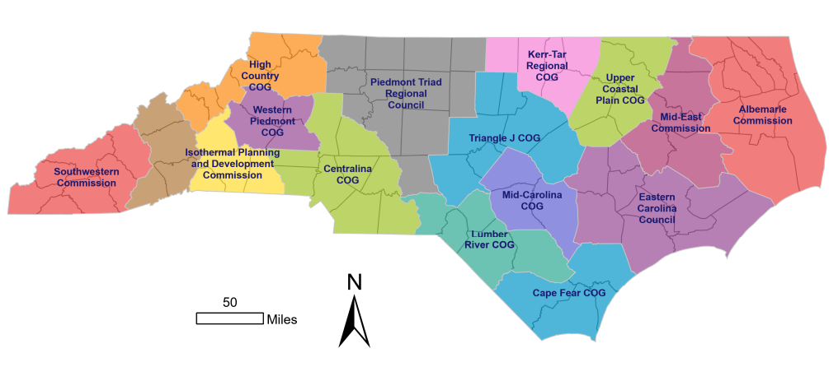
Regional Resilience Program
Nine Regions (Councils of Governments)
Stakeholder partnership in each region
10-20 active members on average; total 245 individuals enrolled
Diverse Landscape
49 counties and many municipalities
Population 3 million +
Declining and booming counties
Population varied in income
Notes:
We hired consultants to work at the regional scale. These consultants ran virtual stakeholder meetings and drafted the two deliverables.

Slide 14
Stakeholder Engagement
Stakeholder Partnership Meetings (65+)
Public Meetings & Workshops (20+)
State Agency Meetings
Public Comment Periods
Stakeholder Partnership Composition
Notes:
Graph- Stakeholder Partnership Composition

Slide 15
Stakeholder Partnership Composition: "Other"

Slide 16
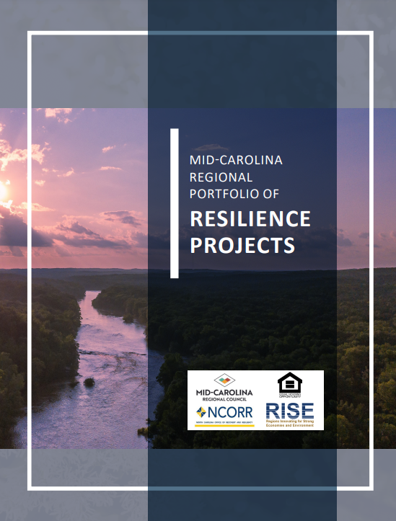
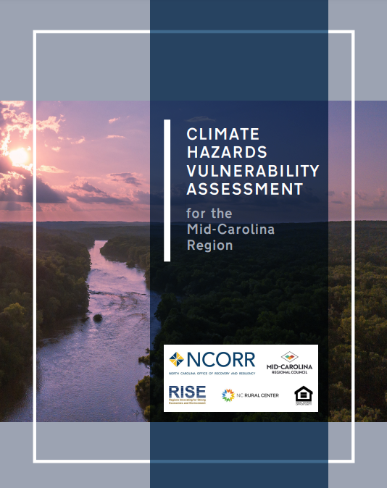
Deliverables
Regional Climate and Natural Hazards Vulnerability Assessment
Portfolio of regional projects
Notes:
**the vulnerability assessments and prioritized projects may touch on many topical areas - e.g. health, transportation, building safety, natural lands
https://www.rebuild.nc.gov/resiliency/resilient-communities/rise/portfolio
Deliverables:
The vulnerability assessment will stand alone but will also contain content that can be integrated into regional and local plans, grant applications, public presentations, and other planning tools.
Public Health Section
Social Vulnerability
Identified Climate Vulnerability Hot spots
The regional resilience project portfolio will identify 5 to 10 priority projects (or actions) to reduce risk and enhance resilience in their region. This will be no longer than about 30 or 40 pages per region.
Portfolios identified-
Scope, location, what vulnerability is addressed, regional impact, population served, environmental considerations, similar efforts
Implementation pathway-
Potential lead implementers
Partners
Potential phases to achieve completion
Maintenance and operation needs
Challenges/Barriers to implementation
Potential Cost
Resources
The boundaries of each COG will serve as the geographic limits for the scope of each project.

Slide 17
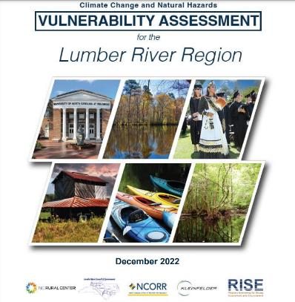
Regional vulnerability assessments
Portfolios of projects
9
55+
Total projects across nine regions
Notes:
We hired consultants to work at the regional scale. These consultants ran virtual stakeholder meetings and drafted the two deliverables.

Slide 18
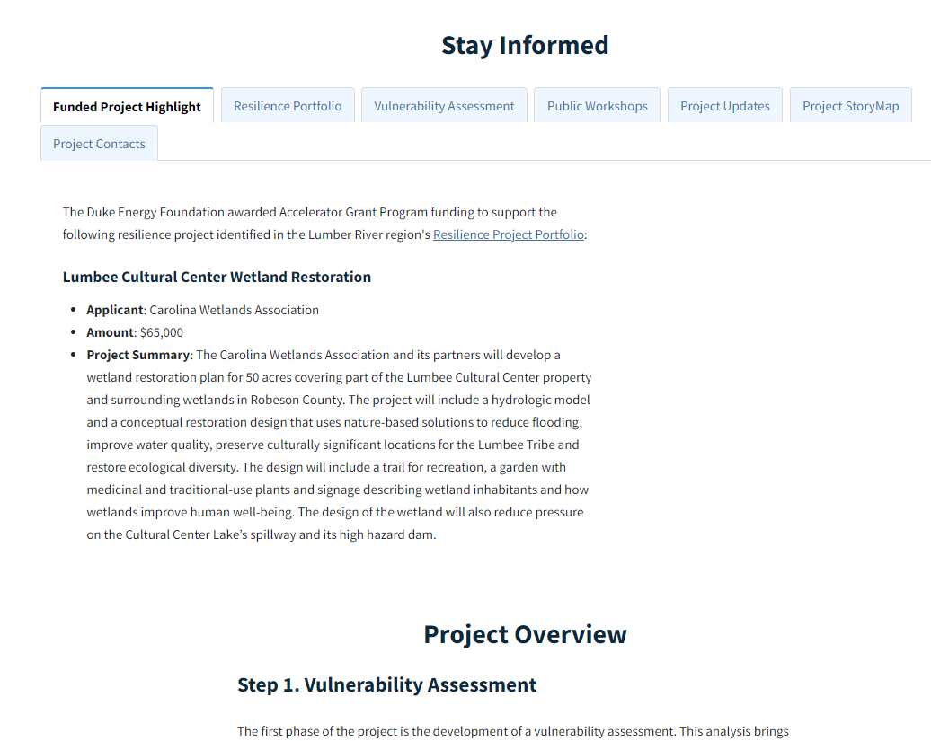

Slide 19
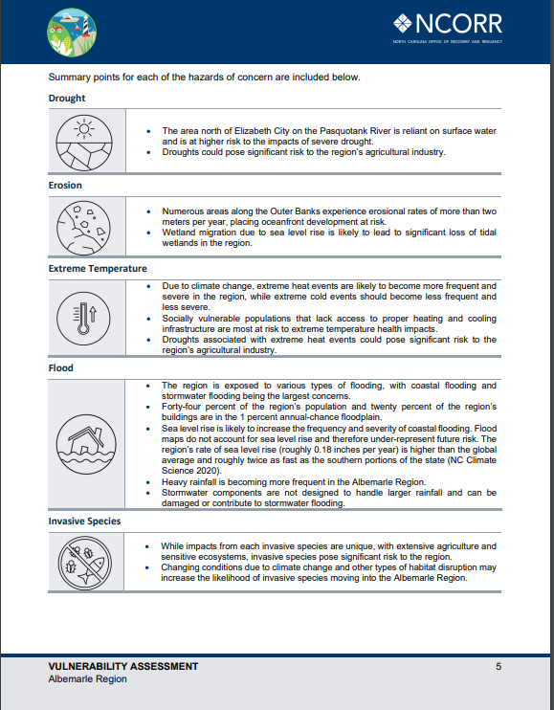
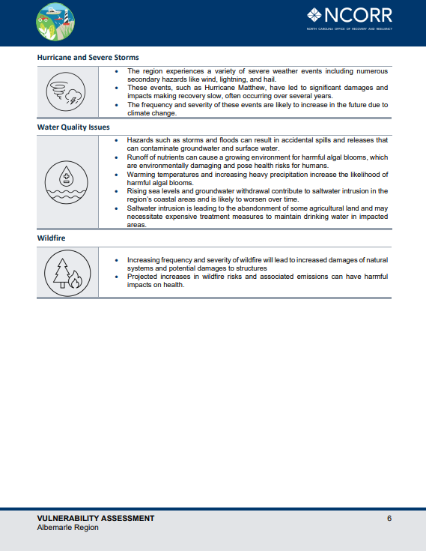
Vulnerability Assessment

Slide 20
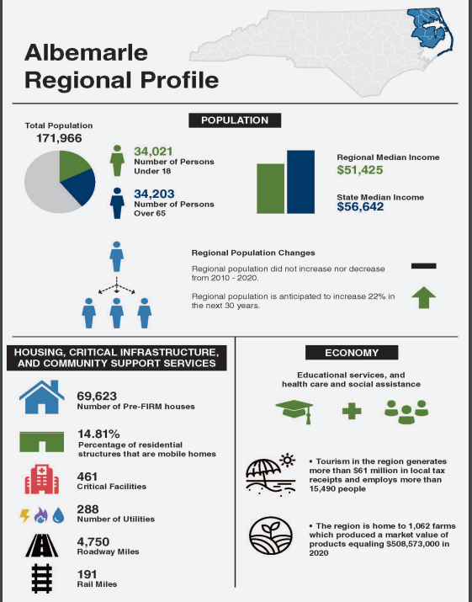

Slide 21
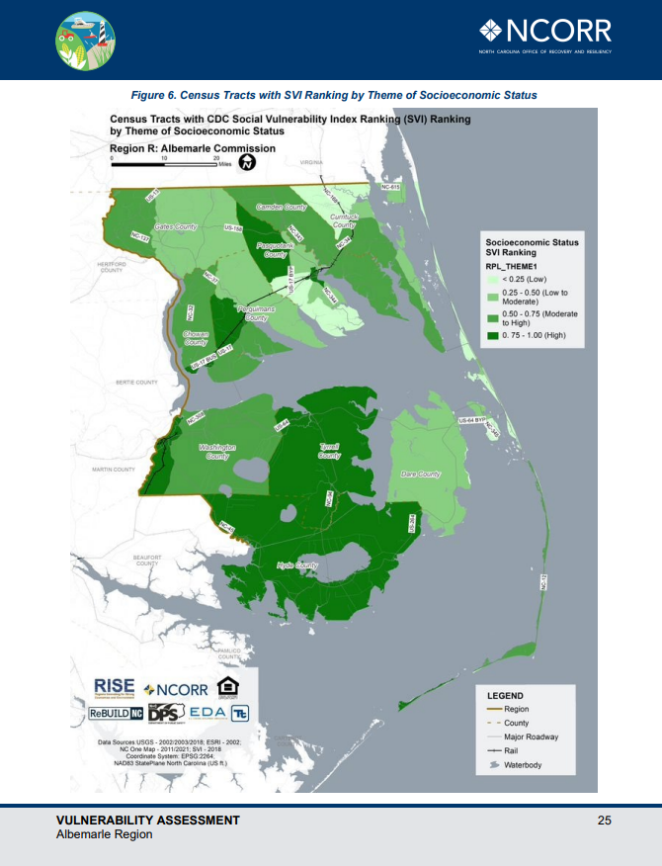
CDC Social Vulnerability Composite Index
Composite index that factors in socioeconomic status; household composition and disability; minority status and language; and housing type and transportation.
Socio-Economic Index
Socioeconomic vulnerable populations are focused in Tyrrell and Hyde County.

Slide 22
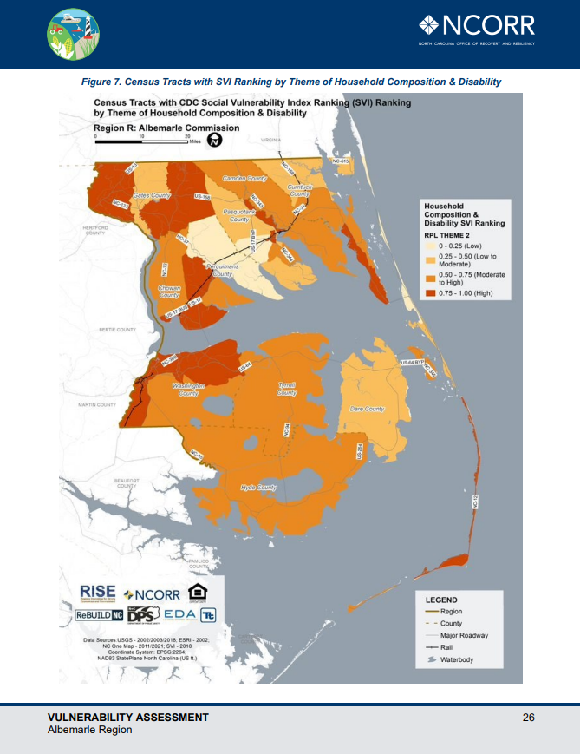
Themed Household Composition & Disability
Populations with vulnerability due to household composition and disability are spread throughout the region.

Slide 23
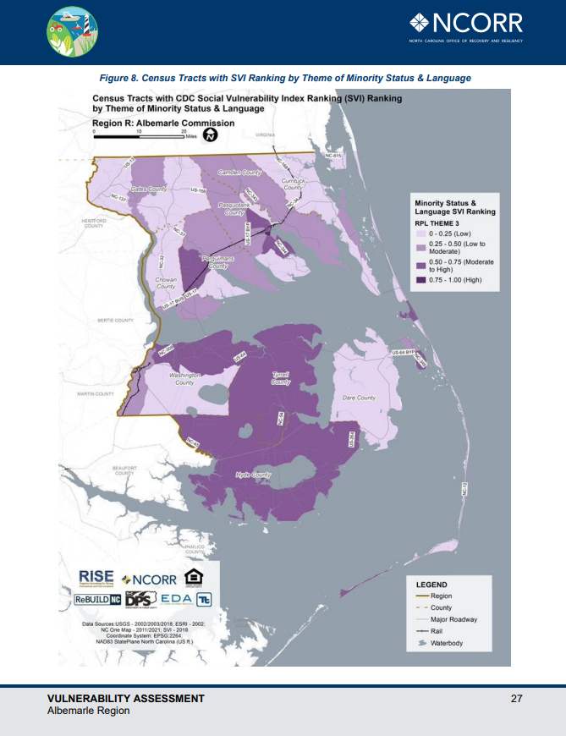
Minority Status and Language
Populations with vulnerability due to minority status and language are focused in Tyrell and Hyde County, with additional populations in Washington County, Perquimans County, and Pasquotank County.

Slide 24
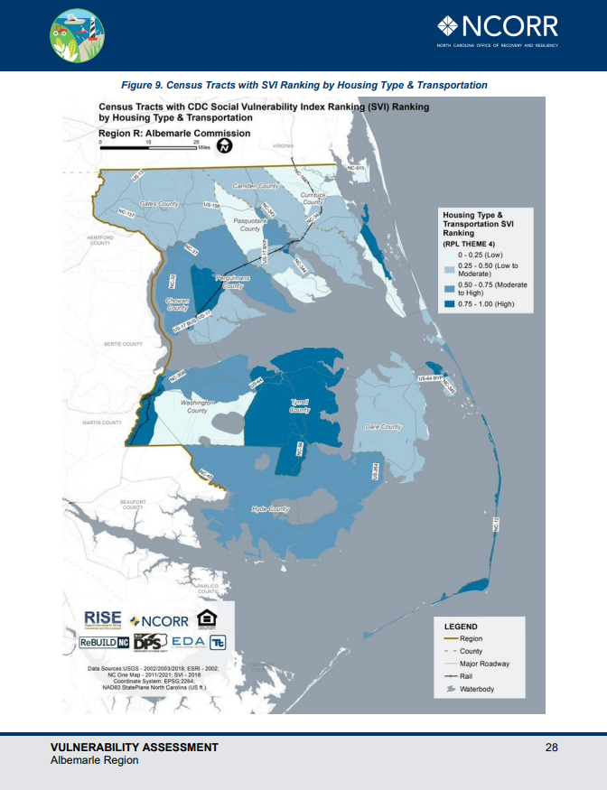
Housing Type & Transportation
Populations with vulnerability due to housing type and transportation are found in Tyrrell County, the western edge of Washington County, the eastern areas of Chowan County, the eastern edge of Pasquotank County, and
the eastern Outer Banks

Slide 25
Vulnerability Assessment Overview

Slide 26
Focused priorities of concern…

Slide 27
Portfolio Project Example
Sample Project

Slide 28
Portfolio Project Example
Sample Project

Slide 29
Portfolio Project Example
Sample Project

Slide 30
Portfolio Project Example
Sample Project

Slide 31
Portfolio Project Example
Sample Project

Slide 32
Project Implementation-
Duke Energy Resilience Accelerator Grants
Goal: Jumpstart at least one RISE portfolio project per region
$608,500 from the Duke Energy Foundation for 10 projects (28 applications)
Eligibility: Projects had to partially or fully implement a project included in a RISE Regional Resilience Portfolio.
Eligible Stakeholder Partnership Members rated eligible projects in their own regions for:
Increases resilience, regional benefit, takes advantage of a unique funding opportunity, and helps address equity
Notes:
DEF wanted to dedicate $600K to jump starting the RISE portfolio projects, and they stated their intention to divide that $600K amongst the nine RISE regions.
NCORR facilitated the grant application and review process.
COGs, local governments and nonprofits were invited to submit applications that were due in early March. State govt agencies were eligible to apply, but none did.
Proposals had to be at least related to a priority project in the RISE portfolios.
For example, a project in the UCP is “Flood-Resilient Roadways for Critical Facilities,” a project intended to identify, prioritize and address roadway flooding that prevents access to critical facilities. One successful application was to do a BCA and an H&H study in Nash County in an area that prevents access to a communications tower.

Slide 33
Duke Energy Accelerator Awards
Triangle J- River Warning System & Back Up Energy Project
Kerr-Tar- Regional Building Inventory & Analysis
Upper Coastal Plain- First St. Extension Flood Resiliency Project
Mid Carolina- Stream Gauge & Early Notification
Lumber- Lumbee Cultural Center Wetland Restoration
Cape Fear- Community Government Resilience Collaboration Center
Eastern Carolina- Beneficial Reuse of Acquired Properties
Mid East- Planning & Engineering Design, Parkers Creek; Latino Focused Information Sharing
Albemarle- Stormwater, Water Quality, & Flooding Outreach Toolkit for Local Governments

Slide 34
Beyond Implementation: “Resiliency Concierge”
Helping….
Connect projects and partners
Support implementers to “lift off” projects
Identify grants and other funding sources

Slide 35
APNEP Focus Areas
Water Quality
Submerged Aquatic Vegetation
Coastal Wetlands
Oyster Habitats
Community Resilience

Slide 36
Portfolio Projects that Overlap APNEP Focus Areas
Highlighted Projects by COG

Slide 37
Portfolio Projects that Overlap APNEP Focus Areas
Water Quality
Agriculture- Environmentally Friendly Farming Practices to Improve Soil Health (Kerr)
Harmful Algal Blooms Prevention & Identification (Albemarle)
Public Outreach- Stormwater, Flooding, & Water Quality (Albemarle)
Stormwater & Watershed Management Planning (Albemarle)
Stormwater Working Group (Albemarle)
Regional Drainage Capacity Assessment (Mid-East/Eastern Carolina)
Upsizing Regional Stormwater Infrastructure (Mid-East)
Green Infrastructure in Urban Flooding Hotspots (Mid-East/Eastern Carolina)
Regional Guidance for Coordinated Stormwater Improvements (Triangle J)

Slide 38
Portfolio Projects that Overlap APNEP Focus Areas
Water Quality
Coastal Stormwater Management Tools (Cape Fear)
Regional Stormwater Engineer Services (Cape Fear)
Outreach and Education for Stormwater Management on Private Property (Cape Fear)
Stormwater Infrastructure & Drainage Assessment (mapping) (Lumber)
Stormwater Infrastructure- Hydrologic & Hydraulic Modeling (Lumber)
Green Infrastructure Pilot Projects (Mid-Carolina)

Slide 39
Portfolio Projects that Overlap APNEP Focus Areas
Community Resilience
Inform Elected Officials about Climate Resilient Decision Making (Upper Coastal)
Comprehensive Plans and Zoning Ordinances Address Climate Change (Upper Coastal)
Regional Resilience Staff Position & Regional Funding (Eastern Carolina/Cape Fear)
Climate Equity Index Tool (Mid-Carolina)

Slide 40
Portfolio Projects that Overlap APNEP Focus Areas
Coastal Wetlands
Plan & Prioritize Stream Restoration (Triangle J)
Living Shorelines Site Analysis and Best Practices (Cape Fear)
Wetland Restoration for Flood Mitigation (Lumber)

Slide 41
Contact us
Amanda Martin
Chief Resilience Officer
919.741.9786
Amanda.martin@ncdps.gov
Brian Byfield
Resilient Communities Program Manager
919.576.4744
brian.byfield@ncdps.gov
Holly B. White, AICP, CFM
Resilience Planner
984.272.5842
holly.b.white@ncdps.gov

Slide 42
Resilient Communities Funding Forum
A free, one-day forum for local governments, non-profits, & other stakeholders
Attendees connected with federal, state and nonprofit funders, who were available to answer project-specific questions
Grant writing advice session
Notes:
We are in a great place for funding. But we need to think critically how to take advantage of it.
All sessions were recorded.
https://www.rebuild.nc.gov/resiliency/resilient-communities-program/north-carolina-resilient-communities-funding-forum

Slide 43
NC Community Resilience Planning Guide
Community Resilience Planning Guide
Playbook
Idea Book
Anticipated Release December 2023
Notes:
a suite of resources to help local leaders, especially local government, plan for a more resilient future in their community.
Playbook: steps to planning for climate resilience in your community
Idea Book: Strategies and Case Studies
The Idea Book provides specific resilience actions and case studies primarily from North Carolina.
Hopefully this guide will inspire you to consider the possibilities for your community and demonstrate concrete pathways to achieving greater resilience.

Slide 44
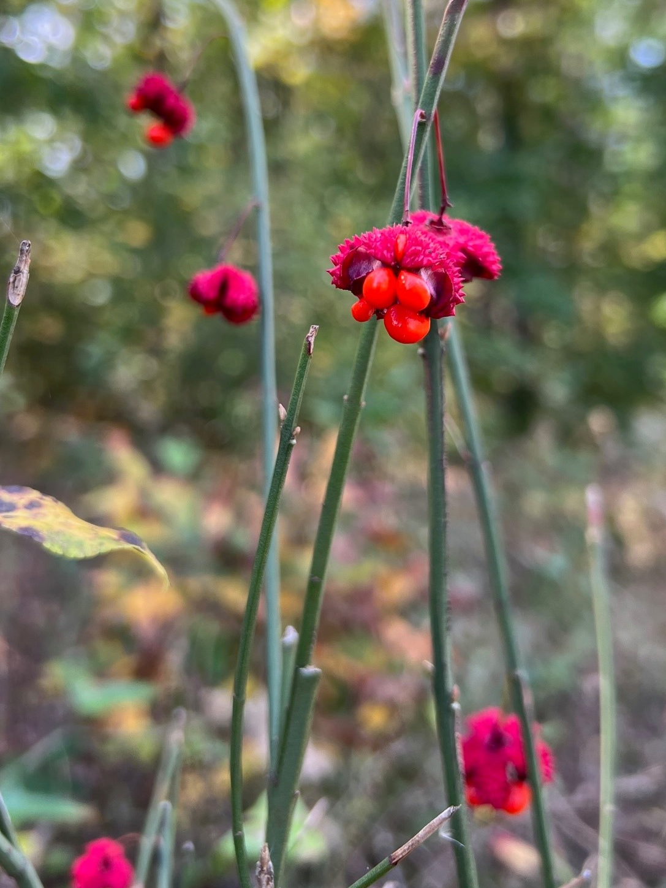
NC Climate Resilience Clearinghouse
VISION
Solutions Database
NC Maps and Data
Funding Opportunities Database
Success Stories
Climate 101
Networking Portal
Spanish Content
Anticipated Launch January 2024

Slide 45
Resilience/Adaptation versus Mitigation

Slide 46
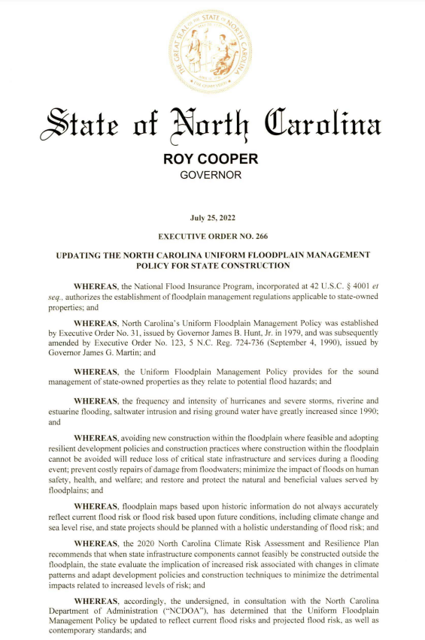
EO266- State Floodplain Policy
Updating the State Floodplain Construction Standards
Direct outcome of interagency coordination
Notes:
https://governor.nc.gov/executive-order-no-266
Updating the State Floodplain Construction Standards – direct outcome of interagency coordination role

Slide 47
Amanda Martin, PhD
Chief Resilience Officer
919.741.9786
amanda.martin@ncdps.gov
Holly B. White, AICP, CFM
Resilience Planner
984.272.5842
holly.b.white@ncdps.gov

